Slide 1
PHYLOGENETIC AND PHYLOGEOGRAPHIC META-ANALYSIS OF COI SEQUENCES OF EAST AFRICAN ARTHROPODS IN THE BOLD DATABASE
Objective:
Improve phylogenetic and phylogeographic descriptions of arthropod diversity in East Africa
Identify the diversity of species that may not yet be recognized as potential crop pests or vectors of human and animal diseases
Allow for better assessments of emerging threat to human, animal and crop health
Kibet Gilbert (DRIP fellow)
Supervisors:
Dr Scott Miller, Dr Jandouwe Villinger, Dr Steven Ger
Collaborators:
Dr Caleb Kipkurui, Dr Jean-Baka, Dr Dan Masiga

Slide 2
workflow
DATA ACCESS
BOLD-Systems via API
Over 36,000 sequences
+
10,000 records
(5000 sequences)
Expected to grow
+
Seqs from select
African countries
Bioinformatics tools
Trials
Alignment
(PASTA,T-coffee,MUSCLE,
MAFFT,SATe)
Phylogenetics
(RaxML, FastTree)
Phylogeography
(BASTA/BEAST)
Data Clean-up
and sorting
R scripts and tools
Tools of Trade
Git & GitHub
Linux System
R & Python
Progress Reports
Thesis
Publications
DATA ANALYSIS
hpc

Slide 3
Data Mining and Clean up
Sequence retrival:
BOLD-Systems via API; using specific syntax:
“arthropoda Kenya Uganda Tanzania Rwanda Burundi”
Metadata (80 columns)
'COI-5P' = 35990 out of 37257 (1 sample)
#nucleotides / unaligned seqs / #ns
Over 700 (592) | Under 500 (705) | 500 -700 (34693) | 650 -660 (21886) | Over 500 (35285)
1 smpl | 1 smpl | 3 smpls | 2 smpls
Build.fasta: ProcessID | order | seq_len | seq
Data clean up:
R, Awk and Bash

Slide 4
MSA
Large dataset:
Accuracy
Speed
Muscle: default | Mafft: G_lins1 | t_coffee: -reg | Pasta: default | sate
Speed | Speed | speed | speed | ***
Low accuracy | Accurate | Accurate | Accurate | ***
(refine,align and merge) | (align, add, addfragments, and merge) | (align, evaluate: core_index, Tcs, | (align and addfragments) | ***
Algorithmn:
Progressive (mafft/muscle)
Progressive & transivity (pasta)
Regressive (T_coffee)

Slide 5
MSA evaluation
Evaluation for Accuracy:
T_coffee: consistency based scoring.
Used to select the most suitable alignments.
TCS ascii can be used to apply different weights to columns in phylogenetic analysis
Scores:
Core index (html)
TCS (html/ascii)

Slide 6
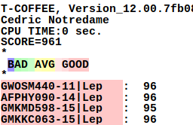
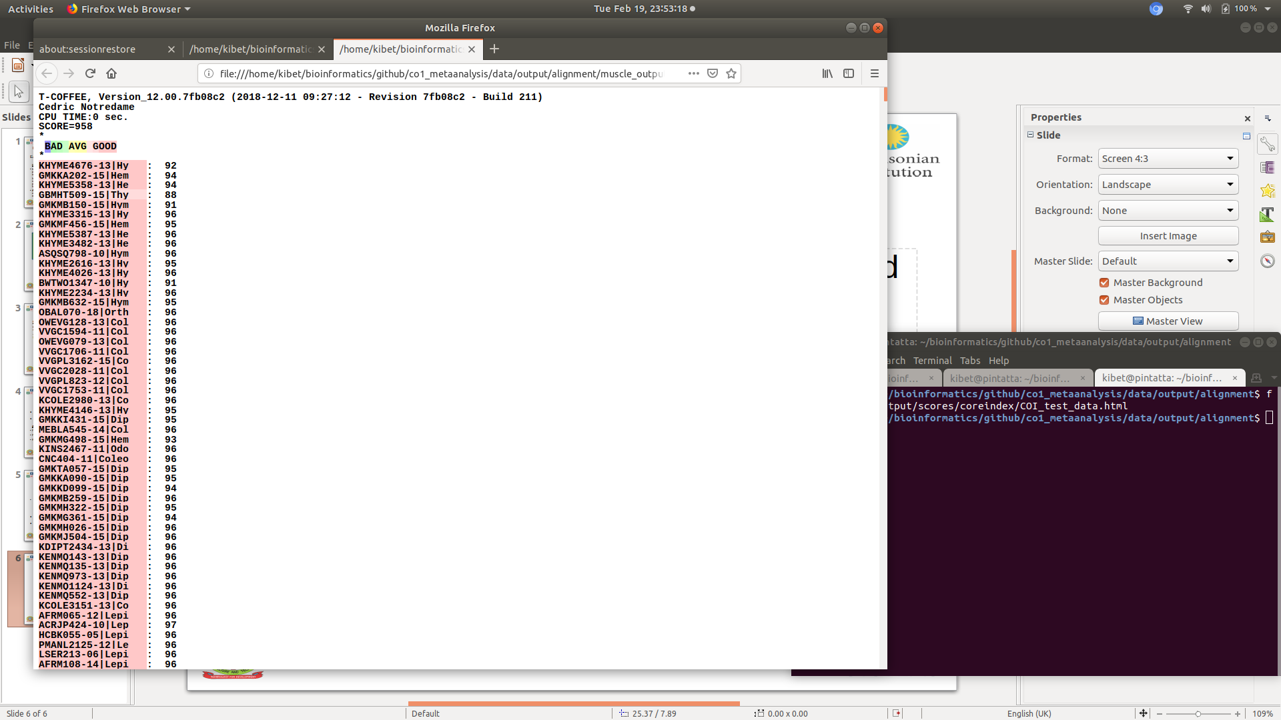
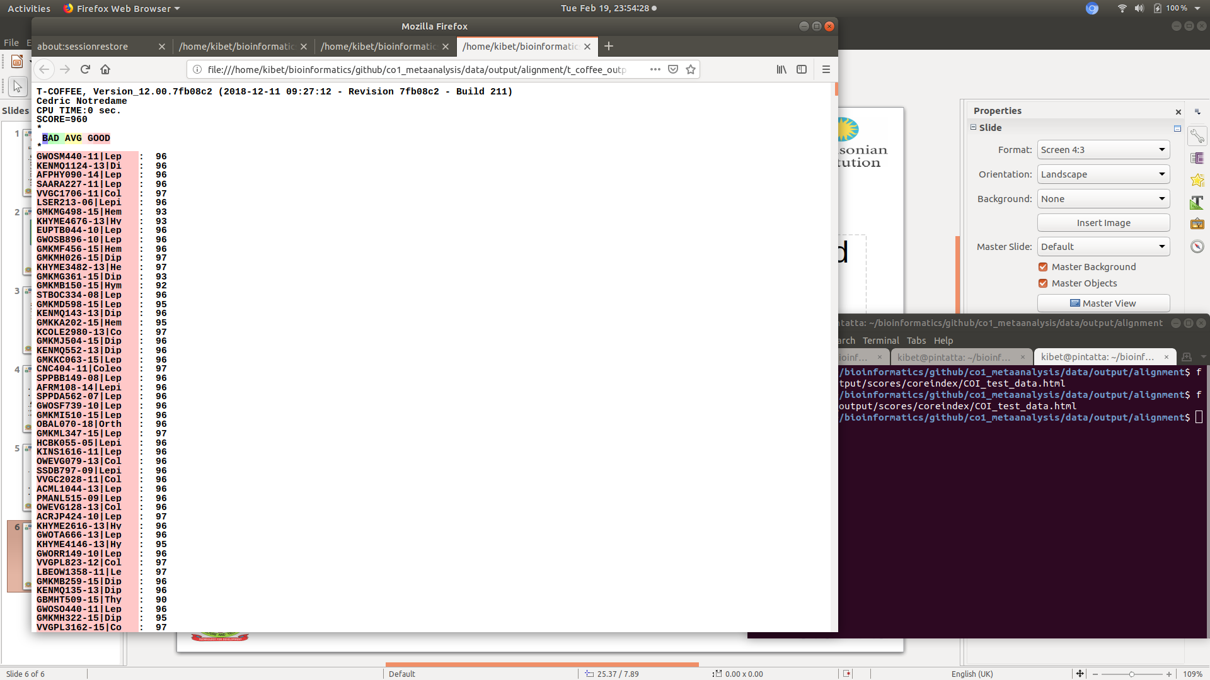
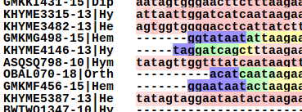
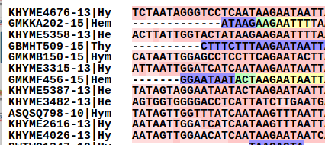
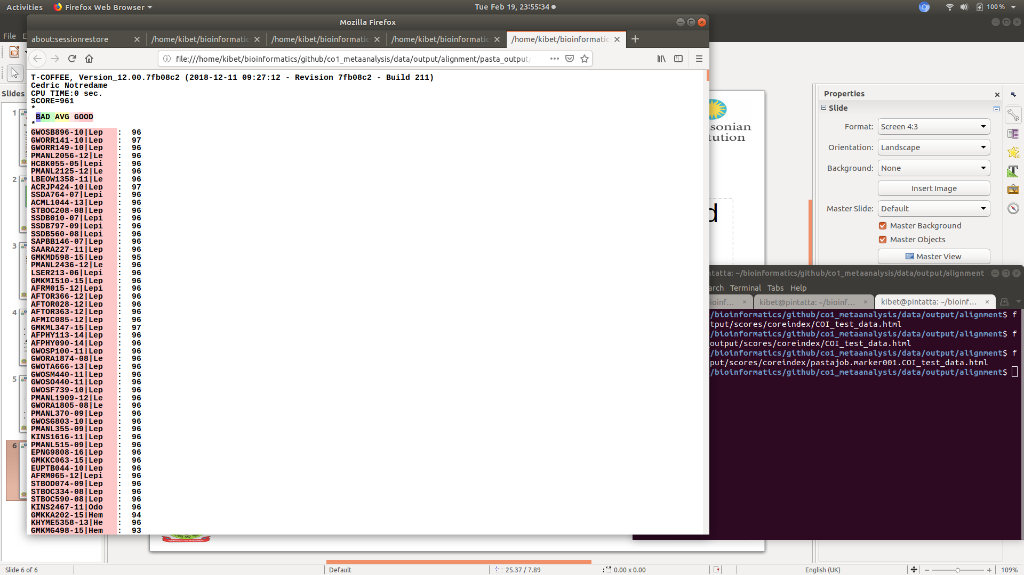
MSA eval...
Mafft
Muscle
T_coffee
pasta

Slide 7
Current progress...
Build my Data set
Setting up a RAxML8 and FastTree pipelines
Improve on alignments:
translation-alignment-threading of DNA
HPC analysis

Slide 8






ACKNOWLEDGEMENT:
Thank you for enabling a bioinformatics dream

