Slide 1
Genomic Surveillance of Dengue
& Chikungunya Virus
Author name: Edward Kiritu
Position: Research Associate
Project: ILRI Genomics Platform
Program: Health
Event; Health Program Weekly Presentation

Slide 2
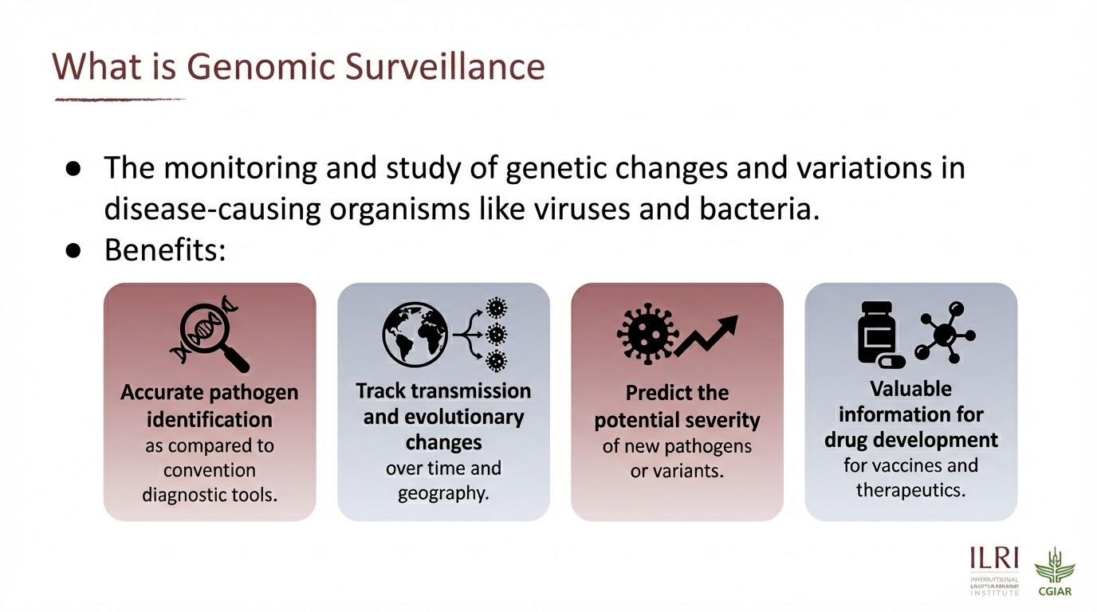

Slide 3
Viral Disease Surveillance challenges
Low Viral Titers: This makes it difficult for standard sequencing methods like Metagenomics to "catch" the viral sequence.
Host Background: In metagenomic sequencing, often more than 99.9% of the data generated belongs to the patient, not the pathogen.
Sample Degradation: Viral RNA is highly unstable and can degrade quickly if not handled correctly or kept in a strict "cold chain" (refrigerated/frozen) from the point of collection to the lab.

Slide 4
Problem Statement
Sub-optimal viral loads in clinical samples often hinder detailed genomic analysis, such as phylogenetics and variant calling. These low viral titers creates a critical gap in pathogen surveillance that necessitates a molecular tool designed for whole genome recovery and accurate strain differentiation.

Slide 5
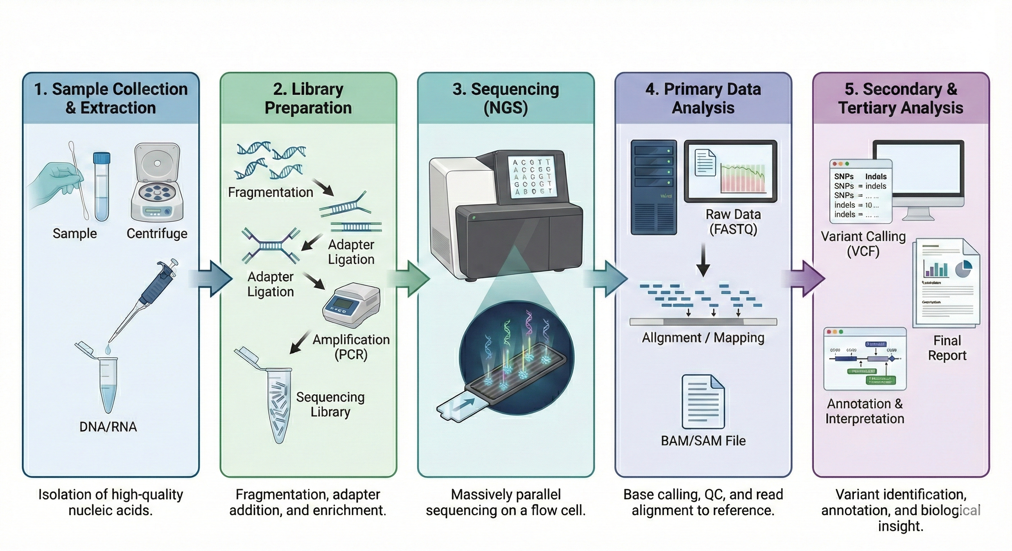
NGS Overview

Slide 6
Tiled Amplicons Sequencing Approach
This is a target enrichment method which employs multiplex PCR to target viral genomes especially in sample with high ct Values (> 30) (equivalent to 10 genome copies/ul)
Tiling refers to the fact that neighboring amplicons overlap one another, ensuring that complete coverage of the target genome is achieved.
To prevent short overlap products being produced between neighboring amplicons, 2 primer pools are used to alternate primer pairs. This avoids primer competition and dimer formation
All regions of the genome are amplified in parallel, producing a dense set of overlapping PCR products.

Slide 7
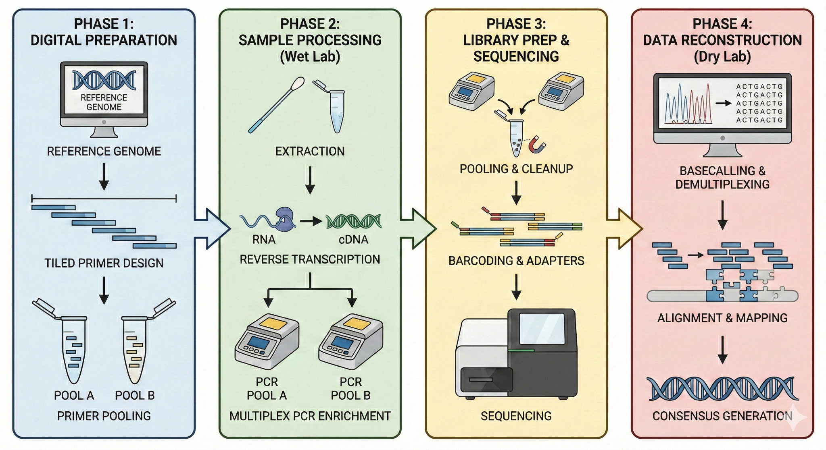
Tiled amplicons Sequencing Workflow

Slide 8
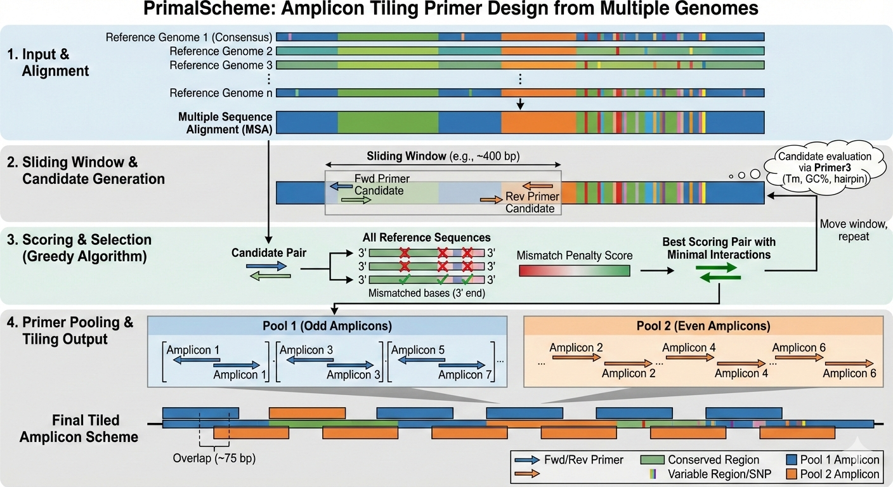

Slide 9
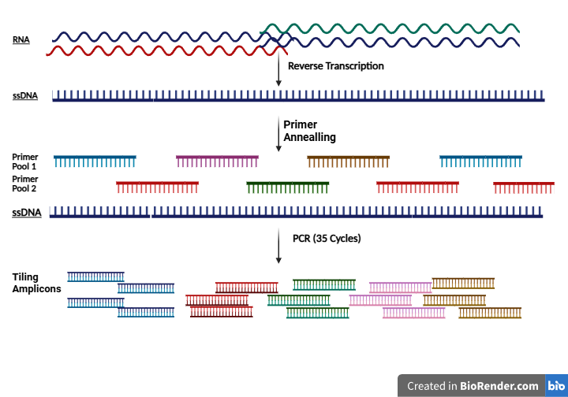
Target Enrichment Step…

Slide 10
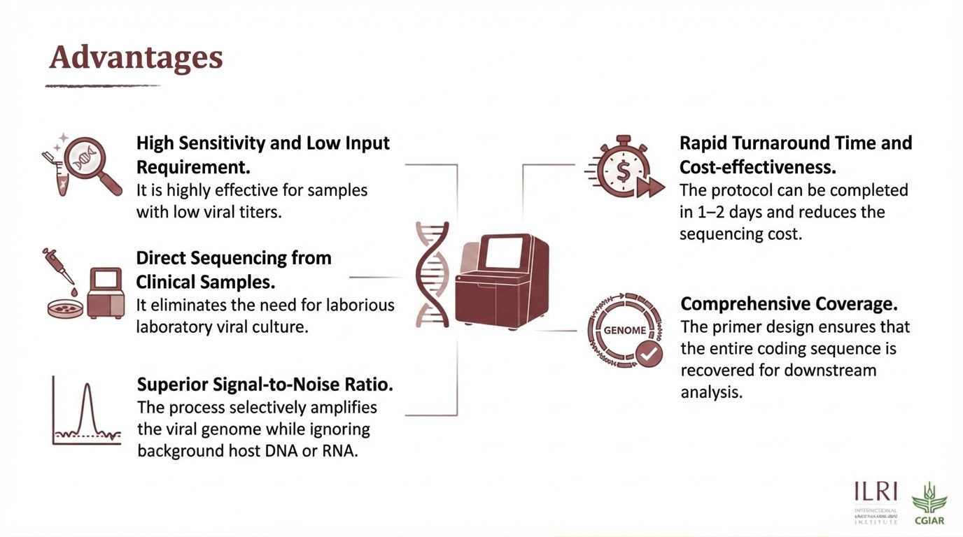

Slide 11
Application.
Dengue Virus
Chikungunya Virus
Dengue is a mosquito-borne viral infection caused by any of four distinct serotypes (DENV-1 to DENV-4)
It has a single stranded RNA genome which is approximately 10.7 to 11 kilobases (kb) in length
Recognized by the WHO as one of the top 10 global public health threats.
Ranges from asymptomatic to life-threatening Dengue Hemorrhagic Fever (DHF) or Dengue Shock Syndrome (DSS).
Heavily concentrated in tropical and subtropical climates, with rising incidence due to urbanization, travel, and climate change.
Chikungunya is a viral disease primarily transmitted to humans by Aedes aegypti and Aedes albopictus mosquitoes.
The CHIKV genome is approximately 11.8 kilobases (kb) in length
Infected individuals typically experience a sudden onset of high fever and severe, often debilitating joint pain, frequently accompanied by muscle aches, headache, fatigue, and a skin rash.
Chikungunya is currently widespread across more than 110 countries ongoing transmission in African nations such as Kenya and Mauritius.

Slide 12
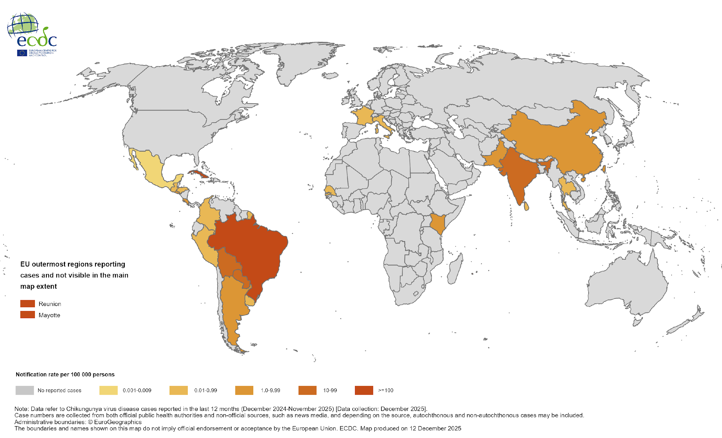
Chikungunya Virus

Slide 13
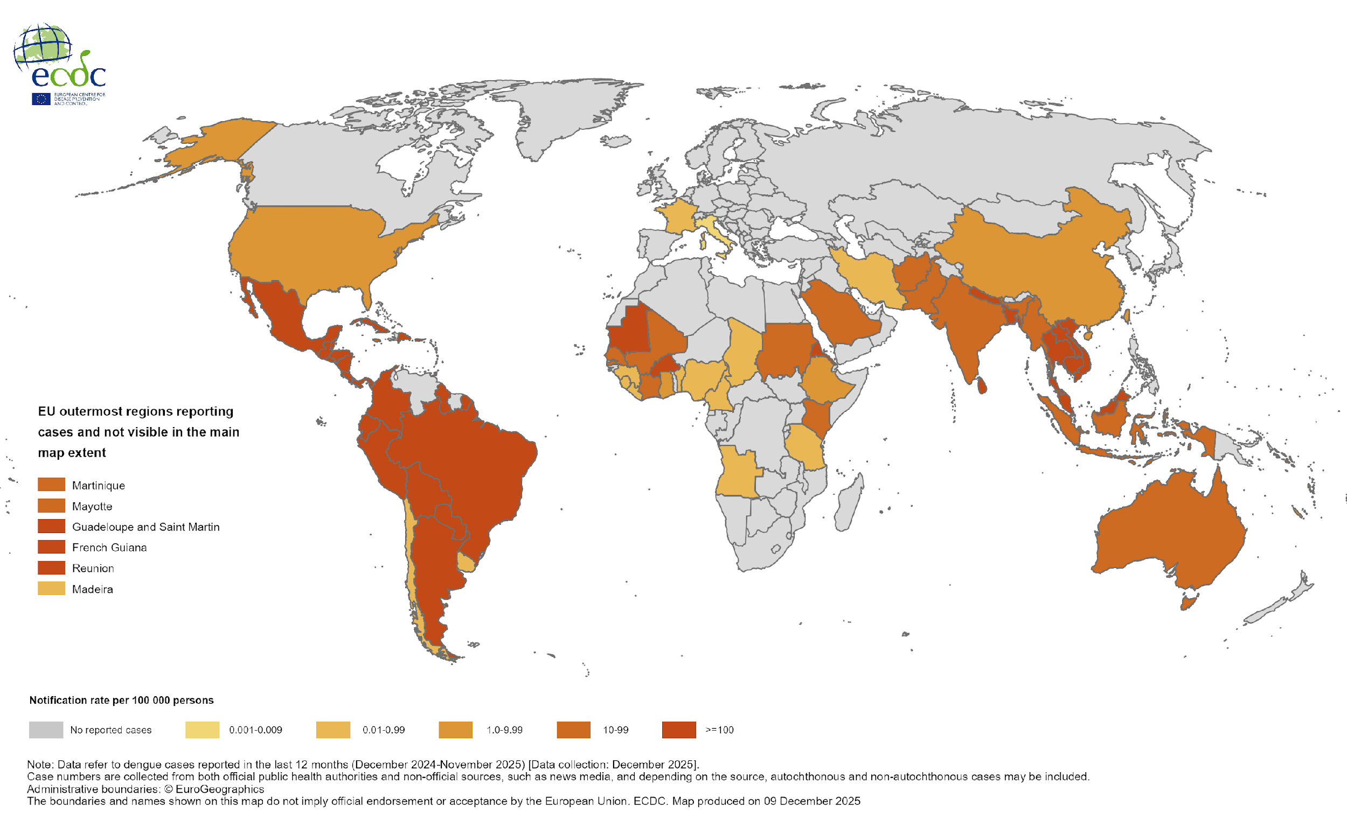
Dengue Virus

Slide 14
Sample Processing
We isolated RNA from Dengue or Chikungunya clinical sera samples (n = 116) using an automated bead-based TANBead Technology.
All samples were screened using Multiplex tiling PCR primers to identify the Pathogen.
The amplicons were run through gel electrophoresis to determine Positive Samples.
11 Samples were positive for Dengue and 30 Samples were Positive for Chikungunya Viruses.

Slide 15
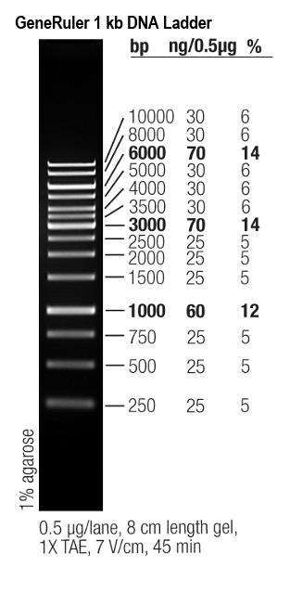
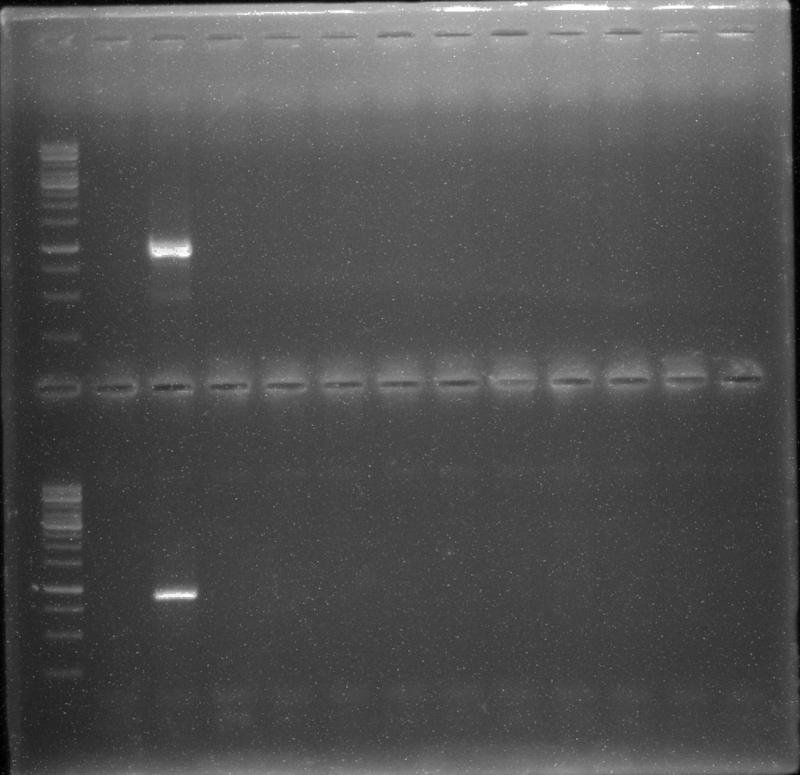
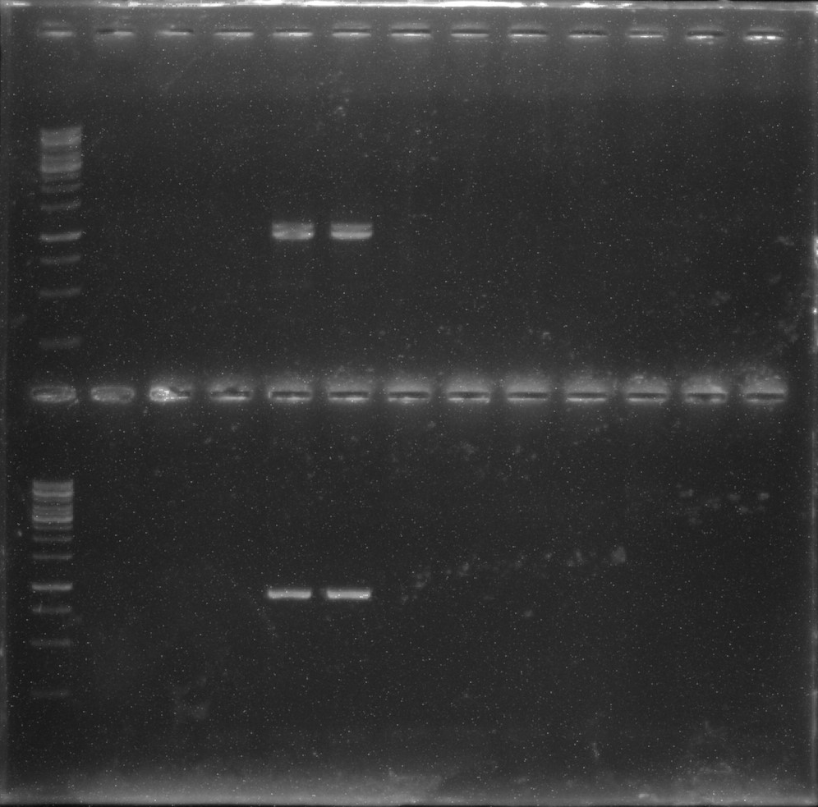
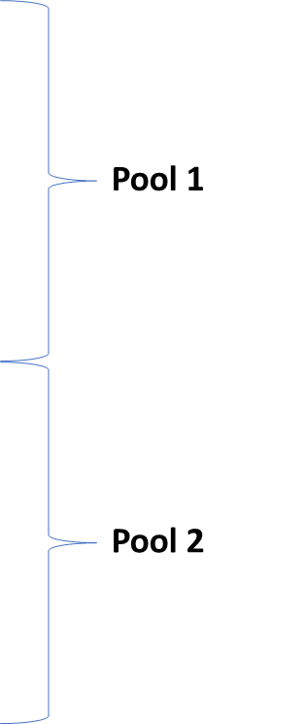
Quality Checks & Screening
DenV-2 Virus tiled Amplicons
L 84
L 98 99

Slide 16
Positive Dengue samples.
Sample No. | Sample ID | DENV1 | DENV2 | DENV3 | DENV4 | Sex | Age | Date | Sample | Location
7 | 063/12/2019 | +ve* |  |  |  | M | 59 |  | Serum | Mombasa, Kenya
74 | NR004 |  | +ve* |  |  | F |  |  | Serum | Mombasa, Kenya
77 | NR007 | +ve |  | +ve* |  | F |  |  | Serum | Mombasa, Kenya
81 | NR011 |  |  | +ve |  | F |  |  | Serum | Mombasa, Kenya
82 | NR012 |  |  | +ve* |  | F |  |  | Serum | Mombasa, Kenya
83 | NR013 | +ve |  | +ve* |  | F |  |  | Serum | Mombasa, Kenya
84 | NR014 | +ve | +ve* |  |  | F |  |  | Serum | Mombasa, Kenya
96 | NR026 | +ve |  | +ve* |  | M | 16 |  | Serum | Somalia
97 | NR027 |  |  | +ve* |  | M | 22 |  | Serum | Somalia
98 | NR028 |  | +ve* |  |  | F | 30 |  | Serum | Somalia
99 | NR029 |  | +ve* |  |  | F | 54 |  | Serum | Somalia
Positive control 1 |  | +ve
Positive control 2 |  | +ve

Slide 17
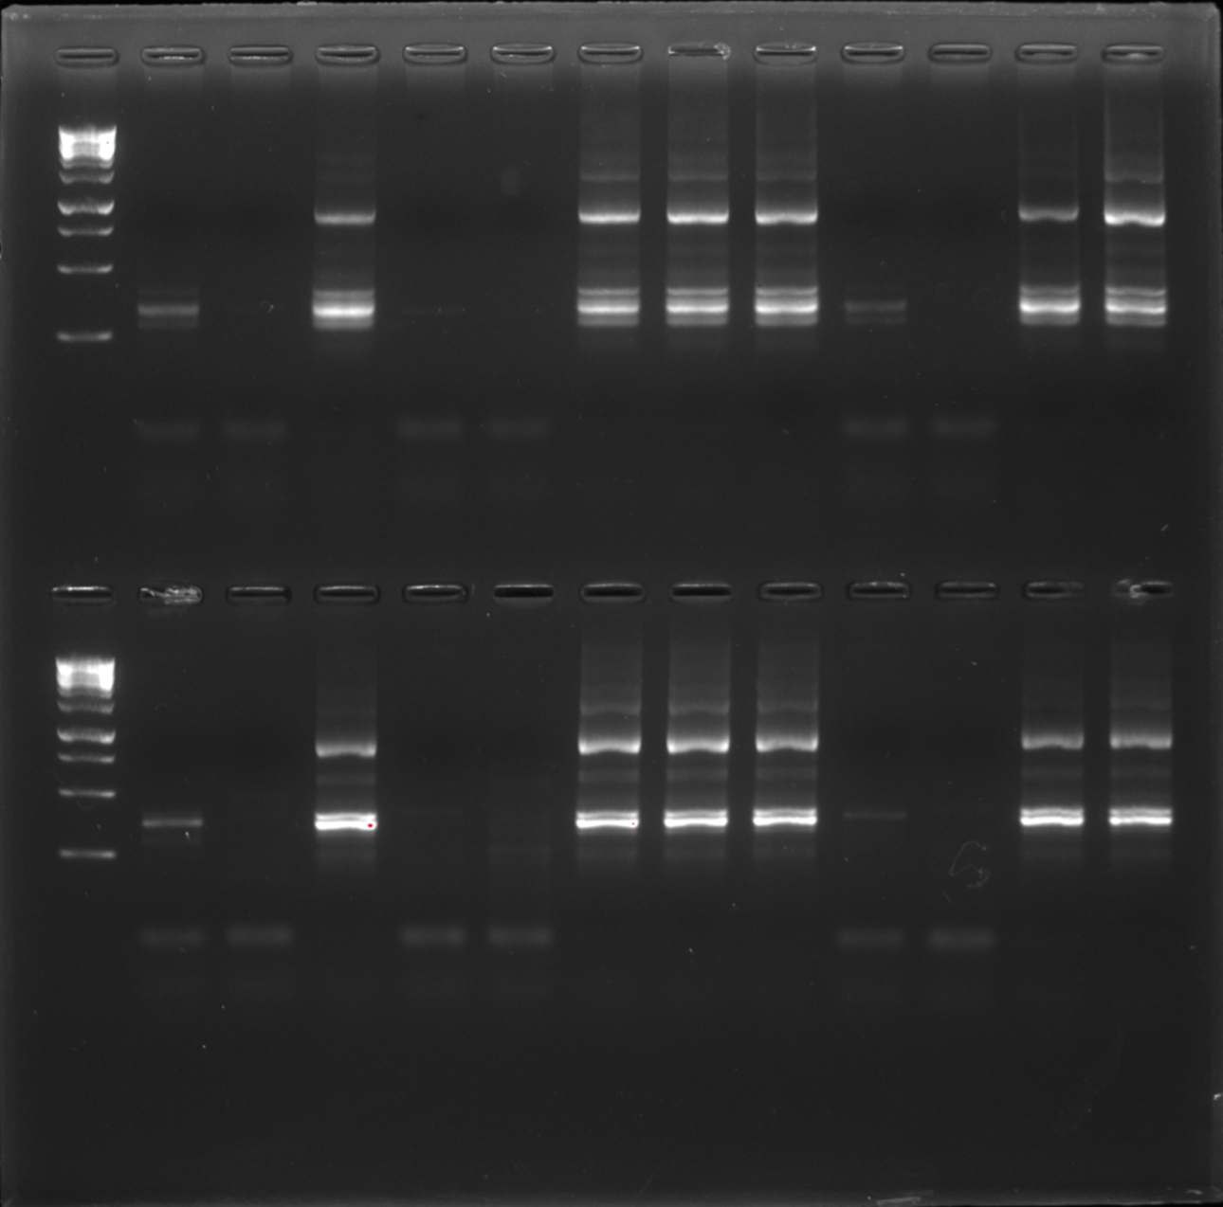
Chikungunya Virus tiled Amplicons
L 37 38 39 40 41 42 43 44 45 46 47 48

Slide 18
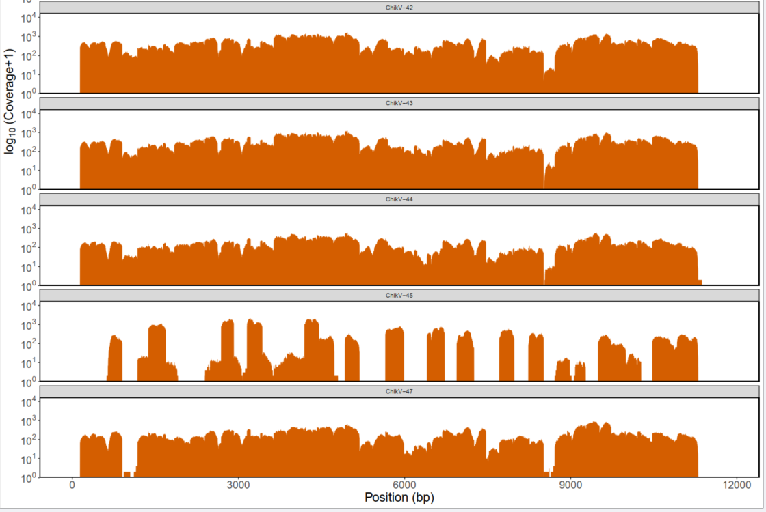
Chikungunya Genome Coverage

Slide 19
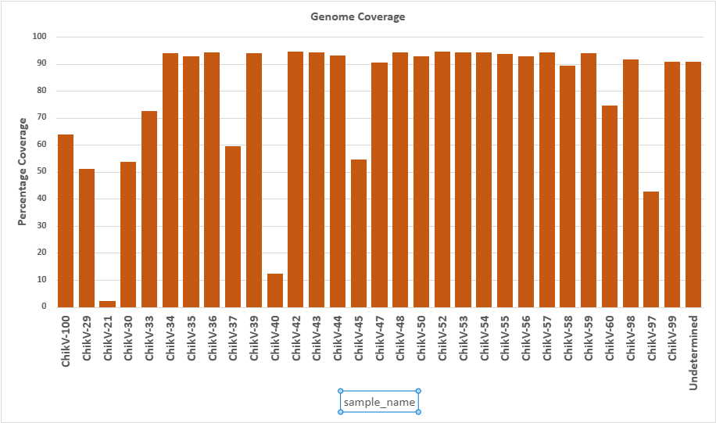
Percentage Genome Coverage

Slide 20
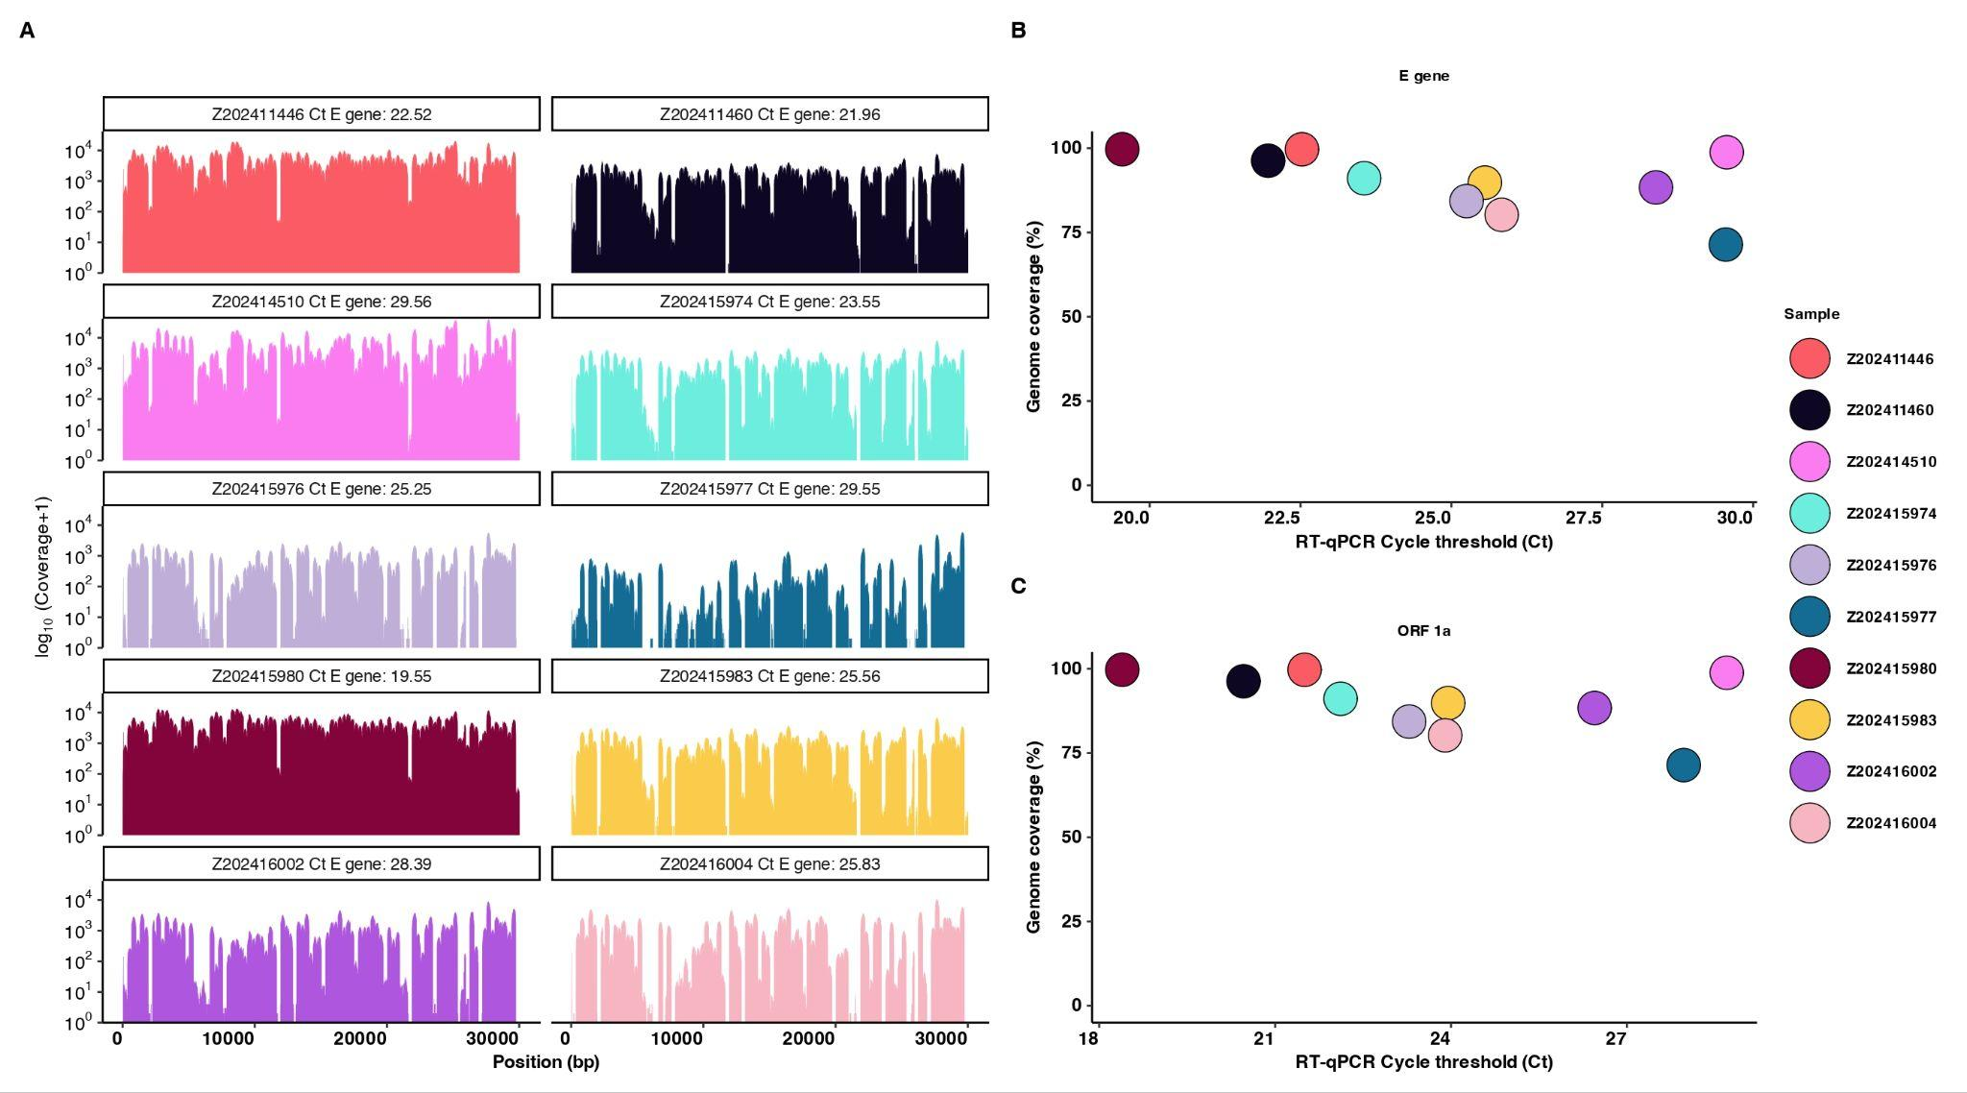
Mers-CoV Genome Coverage to cq-Values

Slide 21
Conclusion
Tiled amplicon sequencing addresses the challenges by enabling sensitive, rapid, and cost-effective whole-genome recovery, making it a practical approach for large-scale surveillance and outbreak response.

Slide 22
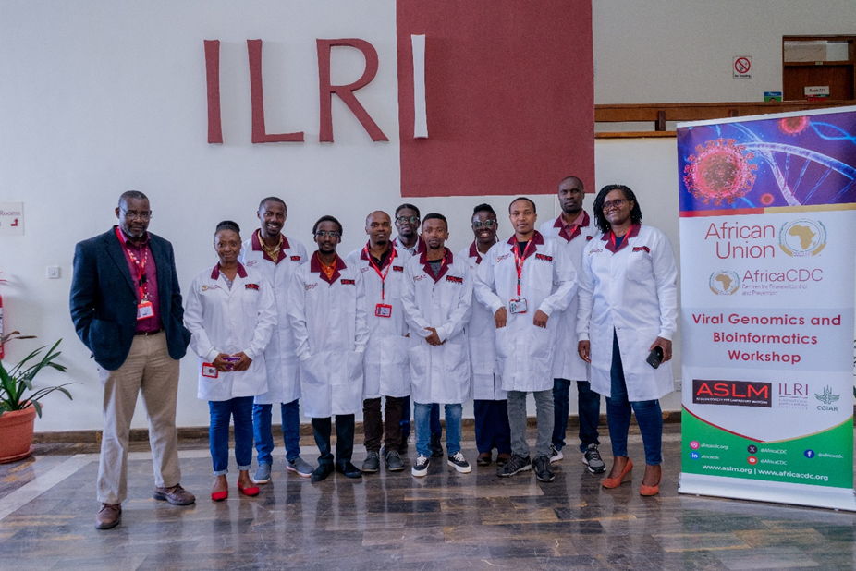
Acknowledgements
Dr Sam Oyola – Senior Scientist
Dr Bernard Mware
Dr John Juma
Collins Muli
Paul Dobi
Gilbert Kibet
Kennedy Mwangi
Shebbar Osiany

Slide 23
