Slide 1
Wastewater-based epidemiological surveillance for public health action
Kennedy Mwangi
Research Associate
Health Program
Animal Health Lab Meeting
Nairobi, 24th April 2026

Slide 2
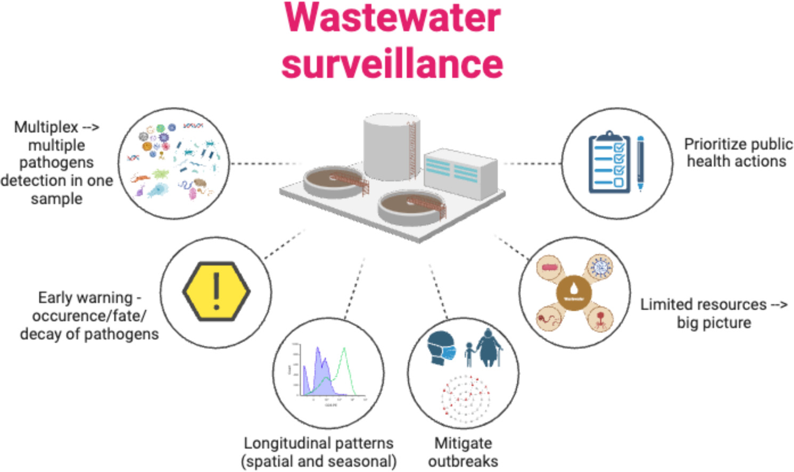
What is wastewater-based epidemiological surveillance?
Wastewater-based epidemiological surveillance is the process of collecting, analyzing, and interpreting data from sewage to monitor the spread of pathogens (like viruses or bacteria) in a community.
It captures biomarkers, such as pathogen DNA or RNA, from both symptomatic and asymptomatic infections, providing a comprehensive, population-level view of disease trends.

Slide 3
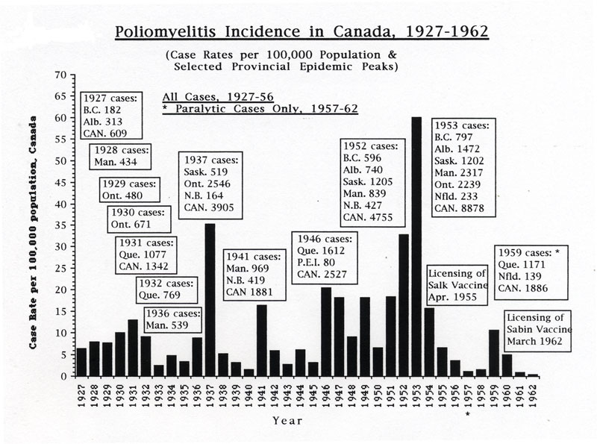

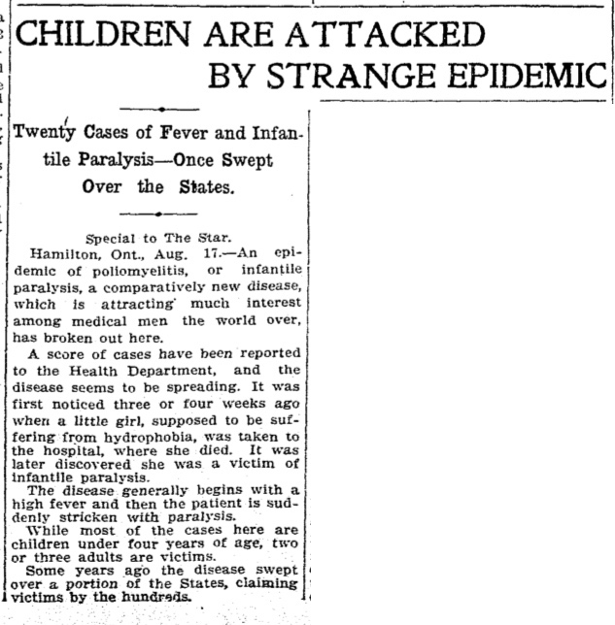
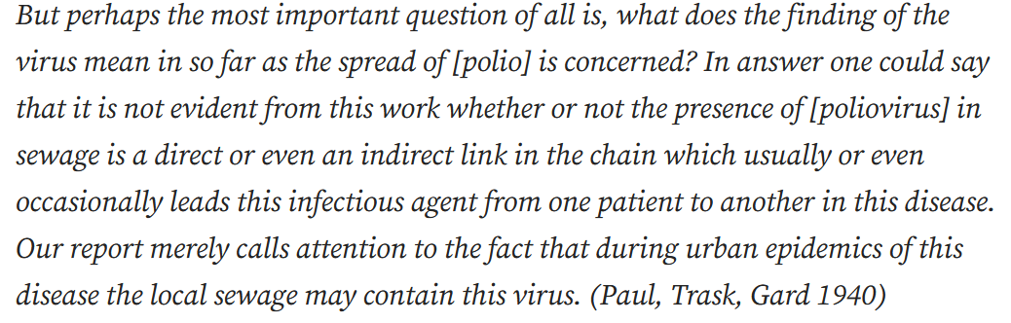
Early wastewater-based surveillance: Polio virus

Slide 4
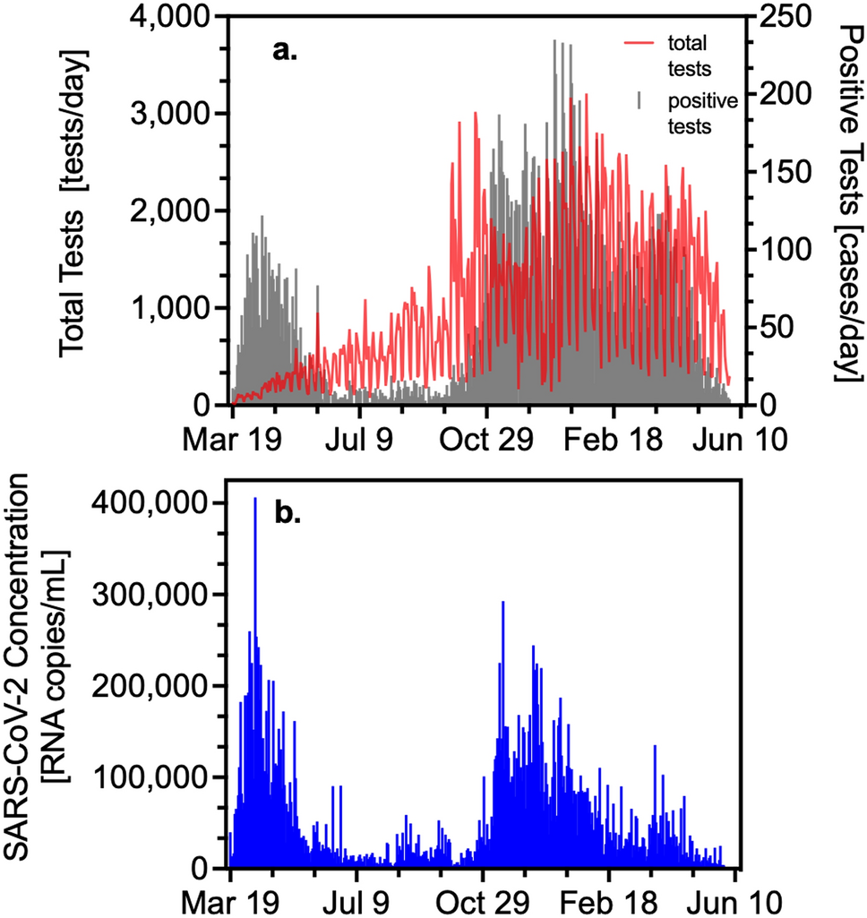
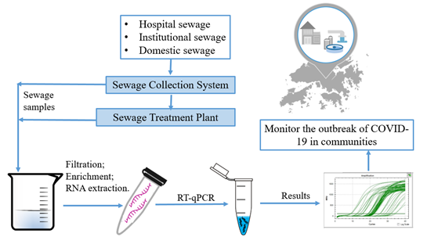
SARS-CoV-2 surveillance in wastewater
Kaplan et al, 2022

Slide 5
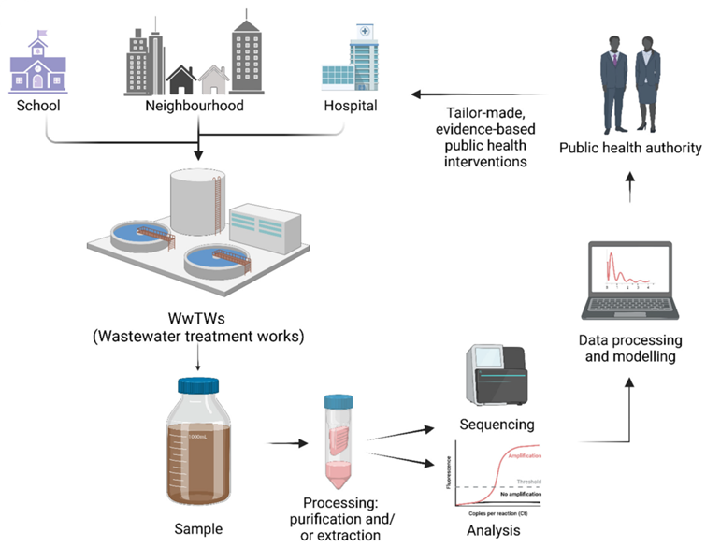
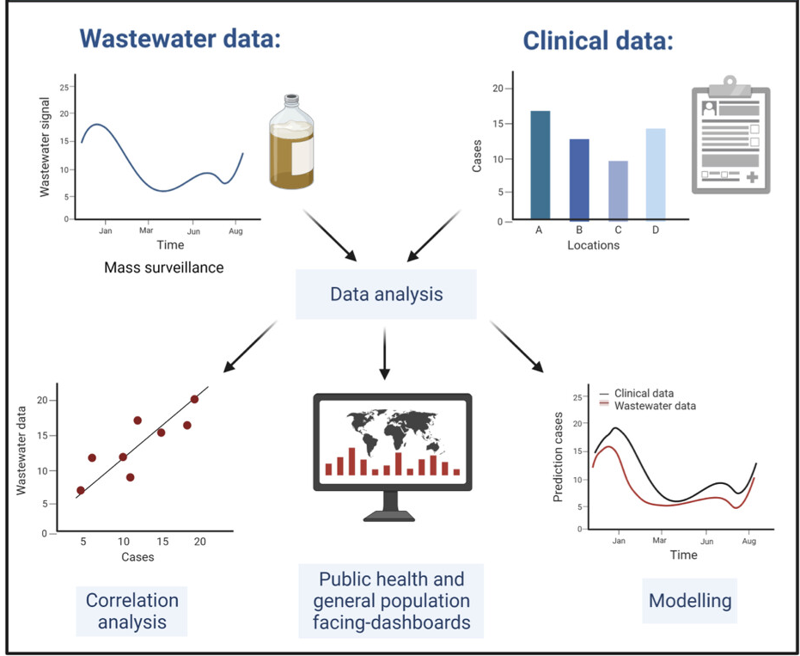
The wastewater surveillance strategy
Parkins et al, 2023

Slide 6
Wastewater sampling to-date…
Number of sampling sites:
- Mombasa: 12
- Kisumu: 18
Sampling period: 19th Oct. 2023 to 30th April 2026
Sampling frequency: bi-weekly
Number of samples sequenced: 1378
Number of sequencing runs: 43
Number of samples analyzed: 1378

Slide 7
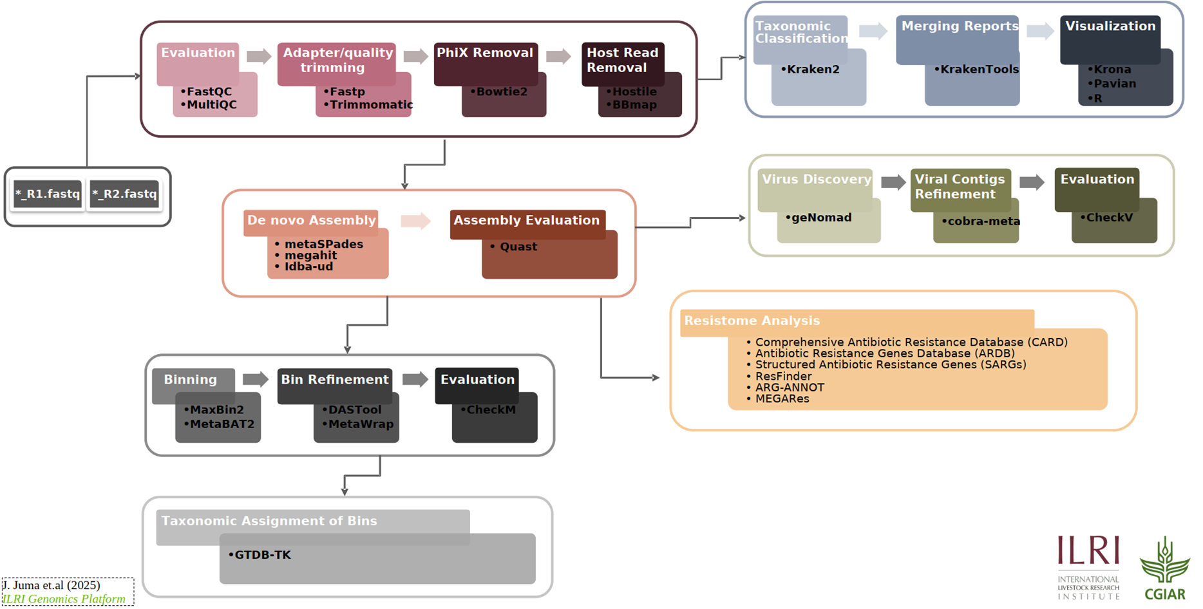
Bioinformatics analysis workflow

Slide 8
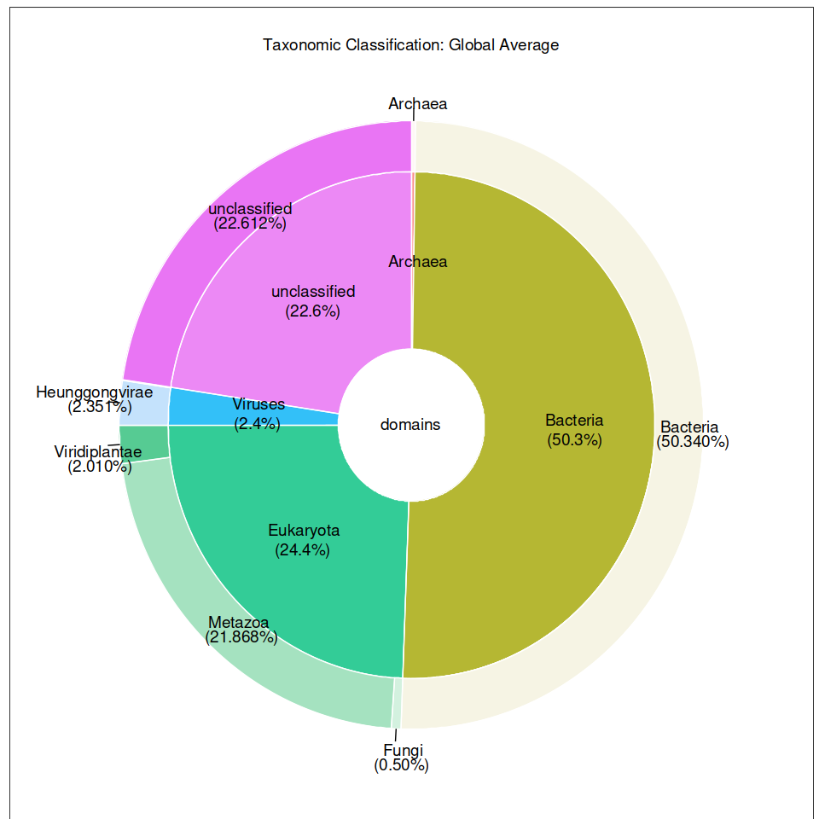
Taxonomic classification results

Slide 9
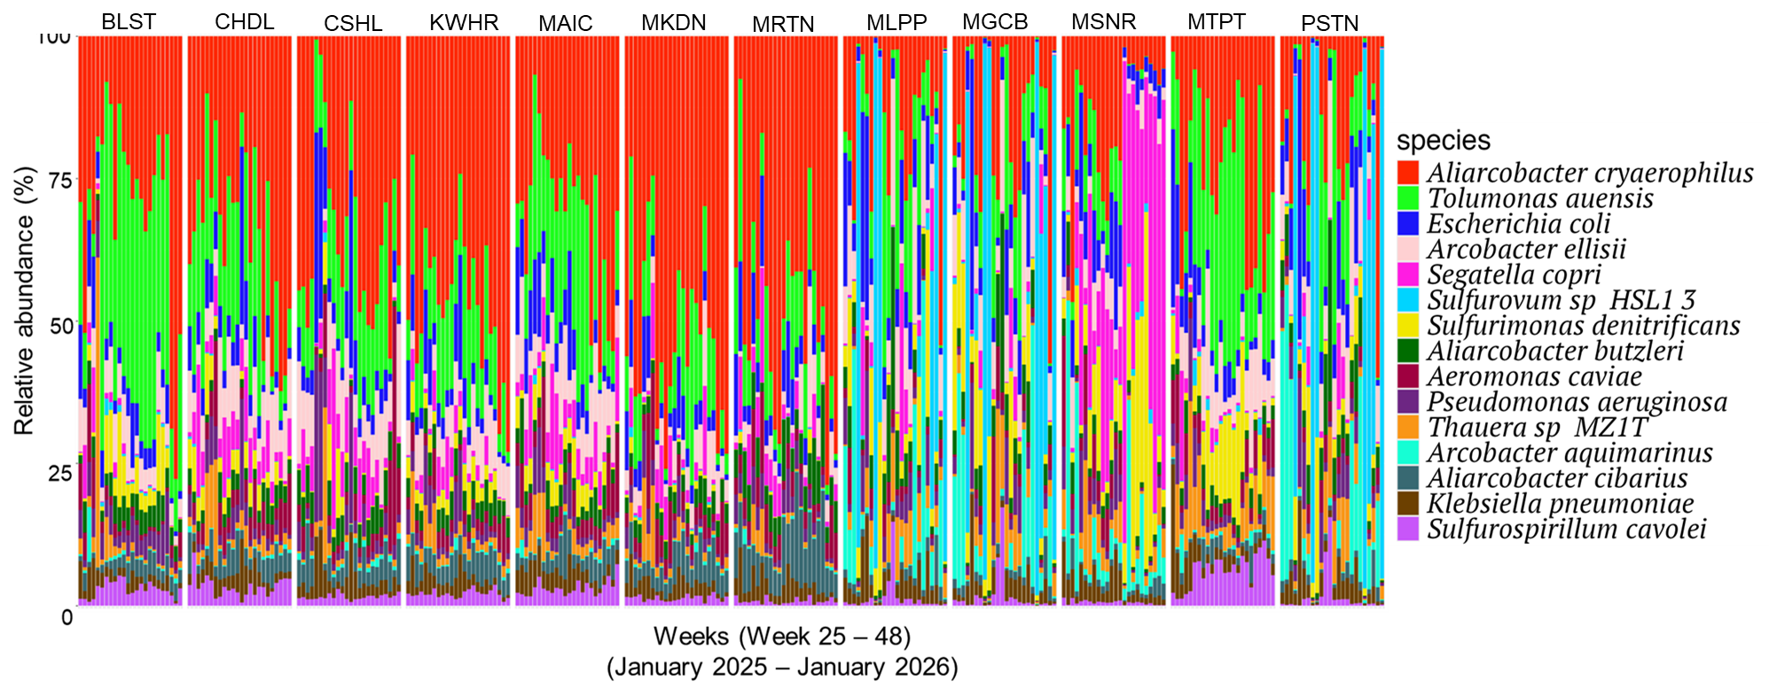
Mombasa: Top 15 Bacteria (week 25 – 48): January 2025 – January 2026

Slide 10
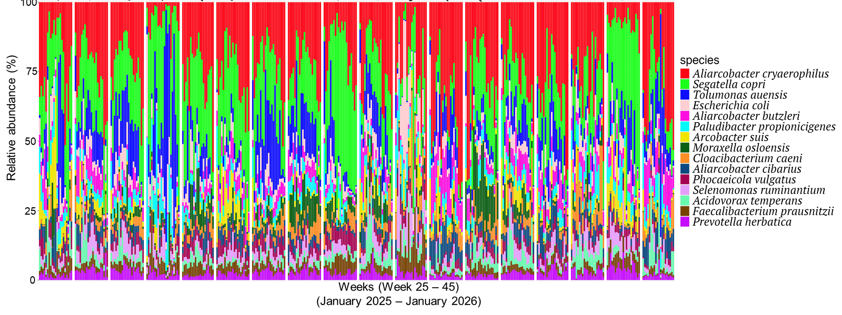
Kisumu: Top 15 Bacteria (week 25 – 45): January 2025 – January 2026
BNDN
BJNC
CJNC
EBTL
JRQR
JNLN
KCBD
KJNC
KCLN
KPTQ
MBSH
MLSL
NBST
NYLG
NYRW
OBNW
SBRD
TMPS

Slide 11
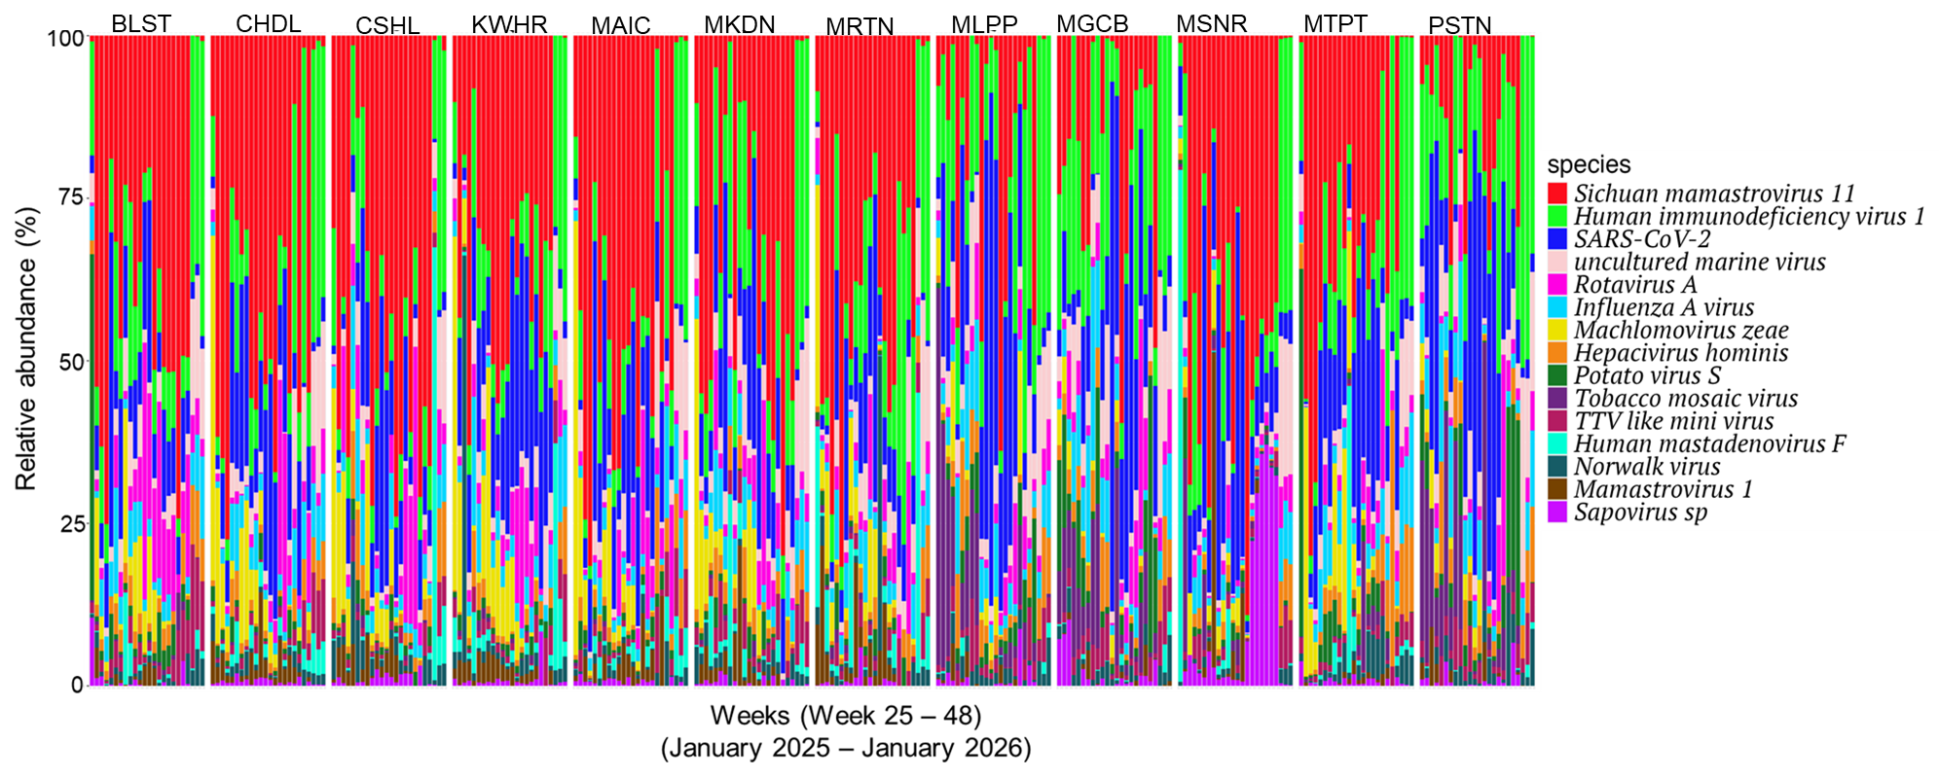
Mombasa: Top 15 Virus (week 25 – 48): January 2025 – January 2026

Slide 12
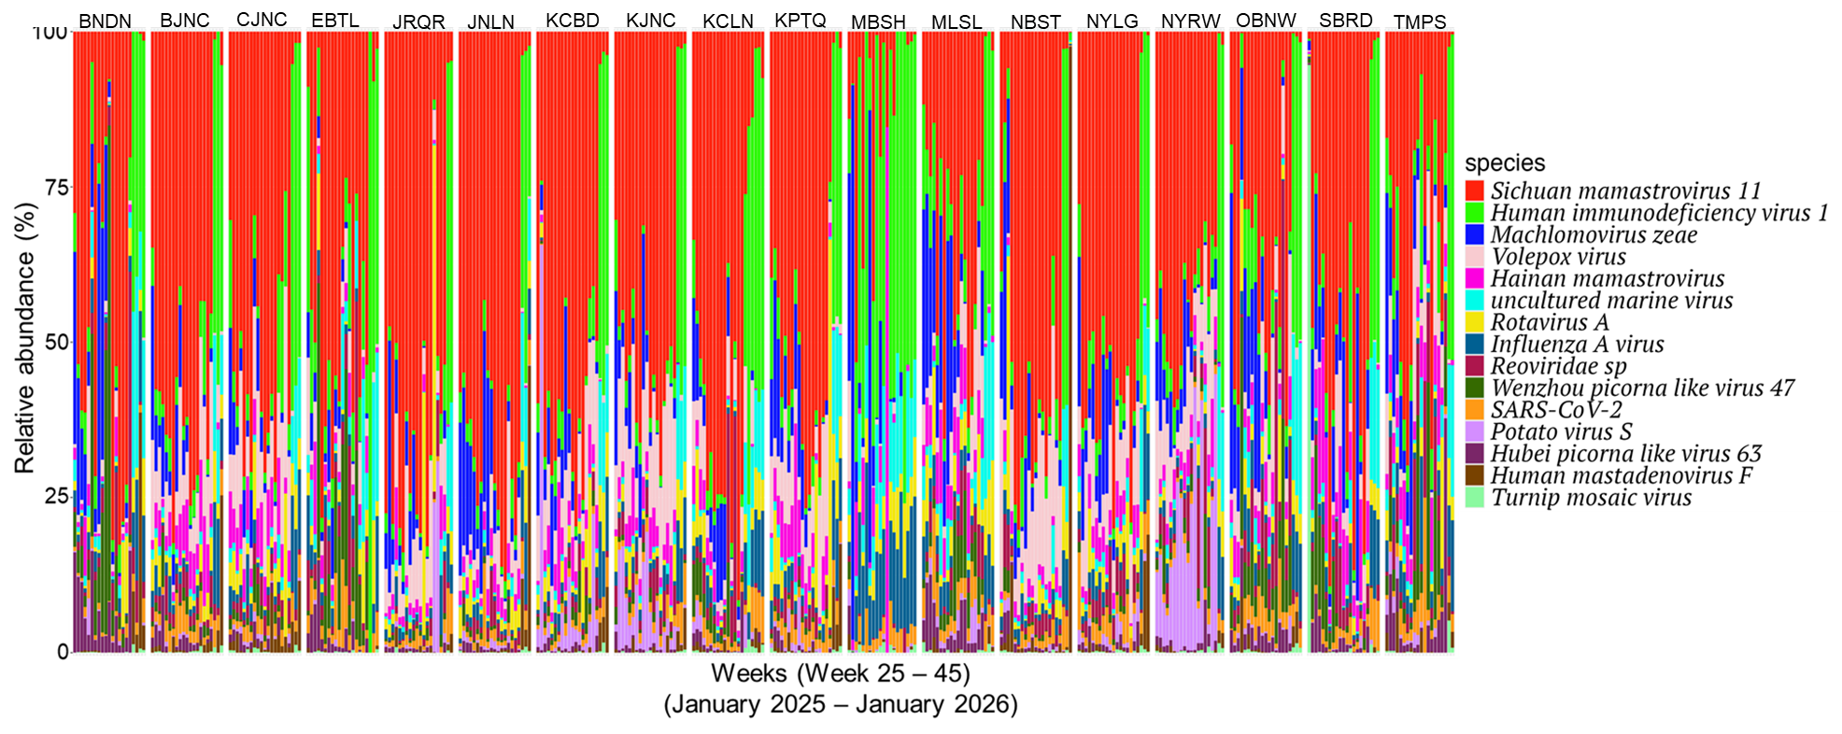
Kisumu: Top 15 Virus (week 25 – 45): January 2025 – January 2026

Slide 13
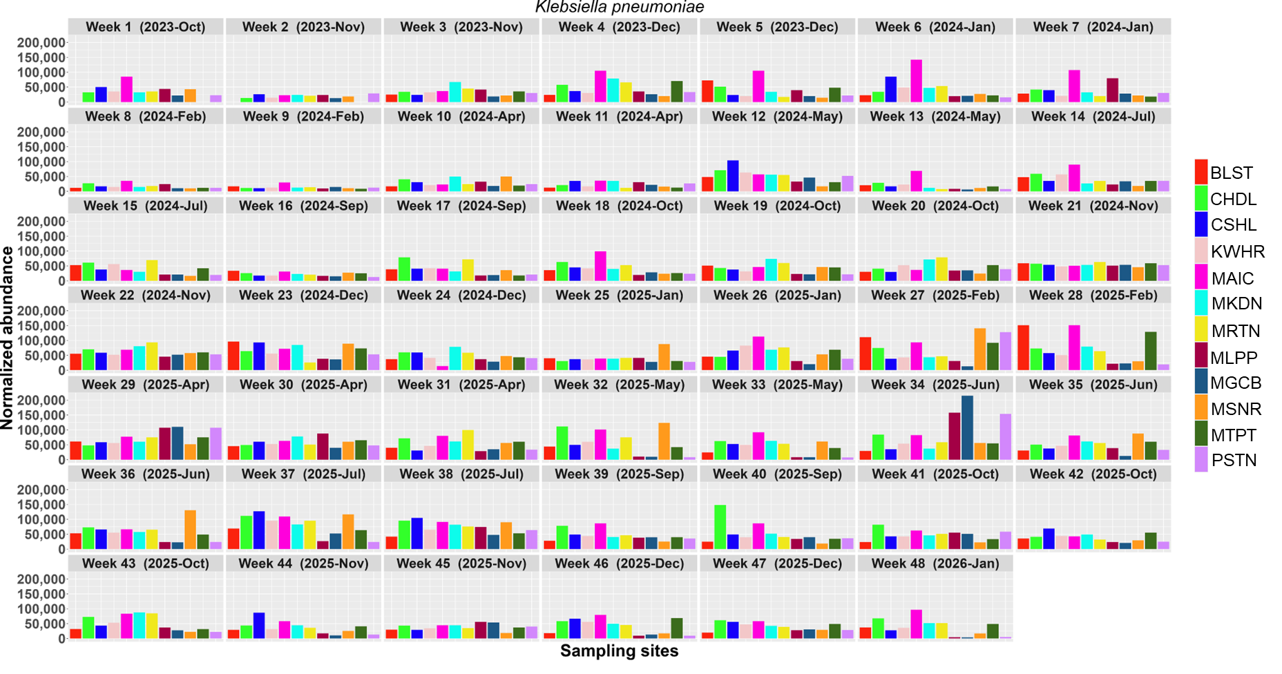
Mombasa: Klebsiella pneumoniae across sampling timeline

Slide 14
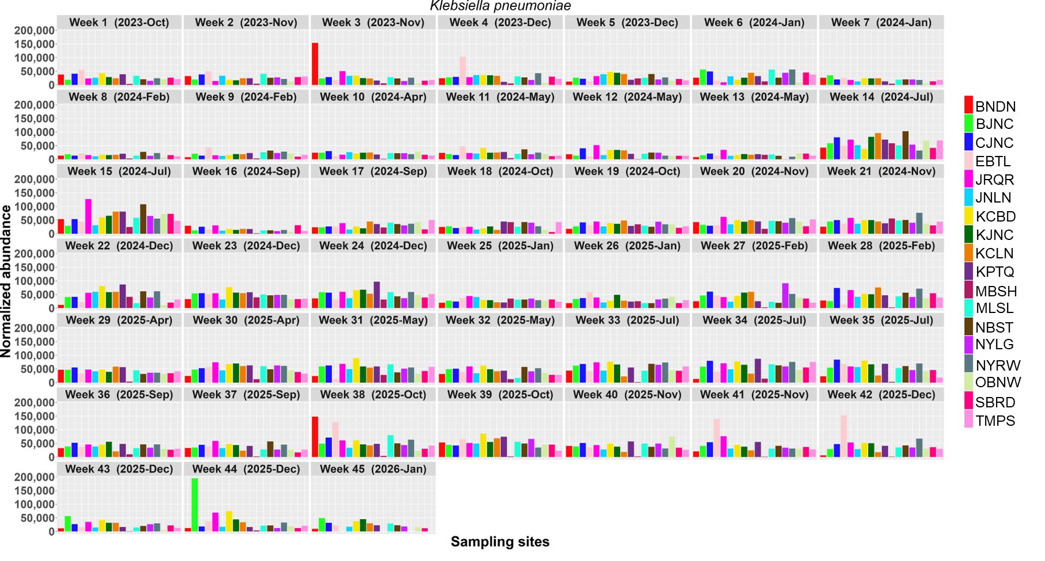
Kisumu: Klebsiella pneumoniae across sampling timeline

Slide 15
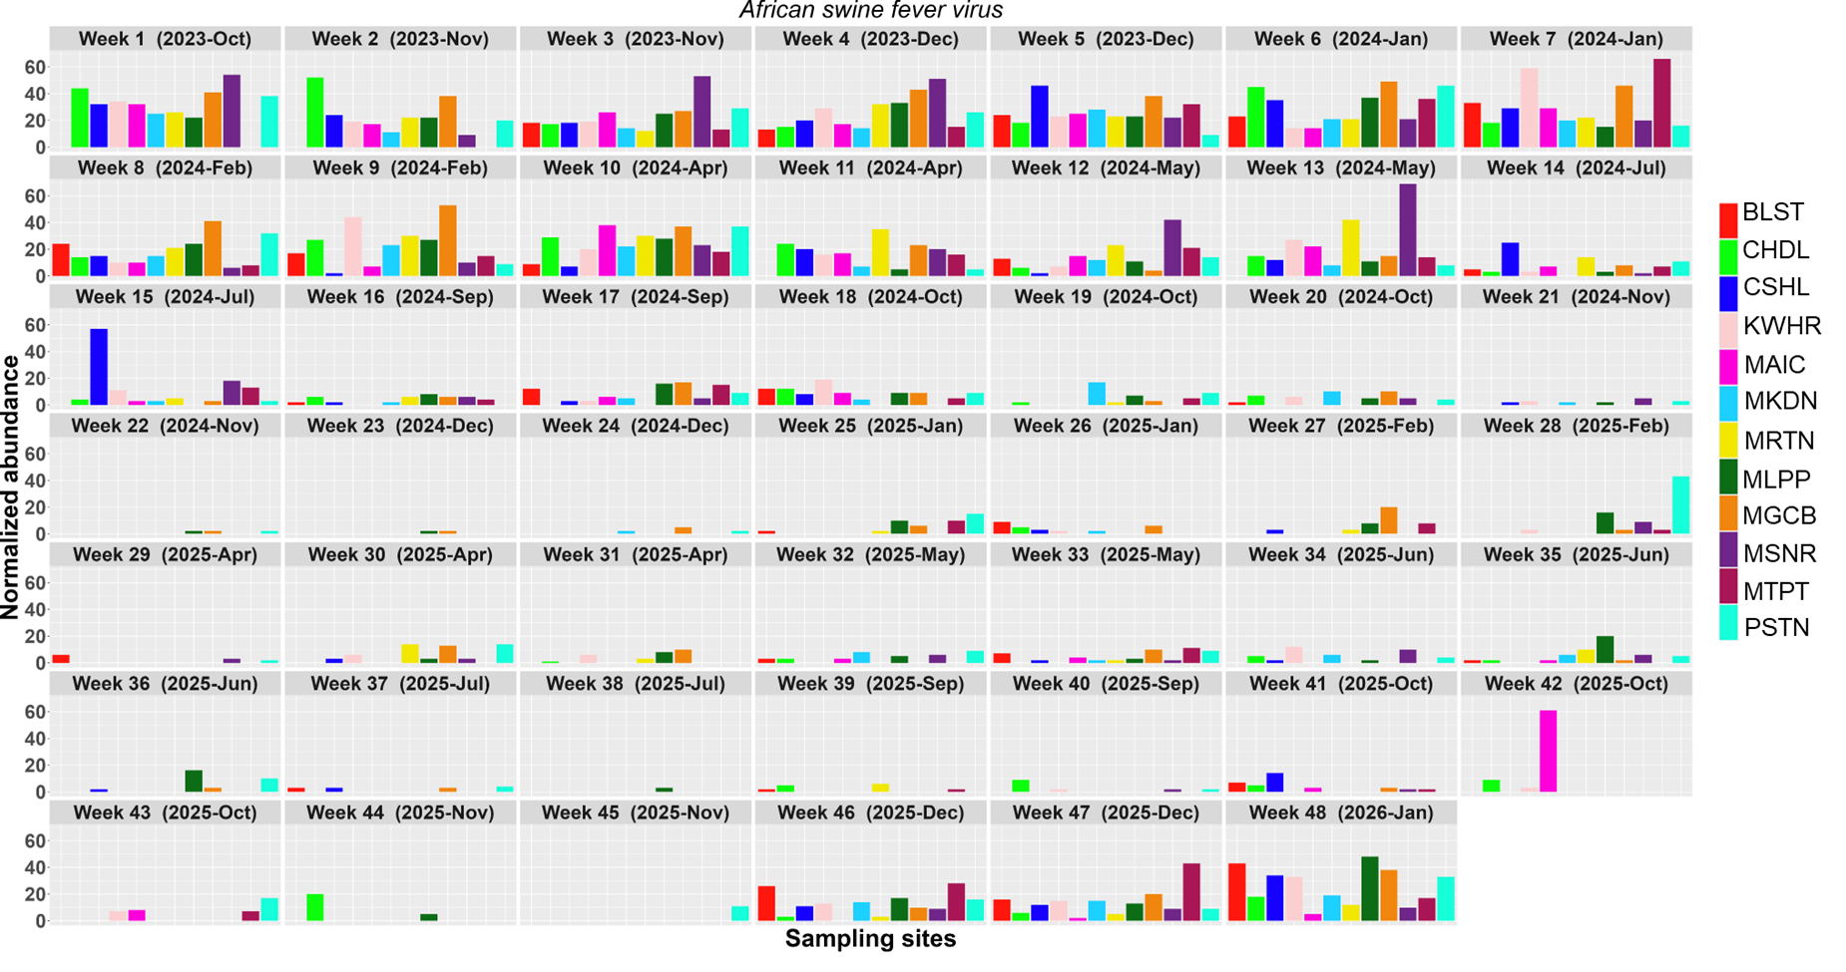
Mombasa: African swine fever virus across sampling timeline

Slide 16
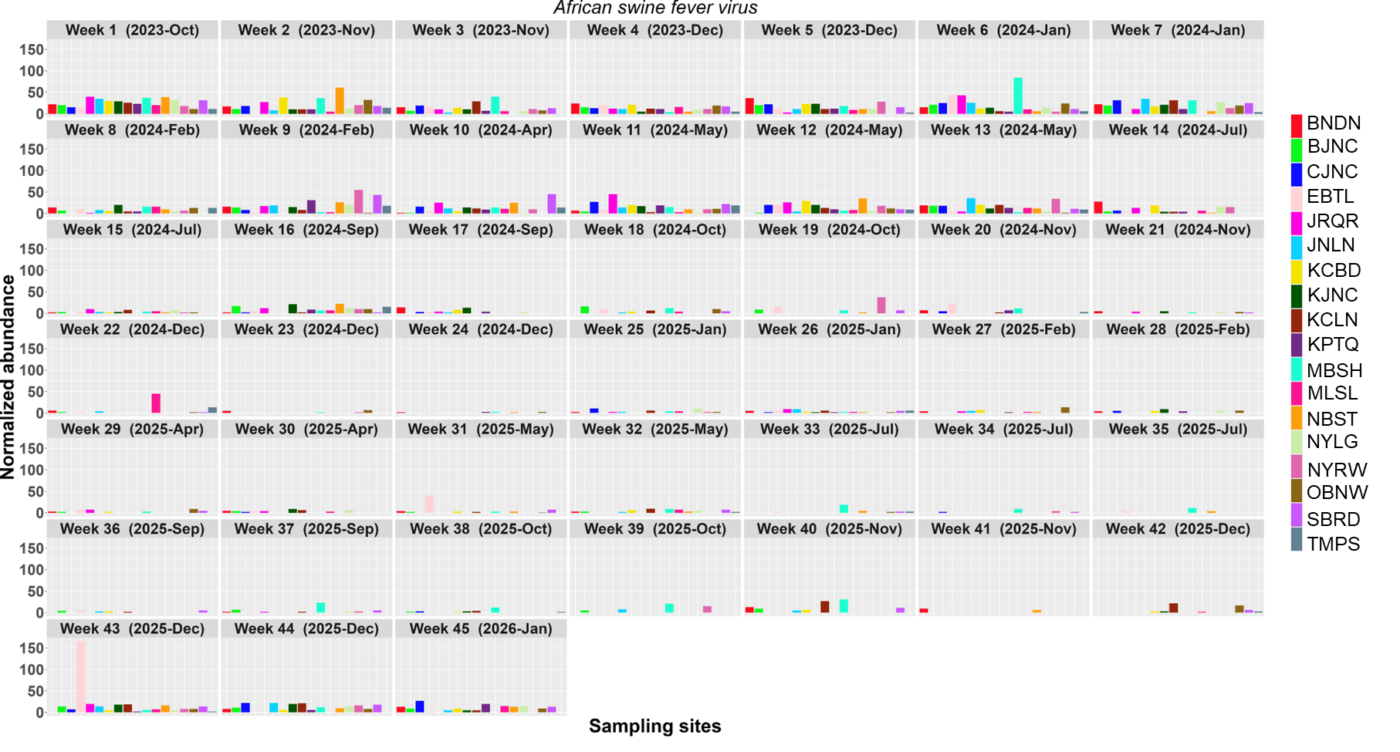
Kisumu: African swine fever virus across sampling timeline

Slide 17
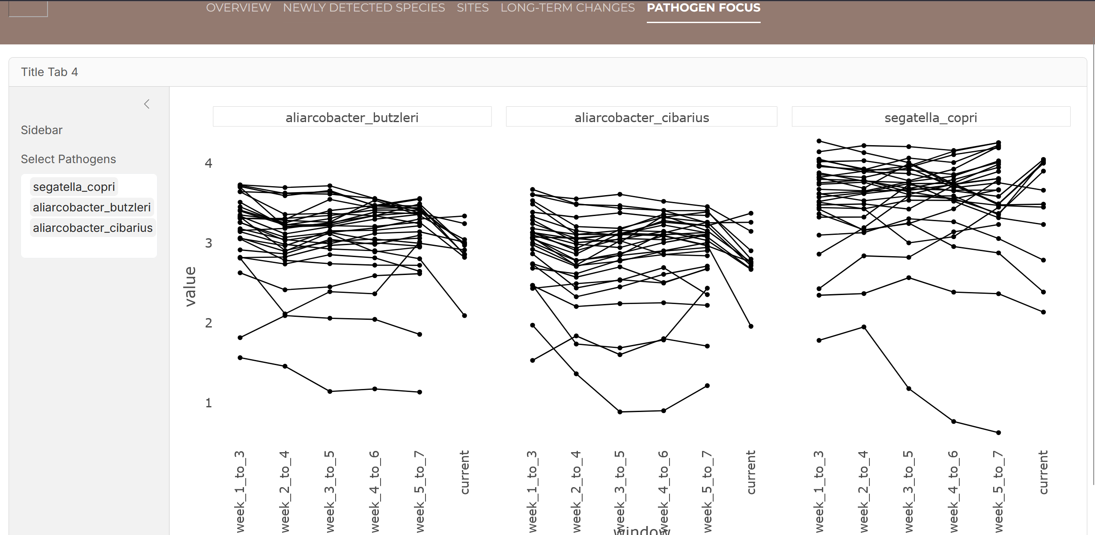
Public Dashboard

Slide 18




Acknowledgements

Slide 19

THANK YOU

