Slide 1


NATHAN KIBET | 9/2025
ANKPHARMACY
When Pharmacy meets technology
NAME OF PROJECT:
PRESENTED BY:
ANKPHARMACY WEBPAGE
NATHAN KIBET

Slide 2

I came up with this idea a few years back when I thought of combining the concept of online ordering services like glovo, and pharmacies like goodlife
Introduction
ANKPharmacy is an online pharmacy service that partners with various pharmacies to provide a variety of medical products
www.reallygreatsite.com

Slide 3
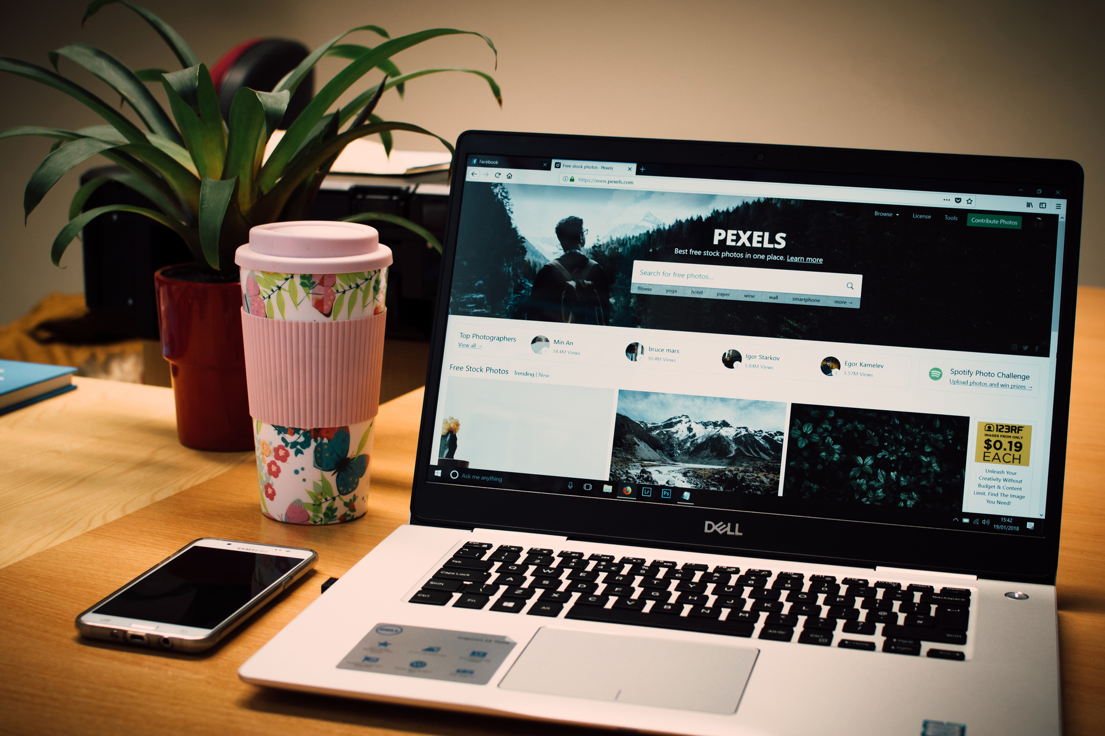
Overview
AnkPharmacy is a modern alternative to traditional online pharmacies.
Instead of selling from a single warehouse, it connects customers to the existing stock of multiple local pharmacies, giving them more choice, better prices, and faster delivery.
A key advantage is the ability for customers to upload their prescriptions directly on the platform, ensuring safe and accurate fulfillment while saving time and effort.

Slide 4



Target Audience
Elderly patients who find it hard to visit or call multiple pharmacies
People with chronic illnesses needing regular refills and hard-to-find prescription drugs
Caregivers who manage medication on behalf of patients

Slide 5

Core Features — Prescription Upload
Easy Prescription Upload
Quick Matching
Faster Access
Customers can scan or upload a photo of their prescription directly.
Our team finds which partner pharmacies have the exact prescribed medication.
Saves customers time compared to calling or visiting multiple pharmacies.

Slide 6
Core Features — Partnerships
Pharmacy Network
Partnership with pharmaceutical firms
Trusted Sources
Integrates stock data from local pharmacies to offer a wide variety of drugs.
Enables consistent supply and better pricing for customers.
Ensures medicines are authentic and sourced from licensed providers.

Slide 7

Development Challenges
Problem with inconsistency in design.
Trouble with gh-pages
Responsive design.
Mobile Nav

Slide 8

Solutions
Soln #1
Using Figma I was able to create a consistent design that I applied to the whole website.
Soln #2
I ditched github pages for netlify which offered faster live updates
Soln #3
Using tailwind breakpoints and a seperate testing file I was able to manage to make most components responsive
Soln #4
Using a youtube tutorial I was able to make a sandwich menu that appeared on medium and small screens

Slide 9
Thank you
CONTACT ME
E-mail
kibetnat@gmail.com
Github
kibetnathan
Phone
+254-798566968
www.ankpharmacyy.netlify.app

