Slide 1
Lab
Design patterns

Slide 2
Uses of Design Patterns
Design patterns can speed up the development process by providing tested, proven development paradigms.
Effective software design requires considering issues that may not become visible until later in the implementation.
Reusing design patterns helps to prevent subtle issues that can cause major problems and improves code readability for coders and architects familiar with the patterns.

Slide 3
Cont..
In addition, patterns allow developers to communicate using well-known, well-understood names for software interactions.
Common design patterns can be improved over time, making them more robust than ad-hoc design

Slide 4
Creational, Structural, or Behavioral
Design patterns are organized into Creational, Structural, or Behavioral purpose. 1. Creational patterns concern the process of object creation.
2.Structural patterns deal with the composition of classes or objects.
3.Behavioral patterns characterize the ways in which classes or objects interact and distribute responsibility.

Slide 5
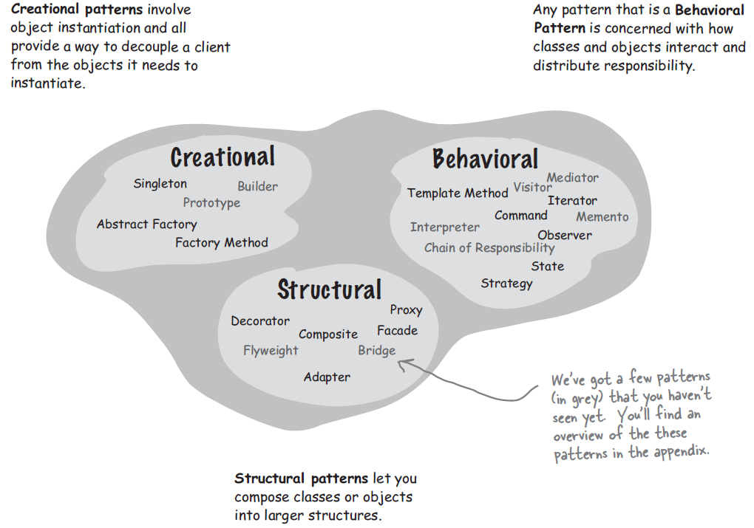

Slide 6
Creational design patterns
Creational patterns involve object instantiation and all provide a way to decouple a client from the objects it needs to instantiate.
This pattern can be further divided into class-creation patterns and object-creational patterns.
While class-creation patterns use inheritance effectively in the instantiation process, object-creation patterns use delegation effectively to get the job done.

Slide 7
Factory Design Pattern - Creates objects without specifying the exact class to create.
Singleton Design Pattern - Ensures only one instance of an object is created.
Abstract Factory Design Pattern - Allows for the creation of objects without specifying their concrete type.
Builder Design Pattern - Separate the construction of a complex object from its representation so that the same construction process can create different representations.
Prototype Design Pattern - Creates a new object from an existing object.

Slide 8
Structural design patterns
Structural pattern let's compose classes and objects into larger structures. Adapter Design Pattern - Convert the interface of a class into another interface the clients expect. Adapter lets classes work together that couldn't otherwise because of incompatible interfaces.
Bridge Design Pattern - Decouple an abstraction from its implementation so that the two can vary independently.
Composite Design Pattern - Compose objects into tree structures to represent part-whole hierarchies. Composite lets clients treat individual objects and compositions of objects uniformly

Slide 9
Decorator Design Pattern - Attach additional responsibilities to an object dynamically. Decorators provide a flexible alternative to subclassing for extending functionality.
Facade Design Pattern - Provide a unified interface to a set of interfaces in a subsystem. Facade defines a higher-level interface that makes the subsystem easier to use.
Flyweight Design Pattern - Use sharing to support large numbers of fine-grained objects efficiently.
Proxy Design Pattern - Provide a surrogate or placeholder for another object to control access to it.

Slide 10
Behavioral design patterns
Behavioral pattern is concerned with how classes and objects interact and distribute responsibility. These design patterns are all about Class's objects communication.
Behavioral patterns are those patterns that are most specifically concerned with communication between objects.
Chain of responsibility - Avoid coupling the sender of a request to its receiver by giving more than one object a chance to handle the request. Chain the receiving objects and pass the request along with the chain until an object handles it.
Command Design Pattern - Encapsulate a request as an object, thereby letting you parameterize clients with different requests, queue or log requests, and support undoable operations.

Slide 11
Iterator Design Pattern - Accesses the elements of an object sequentially without exposing its underlying representation.
Mediator Design Pattern - Allows loose coupling between classes by being the only class that has detailed knowledge of their methods.
Memento Design Pattern - Provides the ability to restore an object to its previous state.
Observer Design Pattern - s a publish/subscribe pattern which allows a number of observer objects to see an event.
State Design Pattern - Allow an object to alter its behaviour when its internal state changes. The object will appear to change its class

Slide 12
Strategy Design Pattern - Define a family of algorithms, encapsulate each one, and make them interchangeable. Strategy lets the algorithm vary independently from the clients that use it.
Template Method Design Pattern - Define the skeleton of an algorithm in an operation, deferring some steps to subclasses. Template method lets subclasses redefine certain steps of an algorithm without changing the algorithm's structure.
Delegation Pattern - It is a technique where an object expresses certain behavior to the outside but in reality delegates responsibility for implementing that behaviour to an associated object

