Slide 1
Chapter 4 – Security Mechanisms and Techniques

Slide 2
5.1 Introduction
  Security mechanisms are also known as security services, security controls, safeguards
  Security mechanisms are elements of the security subsystem of
    An operating system
    A database management system
    An application system
    A communication system
  Access protection (access control): controls access to resources
  Authentication: ensures the authenticity of actors
  Information flow control: controls the flow of information between entities

Slide 3
  Encryption: keeps data secret and prevents unnoticed corruption
  Digital signature: ensures the authenticity of documents, programs, ...
  Auditing: bookkeeping on all security-related events in a system
  Firewalls: control traffic between the Internet and the local system or intranet
  Intrusion detection: detects attempted or successful attacks on a system

Slide 4
Note: the relationship between security and protection remains fuzzy
  It is a common experience that the amount of damage caused by a security violation is not easily quantified (→ risk assessment)
  Whether or not a certain gain in security is worth the protection effort required often remains an open question
  There is a never-ending race between the security experts and the adversaries: for each security hole that is closed a new kind of threat pops up

Slide 5
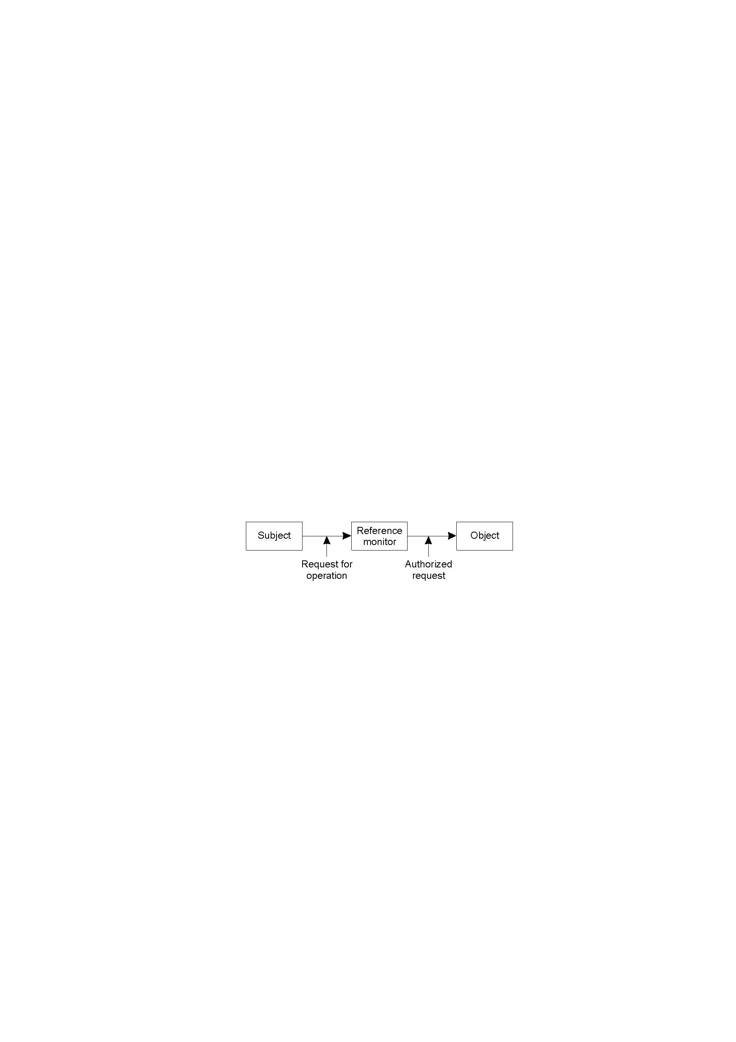
5.2 Access Control (Access Protection)
  Is meant to prevent undesirable access of objects by subjects
  A protection system describes the conditions under which a system is secure
  Access control is used to identify a user to a system
  Associated with each user, there can be a profile that specifies permissible operations and accesses (authorization)
  The operating system can enforce rules based on user profile
Access Control - Generalized View
  Access control: Verifying access rights to prevent misuse of resources
  Authorization: Granting access rights (Do not confuse authorization and authentication!)

Slide 6
Access Control Matrix (ACM)
  The access control matrix arose both in operating systems and in database research
  It describes allowed accesses using a matrix
  Basic elements of ACM
    Subject: An entity capable of accessing objects, such as processes and users; subjects are active; subjects are given security clearance
    Object: Anything to which access is controlled (files, programs, memory segments, …); objects are passive; objects have security classification
    Access right: The way in which an object is accessed by a subject (read, write, execute, …); the exact meaning of the operation depends on the nature of the object; “reading from” a file is obvious but what is “reading from” a process; it could mean that the reader accepts messages from the process being read

Slide 7
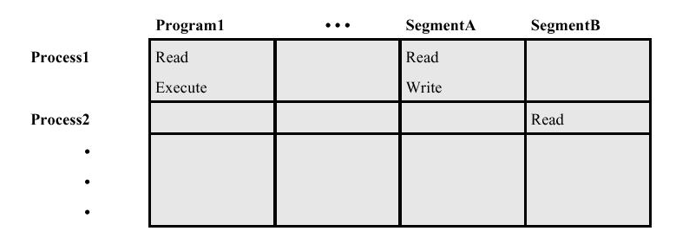
Access Control Matrix
Object
Subject
  In the ACM, each subject is represented by a row and each object as a column
    Capabilities: are stored row-wise - with the subjects
    Permissions: are stored column-wise - with the objects
  ACM [s, o] lists precisely which operations subject s can request to be carried out on object o

Slide 8
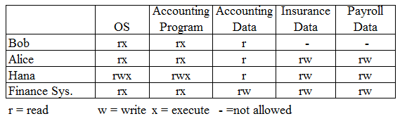
Access Control Matrix - Example
  Subject (Row): Three users (Bob, Alice, and Hana) and one program (Finance Sys.)
  Object (Column): Five objects (OS, Accounting Program, Accounting Data, Insurance Data, and Payroll Data)
  Access Rights (each cell): Read, Write, Execute, Not Allowed)

Slide 9
Problems of ACM
  The number of subjects and objects will be large so that the matrix will use significant amount of storage
  Most entries in the matrix will be either blank (indicating no access) or the same (because implementations often provide a default setting)
  The creation and deletion of subjects and objects will require the matrix to manage its storage carefully, adding to the complexity of the code
Optimizations (variants based on the access control matrix that eliminate many of the problems mentioned) are used
  Access Control Lists in which each object maintains a list of access rights of subjects
  Capability List where each subject is given access rights to objects

Slide 10
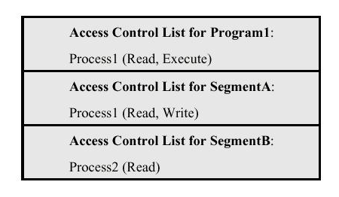
Access Control List
  Decomposition of the ACM by columns (store each column with the object it represents)
  An access control list of an object lists users and their permitted access right on the object
  The list may contain a default or public entry

Slide 11
Capability List
  Decomposition of the ACM by rows (store each row with the subject it represents)
Capability List for Process1: Program1 (Read, Execute) SegmentA (Read, Write)
Capability List for Process2: SegmentB (Read)
  Each subject has associated with it a set of pairs, with each pair containing an object and a set of rights. The subject associated with this list can access the named object in any of the ways indicated by the named rights

Slide 12
Access Control Policies and Models
  Security policy governs a set of rules and objectives needed by an organization
  A security model can be used by an organization to express the policy or business rules to be used in a computer system
  Access control policies are high-level requirements that specify how access is managed and who may access information under what circumstances
  For instance, policies may pertain to resource usage within or across organizational units or may be based on need-to-know, competence, authority, or obligation
  There are two types of access control models
    Discretionary Access Control Model and
    Non Discretionary Access Control Model

Slide 13
Discretionary Access Controls (DACs) is an access policy determined by the owner of an object. The owner decides who is allowed to access the object and with what privileges
  They are called discretionary as users can be given the ability of passing on their privileges of any of the objects under them to other users, without the intervention of the system administrator
Non Discretionary Access Controls (NDACs) are controls that cannot be changed by users, but only through administrative action. Users cannot pass access permissions on to other users at their discretion. NDAC has three popular forms of access control policies
  1. Mandatory Access Control (MAC),
  2. Role-Based Access Control (RBAC), and
  3. Temporal Authorization (TA)

Slide 14
1. Mandatory Access Control (MAC) is a means of restricting access to objects based on the sensitivity of the information contained in the objects and the formal authorization of subjects to access information of such sensitivity
  In MAC, decisions are made by a central authority, not by the individual owner of an object, and the owner cannot change access rights
  An example of MAC occurs in military security, where an individual data owner does not decide who has a Top Secret clearance, nor can the owner change the classification of an object from Top Secret to Secret

Slide 15
2. Role-Based Access Control (RBAC) bases access control decisions on the functions/roles of a user that he/she is allowed to perform within an organization
  This includes the specification of duties, responsibilities, and qualifications. For example, the role “individual associated with a hospital” can include doctor, nurse and patient
3. Temporal Authorization (TA) are formal statements of access policies that involve time-based access restrictions

Slide 16
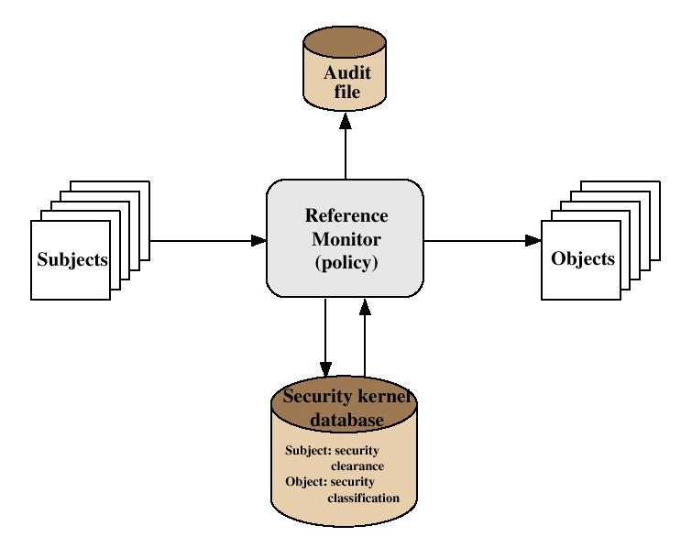
Trusted System: Reference Monitor (Implementing Policies)
  Reference Monitor
    A controlling element in the hardware and operating system that regulates the access of objects by subjects on the basis of security parameters
    It enforces the security policies
    It has access to a security kernel database

Slide 17
Properties of the Reference Monitor
  Complete mediation: Security rules are enforced on every access
  Isolation: The reference monitor and its database themselves are protected from unauthorized modification
  Verifiability: The reference monitor’s correctness must be provable
A system that can provide such verifications is referred to as a trusted system

Slide 18
Multilevel Security Models
  Multilevel Security
    Military-style classifications
    Subjects and objects are partitioned into different security levels
    Protection is based on levels of security
    A subject can only access objects at certain levels determined by its security level and model in use
  There are two Multilevel Security Models
    Bell-LaPadula (BLP) Model
    Biba Integrity Model

Slide 19
5.2.1 Bell-LaPadula Model
  Bell-LaPadula (BLP) model is one of the first multilevel security models that was created to control access to data in government and military applications
  It was developed by David Elliott Bell and Leonard J. LaPadula
  The two basic properties of the Bell-LaPadula model are
    “no read up” : A subject can only read an object of less or equal security level (Simple Security Property)
    “no write down”: A subject can only write into an object of greater or equal security level (*-Property) or (Star Property); this prevents an illegal information flow
  For instance, if we have two levels of security namely unclassified and top secret
    Unclassified personnel cannot read data at top secret level (no read up) and
    Top secret data cannot be written into files at unclassified level (no write down)

Slide 20
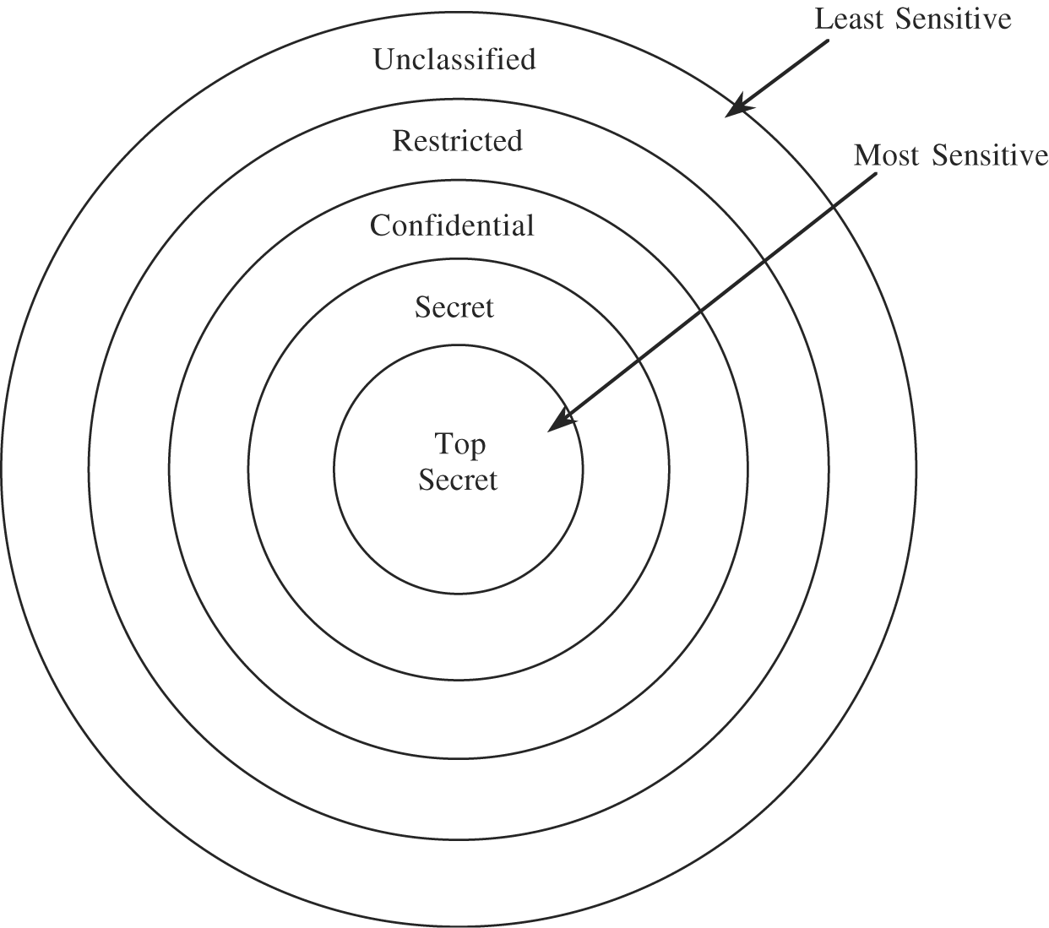
Typical military security categories
  Army, Navy, Air force
Typical commercial security categories
  Sales, R&D, HR
  Dept A, Dept B, Dept C
Hierarchy of Sensitivity

Slide 21
hi
  Examples of security classification
Security Level | Subject | Object
Top Secret | Registrar | Grade Files
Secret | Instructor | Assignment Solutions
Confidential | Student | Assignments
Unclassified | Everyone | Syllabus
  Left: the basic confidentiality classification system; the four security levels are arranged with the most sensitive at the top and the least sensitive at the bottom
  Middle: individuals grouped by their security clearances
  Right: a set of documents grouped by their security levels
  We have Security Levels and Security Categories (the Subjects)
    Levels = {Top Secret, Secret, Confidential, Unclassified}
    Categories = {Registrar, Instructor, Student, Everyone}

Slide 22
Security Level | Individuals | Documents
Top Secret | Thomas, Taye | Personnel Files
Secret | Kiros, Samuel | Electronic Mails
Confidential | Fatuma, Chaltu | Activity Log Files
Unclassified | Alemu, Umer | Telephone Lists
Based on the two basic properties of the Bell-LaPadula model
  Fatuma and Chaltu cannot read personnel files (No read up or Simple Security Property), but Thomas and Taye can read the activity log files; in fact, Thomas and Taye can read any of the files
  Because the Activity Log Files are classified Confidential and Thomas has a clearance of Top Secret, he cannot write to the Activity Log Files (No write down or Star Property)

Slide 23
5.2.2 Biba Integrity Model
  Kenneth Biba (1975) proposed three different integrity access control policies
    1. The Low Water Mark Integrity Policy
    2. The Ring Policy
    3. Strict Integrity Policy
  All assume that we associate integrity levels with subjects and objects, analogous to clearance levels in BLP
  Only Strict Integrity Policy had much continuing influence; it is the one typically referred to as the “Biba Model” or “Biba Integrity”
  It was published in 1977 at the Mitre Corporation, one year after the Bell La-Padula model was published
  It is designed so that subjects may not corrupt objects in a level ranked higher than the subject, or be corrupted by objects from a lower level than the subject

Slide 24
  A problem with the BLP model is, it does not deal with the integrity of data as the *-property makes it possible for a lower level subject to write to a higher classified object that motivated the creation of the Biba model
  BLP is for Confidentiality and controlled access to classified information while Biba is for Integrity of data and they can, at least theoretically, be used together
  If used together it results in reading and writing at a single level which is not what is usually desired; hence it is better to choose one of them depending on the security requirements
    Military policy focuses on confidentiality
    Commercial policy focuses on integrity
      Mandatory commercial controls typically involve who gets to do what type of transaction rather than who sees what

Slide 25
Integrity
  Integrity refers to the trustworthiness of data or resources
  Integrity is usually defined in terms of preventing improper or unauthorized change to data
  There are three main goals of integrity
    Preventing unauthorized users from making modifications to data or programs
    Preventing authorized users from making improper or unauthorized modifications
    Maintaining internal and external consistency of data and programs, i.e., data reflects the real world

Slide 26
Biba Integrity Model – Access Modes
  The Biba model consists of the following access modes
    Modify: the modify right allows a subject to write to an object. This mode is similar to the write mode in other models
    Observe: the observe right allows a subject to read an object. This is synonyms with the read mode of most other models
    Invoke: the invoke right allows a subject to communicate with another subject
    Execute: the execute right allows a subject to execute an object. It essentially allows a subject to execute a program which is the object

Slide 27
Biba Integrity Model – Policies
  Let S be the set of subjects, O the set of objects, I the set of integrity levels, s a subject, o an object, and i(x) the integrity level of x (subject or object)
  Then Biba Strict Integrity Policy consists of the following
    Simple Integrity Property: s ∈ S can observe o∈ O if and only if i(s) ≤ i(o) (“no read-down”)
    Integrity *-Property: s ∈ S can modify o∈ O if and only if i(o) ≤ i(s) (“no write-up”)
    Invocation Property: s₁ ∈ S can invoke s₂ ∈ S if and only if i(s₂) ≤ i(s₁) (“no upward invocation”)

Slide 28
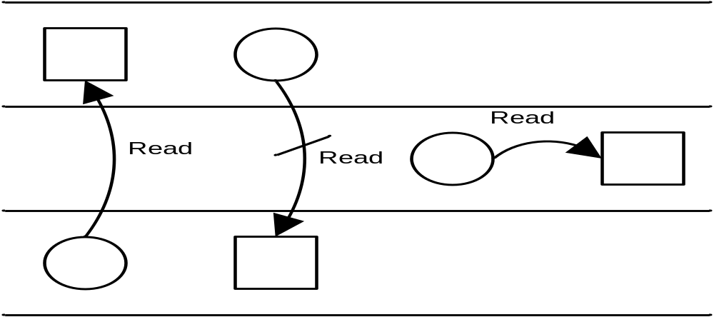
  Simple Integrity Property: “No Read-Down”
    Simple Integrity means that a subject can only read objects at its own integrity level or above
circle = subject, square = object

Slide 29
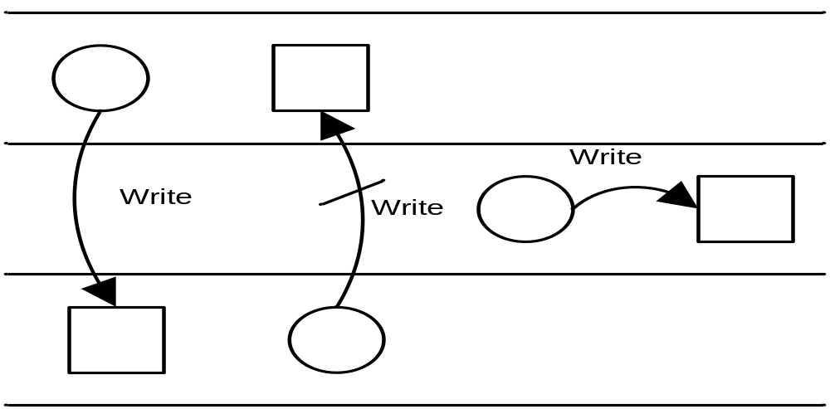
  Integrity *-Property: “No Write-Up”
    The Integrity *-Property means that a subject can only write objects at its own integrity level or below
    It means that a subject cannot affect more reliable (higher integrity) information by writing into it
circle = subject, square = object

Slide 30
  Invocation Property: “No upward invocation”
Invoke
Invoke
Invoke
circle = subject, square = object

Slide 31
Interpretation of Simple Integrity Property (“no read-down”) and Integrity *-Property (“no write-up”)
  Users can only create content at or below their own integrity level
  Conversely, users can only view content at or above their own integrity level
  Analogy: military chain of command
    A General may write orders to a Colonel, who can issue these orders to a Major. In this fashion, the General's original orders are kept intact and the mission of the military is protected (thus "no read down" integrity)
    Conversely, a Private (Tera Wotader) can never issue orders to his Sergeant (Hamsa Aleka), who may never issue orders to a Lieutenant (Meto Aleka), also protecting the integrity of the mission (thus "no write up“ integrity)

Slide 32
  The Biba strict integrity policy enforces “no write-up” and “no read-down” on the data in the system, which is the opposite of the Bell-LaPadula model
  This policy restricts the “contamination” of data at higher level, since a subject is only allowed to modify data at its level or at a lower level
  The “no write-up” limits the damage that can be done by malicious programs in the system.
    For instance, “no write-up” limits the amount of damage that can be done by a Trojan Horse in the system. The Trojan horse would only be able to write to objects at its integrity level or lower. This is important because it limits the damage that can be done to the operating system
  The “no read-down” prevents a trusted subject from being “contaminated” by a less trusted object

Slide 33
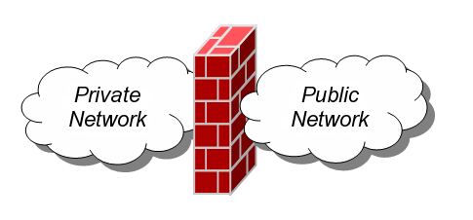
5.4 Firewall
The term firewall has been around for quite some time and originally was used to define a barrier constructed to prevent the spread of fire from one part of a building or structure to another
A network firewall provides a barrier between networks that prevents or denies unwanted or unauthorized traffic
A Network Firewall is a system or group of systems used to control access between two networks: a trusted network and an untrusted network, using pre-configured rules or filters
  A device that provides secure connectivity between networks (internal/external; varying levels of trust)
  Used to implement and enforce a security policy for communication between networks

Slide 34
Firewalls are combinations of hardware and software
Firewalls can be composed of a single router, multiple routers, a single host system or multiple hosts running firewall software, hardware appliances specifically designed to provide firewall services, or any combinations
They vary greatly in design, functionality, architecture, and cost
A firewall is also called a Border Protection Device (BPD) in certain military contexts where a firewall separates networks by creating perimeter networks in a DMZ “Demilitarized Zone”
DMZ is a sub network that contains an organization’s external facing services like Web services, Mail services, FTP Services, etc.
Firewall technology emerged in the late 1980s when the Internet was a fairly new technology in terms of its global use and connectivity. The original idea was formed in response to a number of major Internet security breaches, which occurred in the late 1980s

Slide 35
5.4.1 Firewall Overview
It is more feasible to secure a community of users by putting some control at the entrance rather than trying to secure every host (Boarder Security)
This is done in the real world
  Countries protect themselves at their borders
  Neighborhoods protect the whole neighbors
A firewall provides secured access between two networks
When information moves from the Internet to the internal network, confidentiality is not an issue. However, integrity is. The firewall must not accept messages that will cause servers to work incorrectly or to crash
When information moves from the internal network to the Internet, confidentiality and integrity are both concerns. The firewall must ensure that no confidential information goes to the Internet and that the information that reaches the Internet is correct

Slide 36
Firewall – Design Goals
  All traffic from outside to inside must pass through the firewall (physically blocking all access to the local network except via the firewall)
  Only authorized traffic (defined by the local security policy) will be allowed to pass
  The firewall itself is immune to penetration (use of trusted system with a secure operating system)
  Internal clients are generally allowed to create connections to outside hosts, and external hosts are usually prevented from initiating connection attempts (except on machines in the DMZ)

Slide 37
Firewall - Features
  Port Control: allow some (e.g., 80 for a Web server, 25 for a mail server, 21 and 20 for FTP server) and deny others
  Network Address Translation (NAT): translates the IP addresses of internal hosts to hide them from outside monitoring; NATs were originally designed to solve the IP address depletion problem
  Application Monitoring
  Packet Filtering: rejects TCP/IP packets from unauthorized hosts; rejects connection attempts to unauthorized services
  Data encryption: confidentiality of outgoing packets
  Content Filtering: to block internal users from accessing certain types of content by category, such as hate group propaganda, pornography, etc.
  Virus Scanning
  Popup advertisement blocking/Spam protection
  Spyware protection

Slide 38
5.4.2 Types of Firewalls
Firewalls can be categorized depending on
  The firewall methodology
  Whether the communication is being done between a single node and the network, or between two or more networks
  Whether the communication state is being tracked at the firewall or not
1. By the Firewall Methodology
  Packet Filtering Firewall
  Stateful Packet Inspection Firewall
  Application Gateways/Proxies
  Adaptive Proxies
  Circuit Level Gateway

Slide 39
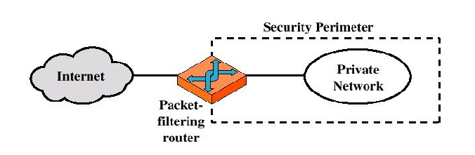
a. Packet Filtering Firewall
  A packet filtering firewall does exactly what its name implies - it filters packets
  As each packet passes through the firewall (in both directions), it is examined and information contained in the header is compared to a pre-configured set of rules or filters
  An allow or deny decision is made based on the results of the comparison
  Each packet is examined individually regardless of other packets that are part of the same connection

Slide 40

Untrusted Network
Firewall Rule Set
Trusted Network
Packet
Packet
Allow
Packet
Inward Flow
Drop
Packet is Blocked or Discarded
Untrusted Network
Firewall Rule Set
Trusted Network
Packet
Allow
Packet
Packet
Outward Flow
Drop
Packet is Blocked or Discarded

Slide 41
The packet filter is typically set up as a list of rules based on matches to fields in the IP or TCP or UDP, etc. header. If there is a match to one of the rules, that rule is invoked to determine whether to forward or discard the packet. If there is no match to any rule, then a default action is taken. Two default policies are possible:
  Default = Discard: Everything not specifically permitted is denied – this is a pessimistic approach
  Default = Forward: Everything not specifically denied is permitted – this is an optimistic approach
The default discard policy is more conservative; However, this is the policy likely to be preferred by businesses and government organizations
The default forward policy increases ease of use for end users but provides reduced security; this policy may be used by generally more open organizations, such as universities

Slide 42
  We use packet filters to instruct a firewall to drop traffic that not meets certain criteria
  For example, we could create a filter that would drop all Ping requests
  We can also configure filters with more complex exceptions to a rule
  Packet filtering rules or filters can be configured to allow or deny traffic based on one or more of the following variables
    Source and Destination IP address
    Protocol type (TCP, UDP, ICMP, OSPF, etc.)
    TCP or UDP source and destination port
    TCP flag bits: SYN, ACK, etc.
    ICMP message type
    Different rules for datagrams leaving and entering the network
    Different rules for the different router interfaces

Slide 43
  A network administrator configures the firewall based on the policy of the organization
  e.g., Policies and corresponding filtering rules for an organization’s network 130.207/16 with Web server at 130.207.244.203
Policy | Firewall Setting
No outside Web access | Drop all outgoing packets to any IP address, port 80
No incoming TCP connections, except those for organization’s public Web server only | Drop all incoming TCP SYN packets to any IP except 130.207.244.203, port 80
Prevent Web-radios from consuming bandwidth | Drop all incoming UDP packets - except DNS packets
Prevent the network from being used for a smurf attack | Drop all ICMP ping packets going to a “broadcast” address (e.g., 130.207.255.255)
Prevent the network from being tracerouted | Drop all outgoing ICMP TTL expired traffic

Slide 44
  A packet filtering firewall is often called a network layer firewall because the filtering is primarily done at the network layer (layer three) or the transport layer (layer four) of the TCP/IP reference model
Application
Transport
Packet Filters
Network
Data Link
Physical

Slide 45
  Firewall rules are implemented in routers with access control lists, with each router interface having its own list; the following is an example access control list for a stateless filter for an organization 222.22/16
Action | Source Address | Destination Address | Protocol | Source Port | Destination Port | Flag bit
Allow | 222.22/16 | Outside of 222.22/16 | TCP | >1023 | 80 | Any
Allow | Outside of 222.22/16 | 222.22/16 | TCP | 80 | >1023 | Ack
Allow | 222.22/16 | Outside of 222.22/16 | UDP | >1023 | 53 | -
Allow | Outside of 222.22/16 | 222.22/16 | UDP | 53 | >1023 | -
Deny | All | All | All | All | All | All
* UDP Port 53 is for DNS

Slide 46
  Rules are applied to each datagram that passes through the interface from top to bottom
  The first two rules together allow internal users to surf the Web: The first rule allows any TCP packet with destination port 80 to leave the organization’s network; the second rule allows any TCP packet with source port 80 and the ACK bit set to enter the organization’s network
  Note that if an external source attempts to establish a TCP connection with an internal host, the connection will be blocked, even if the source or destination port is 80 (because of the ACK flag)
  The third and fourth rules together allow DNS packets to enter and leave the organization’s network
  In summary, this rather restrictive access control list blocks all traffic except Web traffic initiated from within the organization and DNS traffic

Slide 47
Advantages of Packet filtering
  Simplicity
  Transparency to users
  High speed
Disadvantages of Packet filtering
  Difficulty of setting up packet filter rules
  Lack of Authentication

Slide 48


b. Stateful Packet Inspection Firewall
  Stateful packet inspection uses the same fundamental packet screening technique that packet filtering does
  In addition, it examines the packet header information from the network layer to the application layer to verify that the packet is part of a legitimate connection and the protocols are behaving as expected
Application
Stateful Inspection
Transport
Network
Data Link
Physical

Slide 49
  As packets pass through the firewall, packet header information is examined and fed into a connection state table where it is stored. The packets are compared to pre-configured rules or filters and allow or deny decisions are made based on the results of the comparison
  The data in the connection state table is then used to evaluate subsequent packets to verify that they are part of the same connection
  Decisions based on one or more of the following
    Source and Destination IP address
    Protocol type (TCP, UDP, ICMP, OSPF, etc.)
    TCP or UDP source and destination port
    TCP flag bits: SYN, ACK, etc
    ICMP message type
    Different rules for datagrams leaving and entering the network
    Different rules for the different router interfaces
    Connection state

Slide 50
  The connection state is derived from information gathered in previous packets
  It is an essential factor in making the decision for new communication attempts
  Stateful packet inspection compares the packets against the rules or filters and then checks the connection state table to verify that the packets are part of a valid, established connection
  By having the ability to "remember" the status of a connection, this method of packet screening is better equipped to guard against attacks than standard packet filtering

Slide 51
  Stateful filters track all ongoing TCP connections in a connection state table. This is possible because the firewall can observe the beginning of a new connection by observing a three-way handshake (SYN, SYNACK, and ACK); and it can observe the end of a connection when it sees a FIN packet for the connection; Note that the first segment in every TCP connection has the ACK bit set to 0, whereas all the other segments in the connection have the ACK bit set to 1
  The firewall can also assume that the connection is over when it hasn’t seen any activity over the connection for, say, 60 seconds
  The following connection state table (for an organization 222.22/16) indicates that there are currently three ongoing TCP connections, all of which have been initiated from within the organization
Source Address | Destination Address | Source Port | Destination Port
222.22.1.7 | 37.96.87.123 | 12699 | 80
222.22.93.2 | 199.1.205.23 | 37654 | 80
222.22.65.143 | 203.77.240.43 | 48712 | 80

Slide 52
Action | Source Address | Destination Address | Protocol | Source Port | Destination Port | Flag bit | Check Connection
Allow | 222.22/16 | Outside of 222.22/16 | TCP | >1023 | 80 | Any
Allow | Outside of 222.22/16 | 222.22/16 | TCP | 80 | >1023 | Ack | x
Allow | 222.22/16 | Outside of 222.22/16 | UDP | >1023 | 53 | -
Allow | Outside of 222.22/16 | 222.22/16 | UDP | 53 | >1023 | - | x
Deny | All | All | All | All | All | All
An example access control list for a stateful filter
  Additionally, the stateful filter includes a new column, “check connection,” in its access control list
  Note that this table is identical to the access control list in the stateless packet filter, except now it indicates that the connection should be checked for two of the rules

Slide 53
Examples
  Suppose an attacker attempts to send a malformed packet into the organization’s network by sending a datagram with TCP source port 80 and with the ACK flag set. Further suppose that this packet has source port number 12543 and source IP address 150.23.23.155. When this packet reaches the firewall, the firewall checks the access control list, which indicates that the connection table must also be checked before permitting this packet to enter the organization’s network. The firewall checks the connection state table, sees that this packet is not part of an ongoing TCP connection, and rejects the packet
  Suppose that an internal user wants to surf an external Web site. Because this user first sends a TCP SYN segment, the user’s TCP connection gets recorded in the connection state table. When the Web server sends back packets (with the ACK bit necessarily set), the firewall checks the table and sees that a corresponding connection is in progress. The firewall will thus let these packets pass, thereby not interfering with the internal user’s Web surfing activity

Slide 54
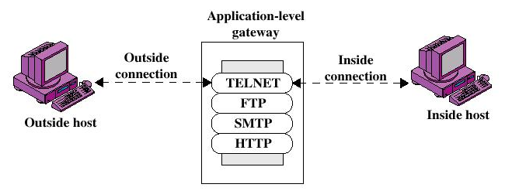
c. Application Gateway/Proxies
  Acts as a relay of application-level traffic
  The user contacts the gateway using a TCP/IP application, such as Telnet or FTP, and the gateway asks the user for the name of the remote host to be accessed. When the user responds and provides a valid user ID and authentication information, the gateway checks if the user has permission to access the server on the outside world and if so contacts the application on the remote host and relays TCP segments containing the application data between the two endpoints

Slide 55
This type of firewall operates at the application layer. For source and destination endpoints to be able to communicate with each other, a proxy service must be implemented for each application protocol
If the gateway does not implement the proxy code for a specific application, the service is not supported and cannot be forwarded across the firewall
Hence, the application gateway/proxy acts as an intermediary between the two endpoints
This packet screening method breaks the client/server model in that two connections are required: one from the source to the gateway/proxy and one from the gateway/proxy to the destination
The gateways/proxies are carefully designed to be reliable and secure because they are the only connection points between the two networks

Slide 56
Application
Application Gateways
Transport
Network
Data Link
Physical
  Advantages
    Higher security than packet filters
    Only need to scrutinize a few allowable applications
    Easy to log and audit all incoming traffic
  Disadvantage
    A different application gateway is required for each application
    Additional processing overhead on each connection

Slide 57
d. Adaptive Proxies
  Also known as dynamic proxies
  Developed as an enhanced form of application gateways/proxies, combining the merits of both application gateways/proxies and packet filtering
  Note that proxies were originally designed to make the WWW faster
e. Circuit-Level Gateway/Circuit-Level Proxy
  It sets up two TCP connections; one between itself and a TCP user on an inner host and one between itself and a TCP user on an outside host
  The gateway typically relays TCP segments from one connection to the other without examining the contents
  The security function consists of determining which connections will be allowed
  Unlike a packet filtering firewall, a circuit-level gateway does not examine individual packets. Instead, circuit-level gateways monitor TCP or UDP sessions

Slide 58
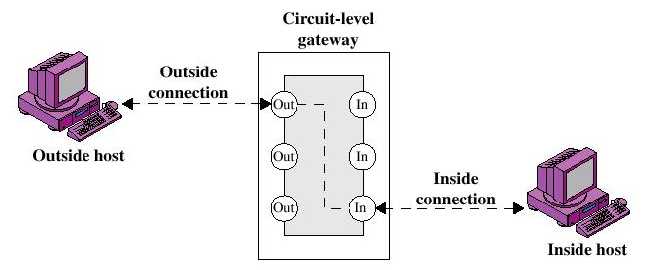
  Once a session has been established, it leaves the port open to allow all other packets belonging to that session to pass. The port is closed when the session is terminated
  Circuit-level gateways operate at the transport layer (layer 4)

Slide 59
  2. With regard to the scope of filtered communications
    Done between a single node and the network, or between two or more networks
      Personal Firewall, a software application which normally filters traffic entering or leaving a single computer
      Network Firewall, normally running on a dedicated network device or computer positioned on the boundary of two or more networks
  3. Whether the firewall keeps track of the state of network connections or treats each packet in isolation
    Stateful firewall
    Stateless firewall

Slide 60
There are problems that Firewalls can’t solve
  Example
    Let’s say that the only thing we allow through our firewall is e-mail
    An employee gets a message from a branch office asking him to e-mail a CAD file to them
    The employee looks at the From address, verifies that it is correct, clicks Reply, attaches the file, and unknowingly sends the CAD file to the hackers who forged the e-mail request because the Reply-to address isn’t the same as the From address
    The firewall can’t do about it because many users have different From and Reply-to addresses for valid reasons (for example, they send e-mail from multiple e-mail addresses but only want to receive mail at one)
    Try it by opening any spam and clicking on Reply (try until you get different From and Reply-to addresses)

Slide 61
5.4.3 Firewall Location and Configurations
  A firewall can be internal or external
  An external firewall is placed at the edge of a local or enterprise network, just inside the boundary router that connects to the Internet
  One or more internal firewalls protect the bulk of the enterprise network
  Between these two types of firewalls are one or more networked devices in a region referred to as a DMZ (demilitarized zone) network
  Systems that are externally accessible but need some protections are usually located on DMZ networks. Typically, the systems in the DMZ require external connectivity, such as a corporate Web site, an e-mail server, or a DNS server

Slide 62
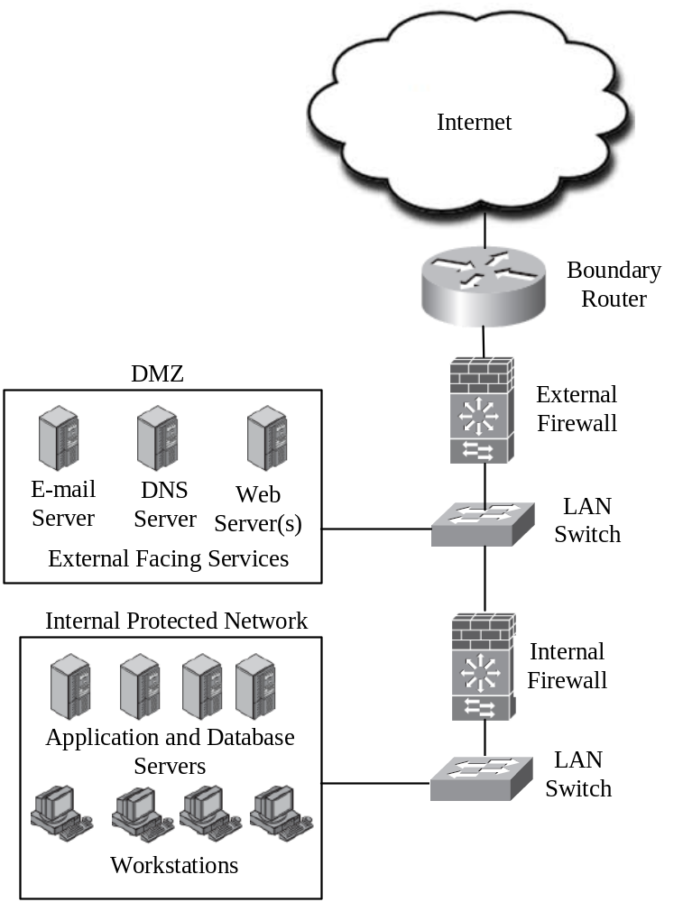
Example Firewall Configuration

Slide 63
The external firewall provides a measure of access control and protection for the DMZ systems consistent with their need for external connectivity
The external firewall also provides a basic level of protection for the remainder of the enterprise network
Internal firewalls serve three purposes
  1. The internal firewall adds more stringent filtering capability, compared to the external firewall, in order to protect enterprise servers and workstations from external attack
  2. The internal firewall provides two-way protection with respect to the DMZ. First, the internal firewall protects the remainder of the network from attacks launched from DMZ systems. Such attacks might originate from worms, bots, or other malware lodged in a DMZ system. Second, an internal firewall can protect the DMZ systems from attack from the internal protected network

Slide 64
  3. Multiple internal firewalls can be used to protect portions of the internal network from each other. For example, firewalls can be configured so that internal servers are protected from internal workstations and vice versa
Distributed Firewalls
  A distributed firewall configuration involves stand-alone firewall devices plus host-based/resident firewalls working together under a central administrative control

Slide 65
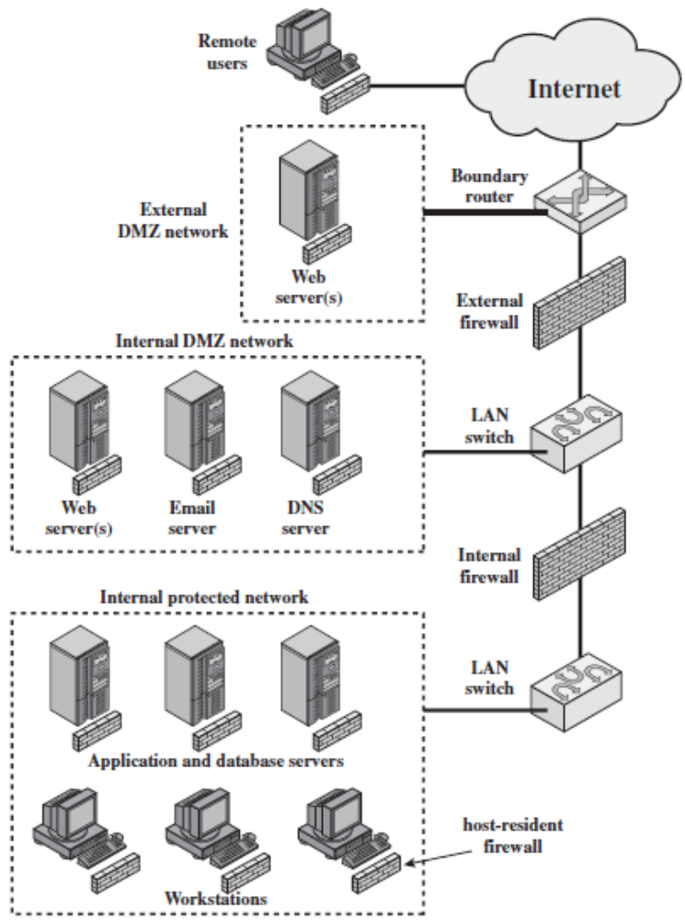
Example Distributed Firewall Configuration

Slide 66
Virtual Private Networks
  A VPN consists of a set of computers that are interconnected by means of a relatively unsecured network and that make use of encryption and special protocols to provide security
  At each corporate site, workstations, servers, and databases are linked by one or more LANs
There are three different protocols that are used to create VPNs: Point-to-Point Tunneling Protocol (PPTP), Layer 2 Tunneling Protocol (L2TP), and IP Security (IPsec)

Slide 67
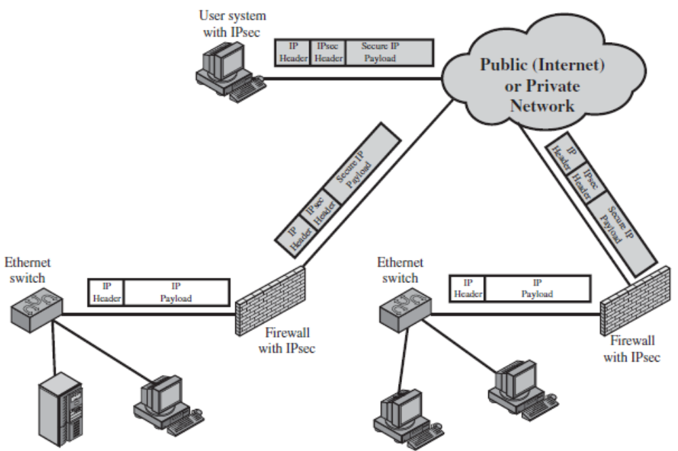
A VPN Security Scenario using IPsec

Slide 68
5.5 Intrusion Detection/Prevention
Firewalls generally don’t detect internal attacks or attacks once the system is compromised
An Intrusion Detection System (IDS) sends an alert to the administrator in an e-mail message or to the network management system or could simply be logged for future inspection
An Intrusion Prevention System (IPS) tries to take corrective measures once it detects a threat (e.g., denying a malicious process access to local system resources or dropping packets); it is proactive
We will use the term IDS to mean both IDS and IPS since both work the same way except the last stage

Slide 69
An IDS gathers and analyzes information from various areas within a computer or a network to identify possible security breaches
It detects both intrusions and misuse
Intrusion detection functions include
  Monitoring and analyzing both user and system activities
  Analyzing system configurations and vulnerabilities
  Assessing system and file integrity
  Ability to recognize patterns typical of attacks
  Analysis of abnormal activity patterns
  Tracking user policy violations
IDS and Firewall products
  Commercial: McAfee, Cisco, Check Point
  Open Source: Snort

Slide 70
IDS Categorization
  There are a number of ways in which Intrusion Detection Systems can be categorized
    Misuse detection versus anomaly detection
    Passive systems versus reactive systems
    Network-based systems versus host-based systems
  Misuse Detection vs. Anomaly Detection
    An IDS that uses misuse detection analyzes the information it gathers and compares it to large databases of attack signatures (IDS signatures); similar to a virus-detection system
    Anomaly detection tries to detect intrusion attempts and notify the administrator

Slide 71
    The system looks for any anomalous behavior; any activity that does not match the pattern of normal user access is noted and logged
    With anomaly-based IDS, it can take some time to create what is considered “normal” activity patterns. While these activity patterns are being established, a high rate of false alarms may be experienced
    Note also that, if the network already contains malicious code, then the activity of this code would be considered normal
  Passive Systems Versus Reactive Systems
    In a passive system, the IDS detects a potential security breach, logs the information, and signals an alert. In a reactive system, the IDS responds to the suspicious activity by logging off a user or reprogramming the firewall to block network traffic from the suspected malicious source

Slide 72
  Network-Based System Versus Host-Based System
    In a network-based system, the individual packets flowing through a network are analyzed
    This system can detect malicious packets that are designed to be overlooked by a firewall’s simplistic filtering rules
    In a host-based system, the activity of each individual computer or host is examined
IDS Approaches
  Preemptive Blocking
    This approach seeks to prevent intrusions before they occur
    This is done by noting any danger signs of impending threats and then blocking the user or IP address from which these signs originate

Slide 73
    For example, if a particular IP address is the source of frequent port scans and other scans of a system, then block that IP address at the firewall
    But there is a risk of blocking out legitimate users. It is better if a human administrator makes the decision whether or not to block the suspicion
  Intrusion Deflection
    An attempt is made to attract the intruder to a subsystem set up for the purpose of observing her/him. This is done by tricking the intruder into believing that s/he has succeeded in accessing system resources when, in fact, s/he has been directed to a specially designed environment
    This is often done by using what is commonly referred to as a honey pot
    A honey pot assumes that an attacker is able to breach a network security

Slide 74
    Create a server that has fake but attractive data such as account numbers or research and just a little less secure than a real server. Then, since none of the actual users ever access this server, monitoring software is installed to alert when someone does access this server
    A honey pot achieves two goals
      First, it will take the attacker’s attention away from the data to be protected
      Second, it will provide interesting and valuable data, thus leading the attacker to stay connected to the fake server, giving time to try and track them
    There are commercial solutions for honey pots, like Specter (www.specter.com/default50.htm)
    Check also www.honeypots.org for more information on honey pots in general, and on specific implementations

