Slide 1
Specific Requirements
1. External Interfaces
2.Functions
3.Performance Requirements
4.Logical Database Requirements
5.Design Constraints
6.Software System Quality Attributes
7.Object Oriented Models

Slide 2
External Interfaces
User interfaces
. Front-end
. Back-end
Hardware interfaces
. All server-side components must execute on server-class
computers
Software interfaces

Slide 3
External Interfaces
Software interfaces
The software interface should follow the Model-View-Controller (MVC) model for rendering and modeling data objects.
Communication interfaces
It uses standard protocols such as Hypertext Transfer Protocol Secure (HTTPS), file transfer protocols (FTP) and etc

Slide 4
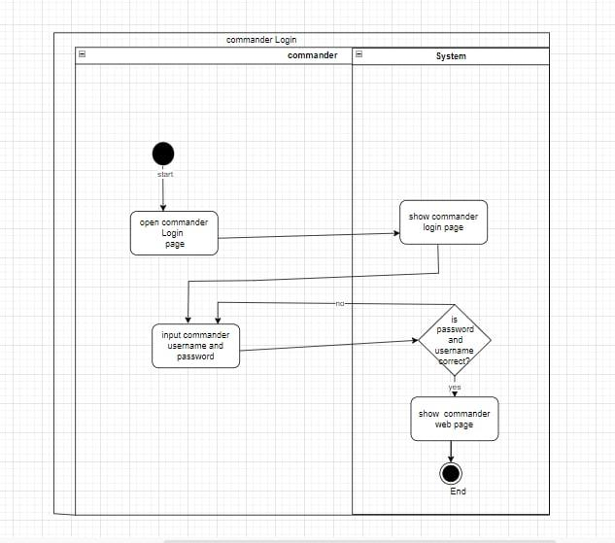
Functions
The use cases presented in Traffic Accident Report system are register accident, find record, view report,log in, create account, update account and delete account
Activate Digram
Commander login

Slide 5
Activity Diagram
Commander login

Slide 6
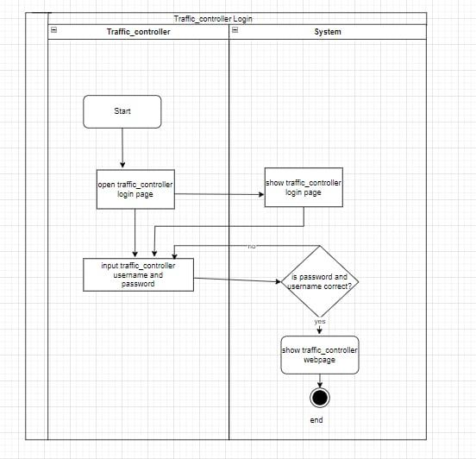
Activity Diagram
Administrator Login

Slide 7
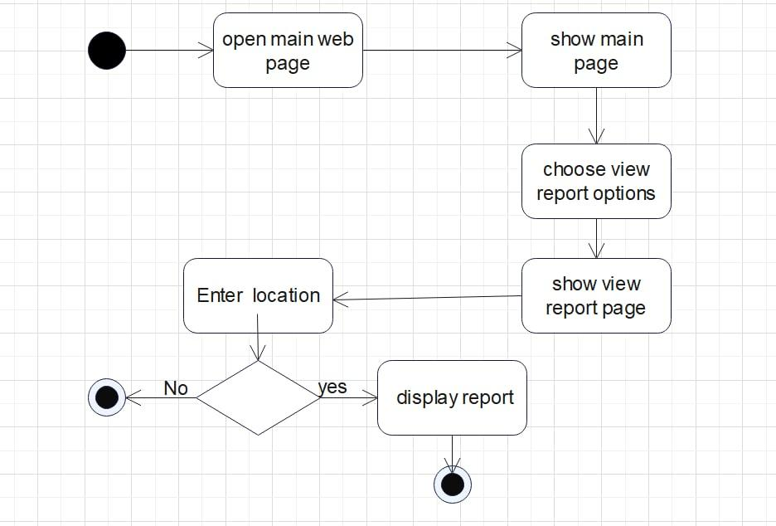
Activity Diagram
Traffic_Controller

Slide 8
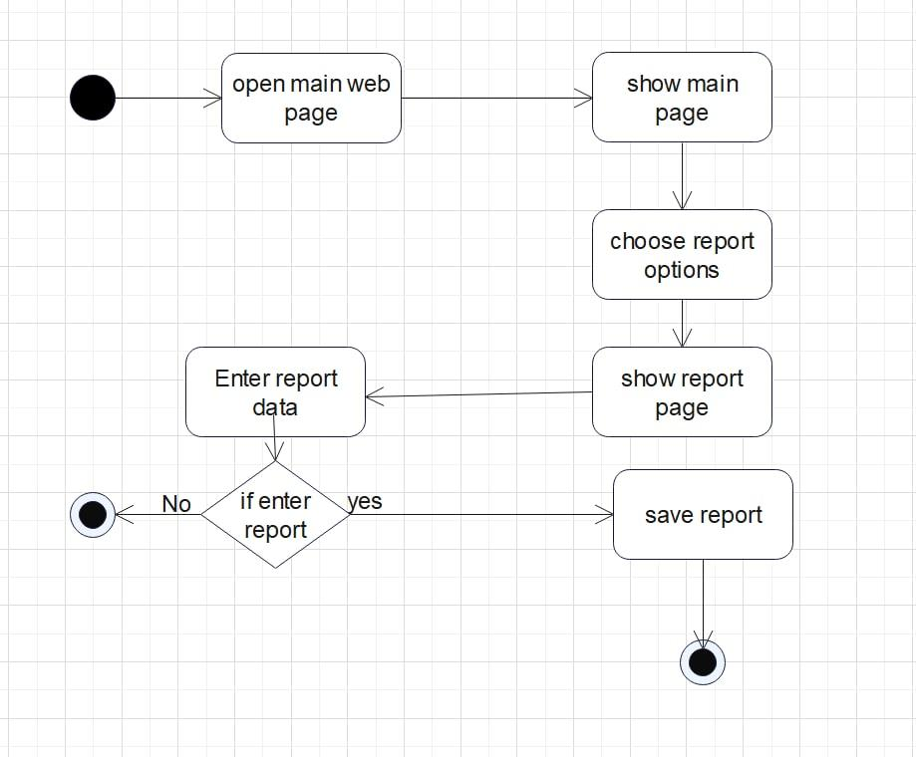
Activity Diagram
Activity diagram of view

Slide 9
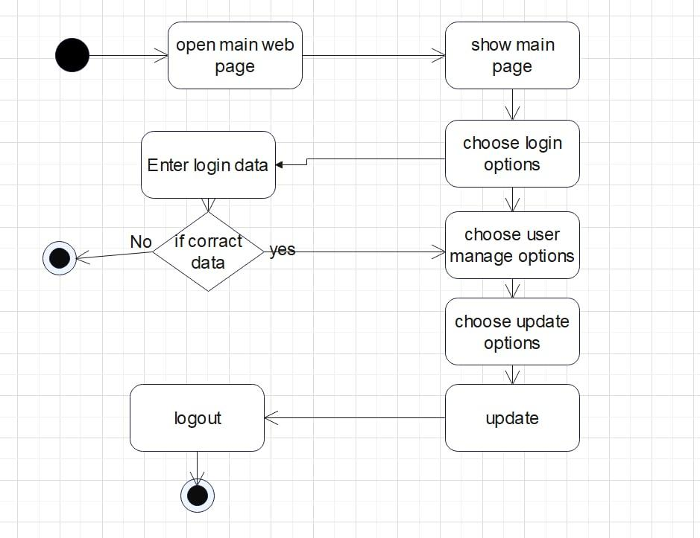
Activity Diagram
Activity Diagram of Report.

Slide 10
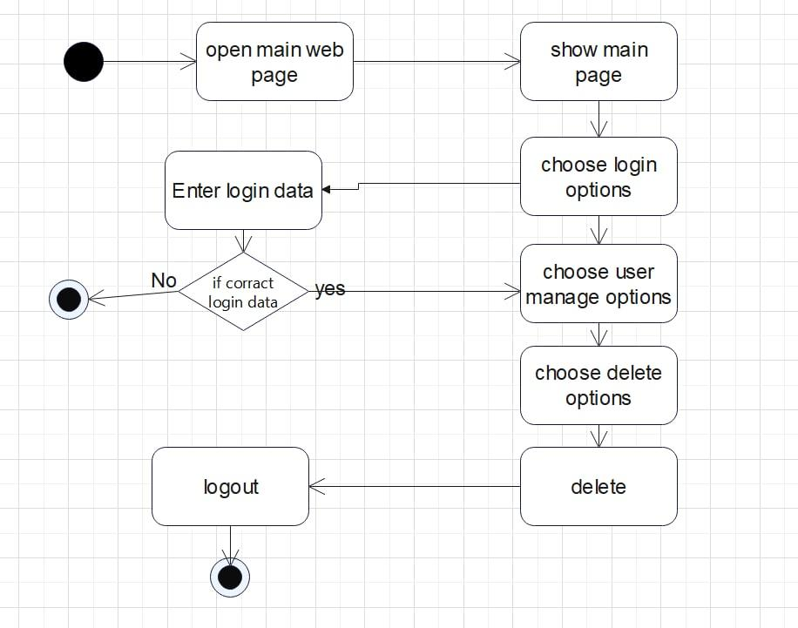
Activity Diagram
Activity Diagram of Update Account

Slide 11
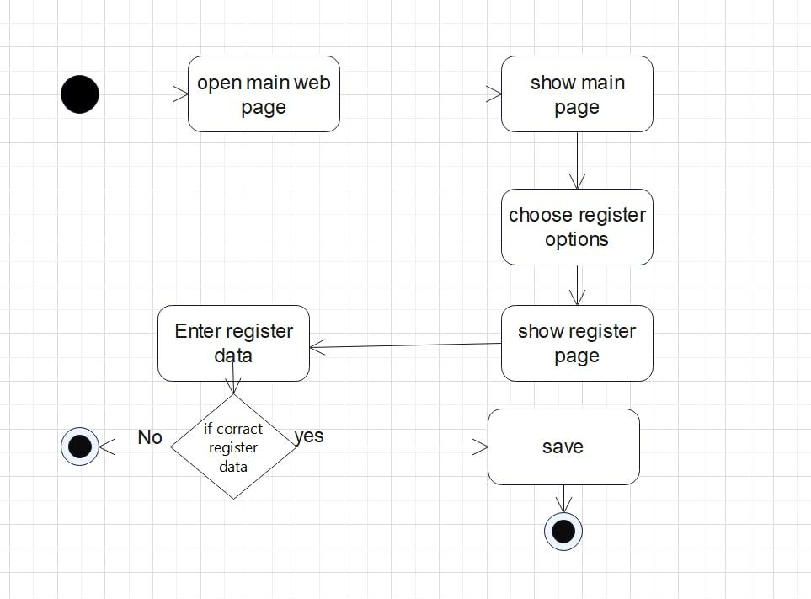
Activity Diagram
Activity Diagram of Delete Account.

Slide 12
Performance Requirements
Performance Requirements define how the software system performs certain functions under certain conditions. Examples include responsiveness, throughput, execution time, and storage capacity of the software.
Example:
Start up time,Response Time,Smooth Scrolling,Workload,Scalability,Platform

Slide 13
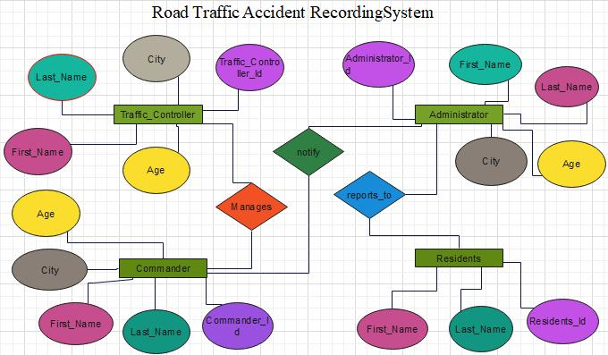
Logical Database Requirements
The system must store the information as well as the accident records

Slide 14
Design Constraints
Project constraints are limiting factors that can impact quality, delivery, and overall project success of ROAD TRAFFIC ACCIDENT RECORDING SYSTEM
Software System Quality Attributes
Usability
Accessibility
Security
Reliability

Slide 15
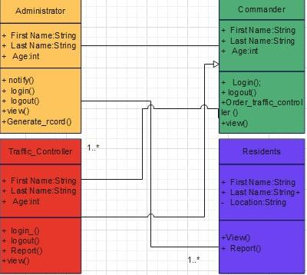
Object Oriented Models
Class Diagram

Slide 16
References
IBEE solutions PID (Project Initiation Document) 2 IBEE solutions Project Plan 3 IBEE Business Requirements 4 [IEEE] The applicable IEEE standards are published in “IEEE Standards Collection,” 2001 edition.

