Slide 1
DEEP LEARNING INTRODUCTION

Slide 2
I. INTRODUCTION

Slide 3
▸ Main objectives
To understand the rationale behind Artifical Neural Networks
To take the hype out of Deep Learning (DL)
To gain a high level understand DL nuts and bolts
To understand how DL can be harness in the context of IoT
Credits & references
Deep Learning with Python, F. Chollet, Manning, 2017
https://github.com/fchollet/deep-learning-with-python-notebooks
Hands-On Machine Learning with Scikit-Learn & TensorFlow, O'Reilly, 2017
Deep Learning, Goodfellow I., Bengio Y. and Courville A., MIT Press, 2016
Notes:
This is an introductory course to deep learning providing a contextual understanding of DL, and a high level understanding of the nuts and bolts of a DL Artificial Neural Network (network architecture, optimization and regularization techniques, ...)
AM4 modules on Artificial Intelligence will further cover convolutional Neural Networks and Recurent Neural Networks
This is important to note that only Supervised Learning will be covered in this course

Slide 4
▸ DL democratization
In early days, required knowledge of C++, Cuda and access to computing power
Today, basic Python skills would suffice to do advanced DL research
Tremendous efforts to disseminate state-of-the-art knowledge
Computing power affordable or accessible in the cloud
Notes:
You can buy a GPU for less than 1000 USD today
State-of-the-art is changing very quickly so need to focus on the mindset, ideas, rationale behind the specific techniques and to not confuse means and ends

Slide 5
▸ A word of warning
This DL course series should not by no means considered as self-sufficient
Precaution taken not to redo in much lower quality what's available through various channels
Guidance will be provided on how to best harness available material
Notes:
This course ambition is to put DL in perspective, to understand technicalities from a high level point of view and finally to exemplify main ANNs architectures through concrete though basic implementations

Slide 6
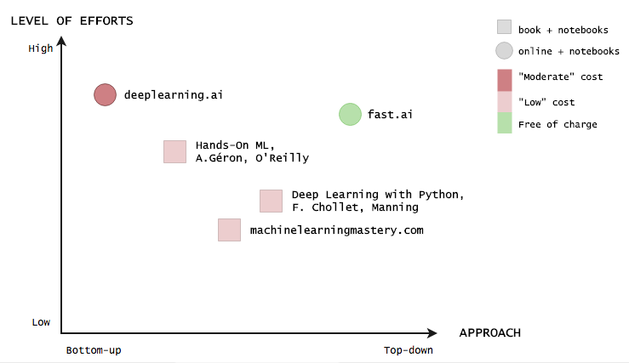
▸ A non exhaustive learning resources chart
Credits & references
deeplearning.ai: https://www.deeplearning.ai/ (Coursera Specialization)
fast.ai: http://www.fast.ai/ and wiki.fast.ai: http://wiki.fast.ai/index.php/Main_Page
Hands-on Machine Learning, A. Géron: https://github.com/ageron/handson-ml
Deep Learning with Python, F. Chollet: https://github.com/fchollet/deep-learning-with-python-notebooks
machinelearningmastery.com: machinelearningmastery.com
Notes:
Disclaimer: this is a very subjective list and classification, should only be considered as such. This chart is subject to changes and improvements
Level of effort is really a fuzzy notion as it all depends on your dedication and taste for details and hacking
But they are all extremely valuable resources you should not ignore!
The notion of moderate, low cost is all relative, depends where you live, your occupation (student, working professional) and the time allocated to study the material. For instance, the deeplearning.ai specialization can be done from 1 to 5 months (around 50 USD a month). If you plan to dedicated one full-month of study, ...

Slide 7
▸ The Maths you need
Depends on your aim
Option 1: Apply successfully state-of-the-art algorithms
Option 2: Monitor progress of Deep Learning scientific research
Option 3: Study and enjoy mathematics as an end in itself and independently of DL aims
Credits & references
Linear Algebra 18.06, MIT OpenCourseWare https://ocw.mit.edu/courses/mathematics/18-06-linear-algebra-spring-2010/
Probabilitic Systems Analysis and Applied Probability 6.041, MIT OpenCourseWare https://ocw.mit.edu/courses/electrical-engineering-and-computer-science/6-041-probabilistic-systems-analysis-and-applied-probability-fall-2010/
Single Variable Calculus 18.01, MIT OpenCourseWare https://ocw.mit.edu/courses/mathematics/18-01-single-variable-calculus-fall-2006/index.htm
Notes:
Option 1 requires not much: basic knowledge of calculus, linear algebra and proabilities. The key aspect in applying successfully DL being to be exposed to a wide variety of datasets and problems. https://www.kaggle.com/ might help in that regard.
Option 2 requires a fairly good knowledge (at Graduate level) of Linear Algebra, Statistics, Optimization (Convex), Analysis, ...
Option 3 follows its own track ...

Slide 8
II. HISTORICAL TRENDS IN DEEP LEARNING

Slide 9
▸ Beyond the media hype
DL is definitely not a new field
It has drawn inspiration from various fields
It made major breakthroughs but human-level general intelligence should not be taken too seriously
But will very likely transform our world (in a ... way)
Credits & references
Deep Learning with Python, F. Chollet, Manning, 2017
https://en.wikipedia.org/wiki/Artificial_general_intelligence
https://www.techradar.com/news/the-10-most-important-breakthroughs-in-artificial-intelligence
Notes:
The way it will transform our world actually depends on us. The tool in itself is not an issue
AI is not synonym of DL. DL is actually a subset of ML which is a subset of DL: DM ⊂ ML ⊂ AI

Slide 10
▸ A rich history with key publications
The field has been rebranded many times
Dates back from 1940s
Has waxed an waned in popularity: the famous AI winters
Three main periods: Cybernetics (1940s-1960s), Connectionism (1980s-1990s), current resurgence (2006)
Credits & references
Deep Learning, Goodfellow I., Bengio Y. and Courville A., MIT Press, 2016
https://en.wikipedia.org/wiki/AI_winter
https://en.wikipedia.org/wiki/History_of_artificial_intelligence#Perceptrons_and_the_dark_age_of_connectionism
Rosenblatt, 1958, The Perceptron: http://citeseerx.ist.psu.edu/viewdoc/download?doi=10.1.1.335.3398&rep=rep1&type=pdf
Notes:
Deep actually reflects more a technical setup (the important number of stacked layers or multiple level of composition - defined later on) rather than a sort of profound understanding of complex ideas as a mixed of intuition and intellectual capacity has human do. But from a marketing point of view, it makes sense.
AI winters mainly due to too unfulfill expectations
Cybernetics: "the art of governing, piloting". Transdisciplinary approach for exploring regulatory systems. Development of theories of biological learning and implementations of the first models such as the Percpetron, enabling the training of single neuron (to be defined).
Connectionism: attempts to represents mental or behavioral phenomena as emergent processes of interconnected networks of simple units. Development of back-propagation technique.
Current resurgence: Deep Learning starting around 2006 with a series of paper starting by Hinton et al. on Deep Belief Nets
It is important to note that Convolutionnal Neural Networks, Sequence Learning techniques such as LSTM, GRU dates back from the 1990s (we will come back to the topics later on)
Complementary list of resources:
Rumelhart et al., 1986a, Learning representations by back-propagating errors: https://www.nature.com/articles/323533a0
Hinton et al., 2006, A Fast Learning Algorithm for Deep Belief Nets: http://www.cs.toronto.edu/~fritz/absps/ncfast.pdf
Bengio et al., 2007, Greedy Layer-Wise Training of Deep Networks: http://www.iro.umontreal.ca/~lisa/pointeurs/BengioNips2006All.pdf
Ranzato et al., 2007, Unsupervised Learning of Invariant Feature Hierarchies
with Applications to Object Recognition: http://yann.lecun.com/exdb/publis/pdf/ranzato-cvpr-07.pdf

Slide 11
▸ Key factors to ANNs revival
Far more data
More computing power
Algorithmic advances
Credits & references
ImageNet Large Scale Visual Recognition Competition (ILSVRC) challenge: https://en.wikipedia.org/wiki/ImageNet#ImageNet_Challenge
Notes:
As regards data, the rise of the internet has been a game changer. From that point of view, IoT will radically further increase the "data growth"
As regards computing power, it is important to note the key role played by GPUs and CUDA
Algorithmic advances relies a lot on hardware and data availability as guided by experimental findings. Choice of activation functions, weight-initialization schemes, optimization schemes such as momentum, RMS are some of the findings that allowed to train deep neural nets on very large datasets.

Slide 12
▸ Is Deep Learning mimicking the workings of the human brain?
Actually, science still does not know how the human brain works!
DL has drawn its inspiration from Cognitive science, Neuroscience, Engineering, ...
Stunning achievements but not easy to justify from a Mathematical point of view
Notes:
We are far from understanding even some of the most simple and well-studied parts of the brain
DL might have some of its roots in cognitive science, psychology, philosophy, ... but when back to concrete implementations it is really an engineering discipline with experimental heuristics, full of more or less working "hacks", and tradeoffs, ... But it does not take anything away from the huge potential and interest of the field. As stated already theory and practice is a permanent catchup game.

Slide 13
▸ Quiz 1
Deep Learning is a completely new field
Deep Learning has drawn inspiration from various fields
Deep Learning state-of-the-art knowledge has not been disseminated yet
Do I need to master at least three PhD to understand and implement Deep Learning algorithms
Notes:
Check the right answer(s)

Slide 14
III. A SNEAK PEAK INTO DEEP LEARNING

Slide 15
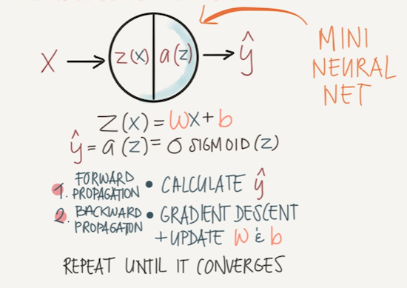
▸ Logistic Regression as a Neural Network
Credits & references
Andrew Ng's Deeplearning.ai course notes: https://www.slideshare.net/TessFerrandez/notes-from-coursera-deep-learning-courses-by-andrew-ng Reproduced by the kind permission of Tess Ferrandez: https://blogs.msdn.microsoft.com/Tess/
Notes:
Have seen in Machine Learning course, a Logistic regression is simply a Linear regression "going through" a sigmoid function in order to re-scale the output between 0 and 1 and hence interpreting it as probability in a binary classification setup
Then using Gradient Descent, simply minimizing the cost function while updating the parameters (w in the drawing above).
This is actually already the most simple neural net (well not really a net yet). And you see that what's called a neuron is actually a simple a linear combination of input features + a sigmoid function. Do you really think that your brain's function is essentially that?

Slide 16
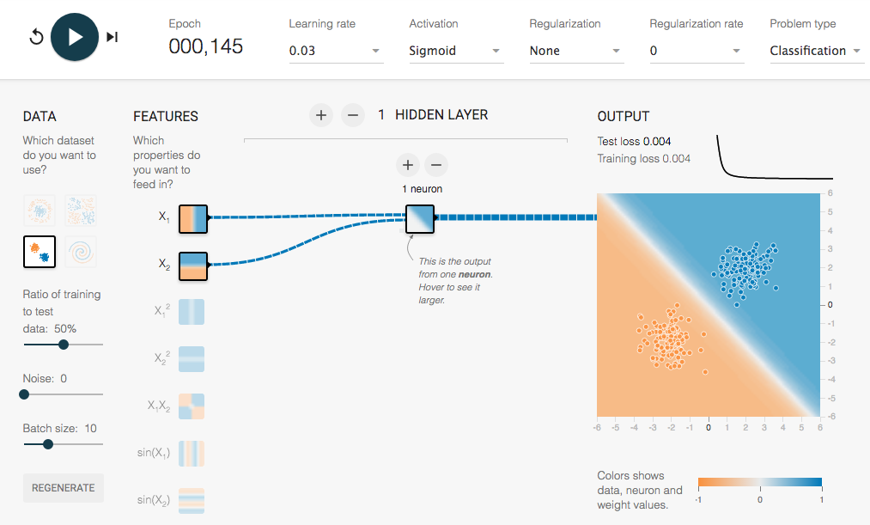
▸ Logistic Regression at cruising speed
Credits & references
http://playground.tensorflow.org/
With settings used: https://goo.gl/d5wwH3
Notes:
The tensorflow playground is an extremely useful web application allowing to develop Neural Networks practical intuition in a variety of setup. Notice the varity of hyper-parameters you can fiddle with: activation function, regularization, number of nodes, of layers, epochs, ... (we will cover then and some more later on).
We are in a simple binary classification use case, 2 input features, a linearly separable dataset. So far so good. No issue, the "network" (essentially a logistic regression) is reducing both training and test loss to zero and clearly separate both classes.

Slide 17
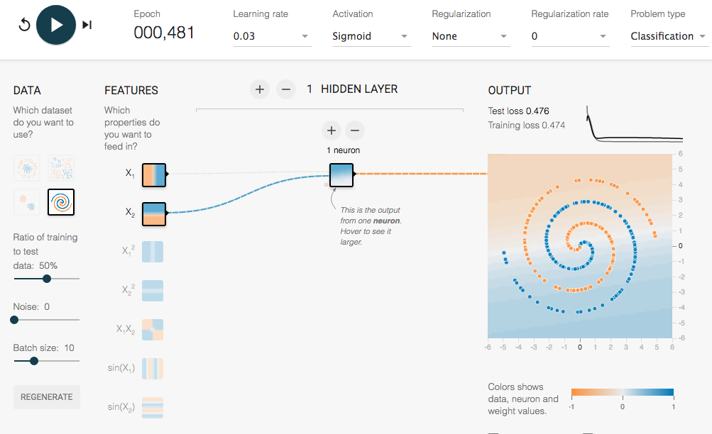
▸ Logistic Regression in trouble
Notes:
Now the dataset is very far from being linearly separable, both test and training loss stall at about 0.47 (not so far from a random guess given that classes are balanced). A Logistic unit simply cannot do the job!
Deep learning to the rescue ...

Slide 18
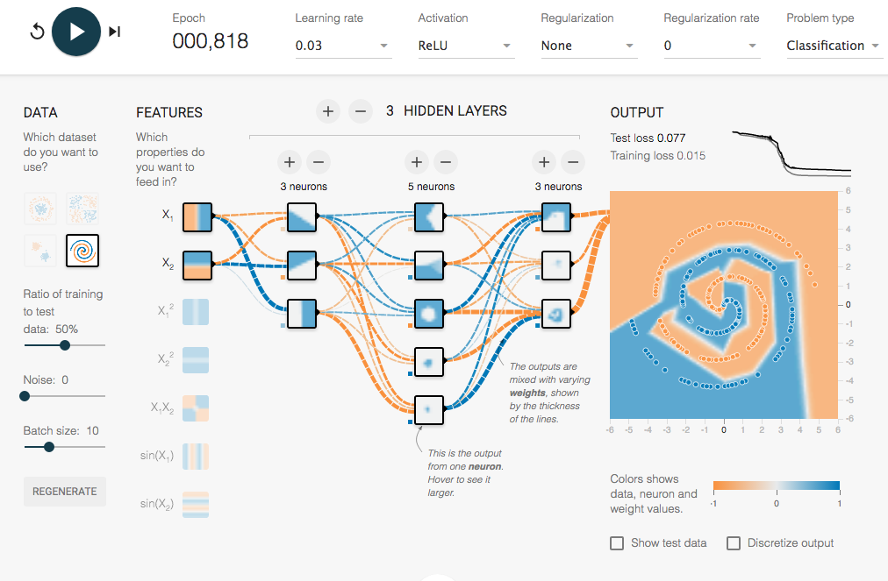
▸ A Neural Net comes on stage
Credits & references
http://playground.tensorflow.org/
With settings used: https://goo.gl/ngcvpV
Notes:
Instead of using one single neuron, we use eleven of them? Why eleven? well that's an hyperparameter so it will depend on many factors and required hyperparameters search.
Note that we did not call it a Deep Neural Net. A Deep Neural Net might have hundreds of nodes layers with thousands of inputs and several millions of parameters to learn.
Last, note that we are not using a Sigmoid function anymore but a ReLu (Rectified Linear Unit). This point will justify later on.
So again, so far so good, we are getting a loss on the test set very close to 0 (meaning we have an accuracy of 1-0.077 = 0.923)
But real datasets barely such regular and beautiful patterns. Let's add some noise.

Slide 19
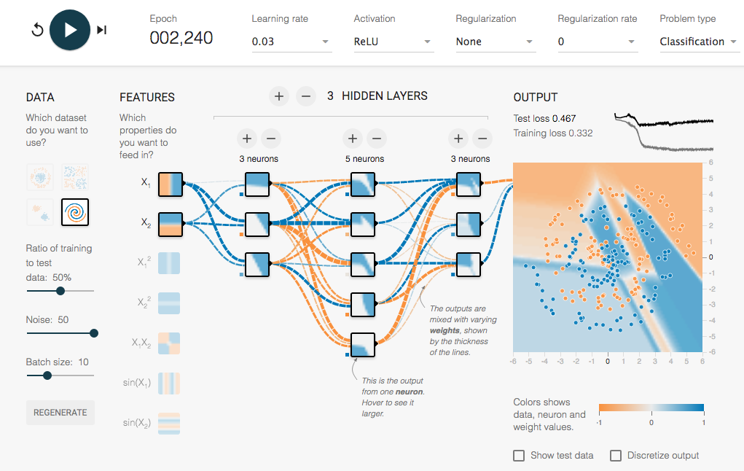
▸ A Shallow Neural Net struggling
Credits & references
http://playground.tensorflow.org/
With settings used: https://goo.gl/wQCbxU
Notes:
We've introduced some noise in the dataset. The Shallow Neural Net struggle to fit the dataset and stalls with a loss of 0.467
Note we are still using a rather contrived dataset. In reality, you will deal with highly multidimensional datasets with highly complex patterns.
However, we noticed that adding more nodes and layers allowed to add degree of freedoms to our model and increast its capacity. Why not doing the same in our new configuration?

Slide 20
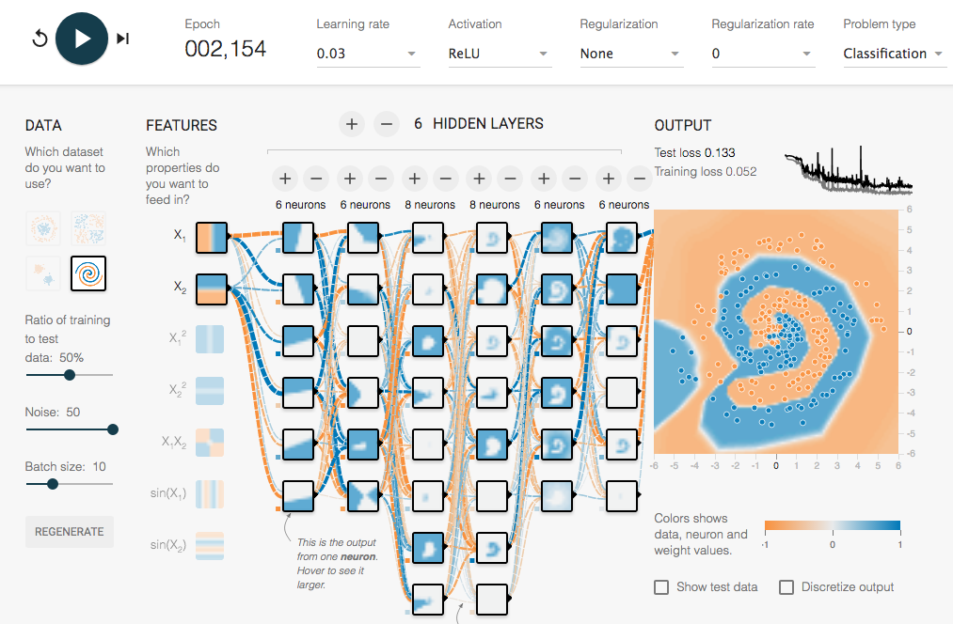
▸ A "Deep" Neural Net comes on stage
Credits & references
http://playground.tensorflow.org/
With settings used: https://goo.gl/6BJ83E
Notes:
We have now 40 neurons spread into 6 hidden layers. Again we are now achieving reasonable accuracy.
Note that we are slightly overfitting the training set (reproduce the settings and display the test set). Adding regularization might definitely help.
So that's essentially the idea behind Deep Neural Nets, at least in its simple form (ConvNets, RecurrentNets, ... add more sophistication).
Last, notice how each neuron learn a specific pattern. A Deep Neural Net could be renamed "layered representations learning" and "hierarchical representations learning"

Slide 21
▸ Hierarchical Representations Learning
Each Node learns a specific "aspect" of the dataset
The deeper you go, the more "abstract"/high-level are the learned pattern
It "completely" automates feature engineering crucial step in machine learning
Notes:
Notice, how we could have added combination of the 2 input features in the previous playgrounds (x1x2, x1^2) or non-linear transformation (sinx, ...). This could have helped, but the NN did the job automatically.
In AM7 module, when covering Convolution (for images) and Reccurent Nets (for sequences: text, audio, time series, ...) the automatic feature engineering property will be even more obvious

Slide 22
▸ Quiz 2
A Deep Neural Nets (DNN) can virtually fits any kind of non-linear dataset
It is always clear how many neurons and hidden layers I need
DNN can be trained with few data
DNN performs feature engineering in an automatic way
Notes:
Check the right answer(s)

Slide 23
IV. DOMAIN SPECIFIC DEEP LEARNING

Slide 24
▸ Reaching Human Level Performance
Until recently, computers enable to reliably perform seemingly human trivial tasks
Naive approach seen earlier is far too short-sighted
Study of brain's visual cortex, computing power and NN optimization techniques led to major breakthoughs
Credits & references
Hands-On Machine Learning with Scikit-Learn & TensorFlow, O'Reilly, 2017
Notes:
Trivial tasks such as detecting a puppy in a picture, or recognizing spoken words

Slide 25
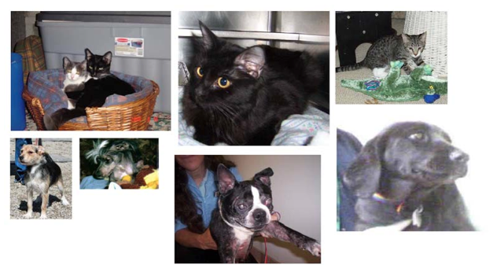
▸ How would you approach this dog vs. cat classification problem?
Credits & references
Hands-On Machine Learning with Scikit-Learn & TensorFlow, O'Reilly, 2017
https://www.kaggle.com/c/dogs-vs-cats
Notes:
Would using each pixel as an input feature make sense?
How would you approach view angles, scales differences, translations, ...?
Each image is 150 x 150 x 3 (RGB) = 67,500 pixels. Hence, you would have 67,500 input features.

Slide 26
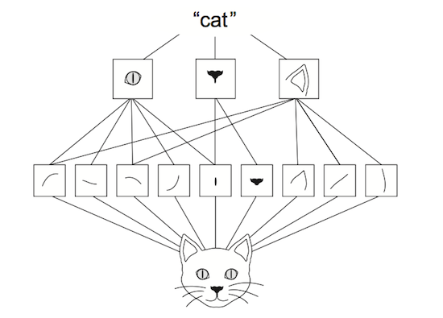
▸ Convolutional Networks
Credits & references
Hands-On Machine Learning with Scikit-Learn & TensorFlow, O'Reilly, 2017
https://www.kaggle.com/c/dogs-vs-cats
Notes:
ConvNets use a mix of convolution layers (performing convolution operation), max pooling layers (downsampling operation) and fully-connected layers (the only one you've seen so far)
And have two very interesting properties: patterns they learn are translation invariant
And they learn spatial hierarchies of patterns
Convolutional Neural Networks will be covered in a next presentation

Slide 27
▸ Natural Language Processing (NLP)
"All grammars leak" -- Sapir
People are always stretching and bending the rule to meet their communication needs
Tasks such as machine translation, words occurence prediction, speech recognition has long been a dream of AI researchers
Deep Learning has brought that dream much closer to reality
Credits & references
https://en.wikipedia.org/wiki/Natural-language_processing
https://en.wikipedia.org/wiki/Edward_Sapir
Foundations of Statistical Natural Language Processing, C.D Manning and H. Schütze, THE MIT PRESS
Notes:
DL Sequence models using Long Short Term Memory (LST), GRU units, attention models, ... + computing power + amout of data have led to enormous breakgrouths

Slide 28
V. THE NUTS AND BOLTS OF DEEP LEARNING

Slide 29
▸ The devil is in details | necessity is mother of invention
Depth of network, size of data requires new means, techniques
Restrain the animal: DL has almost "infinite" representation power/capacity
Handling "signal gain": neuron's weights can potentially vanish or explode
Finding or/escaping minima when computing gradient descent
Credits & references
Hands-On Machine Learning with Scikit-Learn & TensorFlow, A. Géron, O'Reilly, 2017
Notes:
Indeed, if you remember the linear regression setup with 2 parameters, in the case of DL you might end up with millions of them. Hence a DL network has extremely high capacity. Which is exactly what's desired but regularization techniques are as well required so as to control it.
Here's an analogy given by Aurélien Géron in his book nicely capturing Vanishing/exploding gradient problem: "If you set a microphone amplifier's knob too close to zero, people won't hear your voice, but if you set too cloose to the max, your voice will be saturated and people won't understand what you are saying. Now imagine a chain of such amplifiers: they all need to be set properly in order for your voice to come out loud and clear at the end of the chain. Your voice has to come out of each amplifier at the same amplitude as it came in.".
Again, in the linear regression setup, we had one and only one minimum (the global one) when performing gradient descent. This is not the case anymore with DL networks: you might have many local minima. Furthermore, both size of the network and amount of data usually used in DL required to used data batches and use mini-batch gradient descent. As seen already, it makes gradient descent "path" more erratic. For both reasons, optimizations techniques such as moementum, RMS, AdaGrad allow to both "smooth" the descent and add a kind of inertia parameter allowing to "escape" local minima. Obviously they are new hyperparameters

Slide 30
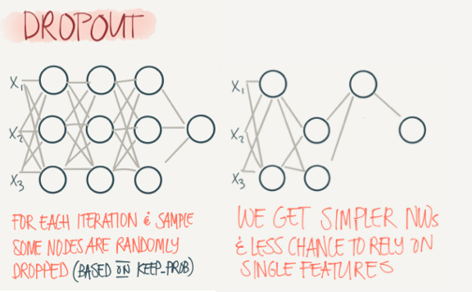
▸ Drop-out regularization
Credits & references
Andrew Ng's Deeplearning.ai course notes: https://www.slideshare.net/TessFerrandez/notes-from-coursera-deep-learning-courses-by-andrew-ng Reproduced by the kind permission of Tess Ferrandez: https://blogs.msdn.microsoft.com/Tess/

Slide 31
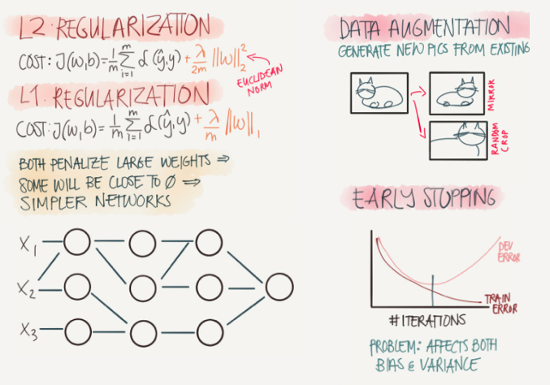
▸ Others regularization techniques
Credits & references
Andrew Ng's Deeplearning.ai course notes: https://www.slideshare.net/TessFerrandez/notes-from-coursera-deep-learning-courses-by-andrew-ng Reproduced by the kind permission of Tess Ferrandez: https://blogs.msdn.microsoft.com/Tess/

Slide 32
▸ Addressing vanishing/exploding gradients
Various weight initialization schemes: Xavier/Glorot and He initialization
Batch Normalization: "Batch Norm"
Proper activation function: Sigmoid, Relu, Leaky Relu, ...
Credits & references
He and al., 2015, "Deep Residual Learning for Image Recognition": https://arxiv.org/pdf/1512.03385.pdf
Glorot and al., 2010, Understanding the difficulty of training deep feedforward neural networkshttp://proceedings.mlr.press/v9/glorot10a/glorot10a.pdf
Ioffe and al., 2105, Batch Normalization: Accelerating Deep Network Training by Reducing Internal Covariate Shifthttps://arxiv.org/pdf/1502.03167v3.pdf
Notes:
We need the signal to flow properly in both directions (forward and back propagation). The main idea of weights initialization schemes is to try keeping variances of inputs and outputs of a particular layer equal. Not possible to guarantee it unless there is an equal number of inputs and ouputs but the initialization schemes suggest a compromise.
These initialization strategy are one of the tricks that led to the current success of Deep Learning
In addition to initialization scheme, Batch norm technique proposes to re-normalizing "on the fly" neurons inputs during learning
Note as these two crucial techniques are 2 years old! Hence, the necessity to continuously monitor current trends.

Slide 33
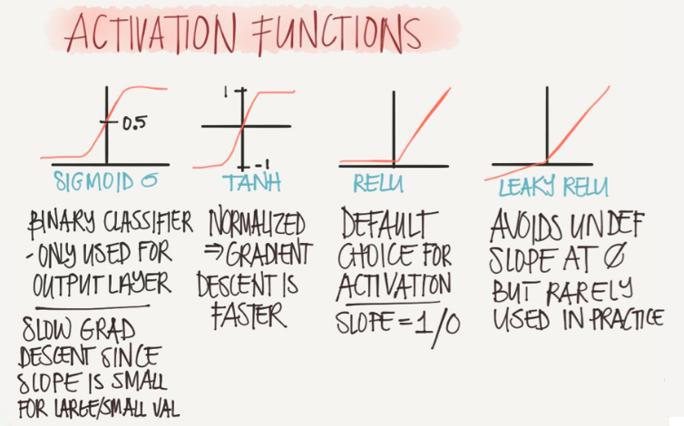
▸ Activation functions
Credits & references
Andrew Ng's Deeplearning.ai course notes: https://www.slideshare.net/TessFerrandez/notes-from-coursera-deep-learning-courses-by-andrew-ng Reproduced by the kind permission of Tess Ferrandez: https://blogs.msdn.microsoft.com/Tess/
Notes:
You can get back http://playground.tensorflow.org/ playground and try out several of them in various contexts.

Slide 34
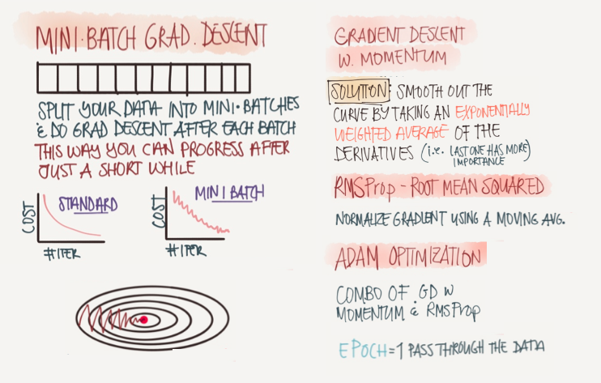
▸ Smoothing the gradient and escaping minima
Credits & references
Andrew Ng's Deeplearning.ai course notes: https://www.slideshare.net/TessFerrandez/notes-from-coursera-deep-learning-courses-by-andrew-ng Reproduced by the kind permission of Tess Ferrandez: https://blogs.msdn.microsoft.com/Tess/
Notes:
We want to reduce oscillation and get to the goal faster while trying to escape local minima
The reason for important oscillation as said already is due to the fact that for large dataset we need to use mini-batch gradient descent. Using Batch gradient descent would be too slow or simply not possible to fit all data in memory. One pass through the whole dataset is called an Epoch. Go back to http://playground.tensorflow.org/ and play around with batch size, visualize number of epochs required to train a specific model, ...
Not that in all cases, input data must be normalized for the same reason we saw in ML: would make gradient descent oscillating even more bumping into “bowl sides". Normalizing input features allow to use larger learning rate as well.

Slide 35
▸ Quiz 3
Overfitting is never an issue in Deep Learning
Initialization schemes, optimization techniques are not going to evolve in the next 2 years
I should always use a Sigmoid Activation function
Gradient Descent cannot be used with big dataset
Notes:
Check the right answer(s)

Slide 36
VI. DEEP LEARNING UNIVERSAL WORKFLOW

Slide 37
▸ Define your problem
What are you trying to predict?
What type of problem are you facing?
What are the hypotheses you make?
What are the data available or to assemble?
Credits & references
Deep Learning with Python, F. Chollet, Manning, 2017
Notes:
Framing problem is a decision of paramount importance that must be put in perspective with data availability, your ambitions, ... For instance, if your goal is to harness data collected by a network of sensors with the aim to monitor air pollution and predict future peaks: would you want to predict next hour PM10 concentration all over the city, probability of exceeding a critival level at city scale for the next month, ... Are you going to harness meteorological forecast, how much historical data is available, ...
By type of problem, we mean: binary classification, scalar/vector regression, multiclass classification, multilabel/multiclass classification, ...
One of the important hypothesis you make is that your outputs can be predicted based on your inputs
This is an aspect which do not cover in that course, but it is possible to re-use already trained Neural Networks and use a technique called "transfer learning". Hence you can tap into models which have been trained using means (both volume of data and computing resources) you would never be able to offer if you are not working in a big tech. company. Then you can just retrain the last layers of the NN in order to finetune the model to your specific problem. This is especillay relevant, when you have rather small datasets.

Slide 38
▸ Choose a measure of success
You need to define what is meant by success
There are "out-of-the-box" standard metrics such as RMS, Precision/Recall, ...
But your problem domain might require more specific ones
Credits & references
Deep Learning with Python, F. Chollet, Manning, 2017
https://www.kaggle.com
Notes:
Look at Kaggle to get a sense of the variety of evaluation metrics you could consider
As an example, consider an indoor-localization probem where ideally you would like to find building, floor and room localization of a device based on WiFI RSSI level of signal received from a network of Access Points. You might use a standard distance metrics (based on GPS measurements used as target variables) or set up an evaluation metrics taken into consideration a combination of building, floor, room putting more weights on building errors thane on room errors considering that such an error should be more strongly penalized.

Slide 39
▸ Defining an evaluation protocol
Notes:
In a DL context, remember that you will have already many hyper-parmaters to finetune over large datasets, most probably over many epochs, most often you don't have the luxury to add another layer of iteration. On top of that, K-fold cross validation main rationale is to provide more accurate evaluation means in a context where you have small datasets or/and unbalanced ones. DL only makes sense in the situation where you have an important amount of data.

Slide 40
▸ Prepare the data
Normalize, hot-encoding, transform, ...
Perform some feature engineering if relevant
Credits & references
Deep Learning with Python, F. Chollet, Manning, 2017
Notes:
We said that feature learning is done automatically in the context of DL. This is often the case, but follow economy of means and "lex parsimoniae" from Occam's razor rule. If clever representation lead to simpler model, you should go for it. This idea is nicely illustrated and very well captured by F.Chollet

Slide 41
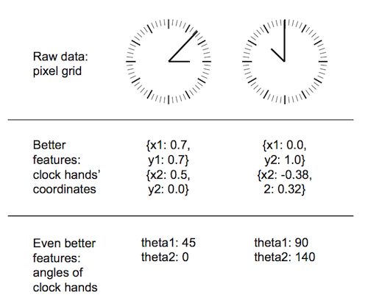
▸ Feature engineering
Credits & references
Deep Learning with Python, F. Chollet, Manning, 2017

Slide 42
▸ Beat a baseline model
You made the hypothesis that your outputs can predicted based on your inputs. Time to check it
Ex. of time series baseline model: today's value is equal to yesterday's one
Ex. of unbalanced binary classification baseline model: predict always majority class
Credits & references
Deep Learning with Python, F. Chollet, Manning, 2017
Notes:
It is worth mentionning that the choice of validation metric may be crucial. In the case of the unbalanced binary classification problem, using accuracy as validataion metrics might not reflect the reality. Instead, Precision/Recall would be a better choice (see Machine Learning course)

Slide 43
▸ Overfit and regularize
If you pass the previous step successfully, time to scale up your model
So, overfit your training set (this is pretty easy in DL)
Then exploit the battery of regularization techniques and hyperparameters tuning
Credits & references
Deep Learning with Python, F. Chollet, Manning, 2017
Notes:
May I remind that one of the first steps of your pipeline should be to split your dataset into train, validation and test sets. Never "touch" your test set before you've considered that you are done. Some precautions should be taken as regards the number of iterations of optimization between your training and validation tests. In both cases information from your test and validation sets would leak into your model resulting in overfitting them. Such a model would generalize poorly with new never-seen dataset. This is a well know instance of "data snooping" bias.

Slide 44
▸ Deploy, monitor and retrain
Last steps are deployment
Monitoring preformance over time (your model will fatally "rot" over time)
And retrain once in a while
Credits & references
Deep Learning with Python, F. Chollet, Manning, 2017

Slide 45
▸ Quiz 3
Overfitting is never an issue in Deep Learning
Initialization schemes, optimization techniques are not going to evolve in the next 2 years
I should always use a Sigmoid Activation function
Gradient Descent cannot be used with big dataset
Notes:
Check the right answer(s)

Slide 46
VII. DEEP LEARNING IN THE CONTEXT OF IOT

Slide 47
▸ Data perspective
IoT is obviously a game changer in the amount of data available
Not restricted to any type of data or domains (image, video, text, time series, ...)
New opportunity and challenges related to the fusion, harnessing of hereogeneous data types
Credits & references
Object detection: https://pjreddie.com/darknet/yolo/
Notes:
One topic which won't be covered is object detection which is one domain where DL achieves amazing results. See reference above (Yolo Algorithm)

Slide 48
▸ Architectural considerations
IoT offers a lot of freedom in that respects
Backpropagation/learning requires a lot of computing resources, forward propagation not
Hence some DL algorithms can be deploy at the edge
Hierarchical, distributed thinking relevant
Credits & references
https://www.nvidia.co.uk/autonomous-machines/embedded-systems-dev-kits-modules/
https://cloud.google.com/blog/big-data/2016/08/how-a-japanese-cucumber-farmer-is-using-deep-learning-and-tensorflow
Notes:
One topic which won't be covered is object detection which is one domain where DL achieves amazing results. See reference above (Yolo Algorithm)
At the edge, simple Raspberry Pi could already run NN using tensorflow framework for instance. NVIDIA proposes now low-power NVIDIA boards than can be deployed at the edge
Indeed, simpler DL tasks can be delegated to the edge (see Cucumber use case where a NN implemented in a Raspberry Pi at the edge filters/screens images -only cucumbers), images later forwarded to larger NN on a server
There is a lot of possibilities that should be informed by the problem/task at hand on a case by case basis: data lake, streaming, centralized, edge-computing, ...

