Slide 1
PYTHON LANGUAGE ESSENTIALS FOR DATA SCIENCE

Slide 2
I. INTRODUCTION
Notes:
In other words, keep your programs simple!

Slide 3
▸ Main objectives
Understanding Python language design philosophy and idioms
Becoming proficient at working with data in Python
Knowledge of Python data science ecosystem
Credits & references
Companion notebook: FM7/notebooks/2-python-language-essentials-for-data-science.ipynb
Notes:
This presentation intends to give the gist of Python for data analysis
Focus on syntax, idioms relevant to Data Science
Becoming proficient is essentially a matter of daily practice, as we do in natural language learning
Killer feature of Python is more its ecosystem than it syntax (though easy to grasp as well)
We will cover more or less Python built-in objects, methods and fundamentals language constructs in that presentation.
The SciPy suites of tools: Numpy, Pandas and Matplotlib will be covered in subsequent presentations/topics: Data transformation and EDA and will use Scikit-learn and Keras for ML and DL

Slide 4
▸ Course logistics
Python 3.x will be used throughout the module;
Jupyter Notebooks will be used to write, execute and document Python code;
This is not an exhaustive introduction to the Python language (see references)
Credits & references
https://docs.python.org/3.5
https://docs.python.org/3/tutorial/index.html
FM7/references/python-fundamentals (series of Jupyter Notebooks)
Notes:
Companion Jupyter interactive notebooks accompanying this presentation are available
Poking around is key to a successful learning process. By poking around we mean executing, modifying, experimenting new features using Companion Jupyter notebooks

Slide 5
▸ Why Python?
General purpose programming language
Meant to be easy to read and learn
Extensive ecosystem for Data Science is a killer feature
Notes:
Python is widely used both in R&D and in production
Python may become the dominant platform for Machine Learning and Deep Learning
Clear syntax captured by the ZEN of python (see below)
Python has been ported “MicroPython” in such a way that it can be run in IoT devices as well
Why not R, SAS, Matlab, Scala ...: in reality, switching from one language to the other is a daily routine for most Data Scientists. You might have your preference, but being able to switch from one language to the other is core Data Scientist competence

Slide 6
▸ Python ecosystem used in FM7 module
Numpy: high performance scientific computing
Pandas: high-level data structures and manipulation tools
Matplotlib: Data Visualization
Scikit-learn: Machine Learning
Keras: Deep Learning
Credits & references
[http://www.numpy.org/](http://www.numpy.org/)
[https://pandas.pydata.org/](https://pandas.pydata.org/)
[https://matplotlib.org/](https://matplotlib.org/)
[http://scikit-learn.org/](http://scikit-learn.org/)
[https://keras.io/](https://keras.io/)
Notes:
Numpy is a fundamental package in the Python Data Science stack as many others are built on top of it: Pandas, Scikit-learn, … Essential for Deep Learning as well as will be seen in subsequent courses.
Pandas is extremely useful for exploratory data analysis
Matplotlib is a low level highly flexible plotting package
All packages will be used extensively throughout FM7 module

Slide 7
II. PYTHON PROGRAMMING PRIMER

Slide 8
▸ A program “does things with stuffs”
In Python: stuffs are objects
you do things with objects using statements
Notes:
Obviously this is loosely speaking but convenient as a mental model

Slide 9
▸ What is an object?
A piece of memory, with value(s)
and sets of associated methods that can modify these value(s)
Notes:
An object can be as simple (atomic) as a string of letters with methods being to capitalize them, make it uppercase, …
Or abstract like a Machine learning, deep learning model, …

Slide 10
▸ Python Objects [Notebook Live Demo]
What is essentially an object?
Python built-in types: Boolean, Numeric, Sequences, Dictionary, ...
Compose built-in types into useful data structures
Expressions and dynamic typing,
...
Credits & references
https://docs.python.org/3/library/stdtypes.html
Notes:
[Teacher] Dedicate 15-30 min to the code snippet below showing and executing code live
[Student] Be sure to run and understand the following code snippets before answering module's assignment

Slide 11
▸ From built-in to domain-specific types
Built-in Python types are the building blocks of any Python program
In complement, Domain-specific packages provides extremely convenient abstract types
Notes:
For instance NumPy provides: ndarray
Pandas: dataFrame
Scikit-learn: models
Keras: Neural Network layers

Slide 12
▸ Typed languages
If you come from a C world, you are used whenever you create a new variable to declare its type
This is not the case in Python
However, Python objects do have types and implicit conversion take place when relevant
Notes:
Implicit conversions is somewhat convenient but it means as well that we need to know what can of implicit conversion to expect.
Some observers might conclude that Python is not a “typed language” because there is no need to declare a variable and its type before its use (like in C-like language for instance) but one of the example above shows that actually this is strongly-typed (when trying to add '5' and 5)

Slide 13
▸ Mutable and immutable objects
Most objects are mutable, such as lists, dicts, ...
Object(s) or value(s) that they contain can be modified.
In contrast, tuple, strings, ... are immutable.
Notes:
One challenge of programming is to handle multitude of states. When different parts of your program can access and modify a same shared variable, keeping track of which part modidy what and when is essentially the biggest source of bug. Ensuring modularity, isolating states, ... is one important strategy to mitigate the risk.
Some programming language paradigm only allow immutable data types

Slide 14
▸ Mutability [Notebook Live Demo]
Mutating a list
Mutating a dictionary
Trying to mutate a string
Notes:
[Teacher] Dedicate 5-10 min to the code snippet below showing and executing code live
[Student] Be sure to run and understand the following code snippets before answering module's assignment

Slide 15
▸ What is a statement?
in simple terms, statements are the things you write to tell Python what your programs should do; for instance:
to create a binding (alias) to an object;
to implement branching rules (if/elif/..);
to iterate over elements of a list;
...
Credits & references
https://docs.python.org/3/reference/simple_stmts.html
Notes:
Function definition, function call, … are as well statements

Slide 16
▸ Statements [Notebook Live Demo]
Assignment
Conditional statement
Loops
...
Notes:
[Teacher] Dedicate 5-10 min to the code snippet below showing and executing code live
[Student] Be sure to run and understand the following code snippets before answering module's assignment

Slide 17
▸ Function statements to:
re-use code / DRY: Don't Repeat Yourself
abstract and hide unecessary details
create a new namespace
Notes:
DRY: Don’t Repeat Yourself. Rule of thumb: whenever you find yourself copying and pasting code snippets more than two times, this is a good signal indicating you should write a function instead.
When attached to an object, a function is called a method
The notion of namespace/scope will be covered later on (Python Essentials)

Slide 18
▸ Function statement [Notebook Live Demo]
Basic syntax
Arguments
Canonical function
Credits & references
https://docs.python.org/3/tutorial/controlflow.html#defining-functions
Notes:
[Teacher] Dedicate 5-10 min to the code snippet below showing and executing code live
[Student] Be sure to run and understand the following code snippets before answering module's assignment

Slide 19
▸ Module statements to:
Modularize your code (as you could have guessed)
Re-use existing code base
Extend your toolbox with an extremely large ecosystem
Notes:
a module is just a regular Python file
a module creates a new namespace (isolated environment)
a module is essentially a toolbox

Slide 20
▸ Module statement [Notebook Live Demo]
import techniques
namespace
Credits & references
https://docs.python.org/3/tutorial/modules.html
Notes:
[Teacher] Dedicate 5 min to the code snippet below showing and executing code live
[Student] Be sure to run and understand the following code snippets before answering module's assignment

Slide 21
▸ Quick recap
Everything in Python is an object
Every object as a type
Python provides many built-in types
Objects are combined using expressions
All the above are “stuffs”
And you can do something with these “stuffs” using statements

Slide 22
▸ Quiz 1
Mention 5 Python built-in data types
What is Dynamic Typing?
How do you specify a comment?
How do you specify a block code?
What is a module for?

Slide 23
III. PYTHON'S LIFELINE

Slide 24
▸ Python essentials
Python language has a relatively low entry barrier
BUT some implementation "details“ must be known
Might save you precious hours

Slide 25
▸ Essentials you must know
The notion of scope
What is a shared reference
Various ways to create copies of mutable types

Slide 26
▸ Scope and Namespaces
Objects can be assigned, references in various parts of your program
From place to place, their "visibility" changes
Each object lives in its own scope, namespace (isolated region)
Notes:
Remind that an assignement is when you bind a name to an object and a reference when you want to retrieve an object in memory using previously bound name(s)

Slide 27
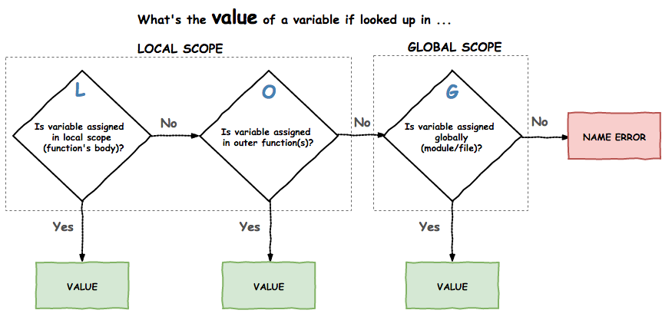
▸ Scope mnemonics: the LOG rule
Notes:
You noticed that we can assign and reference a variable in different locations and that might be ambiguous. To clarify these situations, a simple rule is defined based on notions of namespace, scope and block code which simply define, loosely speaking, regions of your code.
A mnemotechnic way to remember this rule is the acronym LOG: Local (in function's body), Outer function (in "englobing" functions), Global (outside functions - module scope)

Slide 28
▸ Scope [Notebook Live Demo]
Example 1: global scope
Example 2: local and global scope
Example 3: locals (with nested functions) and global scope
Notes:
[Teacher] Dedicate 10-20 min to the code snippet below showing and executing code live
[Student] Be sure to run and understand the following code snippets before answering module's assignment

Slide 29
▸ Shared references
An extremely important notion in Python
Potential source of many bugs
Problem arises when two variables reference the same object
Notes:
This notion highlights as well the importance of the distinction between mutable and immutable data type

Slide 30
▸ Shared references [Notebook Live Demo]
Case 1: immutable objects
Case 2: mutable objects
Case 3: shallow copy
Case 4: Deep copy
Credits & references
http://www.pythontutor.com/
Notes:
Spend some minutes playing around with http://www.pythontutor.com/ visualizing shared references notion

Slide 31
▸ Shared references visualized
Visualizing one of the most important source of bugs
Using http://www.pythontutor.com/
Credits & references
http://www.pythontutor.com/

Slide 32
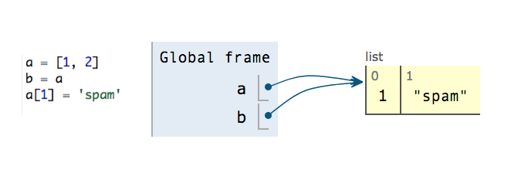
▸ Typical shared reference situation
Notes:
a and b are just two different variables binding the same list object. You can retrieve and update the object from both "ways"

Slide 33
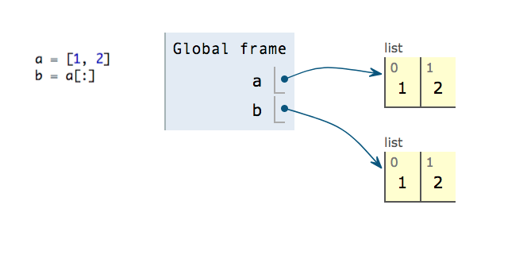
▸ Shallow copy
Notes:
To circumvent default shared reference mechanism, you can "clone“ the original object, using the [:] Python idiom

Slide 34
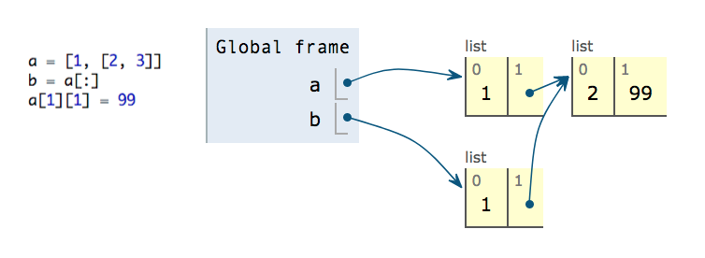
▸ Shared reference's hell!
Notes:
At first glance, you might think that you've created a clone of the a object and that you can safely update it without affecting b ...
But in the case of nested objects, the shallow copy trick (as the term suggests) simply copy the top level of the "hierarchy"/tree and b's second element is still referencing the same list as a's second element. This is barely an expected behaviour!
Instead, perform a deep copy (see next slide)

Slide 35
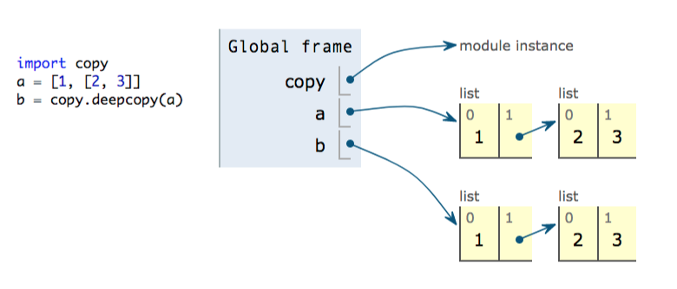
▸ Deep copy to the rescue
Notes:
Back both feet on the ground!

Slide 36
▸ Quiz 2
What's the mnemonics of scope's rules?
Are functions' arguments always passed by reference?
What's the difference between a shallow and deep copy?
Are immutable data types really usefull?

Slide 37
IV. IDIOMATIC PYTHON

Slide 38
▸ The Pythonic way
Knowing the syntax and semantic of a language is a plus
To know how it is used into the wild by experienced practitioners is a must
Inspired by the "Zen of Python", Python often has its very own way to address programming tasks
Credits & references
http://python.net/~goodger/projects/pycon/2007/idiomatic/handout.html

Slide 39
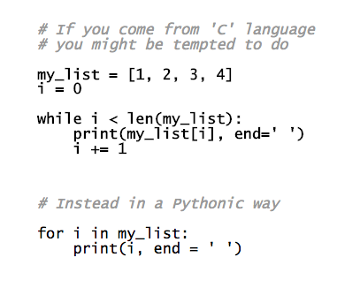
▸ Ex1: Resist counting
Notes:
Anything that can be looped over is called an Iterator. Python syntax provides very simple way to loop over them as you see above

Slide 40
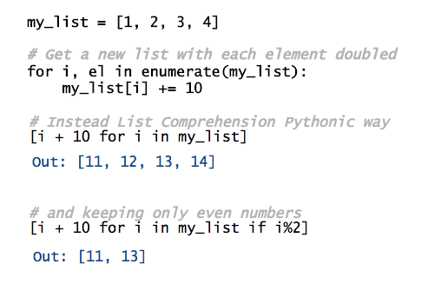
▸ Ex2: List comprehensions

Slide 41
▸ Python for Data Science
Python is even more idiomatic in Data Science
Domain-specific packages: data cleaning, transformation, visualization, deep learning, ...
Domain-specific data structures/types, APIs, programming, computing paradigms
Notes:
For instance, for loops are often replaced by vectorized implementation (see NumPy crash course in Data Cleaning, Preparation course)
In providing a high level of abstraction, Data Science packages allow to focus on the data analysis pipeline while hiding uncessary details
Pandas, Numpy, Matplotlib, Scikit-learn and Keras will be used throughout the module

Slide 42
▸ The Pythonic way [Notebook Live Demo]
Resist counting, List comprehensions
Indexing, slicing a list
Iterators and generators
Data Science "friendly" Python types
Credits & references
https://anandology.com/python-practice-book/iterators.html
http://python.net/~goodger/projects/pycon/2007/idiomatic/handout.html
Notes:
[Teacher] Dedicate 15-30 min to the code snippet below showing and executing code live
[Student] Be sure to run and understand the following code snippets before answering module's assignment

