Slide 1
DATA CLEANING AND PREPARATION

Slide 2
I. INTRODUCTION

Slide 3
▸ Main objectives
To understand why data preparation is a crucial step
To get acquainted with the two workhorses of data wrangling: NumPy and Pandas
To be able to implement all key operations of data pre-processing
Credits & references
Companion notebook: FM7/notebooks/3-data-cleaning-and-preparation.ipynb
Python for Data Analysis, Wes MacKinney, OReilly: https://github.com/wesm/pydata-book
http://pandas.pydata.org/pandas-docs/stable/tutorials.html
Notes:
One of the important objective is to be up and running on both NumPy and Pandas as used extensively in the rest of the course
Wes MacKinney is the author and main developer of Pandas package

Slide 4
▸ Keep data alive
There is no ideal structure for data
All depends on purpose of use
BUT in all cases, every cleaning or transformation steps should be reproducible and automated
Credits & references
Reproducible Research in Computational Science Roger D. Peng (see FM7/references)
Notes:
Again, data is just data! There are many perspectives you may consider depending on problem to solve, domain-knowledge, ...
Consider data as a dynamic flow that you can refine in various way depending on the situation

Slide 5
II. DATA WRANGLING, MUNGLING

Slide 6
▸ What is "raw", primary data?
Data collected from a source (for instance a sensor, data entry clerk, …)
Has not been subject to prior processing
BUT IS RELATIVE: data constantly re-aligned to analysis, predictive goals
Notes:
Ex: Temperature sensors sending data -> might have systematic bias that could be corrected based on other stations, … detection errors mechanism (checksum) might reveal that some of the data transmitter are corrupted, so need to remove them, …
Data entry clercks and spelling mistakes, …
Prior processing: automatically by a program, manually by an analyst, researcher, …
Depending pre-processed data (clean , reshaped, …) for one purpose might not be suitable for another one. In reality, data should be considered as a living entity rather than something set in stone, constantly re-aligned to the needs (that’s reflected by the variety of techniques in data wrangling, versatility of tools, and Big Data tool ecosystem as well)

Slide 7
▸ Some typical data cleaning tasks
Handling missing data
Handling duplicate data
String manipulation (to fix typos, ...)
...
Notes:
Some others: removing data transmitted with bad checksums, defining appropriate data types, ...

Slide 8
▸ Some typical data preparation tasks
Replacing values, binning, indexing, combining, reshaping, ...
Joining, merging, pivoting, stacking with quantitative data exploration in mind
Creating dummy variables, reshaping to feed ML/DL algorithms
Performing feature engineering
Notes:
Pivot table should be familiar to you if you are an Excel user
Feature engineering will be covered in subsequent courses and aims at transforming the original dataset to ease the learning process, ...

Slide 9
▸ Preliminary remarks
Data cleaning and preparation is often reported to take up 80% or more of a data scientist’s time
The whole process MUST BE automated and reproducible
NumPy and Pandas are the two workhorses easing the whole process
Notes:
This is not indeed the most exciting part of a data scientist’s daily work, however, we will introduce tools greatly facilitating the process and when dealing with a real dataset and eager to explore, discover new patterns, insights and eventually creating predictive model, … motivation comes!

Slide 10
▸ The two workhorses of data transformation
NumPy : foundational packages for numerical computing in Python
Pandas: contains data structures and data manipulation tools making data cleaning and analysis fast and easy
Credits & references
[http://www.numpy.org/](http://www.numpy.org/)
[https://pandas.pydata.org/](https://pandas.pydata.org/)
Notes:
NumPy, short of Numerical computing
Pandas often used in tandem with Numpy
Being proficient with both packages is a prerequisite for data science with Python

Slide 11
▸ Quiz 1: Why is data wrangling so crucial?
It makes easier to store data into relational databases
It allows tailoring data to fit your specific needs
It allows "normalize" data acquired removing typos, handling missing data, removing duplicates, ...
Notes:
Sort by importance

Slide 12
III. TIDY DATA

Slide 13
▸ Tidy data
a standard way to organize data values within a dataset
in a way that makes data analysis possible
standardized way to link structure of a dataset (its physical layout) with its semantics
Credits & references
Tidy Data, Hadley Wickham, Journal of Statistical Sosftware (FM7/references/tidy-data-wickham.pdf)
Notes:
Hadley Wickham coined the term in his famous paper "Tidy Data". He is very famous within the R Software community for developing important packages such as ggplot, dplyr, ...
Tidy data paper is a must read!

Slide 14
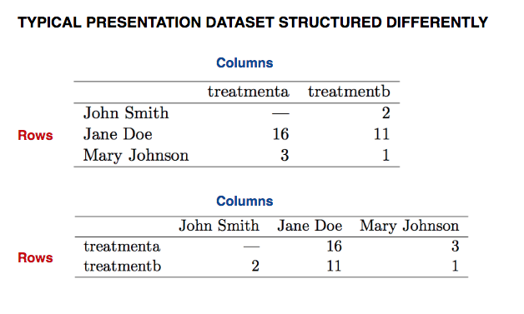
▸ Data structure
Credits & references
Tidy Data, Hadley Wickham, Journal of Statistical Sosftware (FM7/references/tidy-data-wickham.pdf)
Notes:
Our vocabulary of rows and columns is simply not rich enough to describe why the two tables represent the same data
Often people think that providing dataset grouped, pivoted as it can be done for instance for the sake of presentation of analysis in a spreadsheet software will help further data analysis.

Slide 15
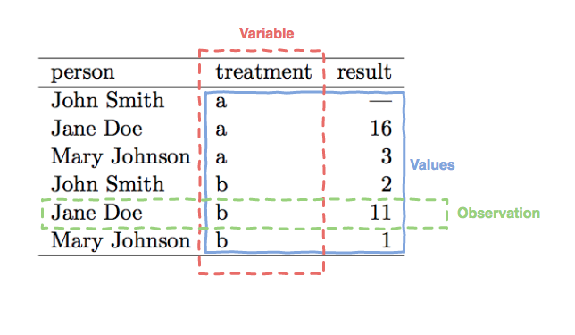
▸ Data semantics
Credits & references
Tidy Data, Hadley Wickham, Journal of Statistical Sosftware (FM7/references/tidy-data-wickham.pdf)
Notes:
A dataset is a collection of values, usually either numbers (if quantitative) or strings (if qualitative)
Values are organized in two ways. Every value belongs to a variable and an observation
A variable contains all values that measure the same underlying attribute (like height, temperature, duration) across units
An observation contains all values measured on the same unit (like a person, or a day, or a race) across attributes

Slide 16
▸ In Tidy data:
Each variable forms a column
Each observation forms a row
Each type of observational unit forms a table
Credits & references
Tidy Data, Hadley Wickham, Journal of Statistical Sosftware (FM7/references/tidy-data-wickham.pdf)
Notes:
The standardized way to link structure of a dataset (its physical layout) with its semantics
Observational units are entities whose characteristics we measure
Tidy data is only worthwhile if it makes analysis easier

Slide 17
▸ Pandas to the rescue
H. Wickham implemented a series of R packages supporting his Tidy data vision
Hopefully, Pandas Python package allows to replicate most of R tidyverse suite of packages functionalities
So let's dive in NumPy and Pandas
Credits & references
Tidy Data, Hadley Wickham, Journal of Statistical Sosftware (FM7/references/tidy-data-wickham.pdf)
Notes:
R packages dplyr is awesome and you should give it a try. It illustrates as well the fact mentionned already that a data scientist should be able to switch from one analytical platform to the other based on needs, environment, ...
Actually in R, there are a suite of packages dubbed "tidyverse" including: lubridate, reshape2, stringr, plyr, ggplot, ... reflecting the whole "Tidy vision"
We will come back to Tidy data once familiar with both Numpy and Pandas

Slide 18
▸ Quiz 2: What's the whole purpose of Tidy data
To ease any further data processing and analysis
To define data sharing best practices
To ease collaboration and replication
Notes:
Check the right answer(s)

Slide 19
IV. NUMPY

Slide 20
▸ Why is NumPy so important?
Efficient way to handle large arrays of data
Most Python Data Science packages use NumPy’s array objects for data exchange
Plays a key role not only in data transformation but as well in Machine Learning, Statistics, Deep Learning, …
Notes:
Pandas is based on NumPy
NumPy arrays appear everywhere in ML and DL pipelines

Slide 21
▸ Main areas of functionality includes:
Fast vectorized array manipulation
Indexing, selection, subsetting datasets
Merging, joining heterogeneous datasets
Efficient descriptive statistics
…

Slide 22
▸ NumPy Crash Course [Notebook Live Demo]
To create NumPy arrays
To understand NumPy arrays main attributes
To Understand important Vectorization and Broadcasting notions
To become proficient in slicing, indexing, ... arrays
To harness powerful NumPy utilities and universal functions
...
Credits & references
[https://docs.scipy.org/doc/numpy-dev/user/quickstart.html](https://docs.scipy.org/doc/numpy-dev/user/quickstart.html)
[https://docs.scipy.org/doc/numpy/reference/routines.array-creation.html](https://docs.scipy.org/doc/numpy/reference/routines.array-creation.html)
Notes:
[Teacher] Dedicate 15-30 min to the code snippet below showing and executing code live
[Student] Be sure to run and understand the following code snippets before answering module's assignment

Slide 23
▸ What about heterogeneous data types?
NumPy is best suited for homogeneous numerical array data
But Dataset often comes with various attributes: time, name, mesurements, …
Based on NumPy, the Pandas package is designed for working with heterogeneous data

Slide 24
▸ Quiz 3: NumPy
What's the most important data type in NumPy?
What's the purpose of vectorization?
What's the shape of array([[ 0, 1, 2],[ 3, 4, 5],[ 6, 7, 8]])?
Is Numpy extensively used in machine and deep learning?

Slide 25
V. PANDAS

Slide 26
▸ Pandas toolbox
Abstract and convenient Data Structures for data cleaning and preparation
Data selection, indexing, visualization, aggregation, merging, reshaping, ...
Time Series dedicated utilities
...
Credits & references
http://pandas.pydata.org/pandas-docs/stable/
http://pandas.pydata.org/pandas-docs/stable/tutorials.html
Notes:
This is essentially your Swiss knife for data science

Slide 27
▸ Pandas Data Structures
Based on Numpy array
Series: a one-dimensional array-like (somewhat similar to NumPy array)
DataFrame: represent a “rectangular” table of data and can be thought of as a dict of Series
Credits & references
http://pandas.pydata.org/pandas-docs/stable/dsintro.html

Slide 28
▸ Pandas Crash Course [Notebook Live Demo]
Pandas Series: creating, indexing, subsetting, aligning, missing values
Pandas DataFrame: creating, updating, appending,
Pandas essential functionalities: reindexing, dropping entries, function applications, ...
Credits & references
http://pandas.pydata.org/pandas-docs/stable/tutorials.html
Notes:
[Teacher] Dedicate 30-45 min to the code snippet below showing and executing code live
[Student] Be sure to run and understand the following code snippets before answering module's assignment

Slide 29
▸ Quiz 4: Pandas
What are axis?
What's the purpose of the ".loc" method?
What's the purpose of the ".iloc" method?
What's the most important data structure in Pandas?
What's the whole purpose of an index?

Slide 30
VI. DATA CLEANING WITH PANDAS

Slide 31
▸ The two main sides of data cleaning
Handling missing values
Transforming data: remove/update irrelevant or erroneous ones, data types, discretizing / binning, ...
Credits & references
http://pandas.pydata.org/pandas-docs/stable/missing_data.html

Slide 32
▸ Missing data
A very common situation in many applications
Should be handled carefully and in an informed way
Use a Sentinel value to be easily detected, NA (Not Available) but can be encoded as NaN (Not a Number) or None
Notes:
Deciding to remove/ignore, fill based on available values missing values is an important and complex decision, let's take an example (see following slide)

Slide 33
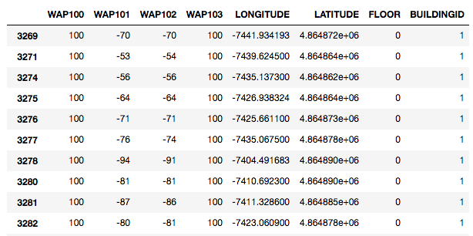
▸ Is it missing data?
Credits & references
FM7/notebooks/use-cases/indoor-localization.ipynb
Notes:
This is a use case where a device records at every time step the RSSIs (Relative Received Signal Strength) of WAP (Wireless Access Points) at a specific location. When RSSI for a WAP not detected is equal to 100. If your objective it to design an indoor location system based on RSSIs received, should you consider these values (100) are missing values?

Slide 34
▸ Data cleaning [Notebook Live Demo]
Encoding missing values: filtering, filling,
Transforming data: removing duplicates, modifying using function or lookup table, ...
Credits & references
http://pandas.pydata.org/pandas-docs/stable/tutorials.html
Notes:
[Teacher] Dedicate 5-10 min to the code snippet below showing and executing code live
[Student] Be sure to run and understand the following code snippets before answering module's assignment

Slide 35
VII. TIDY DATA WITH PANDAS

Slide 36
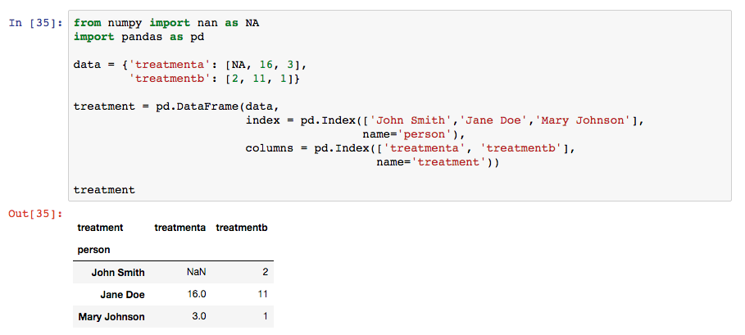
▸ Reproducing Tidy Data motivating example
Credits & references
http://pandas.pydata.org/pandas-docs/stable/tutorials.html
Notes:
A simple dataframe with both columns and rows index

Slide 37
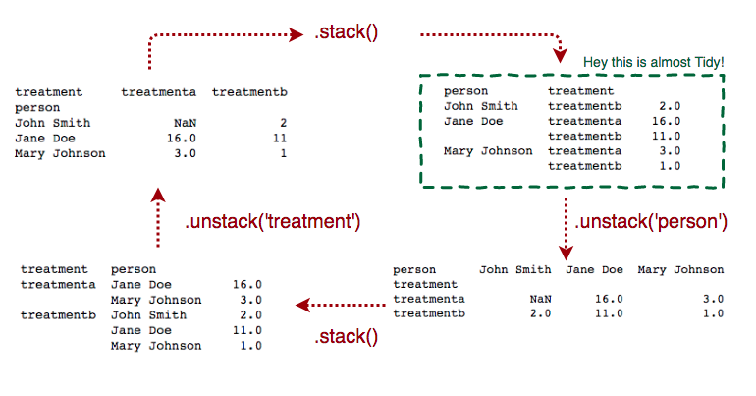
▸ Columns to rows to columns to rows ...
Credits & references
http://pandas.pydata.org/pandas-docs/stable/tutorials.html

Slide 38
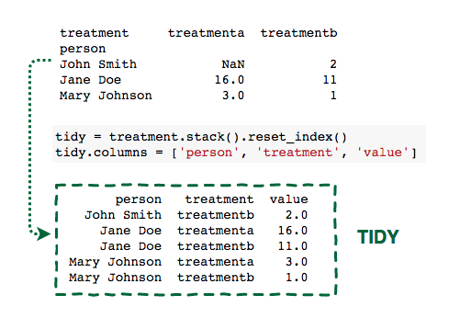
▸ Making it tidy finally!
Credits & references
http://pandas.pydata.org/pandas-docs/stable/tutorials.html

Slide 39
▸ Tidying data with Pandas [Notebook Live Demo]
Stacking, unstacking
Pivoting and melting
Credits & references
http://pandas.pydata.org/pandas-docs/stable/tutorials.html
Notes:
[Teacher] Dedicate 15-30 min to the code snippet below showing and executing code live
[Student] Be sure to run and understand the following code snippets before answering module's assignment

