Slide 1
EXPLORATORY DATA ANALYSIS

Slide 2
I. INTRODUCTION

Slide 3
▸ Main objectives
To understand why Exploratory Data Analysis (EDA) is a key step in data analytics
To be aware of Data Visualization best practices
To harness Python ecosystem for EDA: matplotlib, pandas, ...
To understand the complementarity of quantitative and graphical EDA
Credits & references
Companion notebook: FM7/notebooks/4-exploratory-data-analysis.ipynb
[notebooks/pydata-book](notebooks/pydata-book)
https://www.labri.fr/perso/nrougier/teaching/matplotlib/

Slide 4
▸ EDA motivation
To get acquainted gain insights on "never-seen" dataset
To check assumptions required by modeling approaches
To identify potential correlation between variables
To identify potential similarities and clusters
...

Slide 5
▸ EDA as a detective work
In its tabular form, data is not really conducive to interpretation
Quest is to find the "angle of view" that will suddenly reveal never expected properties
But it is a subtle game and require careful interpretation and critical thinking
Notes:
For instance, human eyes-brain system is extremely good at finding patterns where there is no clear evidence of such presence
Probability and Statistics definitely help accurate statements about what is only due to chance and what is not

Slide 6
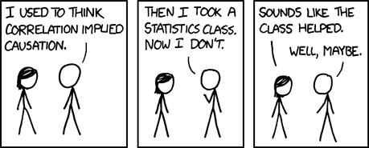
▸ Does correlation imply causation?
Credits & references
[https://www.xkcd.com/552/](https://www.xkcd.com/552/)
[https://www.explainxkcd.com/wiki/index.php/552:_Correlation](https://www.explainxkcd.com/wiki/index.php/552:_Correlation)
Notes:
For instance, you observe a dataset of House prices in a suburbs of a city reveals that homes value is correlated to the percentage of lower status of the population in its neighborhood. Is home value caused by the percentage of lower status of the population? Is the opposite right?
Is the question even relevant given that your are solely focused on predicting home values?
It points the difference between explaining and predicting

Slide 7
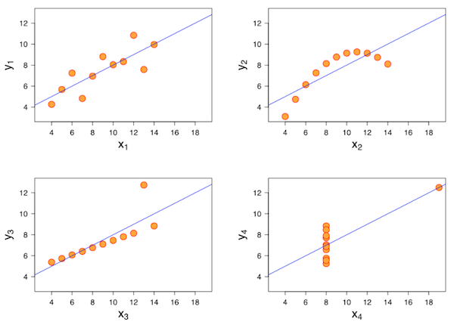
▸ Why quantitative AND graphical EDA?
Credits & references
[https://en.wikipedia.org/wiki/Anscombe%27s_quartet](https://en.wikipedia.org/wiki/Anscombe%27s_quartet)
Notes:
Anscombe's quartet comprises four datasets with the same mean, variance, correlation coefficient, linear regression line. Quantitative EDA might let think they are the same, but when looking at their scatter plots they are clearly different.

Slide 8
▸ Anscombe's Quartet [Notebook Live Demo]
Taking a quick look at rows, columns
Computing summary statistics
Performing linear regression
Plotting scatter plots
Notes:
[Teacher] Dedicate 5-10 min to the code snippet below showing and executing code live
[Student] Be sure to run and understand the following code snippets before answering module's assignment
Correlation coeff., linear regression will be covered in details later on.

Slide 9
▸ Quiz 1
EDA is most of the time an optional step in a data analysis pipeline
Quantitative and graphical EDA should be conducted in parallel
A strong correlation between variables X and Y indicates that a variation of X causes a variation of Y
The issue illustrated by Anscombe is not an issue anymore in the Big Data era
Notes:
Check the right answer(s)

Slide 10
II. MATPLOTLIB PRIMER

Slide 11
▸ Python Data Viz ecosystem
Matplotlib package dates back from 2002 to enable MATLAB-like plotting interface in Python
Highly customizable, provides a fine-grained control over a wide range of plotting features
Plots can be visualized in Notebooks, exported as PDF, SVG, PNG, ...
In complement, based on Matplotlib, a number of other packages provides a high-level interfaces for drawing attractive statistical graphics.
Credits & references
[http://seaborn.pydata.org/](http://seaborn.pydata.org/)
[http://pandas.pydata.org/pandas-docs/stable/visualization.html](http://pandas.pydata.org/pandas-docs/stable/visualization.html)
[https://bokeh.pydata.org/en/latest/](https://bokeh.pydata.org/en/latest/)
[http://datashader.readthedocs.io/](http://datashader.readthedocs.io/)
Notes:
Seaborn package high-level interface is often a proper default choice when doing EDA
Pandas package wraps Matplotlib in order to provide plotting features directly using DataFrame and Series objects
Bokeh is a good choice to create interactive data visualization
Datashader is really convenient when dealing with big datasets

Slide 12
▸ Data Viz as an end in itself
You might have seen compelling data viz. products in then New York Times, The Guardian, ...
Often the fruit of an intense collaborative within a multi-disciplinary team
Should use means and knowledge to the level of the message you want to convey
Data Viz for EDA has different goals
Credits & references
http://fr.anckalbi.net/child-cash-grant
How to lie with maps: http://press.uchicago.edu/ucp/books/book/chicago/H/bo3696845.html
Notes:
Data Viz products you might have seen in the news often supports a strong narrative
Being able to interactively query a multidimensionnal dataset brings sometimes more confusion. For instance showing variations from one selection to the other but is it significative based on data, ...
As all medias, data visualization can be misused to pursue questionable purposes ...
The whole goal of a Data Viz product is to provide interesting and original point of views that shed light on a problem
When publishing Data Viz product online, the excellent D3 https://d3js.org/ provides infinitie possibilities

Slide 13
▸ Matplotlib up and running
Matplotlib provides a straightforward way to plot line plots, scatter plots, histograms, time series visualization, heatmaps, ...
But there are essential facts you must know and that will highly ease your learning process
Credits & references
[https://matplotlib.org/](https://matplotlib.org/)
[https://matplotlib.org/tutorials/index.html](https://matplotlib.org/tutorials/index.html)
[https://matplotlib.org/gallery.html](https://matplotlib.org/gallery.html)
Notes:
Matplotlib as an extremely vast set of possibilities, our goal here is just to give you a leg up
The Matplotlib tutorials and gallery are the best resources to learn advanced features
Additionnaly, we will use Matplotlib thoughout the module: Statistics, Machine Learning, Deep Learning in a variety of context

Slide 14
▸ Matplotlib Primer [Notebook Live Demo]
What's a matplotlib figure?
What are matplotlib axes?
How to customize your plots?
Introduction to Seaborn and Pandas plotting high-level features?
Notes:
[Teacher] Dedicate 15-30 min to the code snippet below showing and executing code live
[Student] Be sure to run and understand the following code snippets before answering module's assignment

Slide 15
▸ Quiz 2
Matplotlib is a low-level, highly customizable and pervasive Python Package for data visualization
D3.js is based on Matplotlib
Matplotlib figures contains the plot elements
the '.histogram' matplotlib method allow to create an histogram
Notes:
Check the right answer(s)

Slide 16
III. DATA VISUALIZATION PRIMER

Slide 17
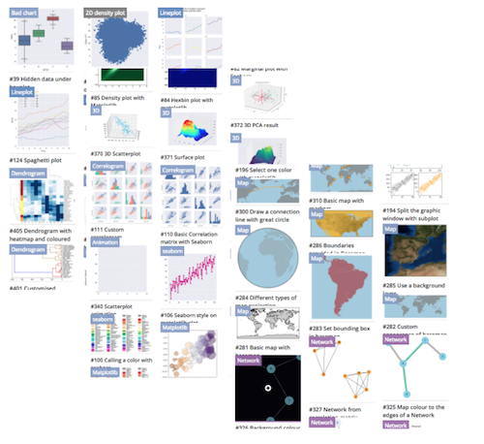
▸ Data viz. design space is huge
Credits & references
https://python-graph-gallery.com
http://www.perceptualedge.com/
Notes:
A hundred different graphics for the same information

Slide 18
▸ Data viz. touchstone
How to assess the relevance of a particular data visualization?
Is there such things as good or bad data visualizations?
Data Viz. is not new
"Semiology Of Graphics", J. Bertin, 1967
Credits & references
https://en.wikipedia.org/wiki/Jacques_Bertin
https://www.crcpress.com/Visualization-Analysis-and-Design/Munzner/p/book/9781466508910
Notes:
"Semiology of Graphics" monumental work, based on his experience as a cartographer and geographer, represents the first and widest intent to provide a theoretical foundation to Information Visualization

Slide 19
▸ Notions of Semiology Of Graphics
Marks are basic geometric elements and channels control their appearance
Effective channels should reflect/match the magnitude of information of your data
For instance, Length channel effectively convey variation of quantitative data. Color Hue channel does not
Credits & references
https://vimeo.com/26205288
https://www.cs.ubc.ca/~tmm/talks/minicourse14/vad15seattle-4x4.pdf
Notes:
Example of a mark is a circle and channels can be sizes, color hue, color saturation, ...
When we refer to magnitude of information, we have in mind: is data quantitative, qualitative, ordered, binned, continuous, ...

Slide 20
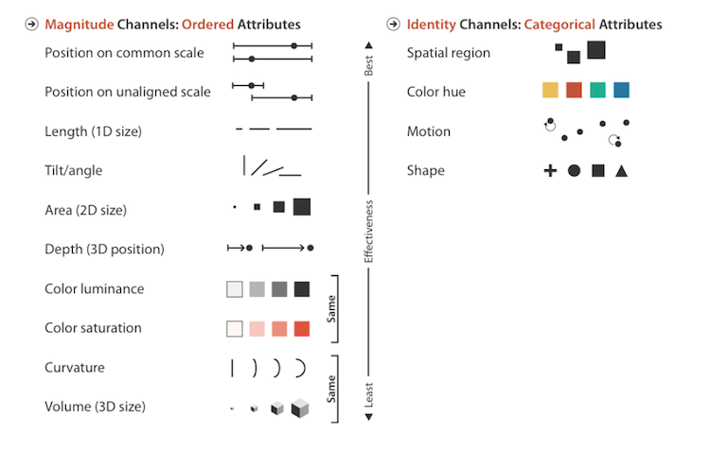
▸ Channels: Rankings
Credits & references
https://www.crcpress.com/Visualization-Analysis-and-Design/Munzner/p/book/9781466508910
http://vda.univie.ac.at/Teaching/Vis/13s/LectureNotes/05_visual_encodings.pdf
http://www.perceptualedge.com/articles/visual_business_intelligence/the_visual_perception_of_variation.pdf
Notes:
Example of a mark is a circle and channels can be sizes, color hue, color saturation, ...
When we refer to magnitude of information, we have in mind: is data quantitative, qualitative, ordered, binned, continuous, ...

Slide 21
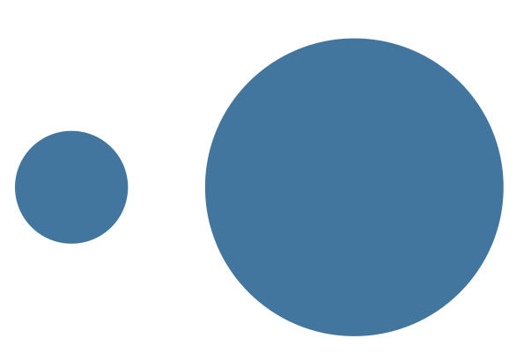
▸ Channel efficiency: comparing area
Notes:
Compare Areas of circles: how much bigger is the second circle?

Slide 22
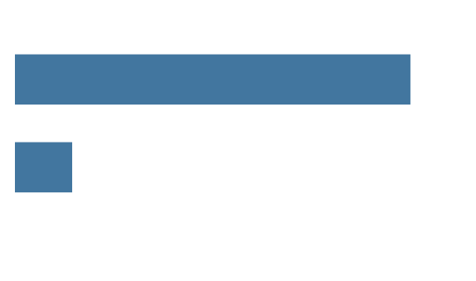
▸ Channel efficiency: comparing length
Notes:
What is the relative length of these bars?

Slide 23
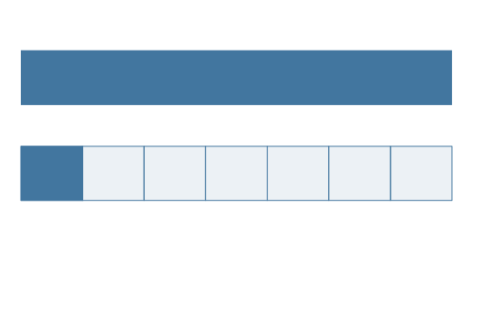
▸ Channel efficiency: Answer
Notes:
Biggest circle area was 7 times bigger as was the longer bar!
Which channel was most efficient, accurate? Required the least amount of cognitive load?

Slide 24
▸ Some remarks on color use
Choosing colors is not a matter of personal taste
Color channels: Hue, Luminance and Saturation have their own functions
Follow best practices: http://colorbrewer2.org/
Credits & references
http://colorbrewer2.org/
http://www.perceptualedge.com/articles/visual_business_intelligence/rules_for_using_color.pdf
http://web.archive.org/web/20131019161245/http://www.sv.vt.edu/~rkriz/Projects/create_color_table/color_07.pdf
Notes:
Arthur H. Robinson, in 1952 brillantly said: "For some reason, as soon as color is applied to a map the color becomes a focus of criticism, and everyone, regardless of his familiarity with the principles of color use, seems to feel that he is entitled to comment upon the color on the basis of his own likes and dislikes&quot"

Slide 25
▸ Techniques to cope with overplotting
Reducing opacity (alpha channel): enable visibility of layered data points
Jittering: to slightly and randomly repositionning data points
Randommy sub-sampling": to reduce dataset size with chances of retaining dataset overall structure
Aggregating
Credits & references
https://www.perceptualedge.com/articles/visual_business_intelligence/over-plotting_in_graphs.pdf
Notes:
Overplotting: the plotting of data on top of a previous plot
Use cases will illustrate the Aggregating technique

Slide 26
▸ Quiz 3
Data visualization is a fairly recent research field
Position on common scale is more efficient than area channel for quantitative data
Color hue channel should be used for qualitative data only
Choosing colors for your data visualization is really a matter of taste
Notes:
Check the right answer(s)

Slide 27
IV. EDA MINDSET

Slide 28
▸ A non canonical pipeline
No standard way to carry out Exploratory Data Analysis
But general frame of mind is to interrogate the dataset at hand
While keeping in mind objective/goal pursued and its context
Notes:
There is no excuse for not performing EDA. This is always beneficial
The more question you ask to your dataset the better prepared you will be to reach your objectives

Slide 29
▸ A proposed EDA path 1/4
Take a quick look at the first and end lines of your dataset
Take a look at Summary Statistics of each variable/column
For Quantitative variables: look at their histograms
Notes:
We assume that we are dealing with structured data and we have gone through the data cleaning process

Slide 30
▸ A proposed EDA path (2/4)
For Qualitative/Categorical variable: get counts per category or/and plot bar charts, ...
For Time Series, take a quick look at line plots
If geo-referenced, plot a quick scatter plot using lon, lat as x and y
Notes:
For each of this task, there are many possible chart type candidates and techniques (for instance to cope with overplotting)

Slide 31
▸ A proposed EDA path (3/4)
Identify potential outliers, are they really outliers?
Look at correlation between continuous variables using scatterplots and correlograms
Check any required assumption (normally distributed, ...) visually or Normality test, ...
Credits & references
https://en.wikipedia.org/wiki/Outlier
https://python-graph-gallery.com/111-custom-correlogram/
Notes:
You can use the IQR rule of thumbs for instance to assess outliers (see references)

Slide 32
▸ A proposed EDA path (4/4)
Aggregate/downsample if facing overplotting or simply summarizing your dataset
Cross-query your data by computing grouped statistics (groupby + average, max, min, ...)
Faceted/small multiples visualizations
Cluster analysis, patterns identification
Credits & references
https://python-graph-gallery.com/125-small-multiples-for-line-chart/
Notes:
For instance K-means clustering could be perform to identify similarities and dissimilarites between groups of values. This could for instance inform further feature engineering tasks (would be covered in Machine Learning Course)

Slide 33
V. CLUSTERING WITH K-MEANS

Slide 34
▸ Discovering hidden structures in data
Strictly speaking K-means is a machine learning algorithm (unsupervised learning)
But its exploratory nature is particularly relevant to EDA
Main goal is to identify similarities and clusters in dataset
Credits & references
https://github.com/rasbt/python-machine-learning-book
http://scikit-learn.org/stable/modules/generated/sklearn.cluster.KMeans.html
http://scikit-learn.org/stable/auto_examples/cluster/plot_cluster_iris.html#sphx-glr-auto-examples-cluster-plot-cluster-iris-py

Slide 35
▸ A sneak peak at Machine Learning
Main branches are: Supervised and Unsupervised learning
Supervised learning: infer output (target) from input(s) (features) using labeled examples
Unsupervised learning: no label, your task is to discover/infer them
Unsupervised learning and K-means in particular allow to gain insight into your dataset valuable for further modeling tasks
Credits & references
https://github.com/rasbt/python-machine-learning-book
http://scikit-learn.org/stable/modules/generated/sklearn.cluster.KMeans.html
http://scikit-learn.org/stable/auto_examples/cluster/plot_cluster_iris.html#sphx-glr-auto-examples-cluster-plot-cluster-iris-py
Notes:
An example of supervised learning setup could be to predict probability of defaults of a network node given monitored temperature, error transmission rate, ... To do so, you would need to get logs of many nodes both functioning and non-functioning ones. The logs (temperature, ...) would be your input features and functioning status (the target/label). Hence using past experience (training dataset), you would be in a position (pending on model relevance) to predict future functioning mode.

Slide 36
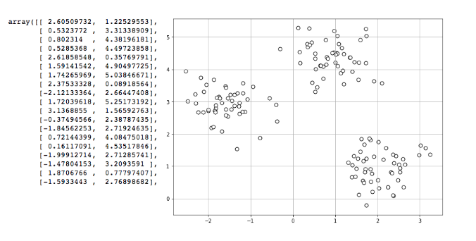
▸ An example of unlabeled data
Credits & references
https://github.com/rasbt/python-machine-learning-book
http://scikit-learn.org/stable/modules/generated/sklearn.cluster.KMeans.html
http://scikit-learn.org/stable/modules/generated/sklearn.datasets.make_blobs.html
Notes:
Dataset has two input features (let's call them X1 and X2) but no label. This type of contrived dataset can be generated using scikit-learn make_blocs method.
Obviously in that case and considering that human eyes and brain is extremely good at spotting such patterns this is a trivial task for us (be warned however that sometimes human brains see nonexistent patterns!)
K-means allows to identify these patterns in an automatic way

Slide 37
▸ K-means in action
Randomly pick k centroids as initial cluster centers
Assign each sample to the nearest centroids
Move centroids to the center of the samples previously assigned
Repeat previous 2 steps until centroids positions settle down
Credits & references
https://www.naftaliharris.com/blog/visualizing-k-means-clustering/
http://scikit-learn.org/stable/modules/generated/sklearn.cluster.KMeans.html

Slide 38
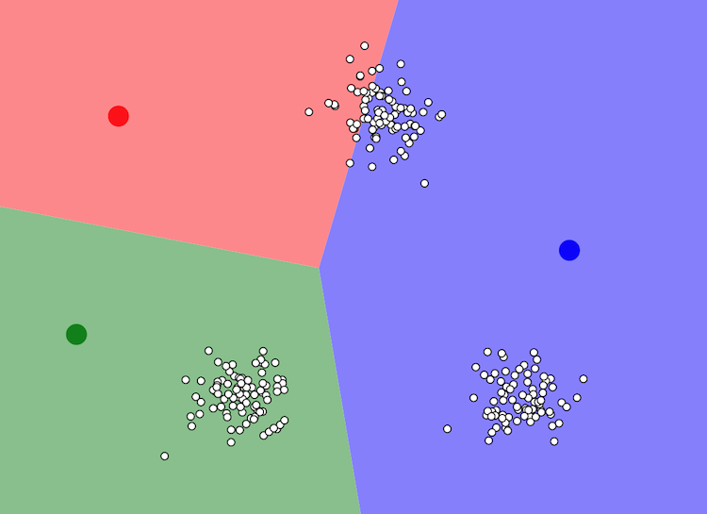
▸ Randomly pick k centroids
Credits & references
https://www.naftaliharris.com/blog/visualizing-k-means-clustering/
http://scikit-learn.org/stable/modules/generated/sklearn.cluster.KMeans.html

Slide 39
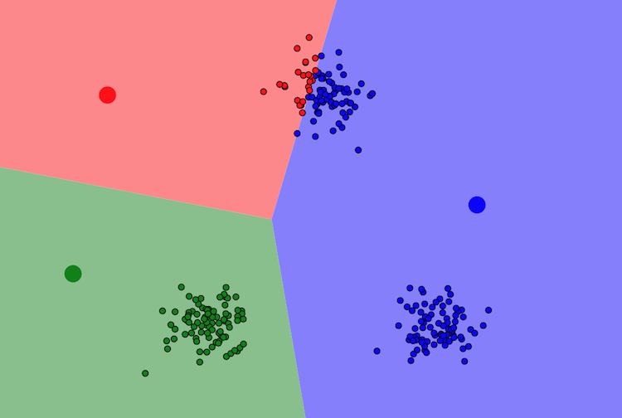
▸ Assign nearest samples (iteration 1)
Credits & references
https://www.naftaliharris.com/blog/visualizing-k-means-clustering/
http://scikit-learn.org/stable/modules/generated/sklearn.cluster.KMeans.html

Slide 40
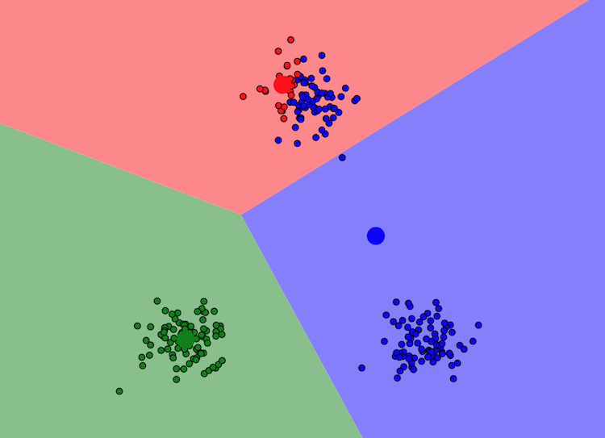
▸ Move centroids to the center (iteration 1)
Credits & references
https://www.naftaliharris.com/blog/visualizing-k-means-clustering/
http://scikit-learn.org/stable/modules/generated/sklearn.cluster.KMeans.html

Slide 41
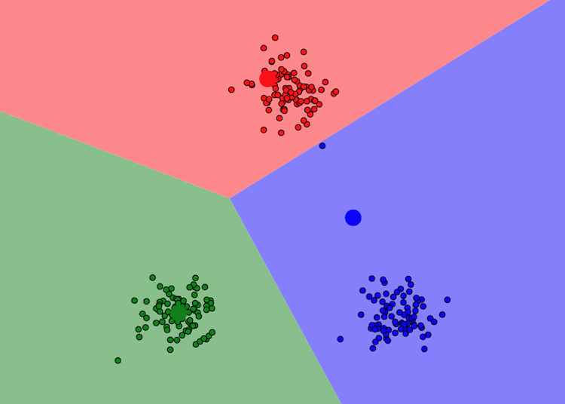
▸ Assign sample to nearest centroids (iteration 2)
Credits & references
https://www.naftaliharris.com/blog/visualizing-k-means-clustering/
http://scikit-learn.org/stable/modules/generated/sklearn.cluster.KMeans.html

Slide 42
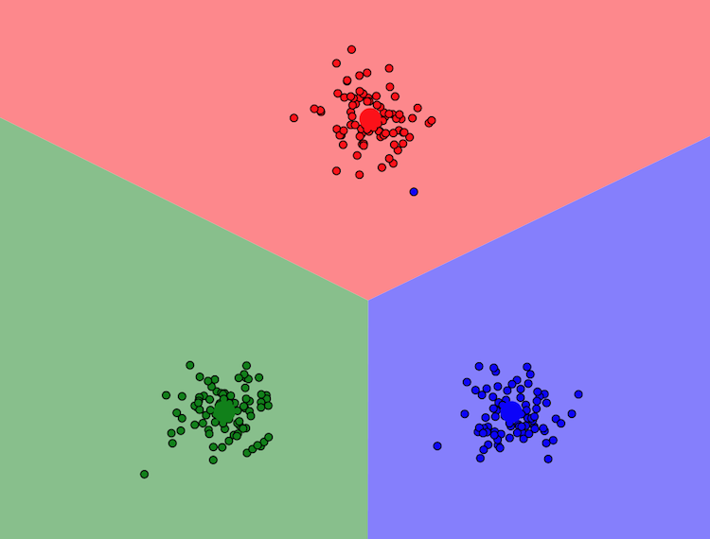
▸ Move centroids to the center (iteration 2)
Credits & references
https://www.naftaliharris.com/blog/visualizing-k-means-clustering/
http://scikit-learn.org/stable/modules/generated/sklearn.cluster.KMeans.html

Slide 43
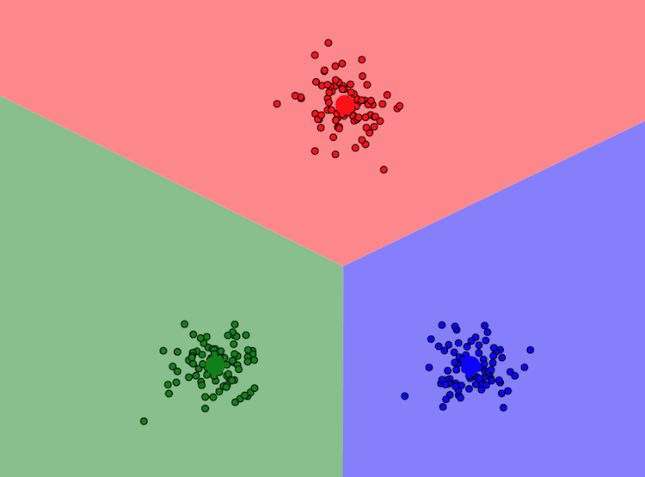
▸ Move centroids to the center (iteration 3)
Credits & references
https://www.naftaliharris.com/blog/visualizing-k-means-clustering/
http://scikit-learn.org/stable/modules/generated/sklearn.cluster.KMeans.html
Notes:
Looks like we successfully found our clusters!
Note however that depending on the initial random position of the centroids, you might end up with very different clusters. For that reason, K-means implementation run the algorithm several time with different initial centroid positions and keep the one with lower inertia: Sum of squared distances of samples to their closest cluster center.
[teacher] Take time to play around with https://www.naftaliharris.com/blog/visualizing-k-means-clustering/ online simulator to highlight previous point

Slide 44
▸ Why 3 clusters and not 4 or 5 or ...
In our case, with a contrived example, looked like an obvious choice
However, will not be always the case
Fortunately, the elbow method to find the optimal number of clusters
Credits & references
https://www.naftaliharris.com/blog/visualizing-k-means-clustering/
http://scikit-learn.org/stable/modules/generated/sklearn.cluster.KMeans.html

Slide 45
▸ The "Elbow" method
Run the K-means algorithm several time with various number of clusters: 3, 4, 5, ...
Calculate the inertia for each
Plot inertia vs. number of clusters and spot the "elbow"
Credits & references
https://www.naftaliharris.com/blog/visualizing-k-means-clustering/
http://scikit-learn.org/stable/modules/generated/sklearn.cluster.KMeans.html
Notes:
inertia or within-cluster SSE (Sum of Squared Error): Sum of squared distances of samples to their closest cluster center

Slide 46
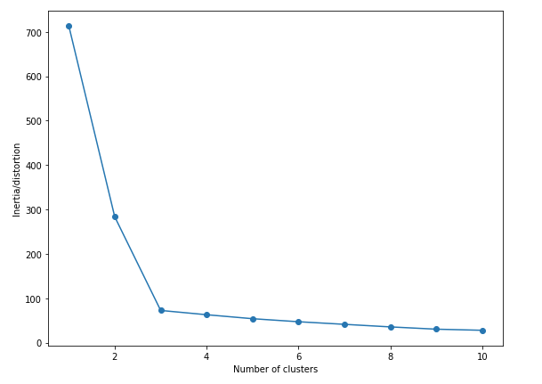
▸ The "Elbow" method in action
Credits & references
https://github.com/rasbt/python-machine-learning-book
http://scikit-learn.org/stable/modules/generated/sklearn.cluster.KMeans.html
Notes:
In the present case the "elbow" can be identified for number of clusters equal 3

Slide 47
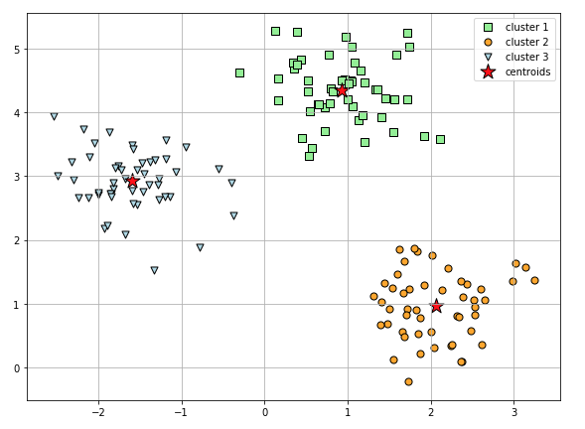
▸ Our initial dataset clustered
Credits & references
https://github.com/rasbt/python-machine-learning-book
http://scikit-learn.org/stable/modules/generated/sklearn.cluster.KMeans.html
Notes:
You will see K-means clustering used in a real use cases in EDA case studies

Slide 48
▸ Quiz 4
EDA pipeline is standardized and should be followed sequentially
When using K-means, it is always clear how many clusters should be chosen
Initial position of K-means cluster centroids does not impact the final result
The "Knee" method allows to assess the number of relevant clusters
Notes:
Check the right answer(s)

