Slide 1
EXPLORATORY DATA ANALYSIS USE CASES

Slide 2
I. INTRODUCTION

Slide 3
▸ Main objectives
To put knowledge acquired so far into practice with real use cases
To illustrate the EDA mindset and associated techniques
To provide further details on how to harness the spatial and time dimensions
Credits & references
Companion notebook: FM7/notebooks/5-exploratory-data-analysis-use-cases.ipynb
https://github.com/Oslandia/open-data-bikes-analysis

Slide 4
▸ Logistics
Current presentation simply provides context and objectives
Code, visualization and analysis are provided in dedicated/companion notebooks
Credits & references
FM7/notebooks/use-cases/open-data-bikes-analysis/Clustering-Bordeaux.ipynb
FM7/notebooks/use-cases/indoor-localization/indoor-localization-eda.ipynb

Slide 5
II. OPEN DATA BIKES

Slide 6
▸ Context and objective
To analyze bikes sharing station data from Bordeaux, France
To analyze the usage patterns
To plot a map with a color for each usage pattern
Credits & references
https://github.com/Oslandia/open-data-bikes-analysis
FM7/notebooks/use-cases/open-data-bikes-analysis/Clustering-Bordeaux.ipynb
Notes:
This is a first part of the Open Data Bikes use cases focusing on Exploratory Data Analysis. A second part will try to predict bike availability
Analyze the daily profile for each station from 2017-07-09 to 2017-09-26

Slide 7
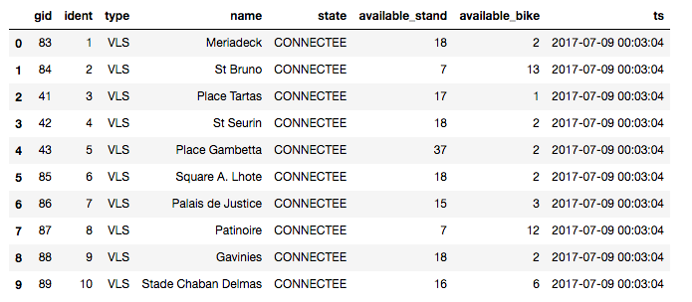
▸ The input data
Credits & references
https://github.com/Oslandia/open-data-bikes-analysis
FM7/notebooks/use-cases/open-data-bikes-analysis/Clustering-Bordeaux.ipynb

Slide 8
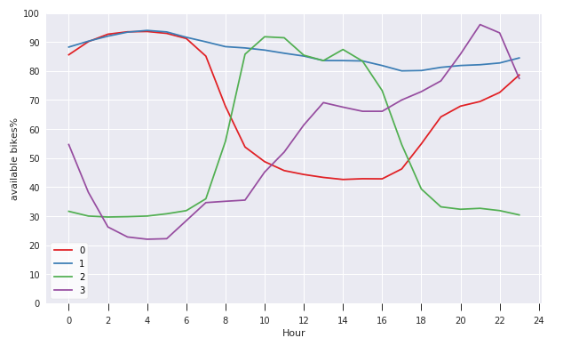
▸ Typical profiles output
Credits & references
https://github.com/Oslandia/open-data-bikes-analysis
FM7/notebooks/use-cases/open-data-bikes-analysis/Clustering-Bordeaux.ipynb

Slide 9
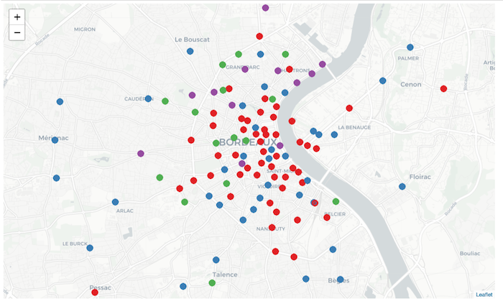
▸ Map of stations profile output
Credits & references
https://github.com/Oslandia/open-data-bikes-analysis
FM7/notebooks/use-cases/open-data-bikes-analysis/Clustering-Bordeaux.ipynb

Slide 10
▸ Open Data Bikes [Notebook Live Demo]
Data cleaning (select columns of interest, remove duplicates, renaming, ...)
Data transformation (alignment, resampling, pivoting, interpolate, ...)
Find typical usage patterns using K-means clustering
Credits & references
https://github.com/Oslandia/open-data-bikes-analysis
FM7/notebooks/use-cases/open-data-bikes-analysis/Clustering-Bordeaux.ipynb
Notes:
[Teacher] Dedicate 15-30 min to the code snippet below showing and executing code live
[Student] Be sure to run and understand the following code snippets before answering module's assignment

Slide 11
III. INDOOR LOCALIZATION

Slide 12
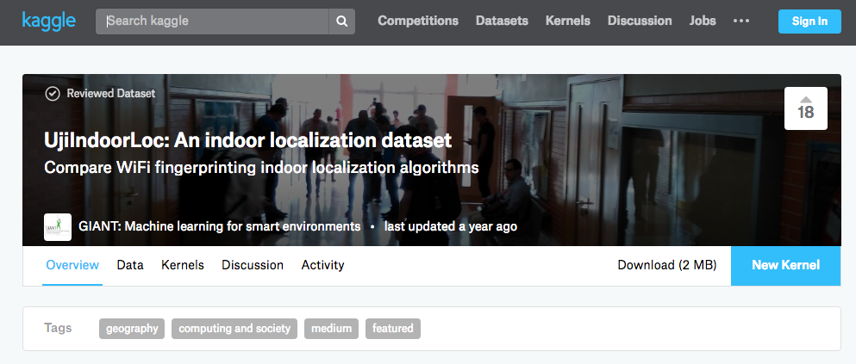
▸ The indoor localization dataset
Credits & references
https://www.kaggle.com/giantuji/UjiIndoorLoc

Slide 13
▸ Indoor localization dataset context
520 WAPs (Wireless Access Points) located in three different building and 4 or more floors
More than 20 different users and 25 Android devices detecting (or not) WAPs while moving
Dataset (529 attributes): WiFi fingerprint (RSSIs), lon/lat, Building, Floors, ...
Determining Building, floors, lon, lat of devices based on detected WPAs RSSIs
Credits & references
https://www.kaggle.com/giantuji/UjiIndoorLoc
http://www.uji.es
Notes:
The prediction objective will be left as Machine Learning exercise

Slide 14
▸ Use case objective
To illustrate the EDA mindset in the presence of never seen data
To exemplify a series of simple but efficient data visualization techniques
Credits & references
FM7/notebooks/use-cases/indoor-localization/indoor-localization-eda.ipynb
Notes:
The prediction objective will be left as a Machine Learning exercise (once covered ML obviously)

Slide 15
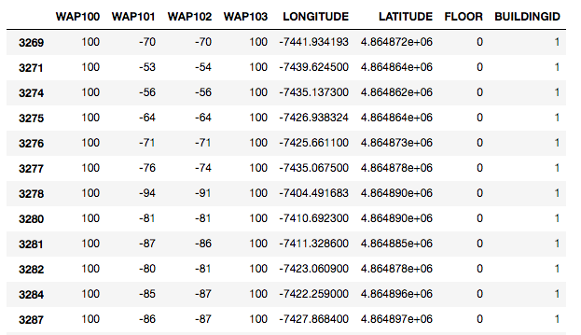
▸ The input data (subset)
Credits & references
https://www.kaggle.com/giantuji/UjiIndoorLoc

Slide 16
▸ The detective works starts ...
How many measurements (instances) per building?
How many measurements (instances) per building and by floor?
How many WPAs detected out of the 520 detected per measurement?
How many measurements do not detect any WAPs?
...
Credits & references
FM7/notebooks/use-cases/indoor-localization/indoor-localization-eda.ipynb

Slide 17
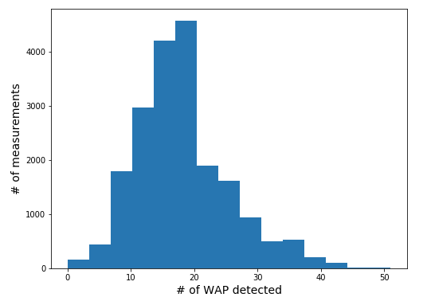
▸ Histogram of number of WAPs detected
Credits & references
FM7/notebooks/use-cases/indoor-localization/indoor-localization-eda.ipynb

Slide 18
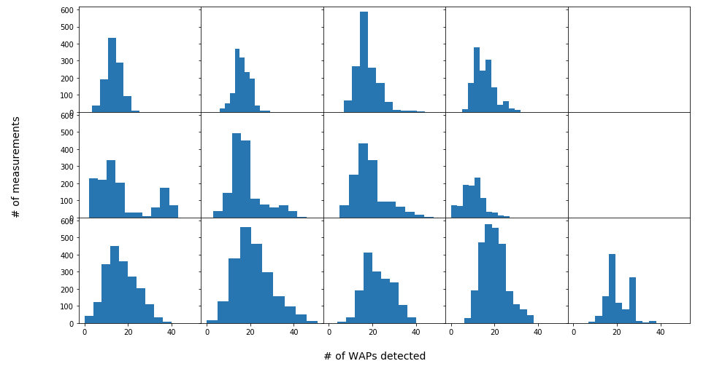
▸ Histogram of number of WAPs detected by Building and Floor
Credits & references
FM7/notebooks/use-cases/indoor-localization/indoor-localization-eda.ipynb

Slide 19
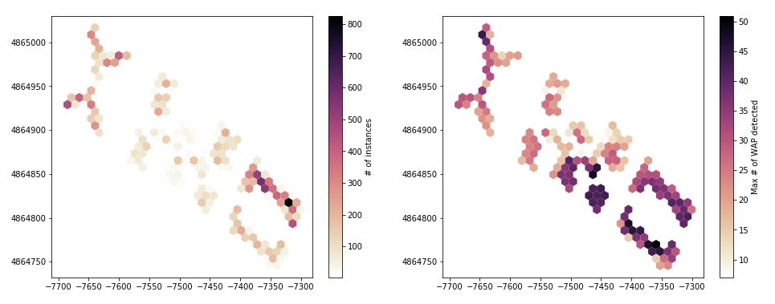
▸ Spatial distribution
Credits & references
FM7/notebooks/use-cases/indoor-localization/indoor-localization-eda.ipynb

Slide 20
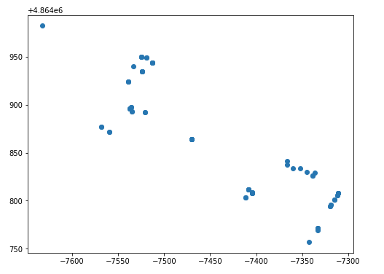
▸ Where are locations where no WAP detected?
Credits & references
FM7/notebooks/use-cases/indoor-localization/indoor-localization-eda.ipynb

Slide 21
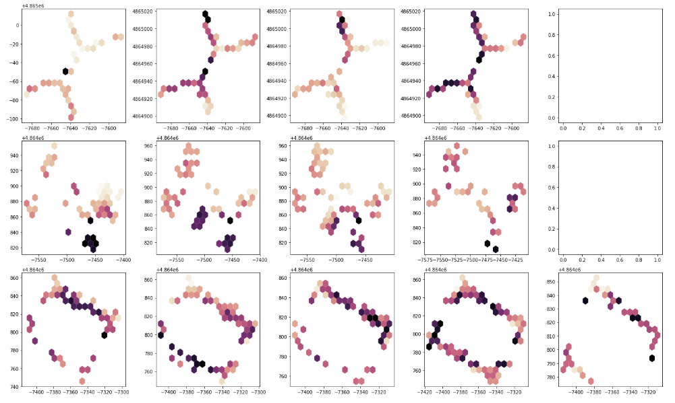
▸ Location of nb. of WAP by building and floor
Credits & references
FM7/notebooks/use-cases/indoor-localization/indoor-localization-eda.ipynb
Notes:
row: building and column:floors

Slide 22
▸ Indoor Localization [Notebook Live Demo]
Data loading
Data summary
Data visualization (alignment, resampling, pivoting, interpolate, ...)
Credits & references
FM7/notebooks/use-cases/indoor-localization/indoor-localization-eda.ipynb
Notes:
[Teacher] Dedicate 15-30 min to the code snippet below showing and executing code live
[Student] Be sure to run and understand the following code snippets before answering module's assignment

