Slide 1
STATISTICS REVISITED IN THE COMPUTER AGE

Slide 2
I. INTRODUCTION

Slide 3
▸ Main objectives
To give an insight into how the Statistics discipline has evolved over the past decades
To highlight how the field of Data Science embodies this change
To illustrate the "Hacking" Statisticians way of thinking with canonical and compelling examples
To prepare the ground for Machine Learning and Deep Learning subsequent courses
[To give you the desire to dig further into these fascinating fields]
Credits & references
Companion notebook: FM7/notebooks/6-statistics-revisited-in-computer-age.ipynb
http://greenteapress.com
Introduction to Bootstrap, Efron & Tibshirani, Chapman & Hall/CRC
Computer Age Statistical Inference, Efron
Probabilitic Systems Analysis and Applied Probability 6.041, MIT OpenCourseWare
Notes:
This course is not an introduction to the fields of Probability of Statistics. See further references

Slide 4
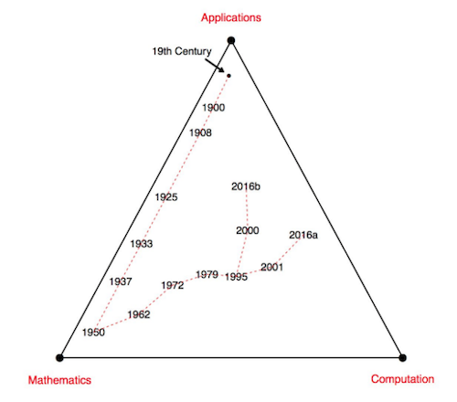
▸ Efron & Hastie's history of Statistics in a simplex
Credits & references
Computer Age Statistical Inference, Efron, http://web.stanford.edu/~hastie/CASI/
https://web.stanford.edu/~hastie/CASI_files/PDF/casi.pdf
Notes:
Development of the statistics discipline since the end of the nineteenth century
The tour starts at the end of the nineteenth century with Mathematicians of the caliber of Gauss, Laplace, ...
1908: Student's *tstatistics
1933: Neyman and Pearson's paper on hypothesis testing
1950: Decision Theory completed the full mathematization of statistical inference
1962: Tukey's paper on "The future of data analysis"
1970: The bootstrap (will be introduced later on), and later MCMC
2001: Random Forest and resurgence of Neural Nets in the ranks of Machine Learning algorithms
2016: Data Science as defined by Data Science Association "... uses scientific methods to liberate and create meaning from raw data"

Slide 5
▸ A delicate balance
Availability of data, computing resources is obviously changing the game
Theory and Application are playing a constant catch-up game
Application well-grounded in Theory is a plus but not always tractable
Credits & references
https://en.wikipedia.org/wiki/Chain_rule#History
https://en.wikipedia.org/wiki/ImageNet
https://www.kaggle.com
https://en.wikipedia.org/wiki/Curve_fitting
Notes:
For instance, Deep Learning algorithms have deep Mathematical roots in the 17th when Leibniz used the Chain rules (derivative of the composition of two or more functions used to perform back propagation in Neural Nets), needs Linear Algebra, Optimization techniques. But at the same time "Mathematical beauty" is not a quest in itself. There are international competitions with clear benchmarks, evaluation rules, ... where Research Labs and private companies proposing their solutions. Performance against a test set is the main criteria. This is very pragmatic. Again Mathematical beauty is a plus but you will see that there are a number of bells and whistels in Deep Learning state-of-the-art some of them with "limited" or no Mathematical justification. For better or worse, up to you to decide (or not)
What's the link between Deep Learning and the field of Statistics? Deep Learning is nothing less, at least in a Supervised Learning setting, then parametric curve fitting, i.e parameters estimation. But with potentially hundred of millions of parameters ...

Slide 6
▸ Most people are not natural-born statisticians
How do people assess probability of uncertain events?
Often rely on a limited number of heuristics in general useful
Cognitive bias sometimes lead to severe and systematic errors
We are too good at picking non-existent patterns that happen to suit our purposes
Credits & references
https://en.wikipedia.org/wiki/Thinking,_Fast_and_Slow
"Judgment under Uncertainty: Heuristics and Biases", Tversky & Kahneman: http://psiexp.ss.uci.edu/research/teaching/Tversky_Kahneman_1974.pdf

Slide 7
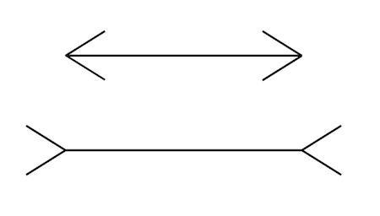
▸ Not all illusions are visual
Notes:
This diagram illustrates the "conflict" between beliefs and impressions. Even when we know that both lines have same length, we still continue experiencing/perceiving them as being of different length
This is contrived in this specific case, but note that there are illusions of thought: cognitive illusions

Slide 8
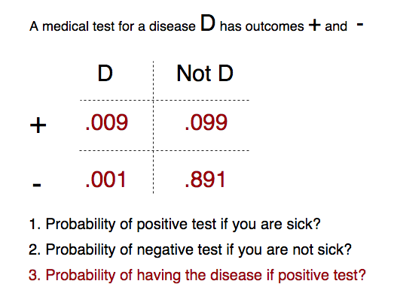
▸ Do you have the disease?
Credits & references
All of Statistics, A concise Course in Statistical Inference, Larry Wasserman, Springer
Notes:
Answer to question 1 is: .9
Answer to question 2 is: .9
Answer to question 3 is: .08
Most people would answer .90 to question 3. Don't trust your intuition!
If answers are unclear, don't panic we will review it in the next section

Slide 9
▸ Probability versus Statistics
Notes:
In Statistics, for any particular problem, there may be several reasonable methods, yielding different answers.

Slide 10
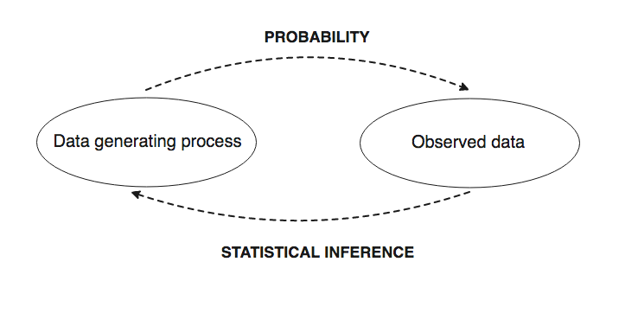
▸ Data generating process and observed data
Notes:
In Probability, the data generating process is fully specified (for instance Binomial, Bernouilli, ... random variables with well defined probability distribution)
In Statistics, based on data, we try to infer some properties of the unknown underlying data generating process

Slide 11
▸ Quiz 1
You need a PhD in Mathematics and/or Applied Statistics to do Data Science and Machine Learning
The field of Statistics mixes Domain Knowledge, Mathematical Theories and Computational approaches
Statistical reasoning is simply common sense and intuitive
In Statistical Inference, we are trying to infer properties of a data generating process
Notes:
Check the right answer(s)

Slide 12
II. PROBABILITY

Slide 13
▸ Why should you not ignore Probability Theory?
Probability is a mathematical language for quantifying uncertainty
Once problem framed, we know what kind of statement can or cannot be done
There are excellent, accessible resources to learn it
Credits & references
Probabilitic Systems Analysis and Applied Probability 6.041, MIT OpenCourseWare
Notes:
Probability theories provides the mathematical framework for statistical inference
Is pervasive not only in data science but in all aspects of life
Will use a radar detection example to illustrate how probility theory helps making statement about uncertainty in a typical use case

Slide 14
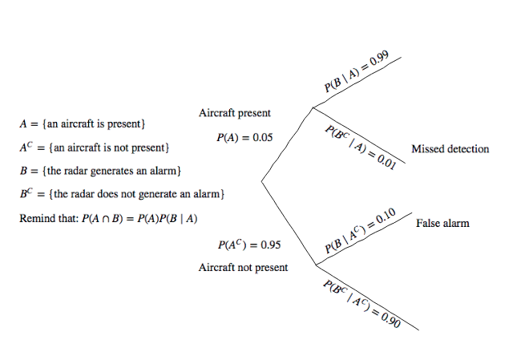
▸ Radar Detection tree-based sequential description
Credits & references
Probabilitic Systems Analysis and Applied Probability 6.041, MIT OpenCourseWare
Notes:
Using the reminder on conditional probability and multiplication rule, try to find the solution on your own (not more than 5 min)

Slide 15
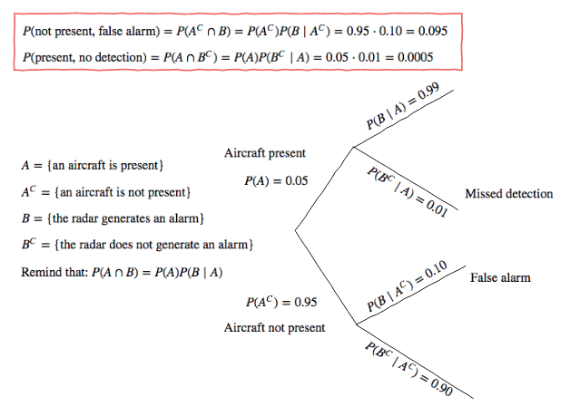
▸ Radar Detection Solution
Credits & references
Probabilitic Systems Analysis and Applied Probability 6.041, MIT OpenCourseWare
Notes:
If notation, concepts, results do not make any sense to you, please watch the 2 first videos of MIT course mentioned as reference.

Slide 16
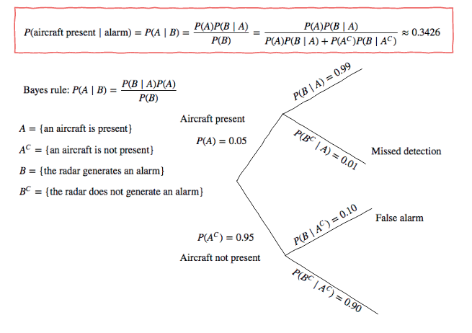
▸ Radar Detection reversed statement with Bayes Rule
Credits & references
Probabilitic Systems Analysis and Applied Probability 6.041, MIT OpenCourseWare
Notes:
To find the denominator P(B), apply the total probability theorem (i.e the expanded form showed above)

Slide 17
▸ Is this challenging?
Getting the right answer is not a prerequisite for the course
However, if this not clear to you and you are curious to learn
Run and watch MIT OpenCourseWare on Probabilistic Systems (see refs)
Credits & references
Probabilitic Systems Analysis and Applied Probability 6.041, MIT OpenCourseWare
Notes:
MIT OpenCourseWare course on Probabilities is more or less 20-30 hours of lectures and really worth watching and studying it. You will discover Markow Chains models used in Queuing Theory extensively use in telecommunications systems for instance, the fundamental of Bayesian Statistics, Central Limit Theorems, ...

Slide 18
▸ Idealized data generating processes
Assume that you get a fair coin
Experiment: Tossing a coin 5 times (as many time as you want)
Count the number of Heads at every iteration: this is a Random Variable
Draw the proportions of time you get 1, 2,.. ,5 heads: this is a Probability Distribution
Notes:
You need as well to define a Sample Space which is in our example {HHHHH, HTTHH, ...} all possible sequences of Heads and Tails
A Random Variable is a function (the name variable is a bit misleading)
In our case this is a Discrete Random Variable and the Proability Distribution is a Probability Mass Function of a Binomial Random Variable, the famous bell-shaped distribution

Slide 19
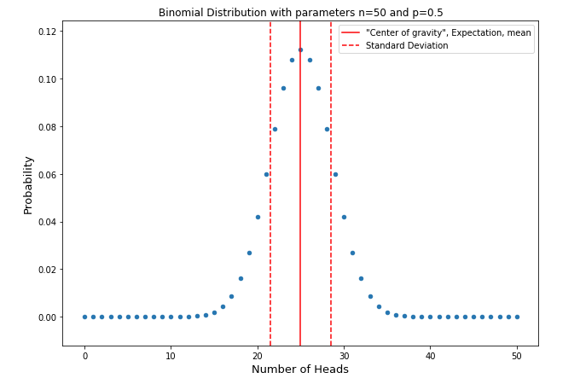
▸ The Binomial Distribution
Notes:
Coss a toin 50 times and count the number of heads. Repeat the experiment an infinite number of times, draw the frequency; the proportion of times you got 1 head, 2 heads, ... out of you infinite times and you will get the Binomial distribution
All distributions are parameterized, for instance this one have n: the number of toss coins and p the probability of having Head for a single toss (fair in our example)

Slide 20
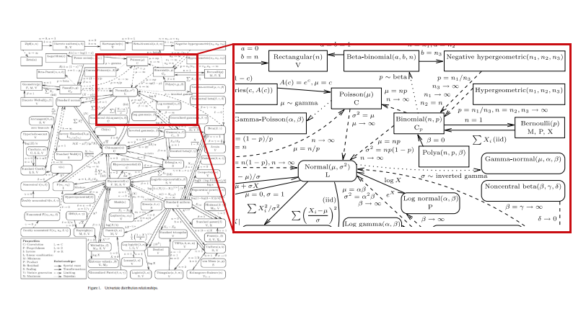
▸ Distributions for everyone tastes!
Credits & references
Univariate Distribution Relationships, Lawrence M. LEEMIS and Jacquelyn T. MCQUESTON, http://www.math.wm.edu/~leemis/2008amstat.pdf
Notes:
All these distributions help building the Mathematical edifice of Probability theory and formulate useful models of phenomenon. For instance, noise as Uniform or Gaussian distribution, ...

Slide 21
▸ Quiz 2
Tree-based sequential descriptions are convenient when reasoning on problem involving conditional probabilities
The multiplication and Bayes rules can be ignored, just follow your intuition
The probability of having x Heads when tossing a (fair/unfair) coin n times can be found using the Binomial Distribution (Probability Mass Function - pmf)
Notes:
Check the right answer(s)

Slide 22
III. SIMULATIONS

Slide 23
▸ Harnessing computing power
Would it be profitable to bet that within 24 rolls of a pair of dice, he would roll a double six?
Pascal and Fermat, mid-17th century resolved the issue: there is 49% chance
BUT given Data Generating Process is well-defined a computer can simulate data
Statisticians knows what happens as we gather more and more data ...
Credits & references
Introduction to Computation and Programming Using Python, The MIT Press
Notes:
We are assuming that each die is fair! We have a fully-specified probabilistic model (Each rolling 1, ..., 6 is equal 1/6 - Uniform)
On the first roll the probability of rolling a six on each die is 1/6, so the probability of rolling a six with both dice is 1/36
Therefore the probability of not rolling a double six on the first roll is 1 - 1/36 = 35/36
Therefore the probability of not rolling a double six twenty-four consecutive times is (35/36)^24, nearly 0.51. Hence the probability of rolling at least a double six is 1 - 0.51 = 0.49

Slide 24
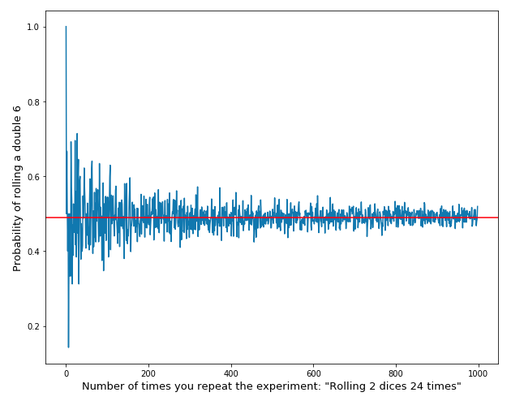
▸ So let's roll dice 24 times but a thousand times ...
Credits & references
Introduction to Computation and Programming Using Python, The MIT Press
https://en.wikipedia.org/wiki/Monte_Carlo_method
Notes:
Simply doing the experiment once or twice is not really informative and conclusion you can draw are very uncertain. But when accumulating data (repeating the experiment again and again), it converges to the value calculated by Pascal and Fermat
Obviously, in that simple case this is heavy machinery for such a simple problem, with closed forms solution, ... But there are many situations where there is no such closed forms and simulation of that kind are extremely handy.
Furthermore, simulation (you will see the Bootrapping technique later on in that course) is fundamental in Statistical Inference, Machine Learning (Random Forest, cross-validation, ...) in general

Slide 25
▸ Pascal's problem simulation with Python [Notebook Live Demo]
Simulate a single roll die
Simulate the experiment: a sequence of 24 successive roll of pair dice
Run and plot the experiment 1000 times
Credits & references
Introduction to Computation and Programming Using Python, The MIT Press
Notes:
[Teacher] Dedicate 5 min to the code snippet below showing and executing code live
[Student] Be sure to run and understand the following code snippets before answering module's assignment

Slide 26
▸ Quiz 3
Simulation helps finding solutions to problems with mathematically intractable problems
Simulation techniques are key to Data Science today
Simulation requires a lot of computing power
Notes:
Check the right answer(s)

Slide 27
IV. THE LAWS OF DATA ACCUMULATION

Slide 28
▸ But in Statistics we only have data
When you get data, what is the data generating process?
If you have not collected it yourself, are you sure your data "reflects" the underlying true distribution?
How do you infer some properties of the true distribution such as mean, ...?
Notes:
Answering these questions is the whole purpose of Statistical inference

Slide 29
▸ Statistical theory three basic questions
How should I collect my data (sample)?
How should I analyze and summarize the data that I've collected?
How accurate are my data summaries?
Credits & references
An Introduction to the Bootstrap, Efron & Tibshirani, Chapman & Hall/CRC
Notes:
In Statistics, we often want to gain knowledge about a properties of a population (height and width of the whole world's population)
You can't affort to conduct a census on whole population of interest most of the time, which is why we have to take a sample

Slide 30
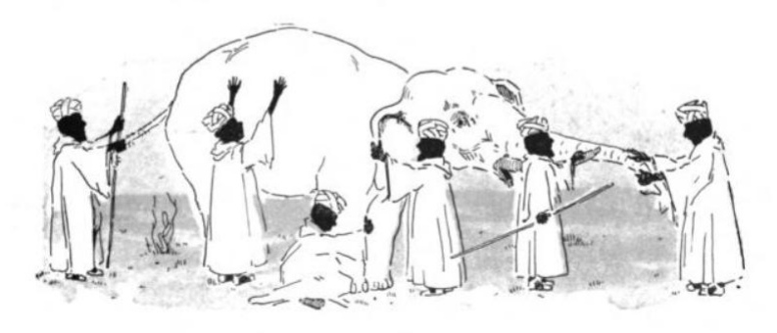
▸ Data collection and sampling bias
Credits & references
From Charles Maurice Stebbins & Mary H. Coolidge, Golden Treasury Readers: Primer, American Book Co. (New York), p. 89. Public Domain.
https://en.wikipedia.org/wiki/Blind_men_and_an_elephant
https://en.wikipedia.org/wiki/Sampling_bias
Notes:
The sample should be collected in a way that all the information contained in the population should be contained/"reflected" in the sample. They are specific methodologies for doing so among other random sampling
If you want to get an estimate of the average height around the world, collecting sample only in Germany or India will not reflect the reality obviously
But if I just get a random sample, how many data should I collect to get an estimate of the property of interest (let's say the mean), how accurate is it?
Probability theory has interesting things to say about the subject.

Slide 31
▸ The Weak Law of Large Numbers (WLLN)
When size of your random sample increase, its mean tends to the true mean
The true mean being the mean of the property of interest of the entire population
The mean of your random sample is called an estimator yielding an estimate
Credits & references
Probabilitic Systems Analysis and Applied Probability 6.041, MIT OpenCourseWare
Notes:
This is obviously not a mathematical statement. This is loosely speaking, just trying to convey the gist of it
In that particular case, the estimator is said to be unbiased
There is a Strong Law of Large Numbers with a subtle difference but the general idea is the same. The more data you get, the more accurate will be your estimate ...

Slide 32
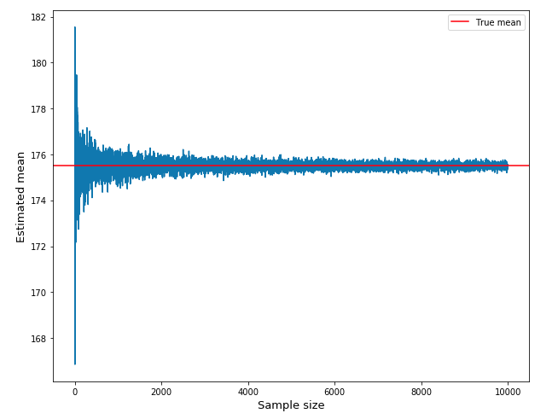
▸ The Weak Law of Large Numbers in action
Notes:
In this example, using Numpy we are simulating random samples drawn from a Normal Distribution (the continuous version of the Binomial distribution) with known parameters mean: 175.5 and standard deviation: 10 (let's say to make it even more concrete that the data collected is the height of a random sample from world's population
The visualization is compelling showing strong oscillations around the true mean when few samples and then converging to the true mean when accumulating more data
Probability Theory does not need this kind of "pictorial proof", assuming an underlying probability model, assuming that samples are drawn from the same distribution and independent, considering the random sample as a sequence of Random Variable is "enough" to prove interesting theorems
At this stage we know that it converges but we are unable to provide clear statement about the accuracy

Slide 33
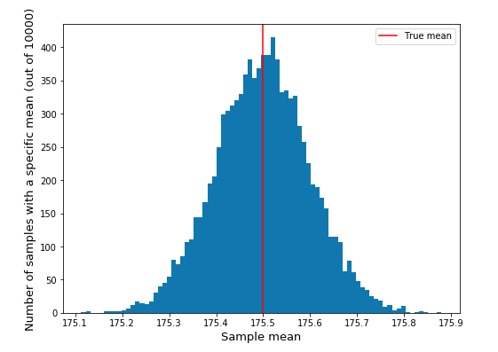
▸ What if we could draw as many samples as we wanted?
Credits & references
Probabilitic Systems Analysis and Applied Probability 6.041, MIT OpenCourseWare
Notes:
Above, we've drawn 10,000 times a sample of size 100 from a normal distribution and plotted the mean of each of them
What do you observe?
This is a Normal/bell-shaped distribution allowing us to make clear probability statements about the probability of being between a certain interval
This is what's revealed by the Central Limit Theorem

Slide 34
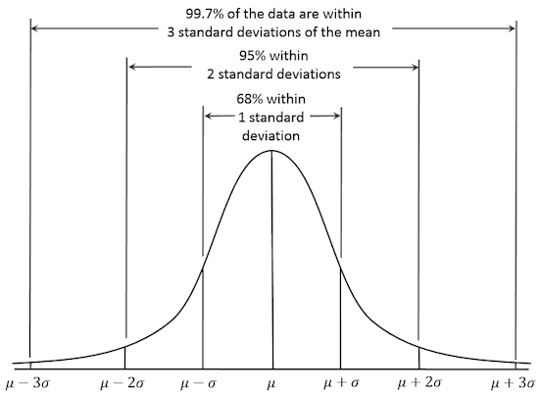
▸ Normal distribution
Credits & references
https://en.wikipedia.org/wiki/Normal_distribution

Slide 35
▸ The Central Limit Theorem (CLT)
Interpret a Confidence Interval: "Were this procedure to be repeated on numerous samples, the fraction of calculated confidence intervals (which would differ for each sample) that encompass the true population parameter would tend toward 90%"
Credits & references
https://en.wikipedia.org/wiki/Confidence_interval
Notes:
The Notebook Live Demo will demonstrates how to compute a Confidence Interval
In particular, a Confidence Interval is not a statement about the probability of the mean of the population to be in it (the true mean is not random)

Slide 36
▸ The laws of data accumulation [Notebook Live Demo]
Simulating, illustrating the WLLN
Simulating, illustrating the CLT
Calculating Confidence Intervals
Notes:
[Teacher] Dedicate 15-30 min to the code snippet below showing and executing code live
[Student] Be sure to run and understand the following code snippets before answering module's assignment

Slide 37
▸ Quiz 4
To infer properties of a unknown data generating process, there is no formalized way to collect data
The true mean is the mean of your data
A Confidence Interval tells you for instance what's the probability that the true mean is equal to the data sample mean
Notes:
Check the right answer(s)

Slide 38
IV. BOOTSTRAP

Slide 39
▸ The limit of the Limit Theorem
There are closed formulas to calculate the accuracy of a sample mean
For correlation coefficients, ..
But what if you want to calculate the accuracy of more sophisticated beast
Notes:
For instance the accuracy of eigen values of a covariance matrix, regression standard errors, ...

Slide 40
▸ Quote from Bootstrap's authors
"Bootstrap is a computer-based method of statistical inference that can answer many real statistical questions without formulas"
Credits & references
Introduction to Bootstrap, Efron & Tibshirani, Chapman & Hall/CRC
Notes:
This is in line with Stan Ulman's quote of "Simulation" section

Slide 41
▸ Bootstrap in a nutshell
The only thing at your disposal is a single random sample so
Resample it with replacement: a bootstrap sample
Take the summary statistics of interest on each bootsrap sample
Compute CI based on empirical distribution
Credits & references
Introduction to Bootstrap, Efron & Tibshirani, Chapman & Hall/CRC
Notes:
There are theoretical justification authorizing the procedures

Slide 42
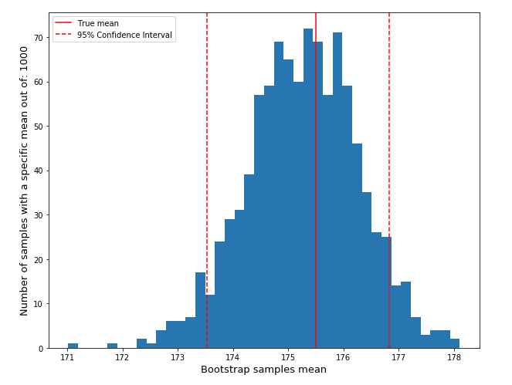
▸ Bootstrap in action
Notes:
We resampled with replacement 1000 times a random sample of size 100
Took the mean of each bootrap sample/replicate
Computed the Confidence Interval using the percentile method
A 90% percentile is the mean value higher than 90% of al means calculated

Slide 43
▸ Bootstrap in action [Notebook Live Demo]
Resampling with replacement a random sample
Plotting bootstrap sample/replicates means
Computing CI using the percentiles method
Notes:
[Teacher] Dedicate 5-10 min to the code snippet below showing and executing code live
[Student] Be sure to run and understand the following code snippets before answering module's assignment

Slide 44
▸ Versatile and pervasive
Simulation and resampling techniques are extremely flexible
You will find them in many domains and in particular in Machine Learning
For instance, to make weak learners strong (case of Random Forest algorithm)
Evaluating modelds using cross-validation techniques
...

Slide 45
▸ Quiz 5
The Bootstrap technique has revolutionized the field of statistics
The Bootstrap technique is used today in state-of-the-art Machine Learning technique and AI in general
A Bootstrap replicate is resampling data without replacement
Notes:
Check the right answer(s)

Slide 46
VI. IS THERE A SIGNIFICANT DIFFERENCE?

Slide 47
▸ The quest for causality goes on ...
“Correlation does not imply causation" statement is disappointing, isn't it?
Main issue is the potential existence of confounding/lurking variables
As a safeguard, try to control the conditions under which changes occurs
The whole purpose of DOE (Design Of Experiment)
Credits & references
https://en.wikipedia.org/wiki/Confounding
https://en.wikipedia.org/wiki/The_Design_of_Experiments
https://www.quora.com/What-is-a-control-treatment-in-an-experiment
Notes:
The issue of confounding/lurking variable: for example, if you are researching whether a lack of exercise has an effect on weight gain, the lack of exercise is the independent variable and weight gain is the dependent variable. A confounding variable would be any other influence that has an effect on weight gain. Amount of food consumption is a confounding variable, a placebo is a confounding variable, or weather could be a confounding variable.
R. A. Fisher wrote in 1935 a foundational book "The Design of experiments"
R. A. Fisher is one of the most influential statisticians in the 20th the century. He has been described as "a genius who almost single-handedly created the foundations for modern statistical science"

Slide 48
▸ The design of experiment in a nutshell
When you do an experiment, you do something to something - the treatment
The control is an identical something to which you did nothing
Then you compare the outcomes, to see what change was effected

Slide 49
▸ Be skeptical: the Null Hypothesis
Given the outcome of an experiment with control/treatment groups
Start by assuming there is no change: the null hypothesis - H0
A null hypothesis is rejected if the observed data are significantly unlikely to have occurred if the null hypothesis were true
Notes:
This is a fairly abstract description and an example will clarify it for ever
A null hypothesis is a kind of intentional conservative or skeptical standpoint where you essentially say "you think there is a significant change? Prove me that this change is not simply due to chance!"

Slide 50
▸ The mouse data experiment
Sixteen mice were randomly assigned to a treatment or a control group
The treatment was intended to prolong survival after a test surgery
Data shows the survival time following surgery, in days for all 16 mice
Credits & references
Introduction to Bootstrap, Efron & Tibshirani, Chapman & Hall/CRC
Notes:
What's the relationship with IoT?
Answer 1: None a priori
Answer 2: this setup is rather canonical and can be seen as a template. It is characteristic of a typical experimental setup and easy to transpose to many other ones.
Exercise: "your" IoT network nodes logs show a number of defaults over a specific duration and you want to design an experiment in order to assess if a particular firmware upgrade would have an effect on this default rate. How would you proceed?
Note here how small is sample size. This is the beauty and art of statistics to determine what is possible to say or not given the data and a problem at stake.
VERY IMPORTANT: indeed, in the context of IoT, you will have access to "huge" amount of data, this is not a sufficient reason to not assess carefully the relevance of effects and variation observed.

Slide 51
▸ The mouse data problem
Treatment data: 94, 197, 16, 38, 99, 141, 23 with mean = 86.86
Control data: 52, 104, 146, 10, 51, 30, 40, 27, 46 with mean = 56.22
Is observed difference of means 30.63 due to chance or treatment?
Credits & references
Introduction to Bootstrap, Efron & Tibshirani, Chapman & Hall/CRC

Slide 52
▸ Simulating the null hypothesis with bootstrap
Put all data together (n treatment samples and m control ones)
Draw with replacement n+m samples: a Bootstrap B replicate
Compute difference of means between first n and last m samples from B
Repeat last previous step 1000, .... times
Compute proportion of difference >= observed mean
Credits & references
Introduction to Bootstrap, Efron & Tibshirani, Chapman & Hall/CRC

Slide 53
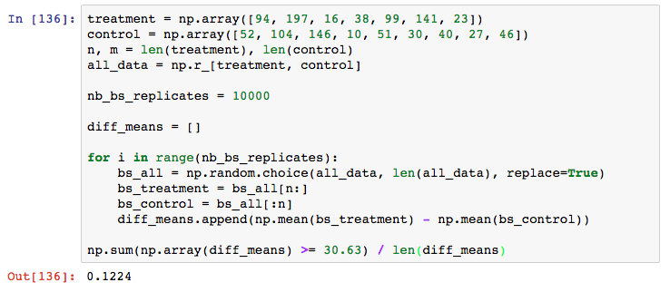
▸ Hypothesis testing with Boostrap in Python
Credits & references
Introduction to Bootstrap, Efron & Tibshirani, Chapman & Hall/CRC
Notes:
About 12% of difference of means of bootstrap replicates exceed the observed difference of means

Slide 54
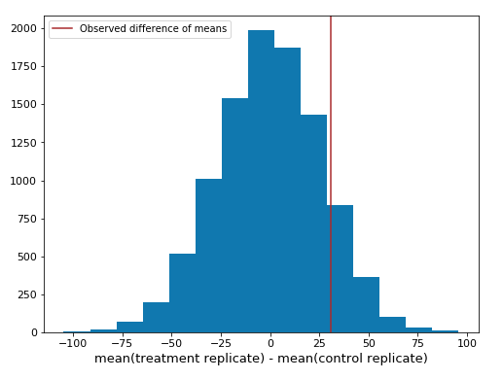
▸ Visualizing Bootstrap replicates
Credits & references
Introduction to Bootstrap, Efron & Tibshirani, Chapman & Hall/CRC

Slide 55
▸ Achieved Significance Level (ASL)
So is our observed mean significant and indicates treatment effectiveness?
Under the Null Hypothesis (simulated with Bootstrap) 12% above the observed means
Again, 12% were above due to chance, what's your intuition?
Credits & references
Introduction to Bootstrap, Efron & Tibshirani, Chapman & Hall/CRC

Slide 56
▸ ASL rule of thumb
ASL < .10: borderline evidence against H0
ASL < .05: reasonably strong evidence against H0
ASL < .025: strong evidence against H0
ASL < .01: very strong evidence against H0
Credits & references
Introduction to Bootstrap, Efron & Tibshirani, Chapman & Hall/CRC
Notes:
Hence in our example 0.12 does not allow to reject H0 and does not allow to state that the treatment is efficient

Slide 57
▸ Quiz 6
A Null hypothesis is a general statement or default position that there is no relationship between two measured phenomena
Hypothesis testing is not relevant anymore in the Big Data era
Implementing Bootstrap Hypothesis Testing from scratch in Python is demanding and challenging
Achieved Significance Level (ASL) and p-values are related concepts
Notes:
Check the right answer(s)

