Slide 1
MACHINE LEARNING PART I

Slide 2
I. INTRODUCTION

Slide 3
▸ Main objectives
To understand and adopt the "Machine Learning mindset"
To introduce main Machine Learning framework and concepts
To be able to understand and set up a typical Machine Learning pipeline
To know how to apply it in the context of IoT
To develop autonomy and lay the foundations for further learning
Credits & references
Aurélien Géron, Hands-On Machine Learning with Scikit-Learn & TensorFlow
https://github.com/ageron/handson-ml](https://github.com/ageron/handson-ml
https://github.com/PacktPublishing/Python-Machine-Learning-Second-Edition
Andrew NG's Machine Learning very famous course on Coursera: https://www.coursera.org/learn/machine-learning
Notes:
Warning: to develop a high level expertise in ML would require hundreds of hours of study and practice dealing and struggling with real datasets, our goal here is to get you started, to help you entering the field, to provide pointers for further learning, and finally to highlight the key role that ML can play in the context of IoT value chain
Nowadays, this is of the paramount importance to develop key skills allowing to harness the wealth of information available online: online courses (MOOC), Github repositories with thousands of example, ...

Slide 4
▸ Prerequisites
Fundamentals of Python Data Science, data cleaning, preparation, EDA
A basic understanding of Linear Algebra, Statistics and Calculus
Good knowledge of Linear Algebra, Convex Optimization and Statistics [only if your objective is to be able to read ML scientific papers]
Notes:
Most of Machine Learning concepts can be understood intuitively. There are some profound mathematics ideas in ML but there are as well trivial ideas behind cluttered notations.

Slide 5
II. LINEAR REGRESSION FROM MACHINE LEARNING MINDSET
Notes:
This definition looks cryptic at first glance. We will revisit it several time trying to make it crystal clear. But let's dive first into one of the simplest learning algorithm: "Linear Regression"
Linear Regression is a very basic algo. but will help defining important Machine Learning Terminology and set the scene: model capacity, features, target, hypothesis space, cost/loss function, ...

Slide 6
▸ Explanatory versus predictive goals
In many disciplines, there is a near-exclusive use of statistical modeling for causal explanation;
With the assumption that models with high explanatory power are inherently of high predictive power;
In Machine and Deep Learning focus is given instead in predictive power based on monitored chosen evaluation metrics.
Credits & references
[https://www.stat.berkeley.edu/~aldous/157/Papers/shmueli.pdf](https://www.stat.berkeley.edu/~aldous/157/Papers/shmueli.pdf)
Notes:
Linear Regression model is an insightful example reflecting the difference of approaches.

Slide 7
▸ The Linear Regression Task
The computer program is asked to predict a numerical value given some input
The predicted numerical value(s) is called: Target(s)
The input(s) are called: Input feature(s)
Each measurement is called an Instance.
Notes:
To predict the energy consumption of a system given a set of sensors measurements

Slide 8
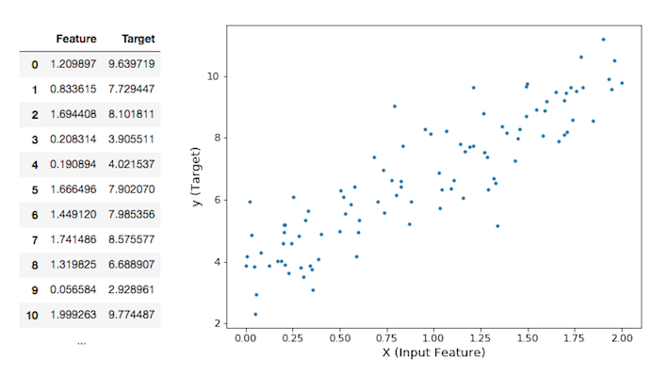
▸ Predict Target(s) from Feature(s)
Notes:
Given the input feature, what prediction strategy should your program adopt?
The program is asked to ouptut a mapping from X to y, don't you think? Should the mapping be linear, polynomial, ...
The task is to output a model so that given a particular input, we want to predict an output

Slide 9
▸ Hypothesis space and Model capacity
Model's capacity is its ability to fit a wide variety of functions.
To control the capacity of a learning algorithm, the computer program is constrained to use a particular class of function only
In the case of a Linear Regression, the hypothesis space is the set of all linear functions: Target = a x Feature + b
Credits & references
Goodfellow, I., Bengio, Y. and Courville, A., Deep Learning, The MIT Press
Notes:
If we want to increase the model's capacity, we can include all polynomial functions in our hypothesis space. We will do that a bit later.

Slide 10
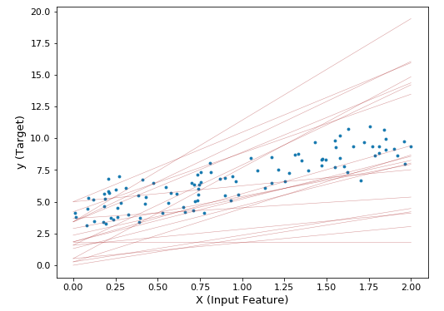
▸ Finding the "best" line
Notes:
What is a best line?
Though constrained (only linear equations), the hypothesis space offers infinite possibilities
We know what is the Task, let's see what Performance means

Slide 11
▸ The Linear Regression Performance
The best line is the one that minimizes the Root Mean Square Error (RMSE)
Then, we need to find the slope and the intercept of the line that will minimze this RMSE
There are different approaches/interpretations leading to the same optimal solutions
the RMSE or MSE is name the Cost function
Notes:
RMSE is a measure of the differences between values predicted by the model and the observed one (the provided data)
In practice, it is simpler to minimize the Mean Saure Error (MSE) than the RMSE and it leads to the same optimal solution
Using the RMSE or MSE as a cost function seems somewhat arbitrary, but there is a beautiful justification interpretation the optimization task as Maximum Likelihood Estimation problem

Slide 12
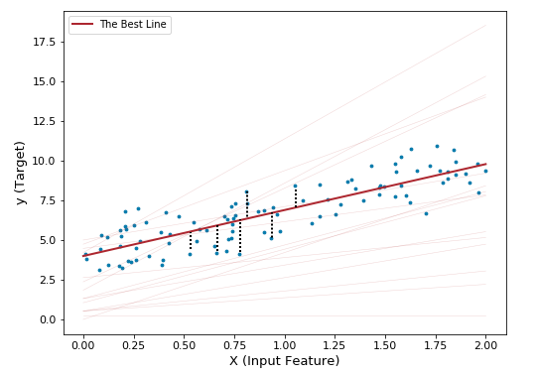
▸ The Best line with residuals
Notes:
The dotted black line are the errors between the predicted and observed value named residuals
Take the square of each residual, add them, then take the square root of the sum and you get RMSE
You might have learned that features value should be Normally distributed. This is the case only if you want to make some probabilistic statements like for instance Confidence Interval of parameters (intercept and slope) estimated. This is not our aim here, the quality of our estimation will be evaluated again its predictive power (see later on°

Slide 13
▸ How does the computer program "learn" the best line?
A closed-form solution: The Normal Equation (Linear Algebra)
A very generic optimization algorithm capable of finding optimal solutions to a wide range of problems: Gradient Descent (Calculus)
Which one to use? The task at hand and computational complexity of each algorithm will tell ...
Notes:
The Normal Equation requires to invert a matrice. Machine Learning often deals with huge datasets with hundred thousands of features and millions of samples/instance. In such a situation, Normal Equation solving approach does not scale well.
Gradient Descent and its variants (Stochastic, Batch, mini-Batch) are very generic and scales well. This is a corner stone in many ML algorithms and in particular in Deep Learning.

Slide 14
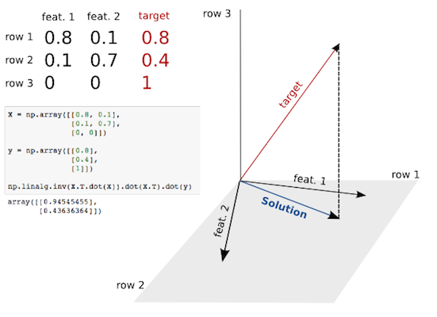
▸ Normal Equation geometrical interpretation
Notes:
We are in the scenario where we have two input features and 3 measurements. If we interpret each measurement as a new dimension, each feature can be interpreted as a vector in a 3D space. The goal here is to find the combination of the two input features vector leading to the target vector. Unfortunately, the target vector is not in plane spanned by the input features. The whole purpose of the Least Square and its solution via the Normal Equation is to find the the closest combination of feature 1 and feature 2 vectors. This is the orthogonal projection of the target vector into the spanned plane. That's all! Here the solution outputs the parameters (a, b) of a x feature_1 + b x feature_2

Slide 15
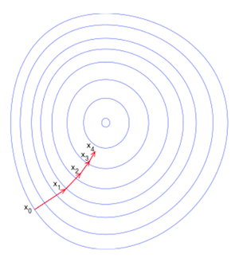
▸ Gradient Descent intuition
Credits & references
https://en.wikipedia.org/wiki/Gradient_descent
Notes:
The MSE cost function is convex ("bowl-shaped")
First take random intercept and slope, look around, find the direction of steepest slope
Take a step into that direction (update the slope and intercept accordingly)
Repeat the process till you reach the bottom of the bowl
Feature scaling is important (the concept will be revisited at several occasions). The range of values of the features should be similar. If not, you might end up with an "elongated" bowl shape and convergence to the minimum might be longer (oscillating between one side and the other)

Slide 16
▸ Gradient Descent variety of flavours
Batch Gradient Descent: consider all instances at once (the full landscape) and find the steepest slope, the Gradient
Stochastic Gradient Descent: at the opposite extreme, consider a single instance and find the steepest slope
Mini-batch Gradient Descent: the right balance between the two previous
Notes:
When dealing with a dataset with millions of instances computing the gradients at every step is very slow. Computing the gradient at each step with both the Stochastic and Mini-batch is much faster.
In return, the descent is far less regular. Imagine yourself, racing down a mountain with a flashlight. Do you think that your way down would be optimal?

Slide 17
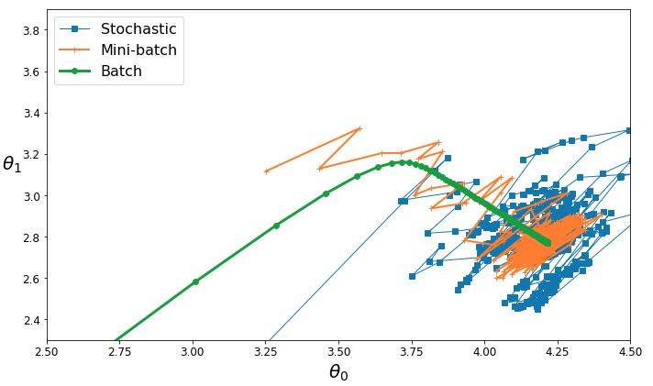
▸ Stochastic, batch and mini-batch
Credits & references
https://github.com/ageron/handson-ml
Notes:
Remember that the initial intercept and slope (here Theta 0 and Theta 1) are chosen randomly
The Maths behind Gradient Descent is pretty simple: just taking partial derivatives
Optimization techniques allow to smooth the stochastic and mini-batch versions (this is a central aspect of Neural Net learning and Deep Learning)

Slide 18
▸ Mitchell's definition in our context
Task: to predict a numerical value given some input
Performance: the Cost function
Experience: the algorithm experience a dataset containing features with associated target (label)
Improves with Experience: SGD iteratively improves the performance with experience.
Notes:
"A computer program is said to learn from experience E with respect to some class of tasks T and performance measure P, if its performance at tasks in T, as measured by P, improves with Experience E"
SGD: Stochastic Gradient Descent

Slide 19
▸ Quiz 1
What is a feature?
How does a computer program learn?
What is a model capacity?
How does Gradient Descent work?

Slide 20
II. POLYNOMIAL REGRESSION AND MODEL CAPACITY
Notes:
What if your data is more complex than a simple line?

Slide 21
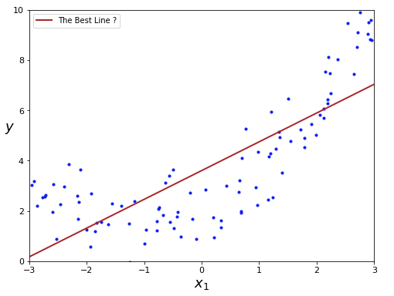
▸ The best line?
Notes:
It is indeed the best line
But do you think that the best model? What about its capacity?
Looks like there is a polynomial trend (quadratic).
But let's increase model capacity by trying a polynomial of degree 2 and 300 (our new class of hypothesis function)!

Slide 22
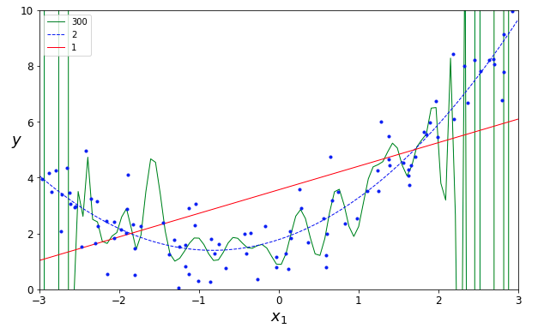
▸ Fiddling with model capacity
Notes:
In our previous case the representational capacity of our class of hypothesis functions (linear) was pretty limited.
Here, in addition to the parameters of the polynomials themselves, we have the ability to choose their degrees. The representational capacity is much bigger.

Slide 23
▸ Generalization error
So far we have only considered training dataset (data we used to train our model)
But the ultimate purpose of Machine Learning is to find a model making accurate predictions with never-seen data
In the previous example, the polynomial of degree 300 is fitting the noise as well: this is called overfitting, it will generalize poorly
By contrast, the linear regression does not allow to reflect a clear polynomial trend, this is called underfitting
Notes:
The whole Machine Learning art is to find the representation/model achieving expected results into the wild
The rest of this course (including) deals with finding the right level of representation.
In the extreme case, algorithms could remember (store) each input and associated label data in a Supervised setup. It would exhibits poor generalization performance with new unseen data points.

Slide 24
▸ Diagnose overfitting and underfitting?
Split your dataset into a training and validation sets
Train and validate your model on successive training set size
and analyse the Learning curve
Notes:
This is one way to diagnoze but not the only one (see later)
There are various cross validation techniques (covered later in the course)

Slide 25
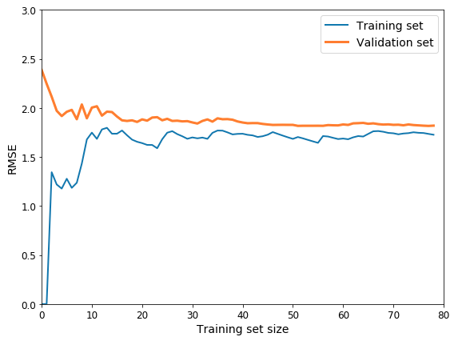
▸ Diagnosing underfitting
Notes:
The model is a Linear Regression.
On the training data, when trained on 1, 2 instances, the model fits them perfectly. But when new instances are added, the RMSE (the validation metric) reaches a plateau. As the capacity of a Linear model is limited, it is simply impossible to fit the quadratic or the noise we see in the scatter plot.
On the validation data, with few instances, the model performs poorly on unseen data. When adding new instances, it reaches as well a plateau, unable to further decrease the error and finally get closer to the training set RMSE curve.
This is characteristic of an underfitting situation. In such case adding more data into the training set will not help.

Slide 26
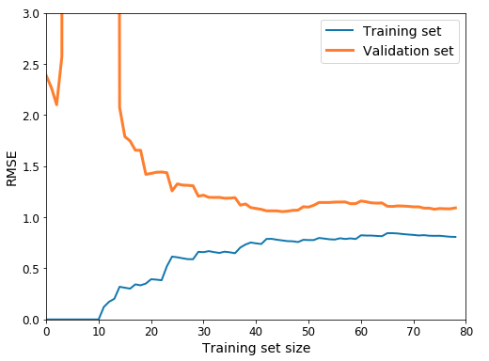
▸ Diagnosing overfitting
Notes:
The model is a Polynomial of degree 300.
The training set error is much lower.
The validation set error is soaring with few instances as expected (it fits perfectly few instances but has too much variance).
There is a gap between the two curves. It is characteristic to an overfitting situation. Using a much larger dataset would help reducing the error.

Slide 27
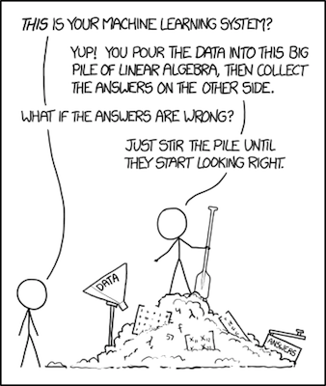
▸ That's all good but how to choose the right model capacity?
Credits & references
[https://xkcd.com/1838/](https://xkcd.com/1838/) Creative Commons Attribution-NonCommercial 2.5 License
Notes:
We mentioned already the "dichotomy" explanatory versus predictive goals in "Statistics Revisited" course.
This drawing captures, caricatures the ML practitioner mindset fiddling with parameters till he finds the model with hightest predictive power for the task at hand
At first sight the methodology might not look so subtle and scientifically-grounded, but actually there is a canonical strategy preventing you going in circles and acting haphazardly. That's the topic of the next section.

Slide 28
▸ Regularization as a "wood chisel"
Each hypothesis space is more or less prone to overfitting
When overfitting, ideally we would like a "knob" allowing to regularize it
The sequence Overfit -> Regularize with training/validation/test datasets is our "wood chisel" to find and fine-tune the proper model
Credits & references
https://en.wikipedia.org/wiki/Occam%27s_razor
Notes:
In the case of polynomial regression, tweaking the degree of the polynomial is one knob you can turn to regularize overfitting. This said, from one polynomial degree to the other, the change is fairly brutal. Ideally, we woud like to fine-tune the level of overfitting in a more subtle way

Slide 29
▸ Parameter and hyperparameters
Coefficients of a polynomial are learnable parameters (i.e slope and intercept of a linear regression)
Degrees of a polynomial are hyperparameters we might want to fiddle with in order to find the proper capacity
One type of regularization strategy is to use hyperparameters adding restrictions on the parameter values
Notes:
It sounds abstract, but in essence, in the polynomial case, hyperparameters are values we can change (a "knob") that will define the range of values that the polynomial coefficients can take.
Let's make it concrete ...

Slide 30
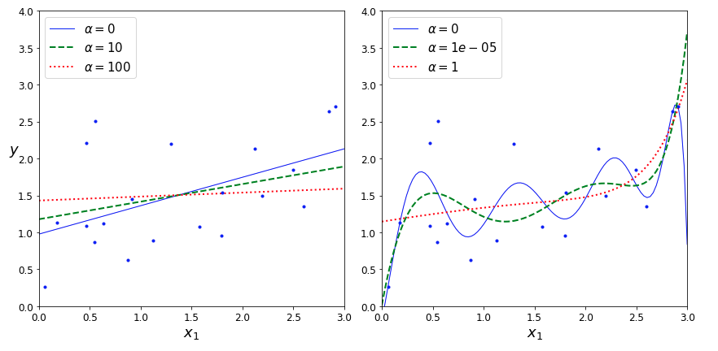
▸ Visualizing the effect of an hyperparameter
Notes:
On the left, regularization on the linear model "regressing" to the mean of the target values as we increase alpha), Why? We never regularize the bias parameter (the intercept in a linear regression), as a result when we extremely constrain the range of values that can take the slope (down to 0) we end up with the intercept. And the intercept that will minimize the cost function (RMS) is the mean
As opposed to simply jumping from one polynomial degree to the other in a "quantum way", notice how subtle can be the regularization effect!

Slide 31
▸ Ridge, Lasso, ElasticNet regularizations
Add a penalizing term to the cost function
These terms "pull" the parameters of the polynomial toward smaller values (0 to the limit)
Ridge, Lasso and Elastic Net Regressions are typical penalization/regularization techniques
Notes:
The Lasso adds the L1 norm (sum of absolute values) of polynomial parameters
The Ridge adds the L2 norm (sum of squared values) of polynomial parameters
The Elastic Net adds a mix of the two previous
The bias parameter (the intercept) is never used in the penalization term (see previous example on the regularized linear regression)

Slide 32
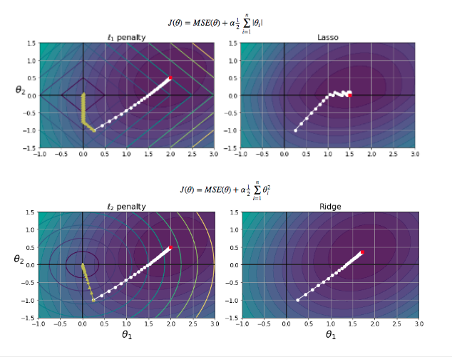
▸ Lasso or/and Ridge regularized Regression
Credits & references
https://www.jstor.org/stable/2346178?seq=1#page_scan_tab_contents
Notes:
L1 = Lasso (Least Absolute Shrinkage Operator Regression)
L2 = Ridge (also called Tikhonov regularization)
Top left: the background contour represents the unregularized MSE cost function; the series of white dot represents the path followed by Gradient Descent (batch) finding a minimum (red dot) while the series of yellow triangle shows a Gradient Descent with L1 regularization alpha infinite. The important property of L1 is that GD (Gradient Descent) path tends to follow "gutter" alon the axis (parameters of the polynomial). Hence it tends to automatically select most "relevant/informative" features - feature selection.
Top right: a Gradient Descent with sensible L1 alpha. Notice at its ends with theta2 equal 0
Bottom left: Idem, the background contour represents the unregularized MSE cost function; the series of white dot represents the path followed by Gradient Descent (batch) finding a minimum (red dot) while the series of yellow triangle shows a Gradient Descent with L2 regularization alpha infinite.
Bottom right: a Gradient Descent with sensible L2 alpha.
Elastic Net is simply the combination of L1 and L2 regularizations. Hence it has 2 hyperparameters

Slide 33
▸ Early stopping
Dropped into a bowl, a ball would inexorably ends up a the bottom of it (the minimum)
We saw that L1 or L2 pull the parameters out of the cost function global minimum.
What if instead we stop the Gradient Descent before it reaches the minimum. This is called early stopping
Notes:
Early stopping regularization technique is as well extensively used in Deep Learning as we will see later on

Slide 34
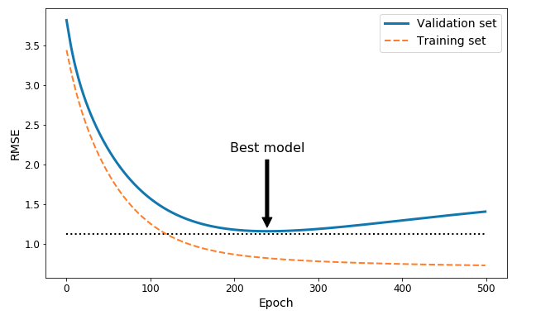
▸ Early stopping visualized
Notes:
Each time the algorithm computes the steepest descent and update the parameters accordingly is called an Epoch
Visualize the cost function (RMSE) while iterating over the epochs (as the gradient descent is progressing towards the global minimum)
Notice how the RMSE curve always decreases on the training set. You might overfit at some point but when?
In contrast, the validation RMSE cuurve decreases up to a certain number of epochs than increases again: that's where your algorithm is starting to overfit. So stop training your model and updating the parameters at this point, that's the best model.

Slide 35
▸ Quiz 2
What is a generalization error?
What's the difference between parameters and hyperparameters?
List three types of regularization technique
WHat is the "wood chisel" to find and fine-tune a model?

Slide 36
IV. CANONICAL MACHINE LEARNING PIPELINE

Slide 37
▸ A canonical pipeline as guideline
So far we've covered isolated pieces of the whole ML pipeline
Fine-tuning a model is a "fun" part but should be re-contextualized in a bigger framework
Below, a 8 steps pipeline is outlined

Slide 38
▸ Step 1. Look at the big picture
Frame/define the problem considering domain-specific knowledge
What is going to be predicted?
What type of data is available
Assemble a dataset
Notes:
Domain knowledge might be health, air quality, ...

Slide 39
▸ Step 2. Reproducible workflow setup
Identify the source
Script tasks, avoid manual manipulation and automate as much as possible
Document intermediate and final outcomes, findings, assumptions, doubts, ...
This is a pipeline so data should flow in the pipes while adding value to it
Notes:
the reproducible data science "concept" has been introduced in "data cleaning and preparation" module's topic

Slide 40
▸ Step 3. Gain insights from your data
Explorative Data Analysis (EDA) is a key to gain insights into the dataset and task at hand
Jump into a detective's shoes and ask as many questions as you can
Explore possible paths along the inquiry
Notes:
the whole process might shed light on what's or not possible, relevant features selection, features transformation, ... There is no standards. Tackling a real world dataset is a real challenge full of surprise, hurdles and ... rewards

Slide 41
▸ Step 4. Clean and prepare your data
Some Machine Learning algorithms require features scaling
Creation of dummy variables (for categorical data) and hot encoding
Feature engineering (combine, transform) to simplify the problem
Splitting the dataset into train, validation and test sets
Notes:
the data cleaning process might occur as well in parallel with the EDA step
Dummy variables, hot encoding, feature engineering will be covered and exemplified later on
Especially, the first thing you must do when getting a dataset is putting a test set aside without looking at it to prevent the "data snooping bias" (extract knowledge from the test set and putting it into your model - a test set should be unseen data
There are various ways and techniques used to split datasets (will be covered later on)

Slide 42
▸ Step 5. Choosing a measure of success
Remember Mitchell's Performance term in its definition
The learning algorithm should "know" how to measure its success, performance
Based on task at hand, there are sensible evaluation metrics defaults like MSE, RMSE, ...
But it is often relevant to create your own measure of success
Notes:
so far we have only considered linear regression tasks with continuous target variable. In this context, MSE and RMSE are sensible default evaluation metrics. In classification situations (predicting labels: yes/no, very hot/hot/warm, ...) accuracy, precision-recall, ROC curve are standards evaluation metrics (covered later on)

Slide 43
▸ Step 6. Select and train a model that does better than your baseline
A baseline is the most elementary modelling approach
In the case of a linear regression, a model whose output is always the mean of the target
In a binary classification setup, predicting binary classes randomly or predicting always the same class
Notes:
In the classification setup, let's say you have 90% of the data with label/target A and 10% of data with label/target B, a baseline model might be to always predict A. That model would have an accuracy of 90%. So your best model should have more than 90% accuracy to be conclusive
In situation where classes are imbalanced (as in previous example), there are more appropriate evaluation metrics than accuracy

Slide 44
▸ Step 7. Fine-tune your model
That's "at least", where the hyperparameters, regularization game start
There is no way to try out hyperparameters manually, there are powerful techniques such as Grid Search, Randomized Search, ... automating the whole process
Always analyze the errors in order to gain even more insights
One model is good but several of them is even better. You can combine various models using Ensemble methods
Notes:
Entire books can be/are written on those topics. Examples in the course, hands-on sessions and self-study with course book/literature references might fill the gap.

Slide 45
▸ Step 8. Launch and monitor
Deploy your model into the wild
Monitor its performance
Maintain, re-train, optimize when required
Notes:
Models tend to "rot" as data evolves over time

Slide 46
▸ Quiz 3
List the 8 ML pipeline steps
Which is the most important one?
What would be a baseline model for a linear regression task?

Slide 47
V. BUT MACHINE LEARNING IS MUCH WIDER

Slide 48
▸ Supervised/Unsupervised learning
We have only covered Supervised learning so far
In Supervised Learning, the dataset has features and targets/label/ground truth
In Unsupervised Learning, the dataset has only features
Notes:
Let's try an analogy:
You want to learn playing the piano:
In the first case, you pay a virtuoso piano player who will give you feedbacks on your attempt to mimic a musical phrase he/she played. With hours of practice, you will end up approaching the example/label/target you heard based on gradual improvement and feedbacks (the evaluation metrics). "This is" Supervised Learning
In the second case, you are given a piano, you have never heard any sort of music nor any piano player obviously and your plan is too learn playing the piano. The learning process is radically different: it might take longer (but actually longer is meaningless here as it has no point of reference) but for sure will end up most probably with a very personal style... You will find specific patterns, clusters, ... "This is Unsupervised Learning"
Following this analogy, it makes sense to approach piano learning using both the supervised an unsupervised approaches simultaneously. In Machine Learning, this is sometimes the case and the frontier between them is fuzzy at times

Slide 49
▸ Reinforcement Learning
Reinforcement Learning is a very different approach.
An agent observes an environment, select actions and receive a rewards or penalties
Then, the agent must try to find the best strategy, policy maximizing the rewards
Notes:
It has been the subject of wide-spread media attention when AlphaGo computer program won the world champion of the game of Go in 2016
So far, this is essentially an active area of research and one of the most exciting field of ML, though not really new.

Slide 50
▸ Batch versus Online learning
Batch Learning: use all dataset at once (from a data lake for instance)
Online Learning: the training takes place incrementally, sequentially when data flows into the system
In the IoT context both scenario are relevant
Notes:
Don't be confused, even in Batch learning, we can use data sequentially (as in Stochastic Gradient Descent), but the whole dataset is available in memory somewhere. Similarly, when dealing with huge datasets that cannot be fit into memory, the training process takes place on part of the data is loaded (out-of-core-training)
Online learning is particularly relevant in the context of IoT when the learning process takes place on streams of sensors data depending on the task at hand.

Slide 51
▸ Quiz 4
Give 3 examples of Supervised Learning task
Give an example of Unsupervised Learning

Slide 52
VI. QUICK OVERVIEW OF MACHINE LEARNING ALGORITHMS

Slide 53
▸ Which ML algorithm should I learn and use?
There are literaly hundreds of Machine Learning Algorithms
Understand the widely used ones: regressions, naive bayes, decision trees, support vector machine, ensemble methods, neural networks, ... and especially their respectice benefits and limitations
Kaggle competitions are a good place where to practice your skills and monitor which algorithms winning competitors use
Credits & references
https://en.wikipedia.org/wiki/Outline_of_machine_learning#Machine_learning_algorithms
https://arxiv.org/
http://arxiv-sanity.com/
https://www.kaggle.com/
Notes:
There is no way to master all of them (actually even know their existence). Research is extremely active, don't even try to cach up with sheer amount of paper uploaded every day in arXiv. The arXiv-sanity website serves as a recommendation engine for new papers and can help you keep track of new developments.
This module does not allow to cover all these fundamental algorithms given the time resources and actually has no vocation to do so. Furthermore, there are plenty of resources online, master course reference book, MOOC, where you can get extremely valuable and first-hand information
Ensemble learning (XGBoost) algorithm was till recently one of the most used and successful algorithm but is currently being superseded by Deep Neural Nets using Keras framework among others

Slide 54
▸ Really, which one should I use?
What is the quantity of data available?
What is your level of domain knowledge?
What is computing and memory budget you want to/can allocate?
How interpretable you want your model to be?
Notes:
Always start with simple models
The list is not exhaustive, what is the required level of accuracy for your use case?
Some models like decision trees are easy to interpret, others like SVMs or PCA (when doing dimensionnality reduction) are less interpretable: notion of white Vs. black box algorithms (but the distinction is always obvious)

Slide 55
VII. THE NEXT STEP

Slide 56
▸ Hands-on session
You will get a "template" ML pipeline using Scikit-learn ML package
You will be asked first to understand it then to try to re-code from scratch without the template
Then you will be asked to use your new skills on proposed tasks

Slide 57
▸ What if my target is discrete instead of continuous?
This is called classification
Then can be binary, multi-class, multi-label
The topic will be introduced and exemplified in next ML course
Notes:
Classification will be extensively covered during the courses on Deep Learning as well

Slide 58
▸ What if I don't even have a target variable?
As seen already, this is an instance of unsupervised learning
The most famous Unsupervised Learning technique K-means have been covered in the EDA course
Many other other interesting techniques:t-SNE, DBSCAN, ... (not covered in this course)

