Slide 1
MACHINE LEARNING PART II

Slide 2
I. INTRODUCTION

Slide 3
▸ Main objectives
To be able to tackle supervised classification problems
To understand three foundational Machine Learning algorithms, namely Logistic Regression, Decision Tree and SVM
To understand the Ensemble Learning approach allowing to scale up prediction power
Credits & references
Aurélien Géron, Hands-On Machine Learning with Scikit-Learn & TensorFlow
https://github.com/ageron/handson-ml](https://github.com/ageron/handson-ml
https://github.com/PacktPublishing/Python-Machine-Learning-Second-Edition
http://scikit-learn.org/stable/user_guide.html
Notes:
Logistic regression is often one of the first, most simple algorithm to deploy to get acquainted with the classification problem at hand. Furthermore, you will see in the Deep Learning course that Logistic Regression can be considered as a single neuron Neural "Network" (well a network which comprises one node)
Scikit-learn documentation (see link reference below) explains pros and cons of every algorithms implemented by the package. It is very informative, full of examples, references, ...

Slide 4
▸ The question in all our minds
Which ML algorithm should I learn and use?
Really, which one should I use?
Deep Learning > XGBOOST > RandomForest > DecisionTree > ...?
Credits & references
https://www.wired.com/2008/06/pb-theory/
Notes:
That's more or less where we left the previous course on Machine Learning. And the answers were disappointingly vague: it depends on data availability, level of domain knowledge, computing and memory budget you want to/can allocate, interpretability of the model, programming framework availability ... And in the context of IoT, all these parameters must be put in perspective with data-stream vs data-lake or centralized vs edge-computing "paradigms" influencing those choices.
At the same time, the research in Machine/Deep learning being very active, there are constantly new algorithms entering the scene with great fanfare
One important point to note is that you should systematically try and evaluate various algorithm. There are always tradeoffs to consider as mentioned in first note's item. And you might want to justify to your client, boss, yourself, ... why this one makers more sense than this one in THAT CONTEXT.
Last, current state-of-the-art approach in ML is Ensemble Learning (covered later in this course), whose approach is to use many different classifiers and combine their predictions. These classifiers can be of same type like RandomForest (with decision trees) or of many different types (SVM, Decision Trees, Logistic Regression, ...). So better not to be opinionated in terms of algorithm choice

Slide 5
▸ More Data or better Algorithms
Again, it depends of bias vs. variance (ref. previous course) or your model(s)
Feature engineering, or smarter representation might make the problem at hand much simpler
What is number of features and their relevance, ...?
Credits & references
https://www.kdnuggets.com/2015/06/machine-learning-more-data-better-algorithms.html
https://www.wired.com/2008/06/pb-theory/

Slide 6
▸ What's our approach
As an introductory course, you should not know the nuts and bolts of every most recent fancy algorithm
But having in your toolbox 3-4 widely used and versatile algorithms will definitely help you approaching and addressing real life Machine Learning challenges
Then up to you to dig further into this fascinating and highly dynamic field

Slide 7
▸ Quiz 1
The main advantage of Machine Learning algorithms is they do not rely on domain-specific knowledge
Deep learning algorithms is now the way to go, Decision tree based algos are outdated
Feature engineering can greatly simplify the learning process
You must know the Maths behind every algorithm
Notes:
Check the right answer(s)

Slide 8
II. LOGISTIC REGRESSION

Slide 9
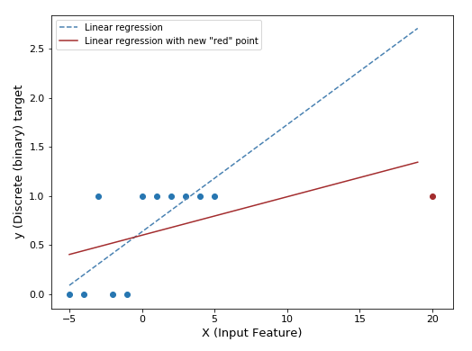
▸ Linear regression as a starting point
Credits & references
https://www.youtube.com/watch?v=nLKOQfKLUks&index=4&list=PLA89DCFA6ADACE599
Notes:
The use case is the following: you have one input feature and one target variable whose values take only 0 and 1 and you want to predict them using a Regression Linear model.
There are two issues in the naive approach followed above. First notice, how a single point (the red one in the example above) might radically change model's parameters. The model is very sensitive to outlier or even valid data instance. Second, we would like ideally to interpret the output of our model as probability to get value 0 or 1.
Hopefully, there is a straightforward way to address first issue and meet second requirement "sending" the linear regression output "through" what's called a sigmoid function that will output value bewteen 0 and 1 that we can interpret as probabilities
It looks like we are pulling this sigmoid function out of the hat but there are some theoretical justification behind it. Look at Andrew Ng's Stanford's lecture on that topic (see references)

Slide 10
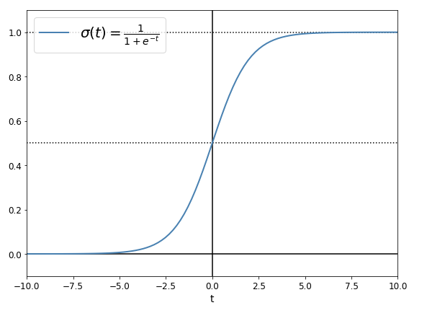
▸ Sigmoid function
Notes:
In the case of a Linear Regression, we calculated the linear combination (weighted sum) of the input feature(s)
In the case of a Logistic Regression, we add an additionnal step by "sending" Linear Regression's output "through" a Sigmoid function that will keep the predicted values between 0 and 1 (For instance 0 for "no default detected" and 1 "default detected")
Notice that when linear combination of input features is > 0 we get probabilities > 0.5 and < 0.5 when the linear combination is negative.

Slide 11
▸ Logistic Regression in practice
Not much different from Linear Regression
The predicted values are simply "re-scaled"
The cost/loss function is not RMS anymore but what's called a log loss
Like Linear Regression, Logistic Regression can be regularized
Credits & references
http://wiki.fast.ai/index.php/Log_Loss
On cumputing derivative of a sigmoid function: https://theclevermachine.wordpress.com/2014/09/08/derivation-derivatives-for-common-neural-network-activation-functions/
https://www.youtube.com/watch?v=nLKOQfKLUks&index=4&list=PLA89DCFA6ADACE599
Notes:
If your Maths are well behind you, you might consider the log loss (Logarithmic loss) expression as an advanced manipulation, but applying the chain rule is essentially what you need to yield its mathematical expression. Don't be fulled by symbols, this is really simple!
Again, you get a second chance to look at Andrew Ng's lecture on Exponential families, ... justifying the Logistic Regression! It well worth the detour and will find Logistic Regression approach less arbitrary (which is not at all actually).
You will see in later Deep Learning courses, that "beautiful" models can be built out of this "simple" Logistic Regression idea. And you will notice that it will be slightly tweaked for the sake of efficiency ... (and you won't find mathematical justification for that this time. That's the beauty of ML/DL field a mix of mathematics, engineering tricks, domain knowledge, inspiration from cognitive science, ...)
You will put Logistic Regression in action during the hands-on session

Slide 12
▸ What if more than 2 output classes
"Out-of-the-box" Logistic Regression only address binary classification problems but there are tricks
One-Vs-The-Rest or One-Vs-One
and there is generalized version of Logistic Regression called Softmax Regression
Credits & references
http://scikit-learn.org/stable/modules/multiclass.html
https://en.wikipedia.org/wiki/Multiclass_classification
About Cross-Entropy and Log Loss (please, simply don't miss it): https://www.youtube.com/watch?v=ErfnhcEV1O8
Notes:
One-Vs-The-Rest (or one-vs.-all, OvA or OvR, one-against-all, OAA): train a single classifier per class (the other ones being considered as a single class now). At prediction time, apply all predictors to the new instance and keep the class with highest probability (you do need output probabilities in that implementation to break potential tie)
One-Vs-One: let' say you have three output classes A, B, C. You train a single classifier for each pair {(A, B), (A,C), (B,C)}, then at predicition time, apply all predictors and keep the class most often predicted (majority voting)
Scikit-learn provides Softmax regression out-of-the box implementation that can be easily harnessed. The idea behind it is really not much different from Logistic regression, simply a generalization.
As regards the Log Loss, in the case of a multi-class classification problem, a cross-entropy is often used (see reference). In essence, it is simply quantifying the degree of dissimilarity of the true and predicted distributions (but watch the video, you will love it)

Slide 13
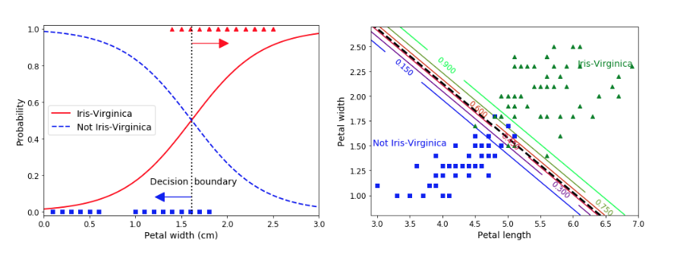
▸ Classification "Hello world": Iris Dataset
Credits & references
Aurélien Géron, Hands-On Machine Learning with Scikit-Learn & TensorFlow
https://github.com/ageron/handson-ml](https://github.com/ageron/handson-ml
http://scikit-learn.org/stable/auto_examples/datasets/plot_iris_dataset.html
Notes:
The Iris dataset consists of 3 different types of irises’ (Setosa, Versicolour, and Virginica) petal and sepal length. The target variable is the species and input features are petal and sepal length.
In our particular example, to "binarized" the problem, the "One-Vs-Rest" technique (simply merging Setosa and Virginica into non-Virginica) is used in order to have a classifier predicting the probability of being Virginica or not.
Left, we only petal width is used as predictor, right both width and height are used.
Logistic regression output can be either a binary variable indicating the predicted class 1 (Virginica) or 0 (Non-virginica) or a probability of being Virginica. In first case, by default the decision boundary" is probability 0.5. In the second case, it is up to you do decide what should be the threshold. In the example below, you notice that some Virginica are predicted Non-virginica and vice-versa. So tweaking the threshold allow to move these rates. It leads us to discuss evaluation metrics such as accuracy, Precision/Recall, ...

Slide 14
▸ Quiz 2
Logistic Regression is a "re-scaled" version of Linear Regression
The cost-loss mathematical expression can be easily found using the chain rule for computing derivatives
Logistic Regression is only applicable to binary classifications
The sigmoid function choice is completely arbitrary
Notes:
Check the right answer(s)

Slide 15
III. EVALUATION METRICS IN THE CONTEXT OF CLASSIFICATION

Slide 16
▸ Accuracy
the accuracy is the proportion of correctly predicted outputs among the total number of cases examined
But totally useless in a context of unbalanced classification problem
Notes:
Correcly predicted means both True Positive (you predicted "True" and it is actullay "True) and True Negative (you predicted "False" and it is actullay "False")
Unbalanced classification problem: let's consider a problem where you want to detect a disease with a dataset composed of 5% with a positive target (disease) and 95% (no-disease). A baseline classifier predicting systematically "no-disease" whatever the input would get a 95% accuracy
Precision/recall addresses this issue as illustrated in next slide

Slide 17
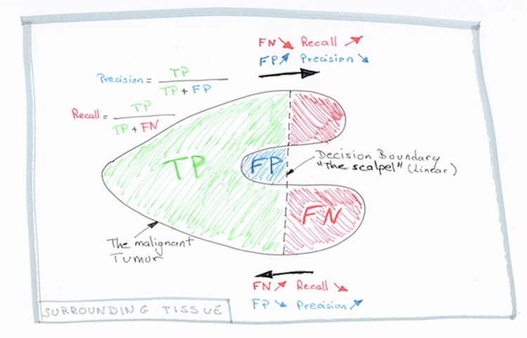
▸ Precision/Recall
Credits & references
https://en.wikipedia.org/wiki/Harmonic_mean
https://en.wikipedia.org/wiki/F1_score
Notes:
Let say you are a surgeon and that you need to remove a malignant tumor with a scalpel allowing to only cut on the vertical axis (your linear decision boundary). As said already, the tumor is malignant and ideally you would like to remove it all but at the same time removing to much surrounding tissue would have undesirable side-effect. So you want to find a compromise. That's what Precision and Recall is exactly doing.
Sometimes, we want only one metric instead of two, then in that specific case, you can use the F1-score which is simply the harmonic mean of Precision and Recall which value will be high when both Precision and Recall are high

Slide 18
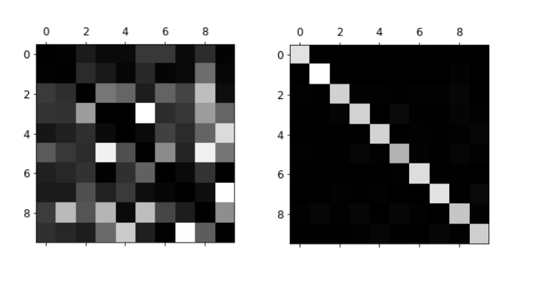
▸ Confusion matrix
Credits & references
Aurélien Géron, Hands-On Machine Learning with Scikit-Learn & TensorFlow
Notes:
The TP, FP, ... rates can be visualized in a table. In the case of a binary classification, Precision/Recall metrics will summarize it well.
In the case of a multiclass classification problem (above classifying written number images into 9 different classes), a confusion matrix is a great way to visualize at a glance the performance of your classifier.
In the best case (right image), the diagonal should be highlighted as it indicates that predicted and actual classes correpond. In the left image, there highlited cells are spread all over the matrix making it "confused"

Slide 19
▸ Quiz 3
If the accuracy of your classifier is 95%, you can compliment yourself and show off your amazing accomplishment to your boss
Precision/Recall metrics allow to assess and identidy compromises
Increasing the False Negative rate will decrease the Recall
Notes:
Check the right answer(s)

Slide 20
III. SUPPORT VECTOR MACHINES

Slide 21
▸ SVMs
Highly versatile algorithm (both classification and regression)
Able to fit linear or non linear problems
well-grounded in applied mathematics (quatradic programming)
though not so popular as it used to be, still good to have it in your toolbox
Credits & references
Professor Stephen Boyd, of the Stanford University Electrical Engineering department, Convex Optimization Course: https://www.youtube.com/watch?v=McLq1hEq3UY
Aurélien Géron, Hands-On Machine Learning with Scikit-Learn & TensorFlow
http://scikit-learn.org/stable/modules/svm.html
Notes:
Indeed, few years ago SVMs had the wind in its sails till Random Forest, till XGBoost, till Deep Neural Networks, ... (please fill in the dots). There are various reasons related to difference of interpretability of SVM vs. Decision Trees, possibility to parallelize computations, the fact that SVMs do not scale well with large number of features, Neural Networs recent revival, ... Nevertheless it is still useful to have it your toolbox and when you are dealing with datasets with large number of features, you can always use dimensionality reduction techniques: PCA, ... It is a good candidate for classification of complex but small- or medium-sized datasets
In those series of slides, we will try to convey the main ideas of SVMs. Please read carefully, the course reference book related chapter to get far far more details.

Slide 22
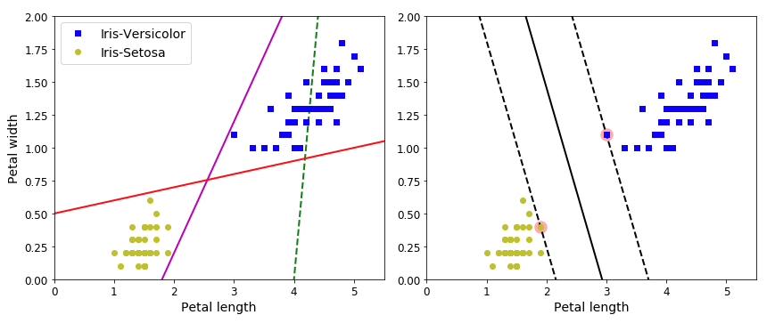
▸ Large/hard Margin Classification
Credits & references
Aurélien Géron, Hands-On Machine Learning with Scikit-Learn & TensorFlow
Notes:
We are dealing here with a binary classification problem. Using the "hello world" dataset for classification and selecting only 2 out of the 3 Iris target classes (Versicolor and Setosa), and knowing that we can find a linear decision boundary in the petal width and height space. With this information available, which linear decision boundary do we choose?
On the left plot, various candidates: two of them are "properly" classifying the target classes (with poor generalization power as they are getting very close to the classes) and a last one is completely wrong. We know that a Logistic Regression would have done the job "properly" as well using the whole dataset and minimizing its logloss.
On the right plot, to find a decision boundary, SVMs is following an other track. The objective is not only to separate the two classes but also stays as far away from the closest training instances (the support vectors circled in pink).
A. Géron, is using a very powerful image by saying that it SVMs can be thought of as "fitting the widest possible street (represented by the dashed lines)"
This is a good first but has two main drawbacks (see next slide)

Slide 23
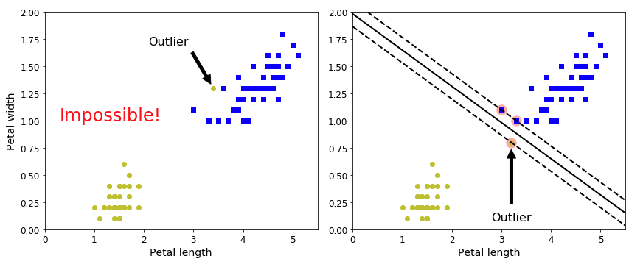
▸ Sensitivity to outliers
Credits & references
Aurélien Géron, Hands-On Machine Learning with Scikit-Learn & TensorFlow
Notes:
Left: given one single outlier, it is impossible to fit a hard margin classifier - no solution in that case assuming that the dataset is linearly separable (see the kernel trick later on for a neat solution)
Right: on single outlier will radically change the classifier which in that case will not generalize well (very small "buffer")
By relaxing some constraint, and admitting some violations, a soft marging classifier will do the job perfectly.

Slide 24
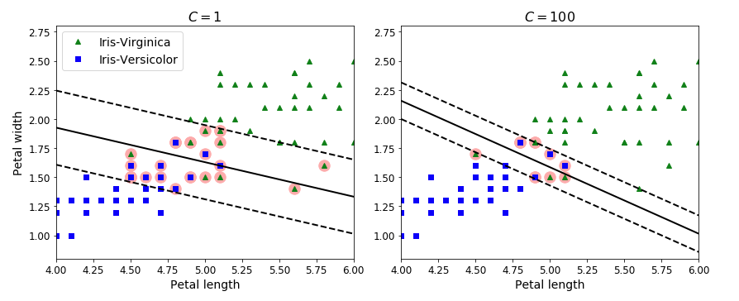
▸ Soft margin classifier with C hyperparameter
Credits & references
Aurélien Géron, Hands-On Machine Learning with Scikit-Learn & TensorFlow
Notes:
SVMs classifier have a "C" hyperparameter. Smaller C values leads to a wider street but more margin violations.
On the left, a low C value leads to a large margin
On the right, a high C value leads to a small one
It is of the highest importance to scale your input features when implementing SVMs (see A. Géron notebook for reference)
Which one will best generalize?
What about non linearly separable dataset?

Slide 25
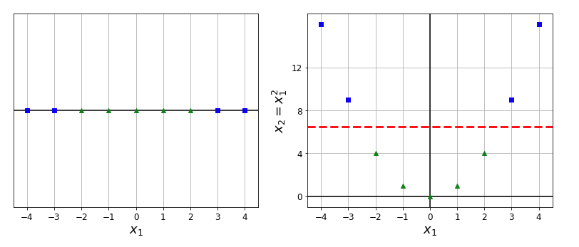
▸ Make it linearly separable!
Credits & references
Aurélien Géron, Hands-On Machine Learning with Scikit-Learn & TensorFlow
*http://scikit-learn.org/stable/modules/svm.html
Notes:
In that illustration, we have a binary target and one single input feature
On the left, using this single input, we cannot linearly separate the targets
However, on the right, by simply "engineering" the single feature we have; in that illustrative example, just taking its squared version and considering it as a new input features, the target classes can be easily linearly separated.
This is the intuition behind the famous "kernel trick"

Slide 26
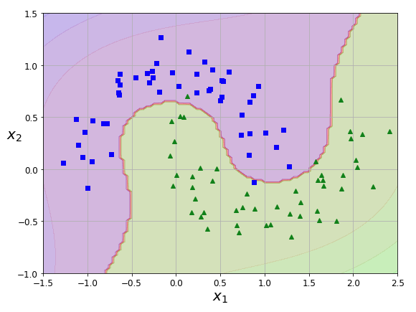
▸ SVMs and the kernel trick
Credits & references
Aurélien Géron, Hands-On Machine Learning with Scikit-Learn & TensorFlow
http://scikit-learn.org/stable/modules/svm.html
Notes:
In that specific example, we use a polynomial kernel (but there are many of them out-of-the-box and you can create your one).
If you remember well, in the first part of the Machine Learning course, when introducing the concept of model capacity starting from a simple linear regression, we then "engineered" new features using polynomial versions of them (degree 2, 3, 4, ...). This is essentially what we do here. But again there are more fancy kernels you can use
As usual, using that techniques and especially if you have more features then instances, this is very easy to overfit your training set. So as usual in Machine Learning and later on in Deep Learning (see later courses), there is always this constant and healthy tension between overfitting and regularization for the sake of generalization power.

Slide 27
▸ Quiz 4
SVMs can only be harnessed for linear problems
SVMs scales well for datasets with thousands of features
SVMs does not require prior feature scaling
You can create your own SVMs kernel
Notes:
Check the right answer(s)

Slide 28
IV. DECISION TREES

Slide 29
▸ Decision Trees
Pervasive algorithms
Extremely easy to interpret anf fairly intuitive
Fundamental components of the most powerful Machine Learning Algorithms (Random Forest, ...)
Credits & references
Aurélien Géron, Hands-On Machine Learning with Scikit-Learn & TensorFlow
http://scikit-learn.org/stable/modules/tree.html
Notes:
Such models, easy to interpret are often called "white box" models as opposed to "black box" ones (for instance a SVM or a Neural Network). This is particularly relevant for instance to gain further insights into your dataset or to explain it to a non-expert audience (your client for instance) and potentially capture domain-knowledge.
It is important to note that Decision Trees do not require feature scaling
Actually, state-of-the-art Machine Learning algorithms such as XGBoost, RandomForest, ... are based on Decision Trees
Last, Decision trees can be used for both classification and regression problems

Slide 30
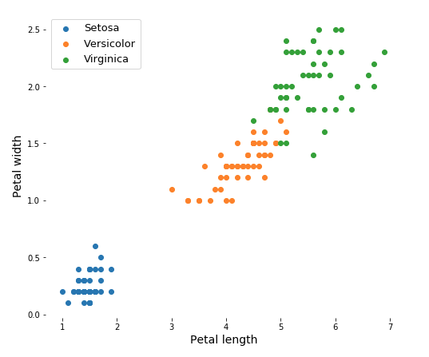
▸ Find your own vertical and horizontal separation lines
Credits & references
Aurélien Géron, Hands-On Machine Learning with Scikit-Learn & TensorFlow
http://scikit-learn.org/stable/modules/tree.html
Notes:
The task at hand is still the Iris Dataset. This is a multiclass classification problem, and based on Petal length and width, we'd like to predict them.
Imagine again that you have a scalpel only allowed to cut either vertically or horizontally. How would you best separate the blue, orange and green dots using only 2 cuts?

Slide 31
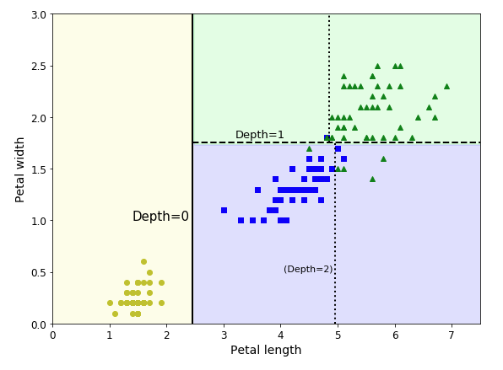
▸ Decision Tree decision boundaries
Credits & references
Aurélien Géron, Hands-On Machine Learning with Scikit-Learn & TensorFlow
http://scikit-learn.org/stable/modules/tree.html
Notes:
This is what a decision tree classifier would ouput (when constraing the depth to 3)
Decision Trees learns with a set of if-then-else decision rules. The deeper the tree, the more complex the decision rules and the fitter the model
This is pretty intuitive, each split (cut in our analogy) should maximize the "impurity" reduction
Consider a bag of 100 marbles all of various colours: this would be very "impure"
Conversely a bag of 100 marbles all of the same colour would be "pure"
There are essentially two metrics that formalizes this notion: Gini Index and Entropy

Slide 32
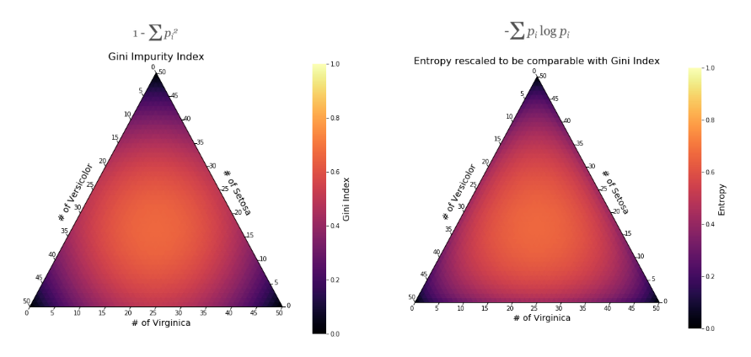
▸ Impurity indexes: do you see the difference?
Credits & references
Aurélien Géron, Hands-On Machine Learning with Scikit-Learn & TensorFlow
Second chance to watch this brilliant explanation of Entropy, Cross-Entropy and Kullback-Leibler divergence: https://www.youtube.com/watch?v=ErfnhcEV1O8
Goodfellow, I. and al. , Deep Learning, MIT Press
Claude Shannon's seminal paper: https://culturemath.ens.fr/sites/default/files/p3-shannon.pdf
Notes:
pi is simply the proportion of instances of a specific class in all training instances
for both metrics, lower is better
Entropy is a central concept in Information Theory and very useful in Machine learning. The Entropy expression looks most probably cryptic if you have not watched the video mentioned above but don't be fooled by the notation!
The basic intuition behind Information Theory is that learning that an unlikely event has occured is more informative than learning that a likely event has occured.
A bit of information according to Claude Shannon reduce uncertainty by 2 (hence the log base 2).
If the weather is sunny 50% of the time and rainy otherwise than if a meteorological station sends you a message saying it is sunny today then it sends 1 bit of information log(1/p) = -log(p) = -log(0.5) = 1
If the weather is sunny 90% of the time and rainy otherwise than if a meteorological station sends you a message saying it is sunny today then it sends 0.15 bit of information log(1/p) = -log(p) = -log(0.5) = 0.15
The Entropy is simply the average amount of information that you get from 1 sample drawn from the probability distribution
For instance going back to the marbles example when 100 marbles all of various colours, each colour has probability 1/100 to be drawn from the bag, hence the Entropy is -(100 x 0.01 x log(0.01)) = 4.6 bits
In the case of the Iris dataset, when all three classes are in equal proportions (50, 50, 50), the Entropy is -(1/3) x log(1/3)-(1/3) x log(1/3)-(1/3) x log(1/3) = -log(1/3) = 1.2 bits
So which one is best, Gini or Entropy? Actually do you see any difference in the plots? (except the rescaling factor)

Slide 33
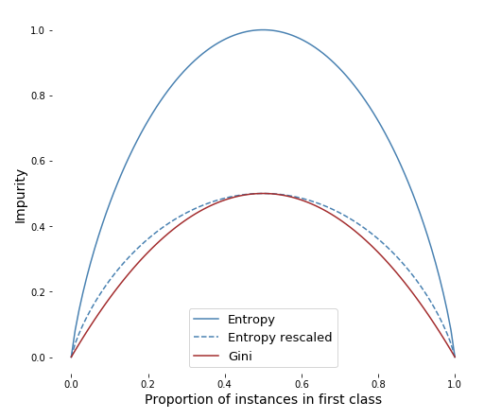
▸ A closer look at Gini Index and Entropy
Credits & references
https://sebastianraschka.com/faq/docs/decision-tree-binary.html
Notes:
Now you know, there is not much difference, except that the Entropy might be longer to compute given the "log", but most of the time you will get simlar results
You did not see much difference in the ternary/simplex plots because the difference is really tiny
So use whatever you want ... Both of them measures the notion of "mixed-ness"

Slide 34
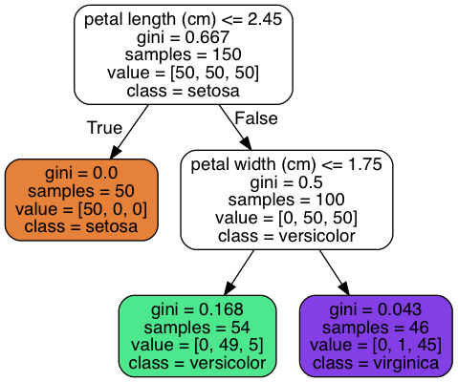
▸ Iris Decision Tree
Credits & references
Aurélien Géron, Hands-On Machine Learning with Scikit-Learn & TensorFlow
Notes:
one main advantage of Decision Trees is that they can be visualized. Below a tree that can be generated using Scikit-learn and Graphviz Python packages
By now you should be able to understand it
In that case we constrained our tree to have a max depth of 2
Producing such tree is really few lines of code. See next slide

Slide 35
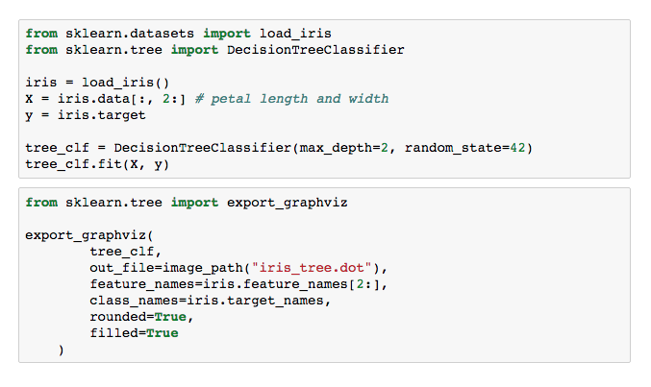
▸ Training and visualizing a Decision Tree with Scikit-learn
Credits & references
Aurélien Géron, Hands-On Machine Learning with Scikit-Learn & TensorFlow
http://scikit-learn.org/stable/modules/generated/sklearn.tree.DecisionTreeClassifier.html
Notes:
A Decision Tree classifier has many hyperparameters that you should search and optimize. One of the most important is obviously the depth. It you don't constrain it, it is very likely that you will overfit the training set. Hence, use the "canonical" machine learning and cross-validation techniques to find the "best" hyperparameters given your training, validation and test sets.
Last, it should be mentionned that Decision Trees do have a few limitations: they love orthogonal decision boundaries, so rotate the Iris dataset and the decision boundaries will look unecessary convoluted. Moreover, Decision trees can be unstable because small variations in the data might result in a completely different tree being generated. As regards dataset-rotation issues, PCAs (Principal Component Analysis) can allow addressing the issue.
Fortunately, Random Forests will allow to limit these instabilities.

Slide 36
▸ Quiz 5
Decision Tree models are easy to interpret
Information Theory is an essential part of Machine Learning
Really, deciding which impurity index Gini or Entropy I should use is a non-issue
Pruning a decision tree or limiting its depth will help fighting overfitting
Notes:
Check the right answer(s)

Slide 37
V. INTRODUCTION TO ENSEMBLE LEARNING

Slide 38
▸ Intuition
A doctor diagnoses you with a very serious illness requiring surgery, what would you do?
It is very likely that before making any decision, you would consult other experts
This is the intuition behind Ensemble Learning
Credits & references
E. Biernat, M.Lutz, Data Science et étude de cas, Eyrolles, (in French)
Notes:
As expert as can be the first doctor, this single diagnosis not be sufficient in that critical decision making
Ensemble learning pushes that approach even further by providing only partial information to each expert. Instead of having one highly complex predictor, multiple simpler one are prefered

Slide 39
▸ From weak to strong learner
A weak learner is a learner (algorithm) that does only slightly better than random guess
Toss a slightly biased coin (49% chance being Head) 1000 times
What's the probability that at least half of them are wrong? (Majority voting)
Using a Binomial Distribution: P(# of wrong pred. > 500) about 25% (hence 75% accuracy)
Notes:
Random guess: imagine you have classification problem whos target is a series of 1000 successive 1 and 1000 successive 0, if you randomly predict the ouput using a toss of a "fair" coin, you will get in the long run 50 % correct and wrong prediction. A weak learner is just required to do slighly better: for instance a decision tree of depth 1 is a weak learner
Head toss coin above is considered to be a wrong prediction: 49% chance being wrong
It is how you would calculate it "binom(1000, 0.49).cdf(500)"

Slide 40
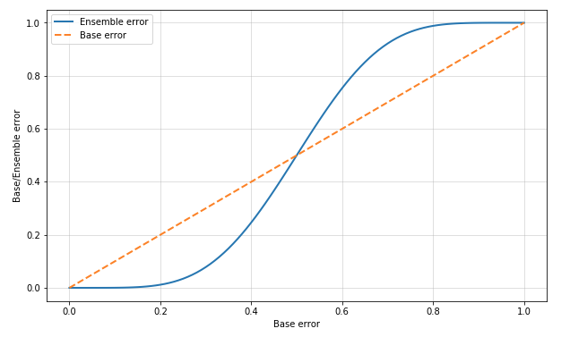
▸ Eleven vs. One prediction errors
Credits & references
https://github.com/PacktPublishing/Python-Machine-Learning-Second-Edition
Notes:
Base error is the one yield by a single predictor

Slide 41
▸ Back to our Statistics Revisited Course
These stories should reminds you the Law of Large Numbers and CLT
With number of repetitions, the variance is decreasing as well
Bit we are assuming that all predictors are independent which is barely the case
Bagging, Random Patches, Random Subspaces, ... to the rescue

Slide 42
▸ Sampling instances and/or features
There are 2 ways to reduce the variance: sampling the instances, or sampling the features
Bagging: sampling with replacement the instance
Sampling both training instances and features is called: Random Patches (Random Forest)
Sampling features only is called: Random Subspaces
Notes:
Bagging stands for Bootsrap Aggregation (yes the Bootstrap you have seen in the Statistics Revisited Course)
The variance is a function of the correlation of pairs of features and number of boostrap sample

Slide 43
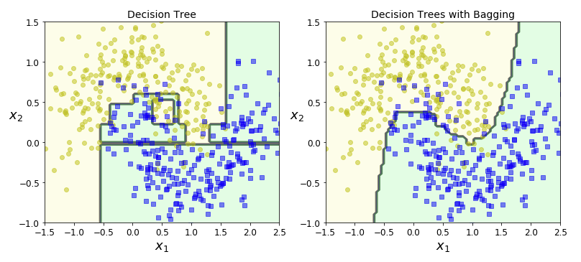
▸ Decision Tree and Bagging
Credits & references
Aurélien Géron, Hands-On Machine Learning with Scikit-Learn & TensorFlow
Notes:
The effect of variance reduction is absolutely clear here

Slide 44
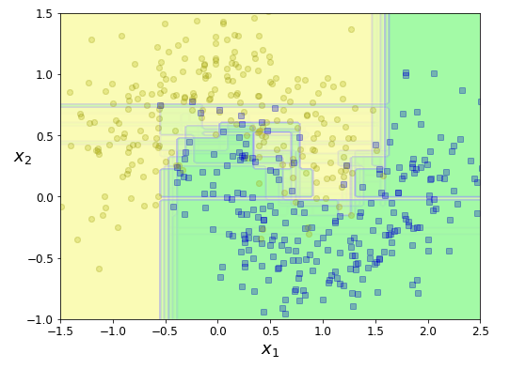
▸ A Random Forest in action
Credits & references
Aurélien Géron, Hands-On Machine Learning with Scikit-Learn & TensorFlow
http://scikit-learn.org/stable/modules/generated/sklearn.ensemble.RandomForestClassifier.html
http://scikit-learn.org/stable/modules/generated/sklearn.ensemble.VotingClassifier.html
Notes:
Remember that a Random Forest allow both instances and features sampling. But this is optional, they are 2 hyperparameters among many others (look at Scikit-learn documentation - you will find all hyperparameters of a Decision Tree as well)
It is important to note that Random Forest do use the same type of predictor (Decision Tree) but Ensemble learning is often used combining a wide range of classifiers (the VotingClassifier method in Scikit-learn make it easy)

Slide 45
▸ The side effects of Random Forests
Computation can be easily parallelized
Allow to assess feature importance
Though far less interpretable than a single decision tree
Credits & references
Aurélien Géron, Hands-On Machine Learning with Scikit-Learn & TensorFlow
Notes:
As regards feature importance, Scikit-learn computes how much the tree nodes that use that feature reduce impurity on average. In the case of the Iris dataset, this is not so crucial, but in ML, you might have several thousands of features. See below an example on the MNIST dataset

Slide 46
▸ Assessing feature importance
Computation can be easily parallelized
Allow to assess feature importance
Though far less interpretable than a single decision tree
Credits & references
Aurélien Géron, Hands-On Machine Learning with Scikit-Learn & TensorFlow
Notes:
As regards feature importance, Scikit-learn computes how much the tree nodes that use that feature reduce impurity on average.
On the Iris dataset using the four features available (Petal and Sepal length and weight), feature importance is the following: petal length (cm)=0.44, petal width=0.42, sepal length (cm)=0.11, sepal width (cm)=0.023
In the case of the Iris dataset, this is not so crucial, but in ML, you might have several thousands of features. See below an example on the MNIST dataset

Slide 47
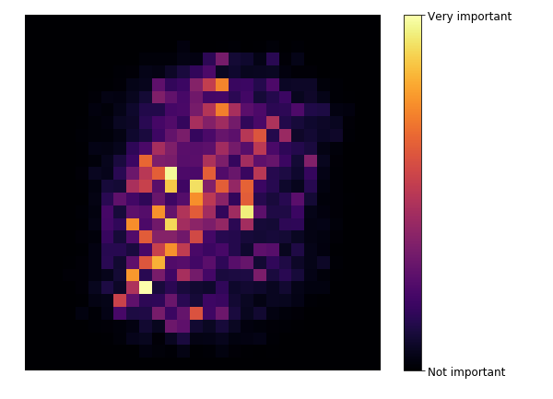
▸ MNIST dataset features importance
Credits & references
Aurélien Géron, Hands-On Machine Learning with Scikit-Learn & TensorFlow
http://yann.lecun.com/exdb/mnist/
Notes:
The MNIST dataset is a famous benchmark dataset of handwritten digits of size 20x28 pixels and in black and white. Look at the reference above and look at the accuracy improved over time with state-of-the-art algorithms in the last 20 years. This is a mini-history of Machine and Deep Learning in itself!
Note that today a Convolutional Neural Network would achieve better result than a Random Forest. But this is a compelling example to illustrate feature importance as outputted by a Random Forest

Slide 48
▸ Quiz 6
Ensemble Learning can be only used with Decision Trees
Ensemble Learning techniques are used extensively in Kaggle competitions
Random Forest algorithm only samples features
Random Forest algorithm helps identifying feature importance
Notes:
Check the right answer(s)

