Slide 1
MACHINE LEARNING USE CASES

Slide 2
I. INTRODUCTION

Slide 3
▸ Main objectives
To put knowledge acquired so far into practice with real use cases
To highlight role played by feature engineering
To provide instances of state-of-the-art machine learning pipelines
To provide an opportunity to provide improvements to approaches highlighted
Credits & references
Companion notebook: FM7/notebooks/9-machine-learning-use-cases.ipynb
https://github.com/Oslandia/open-data-bikes-analysis
https://github.com/nlathia/pydata_2016

Slide 4
▸ Logistics
Current presentation simply provides context and objectives
Code, visualization and analysis are provided in dedicated/companion notebooks
Credits & references
FM7/notebooks/use-cases/accelerometer-detection/accelerometer-explore.ipynb
FM7/notebooks/use-cases/open-data-bikes-analysis/notebooks/Prediction-Lyon.ipynb

Slide 5
▸ How best approach this material?
Both use cases are instances of professional ML pipelines
Understanding the nuts and bolts might be a daunting challenge at firt glance
A top-down approach is advised: general idea then the details
Getting inspiration from "Pros" is the only way to further develop your ML skills
Credits & references
FM7/notebooks/use-cases/accelerometer-detection/accelerometer-explore.ipynb
FM7/notebooks/use-cases/open-data-bikes-analysis/notebooks/Prediction-Lyon.ipynb

Slide 6
II. OPEN DATA BIKES

Slide 7
▸ Context and objective
Based on preliminary EDA performed on bikes sharing station data
To predict bikes availability for the next 30 minutes and 1 hour for every station
Credits & references
https://github.com/Oslandia/open-data-bikes-analysis
FM7/notebooks/use-cases/open-data-bikes-analysis/notebooks/Prediction-Lyon.ipynb

Slide 8
▸ Recap of EDA steps
Identifying typical bike availability patterns during working days
Visualizing the identified patterns as time series and maps
Credits & references
https://github.com/Oslandia/open-data-bikes-analysis
FM7/notebooks/use-cases/open-data-bikes-analysis/notebooks/Clustering-Lyon.ipynb

Slide 9
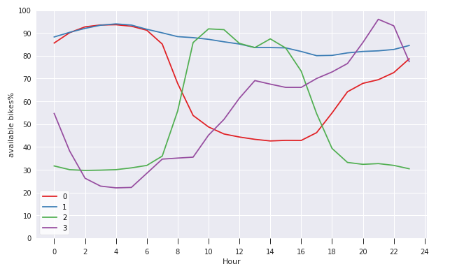
▸ Typical profiles output - refresher
Credits & references
https://github.com/Oslandia/open-data-bikes-analysis
FM7/notebooks/use-cases/open-data-bikes-analysis/Clustering-Bordeaux.ipynb

Slide 10
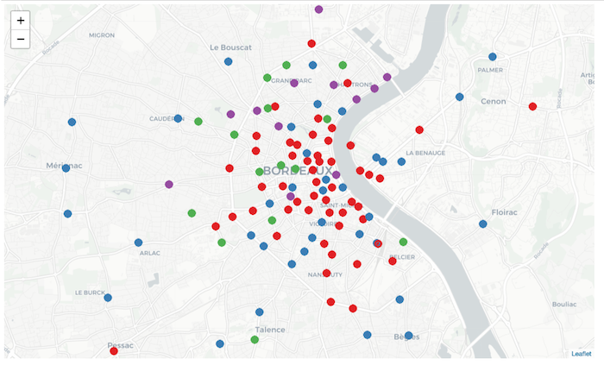
▸ Map of stations profile output - refresher
Credits & references
https://github.com/Oslandia/open-data-bikes-analysis
FM7/notebooks/use-cases/open-data-bikes-analysis/Clustering-Bordeaux.ipynb

Slide 11
▸ Framing the Machine Learning problem
Supervised classification problem with
Features: station_id, time, day, hour, minute, ...
Target: availability rate (nb_bikes/nb_stands)
Focusing on the summer holiday period in Lyon, France
Credits & references
https://github.com/Oslandia/open-data-bikes-analysis
FM7/notebooks/use-cases/open-data-bikes-analysis/notebooks/Prediction-Lyon.ipynb
Notes:
Focusing on the summer holiday period allow to avoid non-stationary problem. We can potentially relax this constraint obviously if we use several years of data but in the present situation, let's start "simple" with a typical period that would guarantee a sort of stationarity and predictability given data available (still to be proved!)

Slide 12
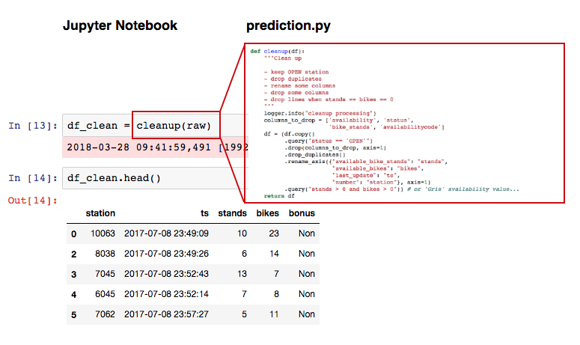
▸ Organizing the codebase like a "Pro"
Credits & references
https://github.com/Oslandia/open-data-bikes-analysis
FM7/notebooks/use-cases/open-data-bikes-analysis/notebooks/Prediction-Lyon.ipynb
FM7/notebooks/use-cases/open-data-bikes-analysis/notebooks/lib/prediction.py
Notes:
"prediction.py" provides the nuts and bolts of the data cleaning, processing and predition through a series of utilities functions
the Jupyter notebook, hence focus and highlight the overal Machine Learning pipeline while delegating the details of the implementation to "prediction.py"
This approach is relevant for several reasons: readibility and reusability
Note the use of "pipe" Pandas method to chain data processing
Note the use of "daiquiri" Python package to log relevant information

Slide 13
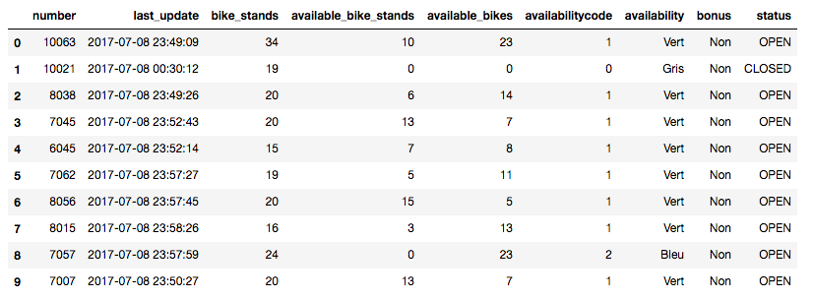
▸ The input data
Credits & references
https://github.com/Oslandia/open-data-bikes-analysis
FM7/notebooks/use-cases/open-data-bikes-analysis/notebooks/Prediction-Lyon.ipynb
FM7/notebooks/use-cases/open-data-bikes-analysis/notebooks/lib/prediction.py

Slide 14
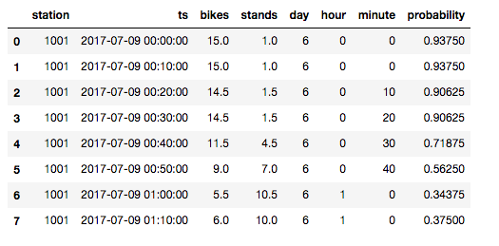
▸ Create supervised learning-friendly dataset
Credits & references
https://github.com/Oslandia/open-data-bikes-analysis
FM7/notebooks/use-cases/open-data-bikes-analysis/notebooks/Prediction-Lyon.ipynb
FM7/notebooks/use-cases/open-data-bikes-analysis/notebooks/lib/prediction.py
Notes:
After some cleaning and transformation (selecting features, renaming, ...)
"probability" is simply the availability_rate = num_avail_bikes / station_capacity

Slide 15
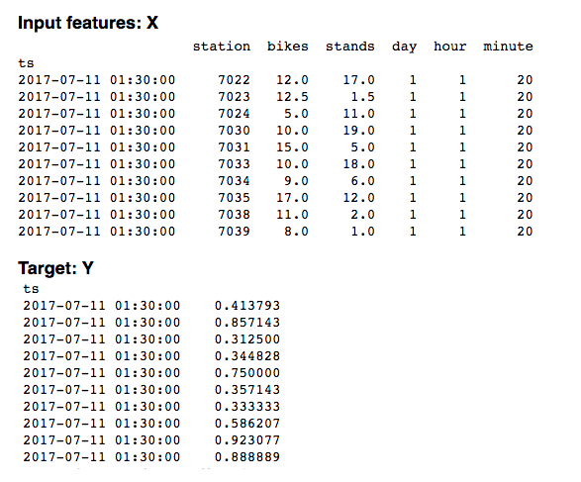
▸ Features and target for training set
Credits & references
https://github.com/Oslandia/open-data-bikes-analysis
FM7/notebooks/use-cases/open-data-bikes-analysis/notebooks/Prediction-Lyon.ipynb
FM7/notebooks/use-cases/open-data-bikes-analysis/notebooks/lib/prediction.py
Notes:
Obviously similar data structure is created to be used as test set later on

Slide 16
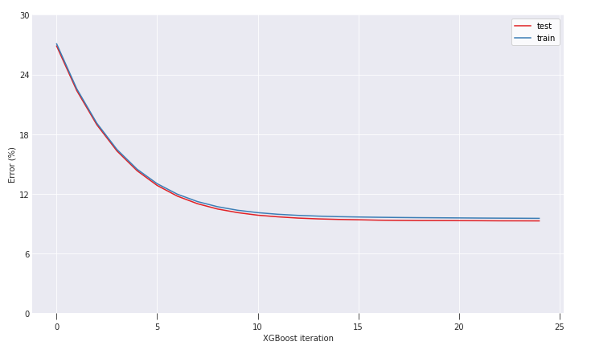
▸ Training an XGBoost ensemble algorithm
Credits & references
https://github.com/Oslandia/open-data-bikes-analysis
FM7/notebooks/use-cases/open-data-bikes-analysis/notebooks/Prediction-Lyon.ipynb
FM7/notebooks/use-cases/open-data-bikes-analysis/notebooks/lib/prediction.py
Notes:
XGBoost is a star algorithm in "Kaggle" competition. This algorithm belongs to the family of "Ensemble Learning" as RandomForest. The main difference is that instead of running several different decision tree (with potentially feature and instances sampling) as in a RandomForest, Boosting techniques train predictors sequentially, each trying to correct its predecessor. Hence the XGBoost iterations visualized above

Slide 17
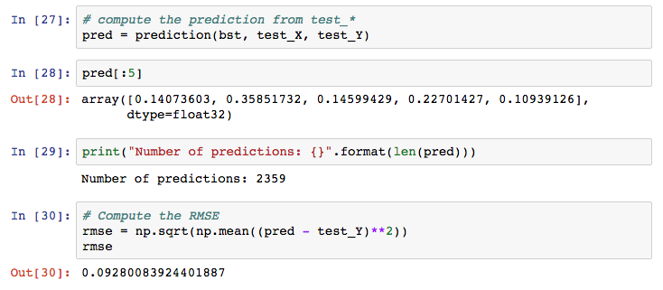
▸ Evaluating predictions on test set
Credits & references
https://github.com/Oslandia/open-data-bikes-analysis
FM7/notebooks/use-cases/open-data-bikes-analysis/notebooks/Prediction-Lyon.ipynb
FM7/notebooks/use-cases/open-data-bikes-analysis/notebooks/lib/prediction.py

Slide 18
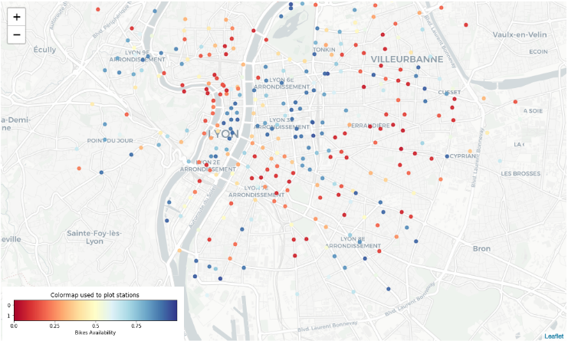
▸ "Spatializing" predictions
Credits & references
https://github.com/Oslandia/open-data-bikes-analysis
FM7/notebooks/use-cases/open-data-bikes-analysis/notebooks/Prediction-Lyon.ipynb
FM7/notebooks/use-cases/open-data-bikes-analysis/notebooks/lib/prediction.py

Slide 19
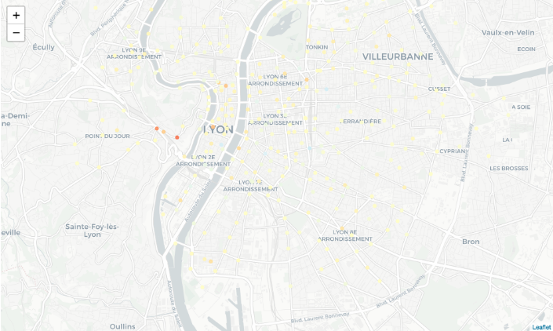
▸ "Spatializing" error predictions
Credits & references
https://github.com/Oslandia/open-data-bikes-analysis
FM7/notebooks/use-cases/open-data-bikes-analysis/notebooks/Prediction-Lyon.ipynb
FM7/notebooks/use-cases/open-data-bikes-analysis/notebooks/lib/prediction.py

Slide 20
▸ Open Data Bikes [Notebook Live Demo]
Data loading, processing, feature engineering
Splitting codebase between Jupyter Notebook and utilities functions
Training and asssesing an XGBoost algorithm
Visualizing predictions
Credits & references
https://github.com/Oslandia/open-data-bikes-analysis
FM7/notebooks/use-cases/open-data-bikes-analysis/notebooks/Prediction-Lyon.ipynb
FM7/notebooks/use-cases/open-data-bikes-analysis/notebooks/lib/prediction.py
Notes:
[Teacher] Dedicate 30 min to the code snippet below showing and executing code live
[Student] Be sure to run and understand the following code snippets before answering module's assignment

Slide 21
III. ACCELEROMETER-BASED TRANSPORTATION DETECTION

Slide 22
▸ Context and objective
Using mobile phones accelerometers,
Collecting 3-D accelerometry data while walking, running, on trains, climbing stairs, ..
Predicting activity based on accelerometry data
Credits & references
https://github.com/nlathia/pydata_2016
FM7/notebooks/use-cases/accelerometer-detection/accelerometer-explore.ipynb

Slide 23
▸ ML pipeline overview
Visualizing data
Transforming raw dataset into a Supervised Classification-friendly one
Performing feature engineering
Train and predict
Credits & references
https://github.com/nlathia/pydata_2016
FM7/notebooks/use-cases/accelerometer-detection/accelerometer-explore.ipynb

Slide 24
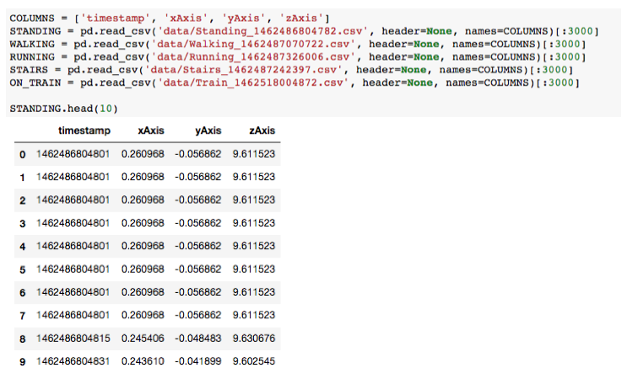
▸ The input/raw dataset
Credits & references
https://github.com/nlathia/pydata_2016
FM7/notebooks/use-cases/accelerometer-detection/accelerometer-explore.ipynb

Slide 25
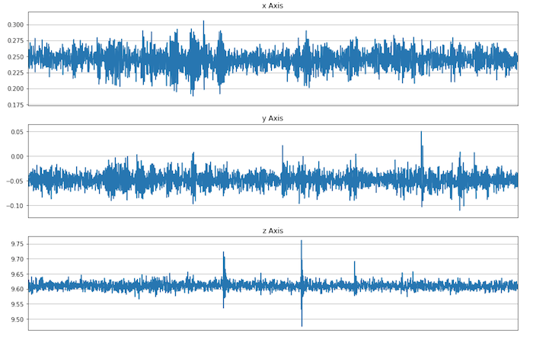
▸ Standing according to accelerometry
Credits & references
https://github.com/nlathia/pydata_2016
FM7/notebooks/use-cases/accelerometer-detection/accelerometer-explore.ipynb

Slide 26
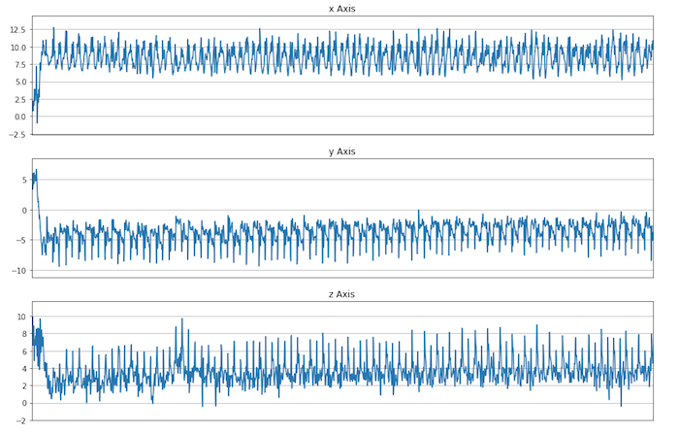
▸ Walking according to accelerometry
Credits & references
https://github.com/nlathia/pydata_2016
FM7/notebooks/use-cases/accelerometer-detection/accelerometer-explore.ipynb

Slide 27
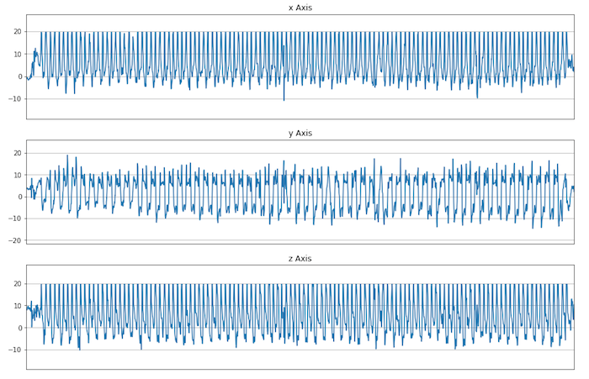
▸ Running according to accelerometry
Credits & references
https://github.com/nlathia/pydata_2016
FM7/notebooks/use-cases/accelerometer-detection/accelerometer-explore.ipynb

Slide 28
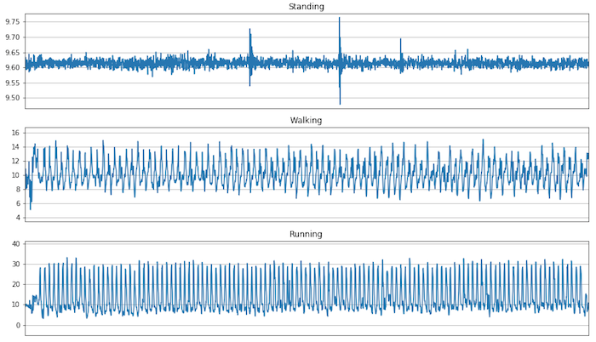
▸ Feature engineering part 1: Magnitude
Credits & references
https://github.com/nlathia/pydata_2016
FM7/notebooks/use-cases/accelerometer-detection/accelerometer-explore.ipynb
Notes:
Magnitude being equal to sqrt(x_axis^2 + y_axis^2 + z_axis^2) (the L2 norm)

Slide 29
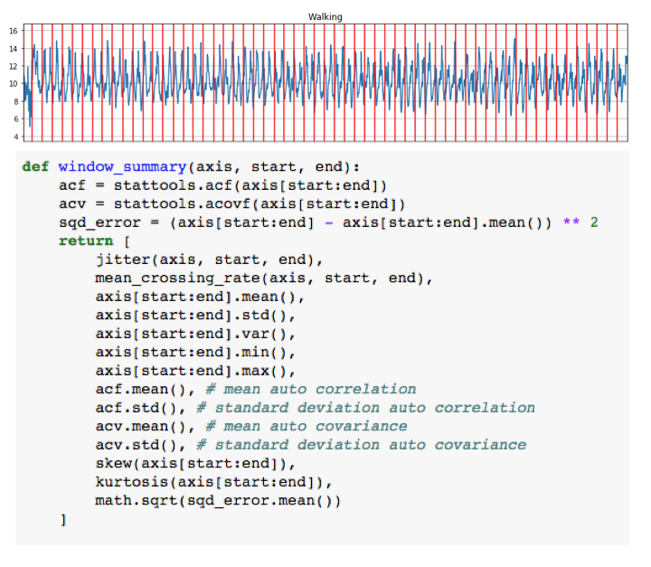
▸ Feature engineering part 2: Windowing
Credits & references
https://github.com/nlathia/pydata_2016
FM7/notebooks/use-cases/accelerometer-detection/accelerometer-explore.ipynb
Notes:
Each slices is characterized by: jitter, mean_crossing, acv, ...
Now we have a dataset amenable to supervised classification problems with:
windows as instances
jitter, mean_crossing_rate, mean, std, min, ... as features
activity type ("running", "walking", ...) as target

Slide 30
▸ Prediction steps
Split dataset into train and test sets
Train a RandomForest classifier
Evaluate accuracy and compare to a baseline model
Credits & references
https://github.com/nlathia/pydata_2016
FM7/notebooks/use-cases/accelerometer-detection/accelerometer-explore.ipynb

Slide 31
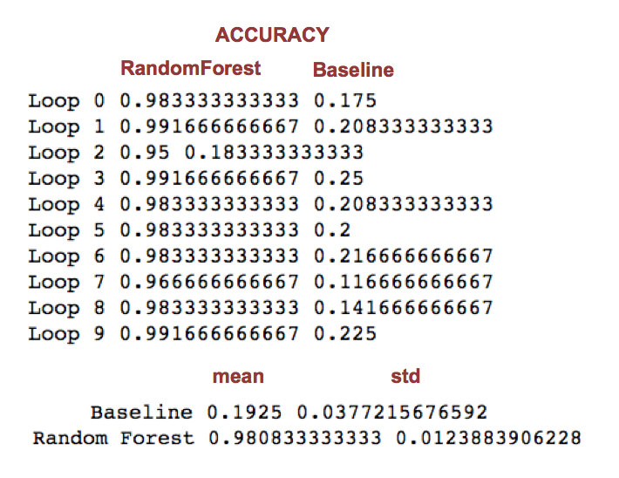
▸ Scores of RandomForest and Dummy classifiers
Credits & references
https://github.com/nlathia/pydata_2016
FM7/notebooks/use-cases/accelerometer-detection/accelerometer-explore.ipynb
Notes:
The "Score" method of RandomForest return the accuracy

Slide 32
▸ Activity detection [Notebook Live Demo]
Data loading, processing, feature engineering
Transforming time series data to Supervised Learning classification problem
Training a RandomForest
Assessing accuracy compared to a baseline model
Credits & references
https://github.com/nlathia/pydata_2016
FM7/notebooks/use-cases/accelerometer-detection/accelerometer-explore.ipynb
Notes:
[Teacher] Dedicate 30 min to the code snippet below showing and executing code live
[Student] Be sure to run and understand the following code snippets before answering module's assignment

