Slide 1

Introduction about GIT & GIT HUB
KICE Infosystems- Tirupur

Slide 2
What is Git?
Git is an open-source, version control tool created in 2005 by developers working on the Linux operating system
Why we use Git?
Git is particularly useful when you and a group of people are all making changes to the same files at the same time.
Tracks changes in source code during software development.
Helps coordinate work among developers
Protects against code loss

Slide 3
What is GitHub?
GitHub is a cloud-based platform where you can store, share, and work together with others to write code.
Use of GitHub?
Storing your code in a "repository" on GitHub allows you to:
Showcase or share your work.
Track and manage changes to your code over time.
Let others review your code, and make suggestions to improve it.
Collaborate on a shared project, without worrying that your changes will impact the work of your collaborators before you're ready to integrate them.

Slide 4
Example:
You work on a project in Tirupur.
Your friend works in Chennai.
If you both use GitHub, you can share your project, make changes, and GitHub will merge the changes.
It’s like Google Drive for code, but much more powerful with collaboration features.

Slide 5
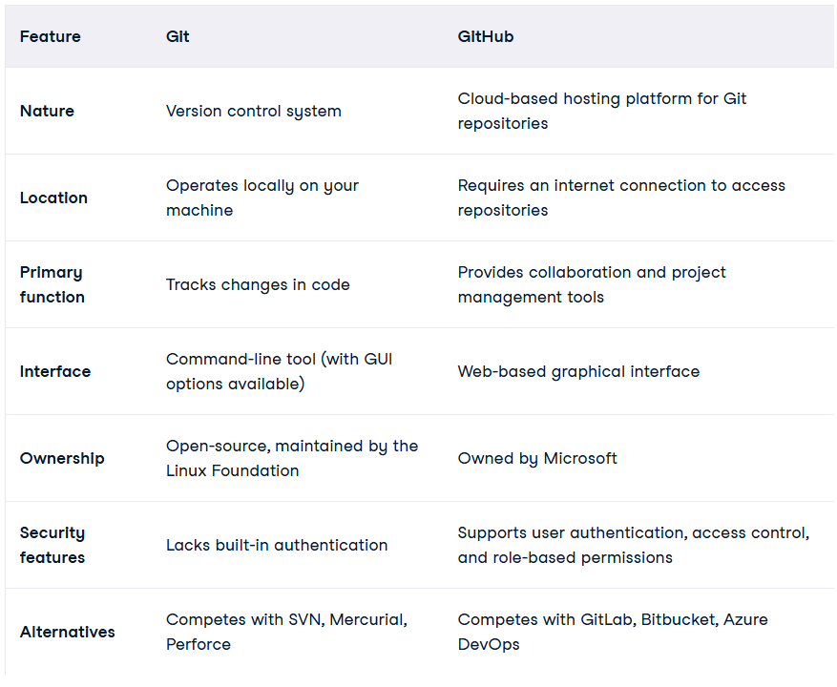
Difference B/W Git and GitHub:

Slide 6
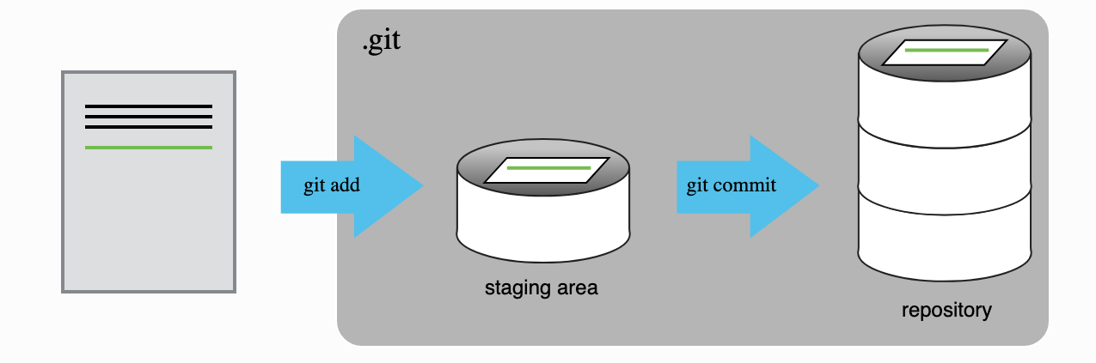
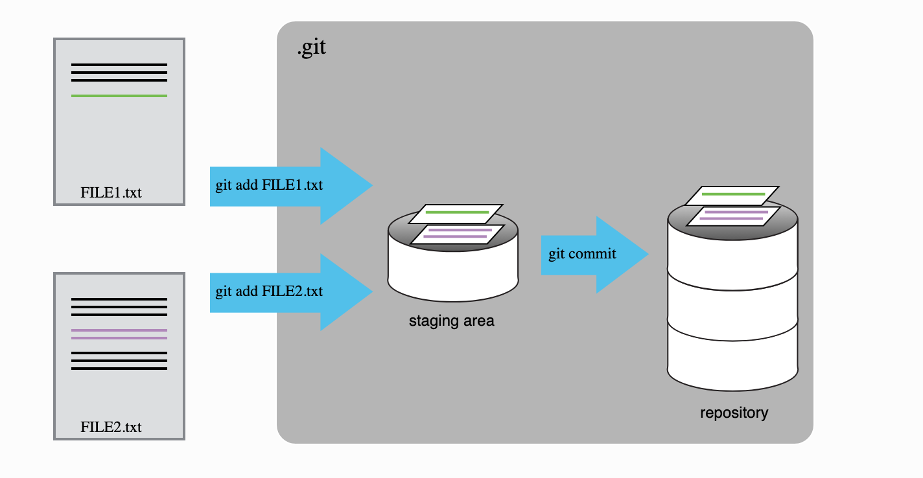
How Does it Works:

Slide 7
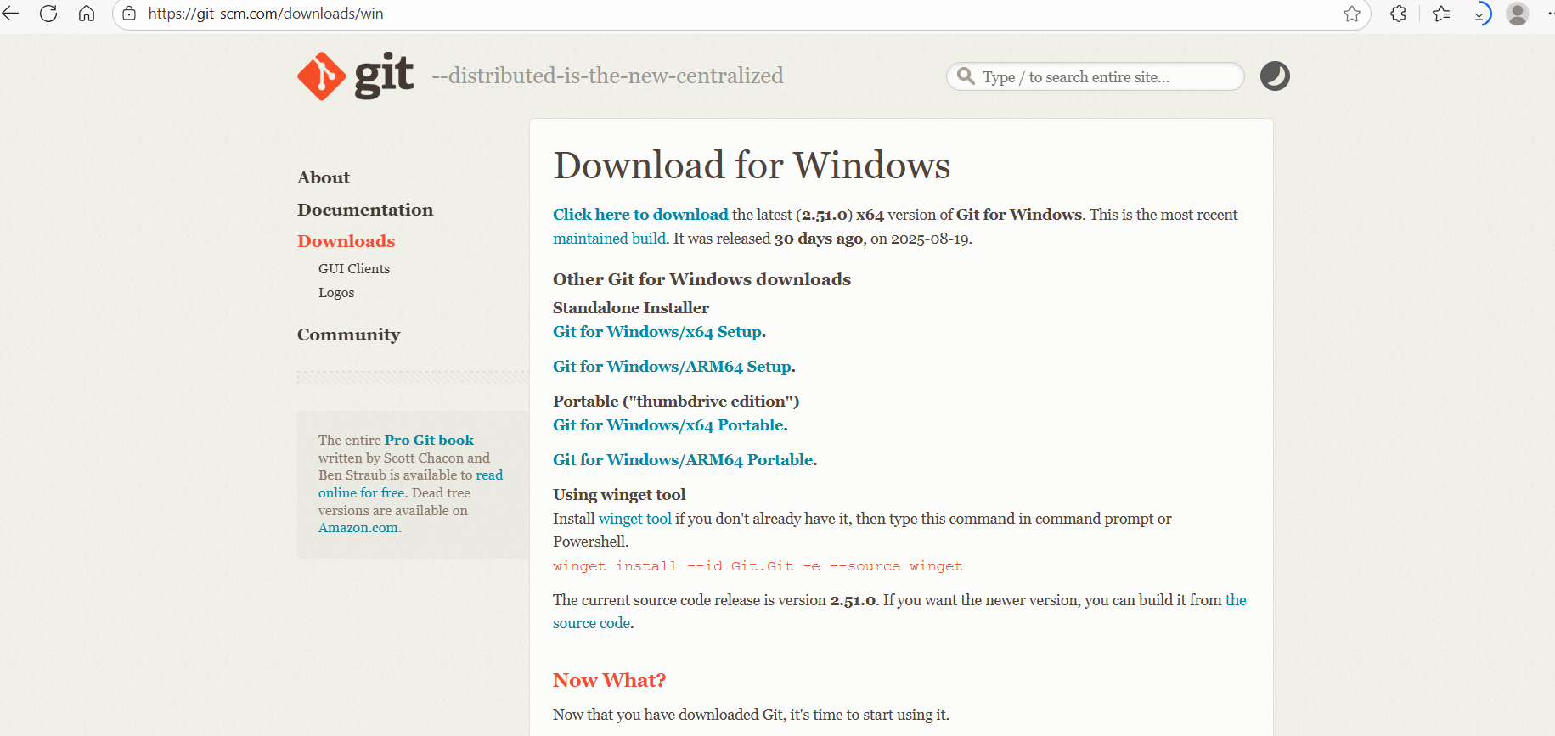
Install Git:
Go to Git Official Website (Git - Downloading Package)
Click Download for Windows
install it
after install confirm whether it is installed on your computer
cmd -- git
git --version

Slide 8
Setting up Git
$ git --version
$ git config --global user.name “kiceinfosystem”
$ git config --global user.email “kiceinfosystems@gmail.com”
$ git config -h (list of commands)
$ git config --help (git manual)

Slide 9
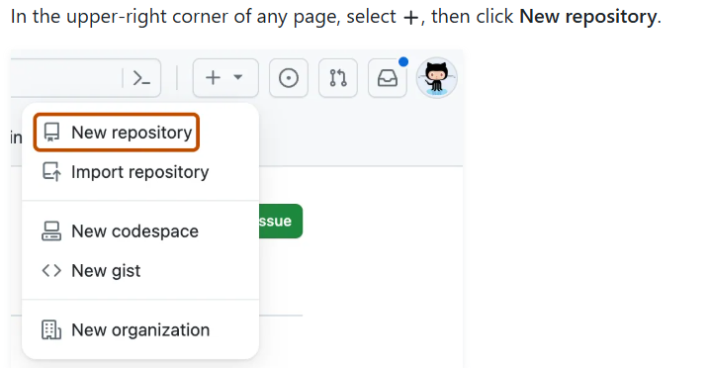
Create a New Repository on GitHub
Go to https://github.com
Login → Click New repository
Enter repository name (e.g., my-first-repo)
Optional: Add description
Choose Public or Private
Click Create repository

Slide 10
Clone the GitHub Repository to Your PC
git clone https://github.com/yourusername/my-first-repo.git
( here repo folder is created in your local directory)

Slide 11
Create and Save a New File
In VS Code, right-click folder → New File
Name it (e.g., sample.py)
Add content → Save the file

Slide 12
Creating a Repository
$ mkdir gitlab (make a directory - repository)
$ cd gitlab
$ git init (to initialise git)
$ vim readme.md (Press ‘i’ to go to insert mode, press ’escape’ to come out of insert mode. Press ‘:x’ to save and exit)
$ ls (to list items)
$ ls -a (to show hidden directory)
$ git status (to show on which branch are you)
$ git add . (sends file to staging area)
$ git commit -m “my initial commit” (sends file to local repo)

Slide 13
Open the Cloned Repo in VS Code
Open Visual Studio Code
Click File > Open Folder
Choose your cloned my-first-repo folder
Start coding!
new terminal-- git status
(check git status)

Slide 14
Create and Save a New File
In VS Code, right-click folder → New File
Name it (e.g., sample.py)
Add content → Save the file

Slide 15
Add and Commit the File Using Git
git add sample.py
git commit -m "Added sample.py"
git push origin main (push this file into Git)

Slide 16
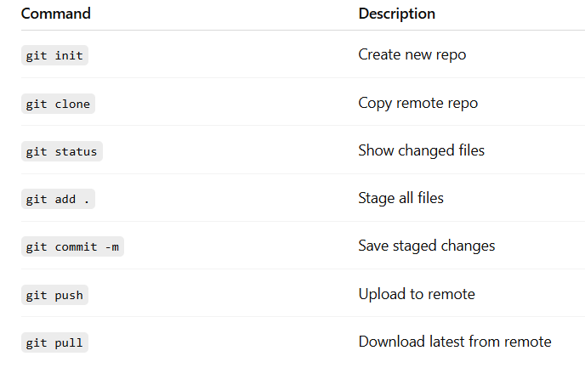
Common Git Commands

Slide 17
Understanding Branches
Branch: A copy of code to experiment or develop features
Default branch: main or master
Commands:
git branch – List branches
git checkout -b feature – Create new branch
git merge – Merge changes

