Slide 1
Deep Learning
Michał Korwek, Emil Łasocha

Slide 2
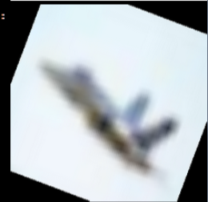
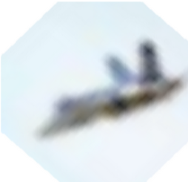
What's the difference

Slide 3
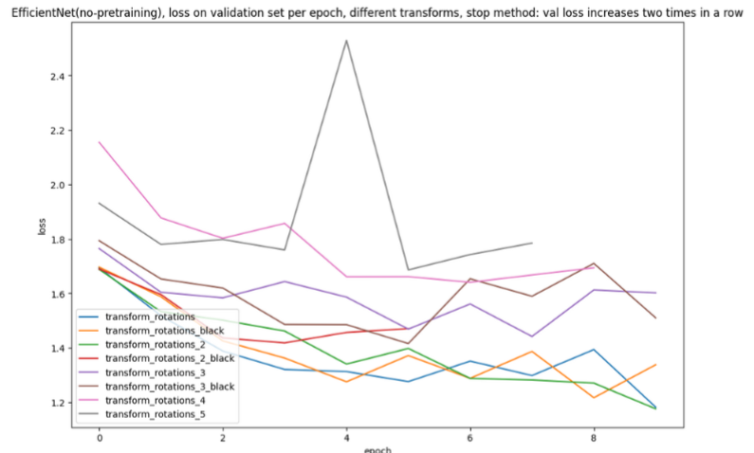
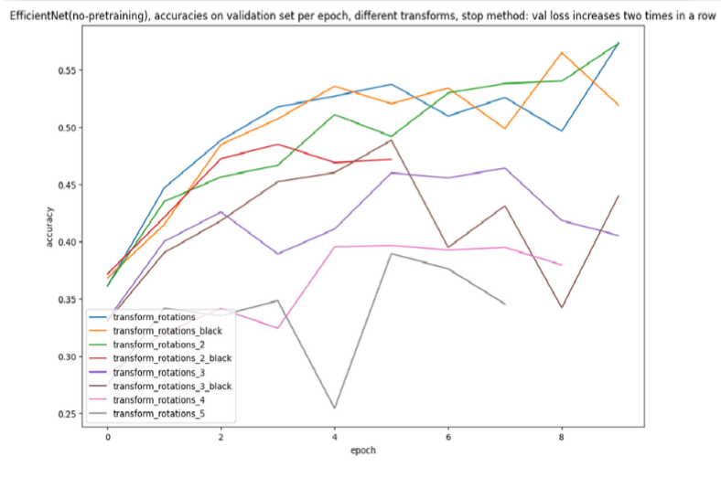
It seems, there is not

Slide 4
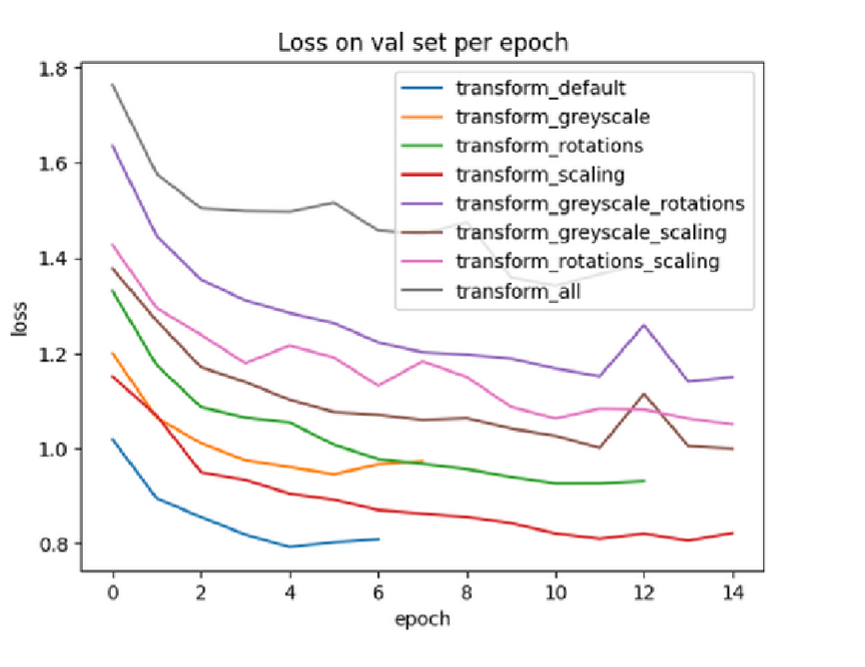
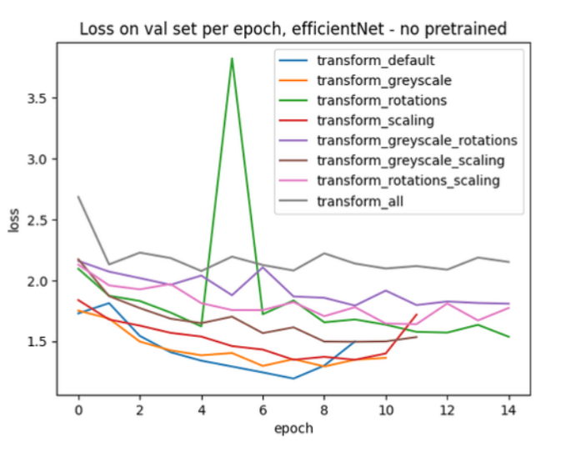
Pretrained vs notpretrained
Different data augmentation loss on pretrained model
Different data augmentation loss on not pretrained model​

Slide 5
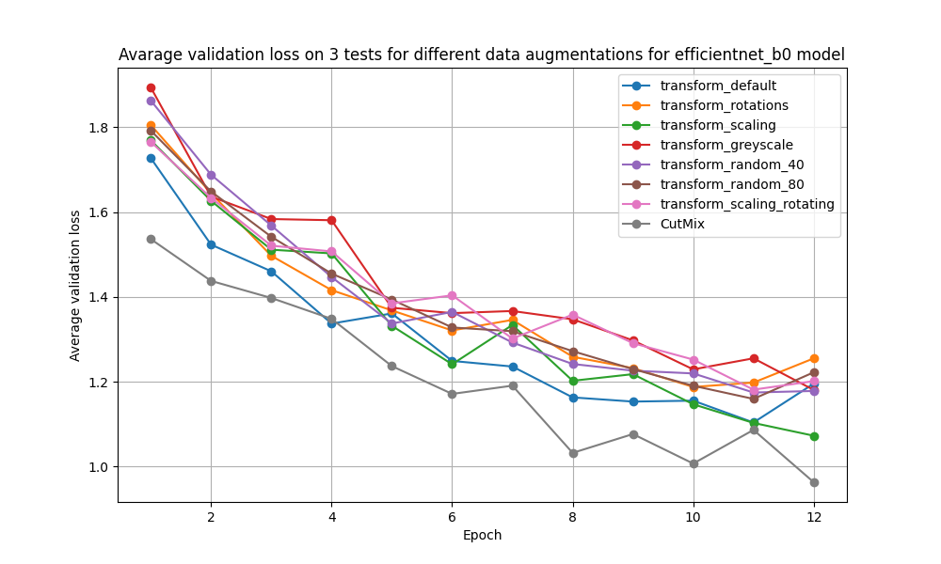
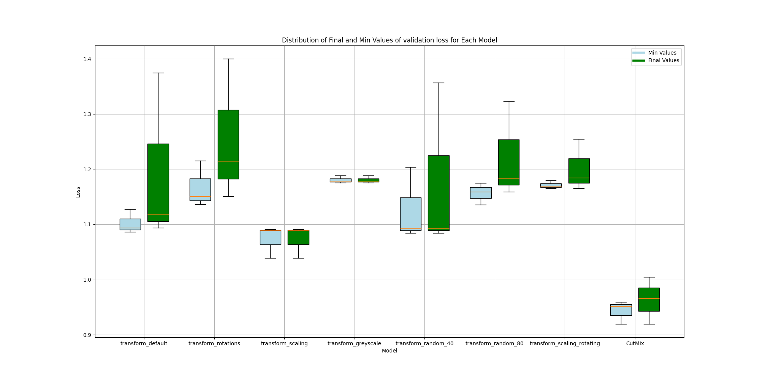
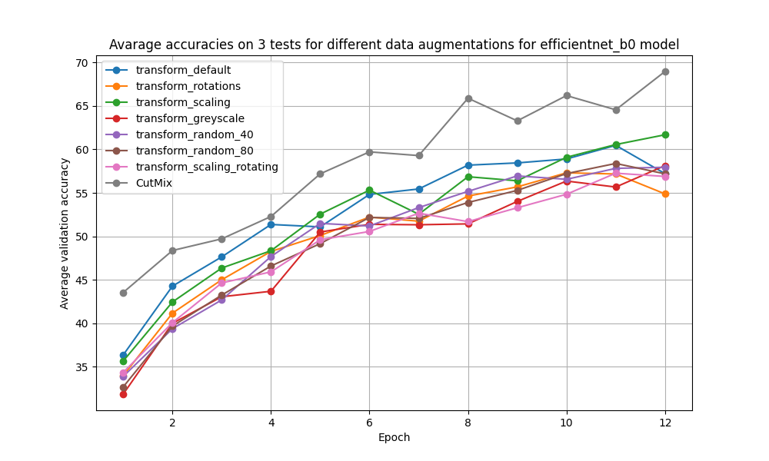
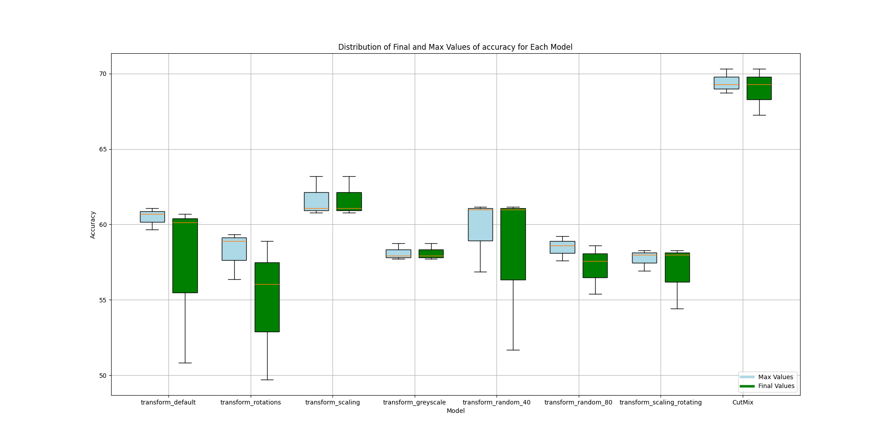
loss
accuracies

Slide 6
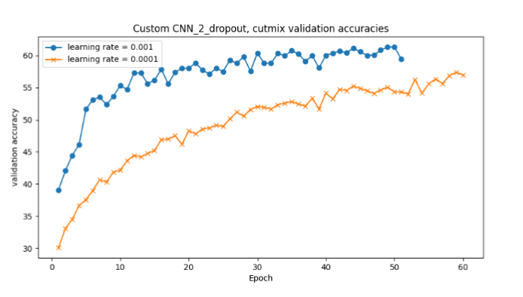
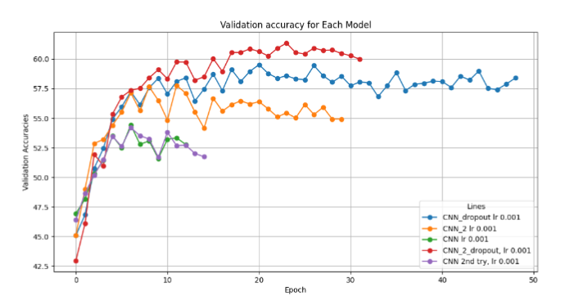
Yes, but...

Slide 7
Dropout models
Three models considered. Three different dropout hyperparameters.
0.2 0.2 0.35
0.3 0.25 0.4
0.4 0.3 0.45
0.5 0.35 0.5

Slide 8
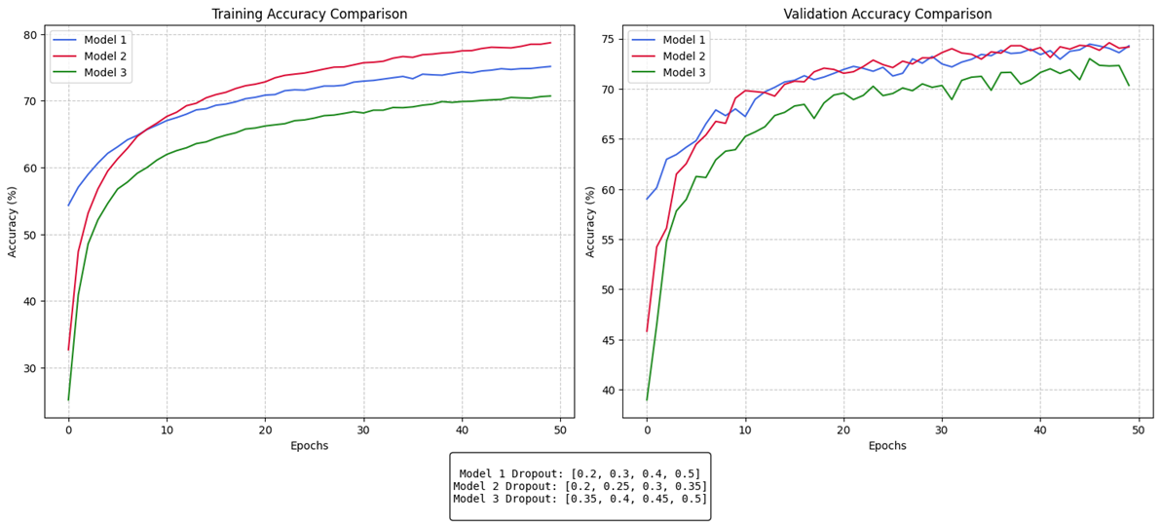
DROPOUT MODELS

Slide 9
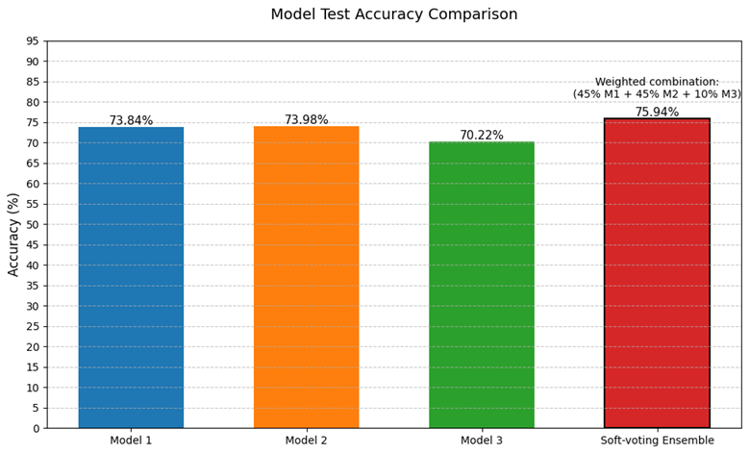
SOFT-VOTING
0.45
0.45
+2p.p.
0.1

Slide 10
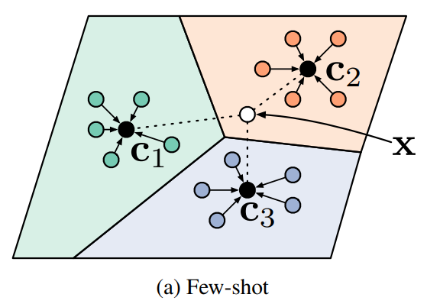
FEW-SHOT
30-shot
10-way
For 3000 episodes
Source: [1]

Slide 11
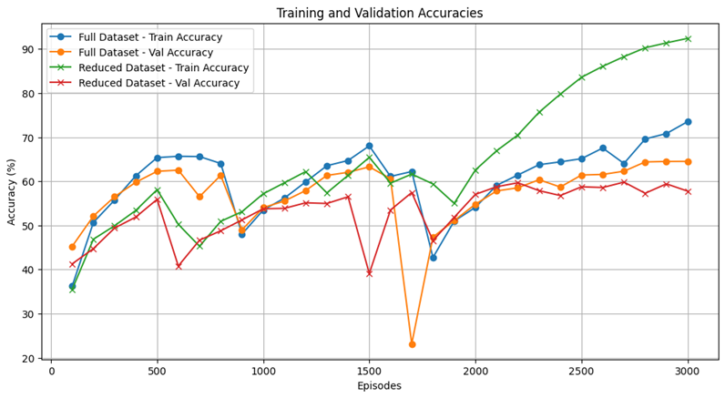
FEW-SHOT W/ REDUCED DATA

Slide 12
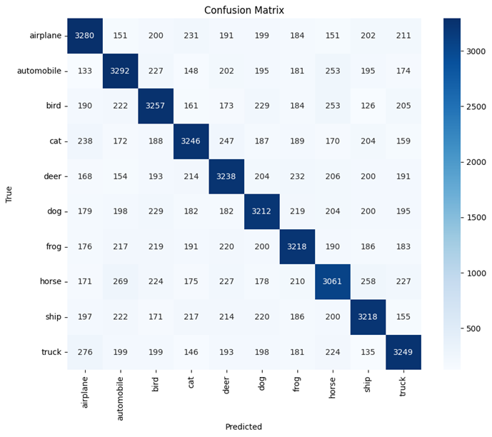
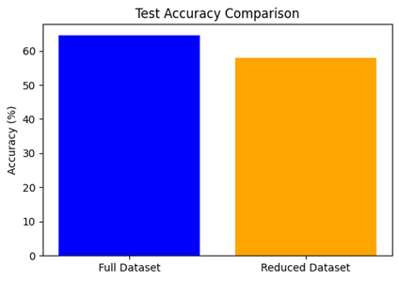
FEW-SHOT summary

Slide 13
THANK YOU FOR YOUR ATTENTION
Bibliography:
[1] Prototypical Networks for Few-shot Learning by Snell et al. (2017), in Advances in Neural Information Processing Systems (NeurIPS), Vol. 30, pp. 4077–4087.
Michał Korwek, Emil Łasocha

