Slide 1



Slide 2
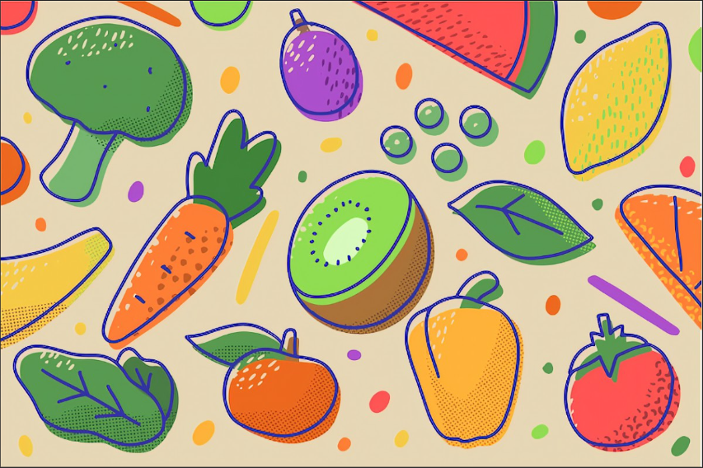
What is Repeopedia?

Slide 3
Check fruits and vegetables
Bad fruit or not?
How many days left?

Slide 4
Let’s use our product! Why?

Slide 5
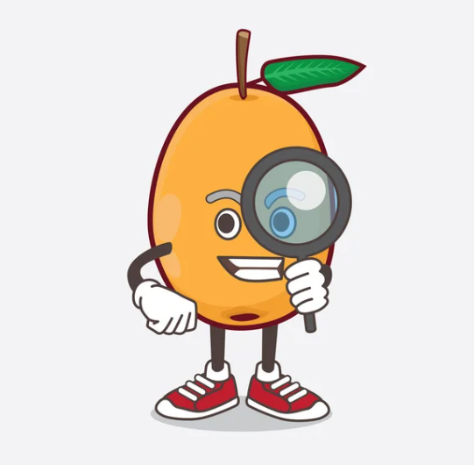


Features
DETECT
WARNING
RECIPE SUGGESTION

Slide 6





Team

Slide 7
Demo of our marketing products website

Slide 8
Thank you !

