Slide 1
What Factors Contribute to A Top Tier Red Wine? An Analysis
John Henry Cruz
Jec4968
SDS 325H

Slide 2
Objective
Does an increase in alcohol concentration lead to an increase in the red wine quality, while controlling for pH, fixed acidity, and residual sugar?
Are pH, alcohol concentration, fixed acidity, and residual sugar significantly linearly related to the quality of red wine?
Factors: pH, alcohol concentration, fixed acidity, residual sugar

Slide 3

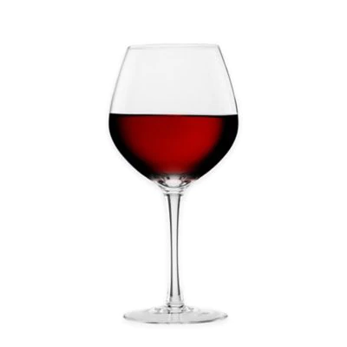
Dataset and Methods
Linear Regression Model
Factors: pH, alcohol concentration, fixed acidity, residual sugar
Analysis of Results
Correlation Test

Slide 4
Results
Correlations and Correlation Tests
Factor | R | P value
pH | -0.058 | 0.02096*
Alcohol concentration | 0.476 | < 2.2e-16*
Residual Sugar | 0.014 | 0.5832
Fixed Acidity | 0.124 | 6.496e-07*
* means significant to alpha level = 0.05

Slide 5
Results
Linear Regression Model
Factor | Slope Estimate | P value
pH | -0.558 | 0.000462*
Alcohol concentration | 0.380 | < 2e-16*
Residual Sugar | -0.014 | 0.252841
Fixed Acidity | 0.042 | 0.002458*
Fixed Acidity interacting with Alcohol concentration | -0.0097 | 0.232832
* means significant to alpha level = 0.05
Adjusted R-squared: 0.2548

Slide 6
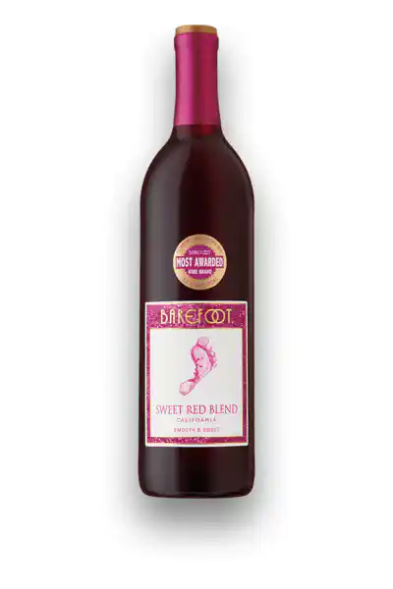

Implications
Quality Score
1
2
3
4
5
6
7
8
9
10

Slide 7
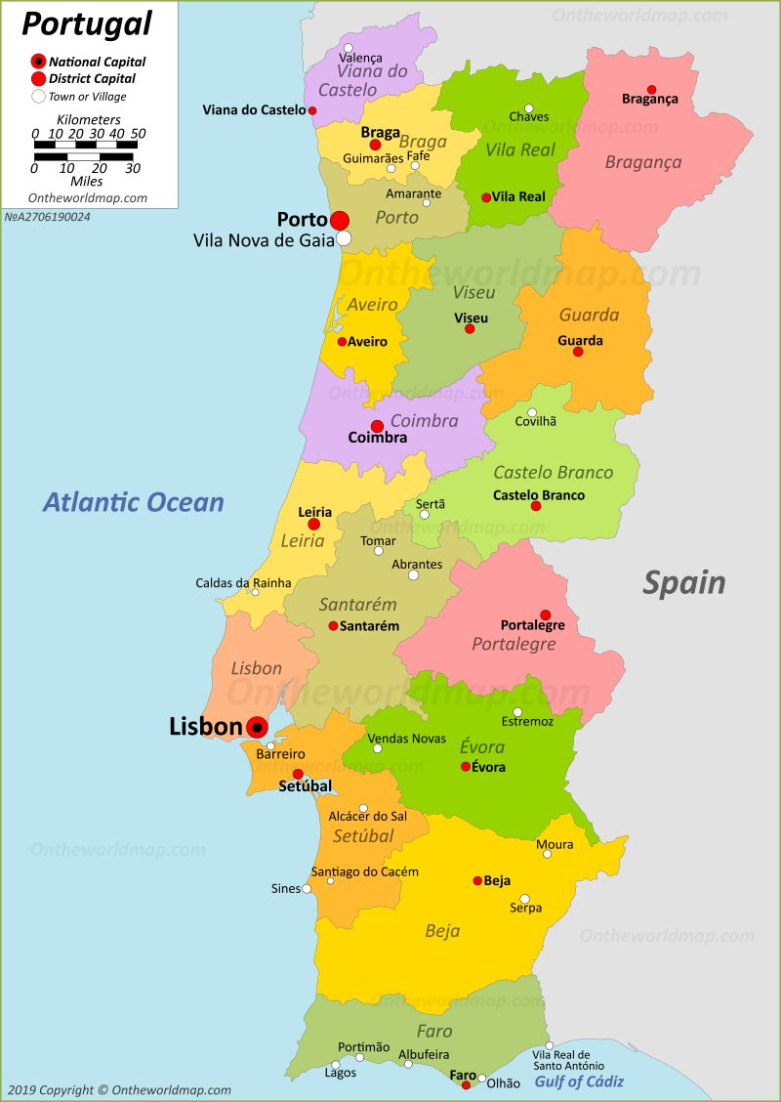
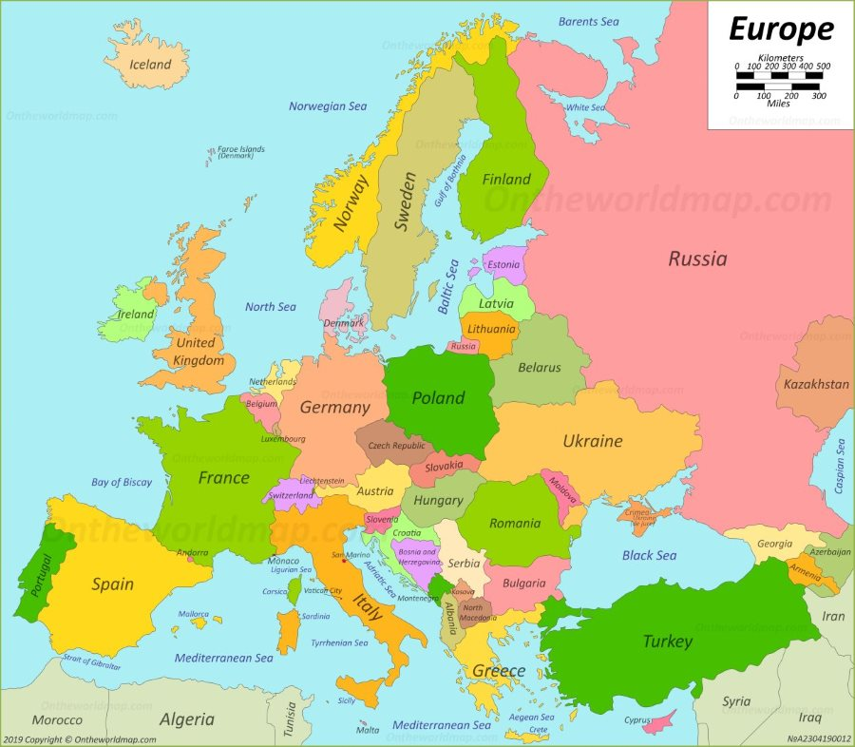

Limitations/Areas for Future Research

Slide 8
Picture Sources
World Map: https://www.google.com/url?sa=i&url=https%3A%2F%2Fwww.amazon.com%2FWorld-Map-Robinson-Projection-19-9%2Fdp%2F1635979684&psig=AOvVaw09yeBme_8BsL4KnqHrkEpT&ust=1588537478978000&source=images&cd=vfe&ved=0CA0QjhxqFwoTCPDLjrqBlukCFQAAAAAdAAAAABAD
Europe Map: https://www.google.com/url?sa=i&url=http%3A%2F%2Fontheworldmap.com%2Feurope%2F&psig=AOvVaw38t4NWXpT7sArIjw2PsVf4&ust=1588537385408000&source=images&cd=vfe&ved=0CA0QjhxqFwoTCKji2NmBlukCFQAAAAAdAAAAABAD
Portugal Map: https://www.google.com/url?sa=i&url=http%3A%2F%2Fontheworldmap.com%2Fportugal%2F&psig=AOvVaw38AcYf9wGd6o4TNTuoGO6S&ust=1588537320960000&source=images&cd=vfe&ved=0CA0QjhxqFwoTCLiHouKBlukCFQAAAAAdAAAAABAD
Question Mark: https://www.google.com/url?sa=i&url=https%3A%2F%2Fwww.pngwave.com%2Fpng-clip-art-dllff&psig=AOvVaw357L_4vbsoaWqV1bA20UE4&ust=1588537011702000&source=images&cd=vfe&ved=0CA0QjhxqFwoTCIDlzvCBlukCFQAAAAAdAAAAABAD
Glass of Red Wine: https://www.google.com/url?sa=i&url=https%3A%2F%2Fwww.bedbathandbeyond.com%2Fstore%2Fproduct%2Flenox-reg-tuscany-classics-reg-24-oz-red-wine-glasses-buy-4-get-6-value-set%2F1040165684&psig=AOvVaw0wbbcPMg91Ao77BDs1TNq4&ust=1588536669856000&source=images&cd=vfe&ved=0CA0QjhxqFwoTCPDvrf-BlukCFQAAAAAdAAAAABAD
Wine Bottle: https://www.google.com/url?sa=i&url=https%3A%2F%2Fdrizly.com%2Fwine%2Fred-blend%2Fproprietary-red-blend%2Fbarefoot-sweet-red-blend%2Fp10282&psig=AOvVaw0wbbcPMg91Ao77BDs1TNq4&ust=1588536669856000&source=images&cd=vfe&ved=0CA0QjhxqFwoTCPDvrf-BlukCFQAAAAAdAAAAABAJ

