Slide 1
TITLE SLIDE

Slide 2
Two Main Questions
Is it possible to classify user tastes into discrete, identifiable categories?
Can we define the characteristics that make songs similar?

Slide 3
Two Main Questions
Primary Approach : Clustering
Two related datasets:
One Million Songs
EchoNest Taste Profile Subset

Slide 4
Exploring the OMS Dataset
One Million Songs (280GB)
Collaboration between The Echo Nest and LabROSA
Lots of Metadata (Sort of)
Comes as HDF5 files, which matlab can process, but take a bit of finessing

Slide 5
The Taste Profile Subset
Listener Data
Over 1,000,000 users
Play counts for about 385,000 songs from the One Million Songs dataset
Comes as triplets that need to be reworked into a more helpful format

Slide 6
CLUSTERING
Theoretically clustering slides would be in here?

Slide 7
Evaluating the Clusters
Collaborative Filtering
Potential way of assessing our clusterings
How many clusters is correct?
Is there a relation between error in Collaborative Filtering and strength of clustering?

Slide 8
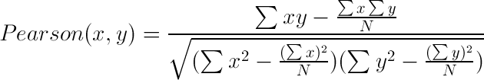
Collaborative Filtering
Mahout package
Clusters for Items, Play Count for Value
User Based
Default Configuration :
  2 Nearest Neighbors
  Pearson Correlation for Similarity

Slide 9
Evaluating the Clusters
Use the built-in evaluator to determine how well each possible number of clusters (2-49) lends itself to Collaborative Filtering
Built-in evaluator uses an Averaged Absolute Difference to determine how accurate predictions are
Run 10 trials with different held out data, then average those results to get a mean error for each set of clusters

Slide 10
Evaluating the Clusters
So what did we find?
The GMM clustering has the lowest error
GMM error minimum is at 23 clusters, the same as the BIC
But what does this indicate?

Slide 11
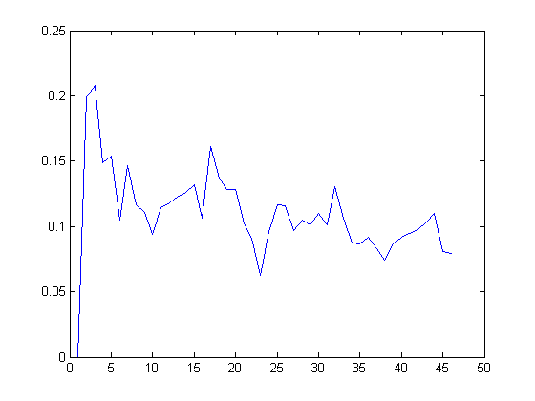
Average Error
Number of Clusters

