Slide 1
Tigray Martyrs' Memorial Monument Center
ELECTRONIC DOCUMENTS MANAGEMENT SYSTEM – E-DMS Project

Slide 2
About E-DMS
Electronic Document Management Systems (E-DMS) is a framework of tools for managing the creation, use and storage of digital documents that are available within the organization.
The digital documents can have several formats (Video, Audio, Image, and Text).

Slide 3
Why E-DMS
The main need of an Electronic Document Management System (E-DMS) is to provide a central repository for digital documents

Slide 4
Cont.d
An electronic document management system is used for:
Storage of digital assets in a centralized and secure environment
Immediate web based access to documents by authorized personnel from any location
Multiple users can access the same document simultaneously, at anytime
Management of versions of documents to minimize inconsistency and redundancy
Increased speed of storing, retrieving and modifying documents
Reduction of paper, space and staffing requirements associated with paper filing systems

Slide 5
E-DMS Modules
Main Modules of the System are:
User Management Module
Access Control Module
Digital Document Uploading Module
Digital Document Searching Module
Digital Document Display Module
Digital Document Downloading Module
Digital Document Sharing Module
Action Tracking Module
Permission and Security Module
Reporting Module

Slide 6
E-DMS User Types
System Admin is the main and most powerful user in the system that is capable of:
Create new Roles
Assign Permissions to Roles
Create Users & Assigns Roles
Upload Digital Documents
Approve Uploaded Documents
View Summarized Data

Slide 7
Cont.d
Public User is everyone who has access to the system with out having an account. These users can access public documents that are permitted by System Admin.
N.B Any User Type such as Library Head, ICT Head, Data Entry or any other can be created and granted access permissions by system admin at any time.

Slide 8
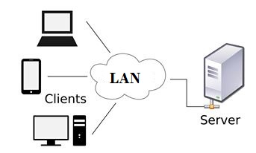
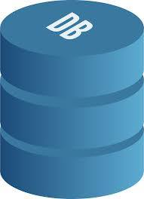
Architecture Followed
Model View Controller (MVC) Architecture which allows separation of concerns by providing different layers for application logic, user interface and data access layer.

Slide 9
Technology Used
Backend: Laravel PHP Framework
Which provides powerful security features such as CSRF attack protection and middlewares that allows developer to interrupt and process any incoming request and outgoing response to enforce security policies set by System Admin.
Great extent of scalability.
Clean and easily maintainable code structure
Large community support

Slide 10
Cont.d
Frontend: Jquery + HTML to achieve
Single Page Application design pattern to reduce bandwidth consumption.
Partial rendering to boost response time.
To display input based dynamic forms.

Slide 11
Cont.d
Database: MySql Database
Most popular relational database

Slide 12
Tools Used
Composer: Dependency management tool for PHP. It allows us to list the packages our application depends upon to function correctly.
XAMP which comes with the required tools i.e Apache Server, MySql database and PHP
It is used to deploy and run the project

Slide 13
Installation
To deploy the system the following steps has to be followed
Install XAMP and place the project in side /xamp/htdocs/ folder
Install Composer
Open Terminal and run the following commands
mysql –uroot –p
create database edms
cd project-name/application-core
php artisan migrate

Slide 14
Cont.d
Setting Up Your Environment Variable Laravel offers easy management of environmental variables for your application. In the laravel application there is a file named .env. This file will contain environment variables used in the project:
DB_CONNECTION=mysql
DB_HOST=127.0.0.1
DB_PORT=3306
DB_DATABASE=edms
DB_USERNAME=root
DB_PASSWORD=root

Slide 15
Recommendation
In order to achieve its objective this system needs active user community involvement and periodic data inputs to keep it up to date.

