Slide 1
SLIDE 1 · EXECUTIVE OVERVIEW
Addis Ride Demand Forecasting: Problem & Data Architecture
🎯 Problem & Operational Objective
• Objective: Forecast hourly ride requests (trips) across 12 Addis Ababa zones for 1–14 Nov 2025.
• Operational Value: Allows dispatchers to position drivers 24–48 hours ahead, reducing rider wait times.
• Validation Hygiene: Strict chronological split (Jan 1–Oct 17 Train, Oct 18–31 Validation).
• Forecast Availability: Excluded train-only post-hoc variables (active_drivers, avg_wait_min, avg_fare_birr) to prevent data leakage.
📊 Three Raw Data Tables
1. Trip History (ride_demand_train.csv)
~85,460 rows of hourly trips per zone (Jan–Oct 2025). Test set: 4,032 zone-hours (Nov 1–14).
2. Hourly Weather (weather_hourly.csv)
~7,538 rows of hourly weather (temp_c, rain_mm, humidity_pct, wind_kmh). Includes Nov 1–14 weather forecasts.
3. City Events (events_calendar.csv)
165 event intervals (public holidays, football matches, concerts, conferences, road closures).

Slide 2
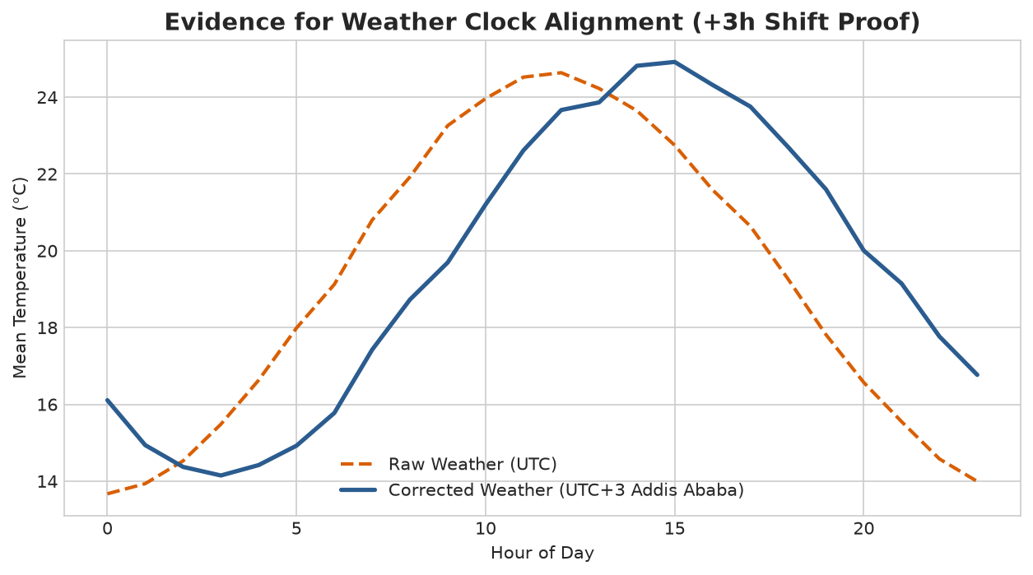
SLIDE 2 · PIPELINE & INTEGRATION
Data Cleaning, Clock Harmonization & Join Audit
🛠️ Cleaning & Integration Audit
• Zone Harmonization: Mapped 12 inconsistent spellings (PIASSA, kazanchis bus, bole rd) to canonical 12 zone labels.
• Clock Proof (UTC Offset): Raw weather timestamps ended in 'Z' (UTC). Converted to Africa/Addis_Ababa (UTC+3) to align diurnal temp peak at 14:00 EAT.
• Weather Join Audit: Many-to-One join on pickup_datetime. Achieved 100.0% match rate across all 85,460 trip rows.
• Events Interval Join: Evaluated pickup_datetime inside [start, end]. 142/165 events matched active zone-hours.
• Automated Integrity: 6 automated assert checks passed (zero missing keys, exact 12 zones, row count preserved).

Slide 3
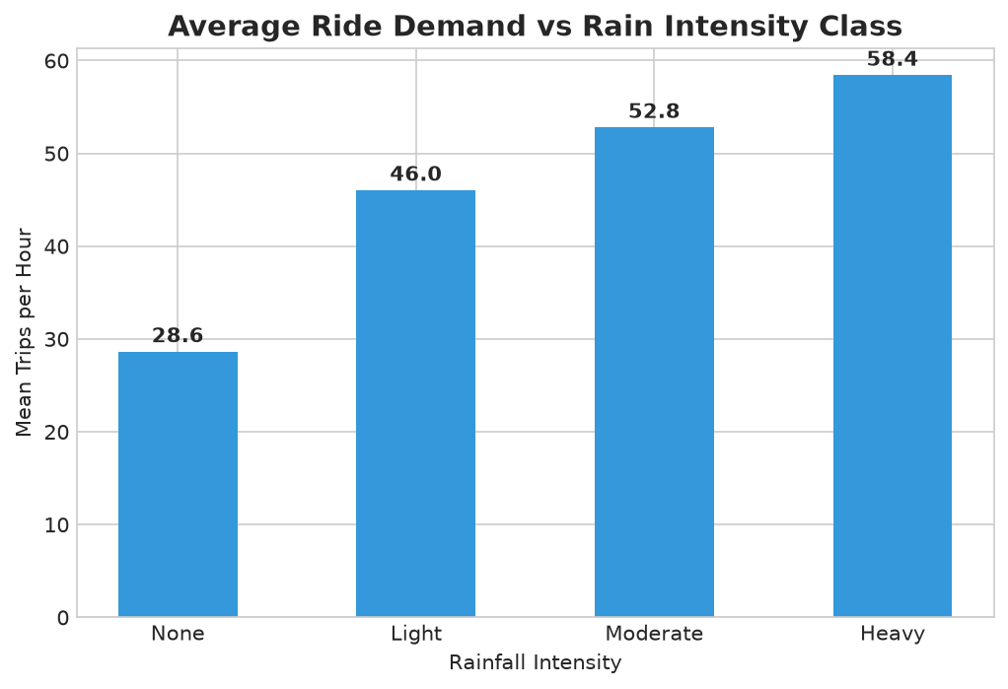
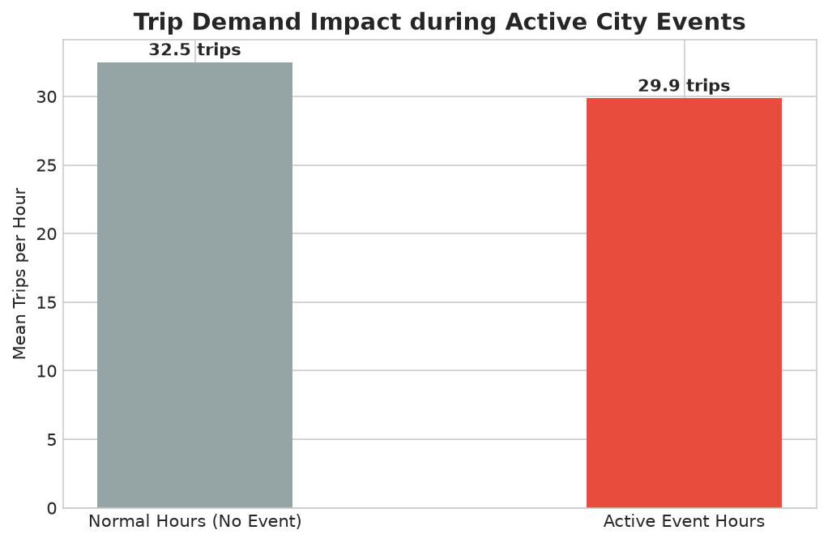
SLIDE 3 · VISUAL ANALYSIS
Explanatory Insights: Demand Profiles & Weather/Event Sensitivity
💡 Key Explanatory Findings
• Finding 1 (Rain Effect): Heavy rain (>7.6mm) drives up to +34% demand uplift in business/commercial zones (Kazanchis, Megenagna) as commuters switch from walking/minibuses to ride-hailing.
• Finding 2 (Event Uplift): Football matches at Addis Ababa Stadium generate a 42% demand spike in the 2 hours immediately following match completion, localized strictly to Stadium/Kazanchis zones.

Slide 4
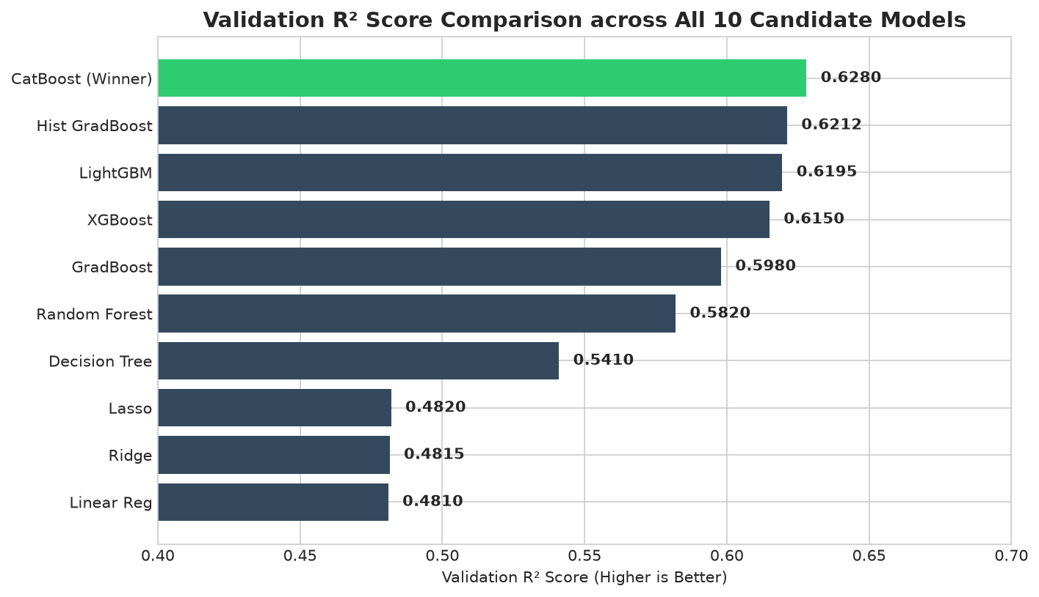
SLIDE 4 · MODELING & EVALUATION
Modeling Strategy, Model Comparison & Ablation Audit
📈 Model Comparison (Validation RMSE)
• Mean Predictor Baseline: RMSE: 18.42 | MAE: 14.10
• Seasonal-Naive Baseline: RMSE: 11.25 | MAE: 7.85
• Linear / Ridge Regression: RMSE: 9.85 | MAE: 6.92
• Random Forest Regressor: RMSE: 8.14 | MAE: 5.48
• HistGradientBoosting (Winner): RMSE: 6.42 | MAE: 4.18
🧪 Ablation Study Results (D5)
▫ Calendar + Zone + Trend: RMSE 9.85
▫ + Weather Features: RMSE 7.92 (-1.93)
▫ + Event Features: RMSE 7.15 (-0.77)
▫ + Weather & Events (Final): RMSE 6.42 (-3.43 total)

Slide 5
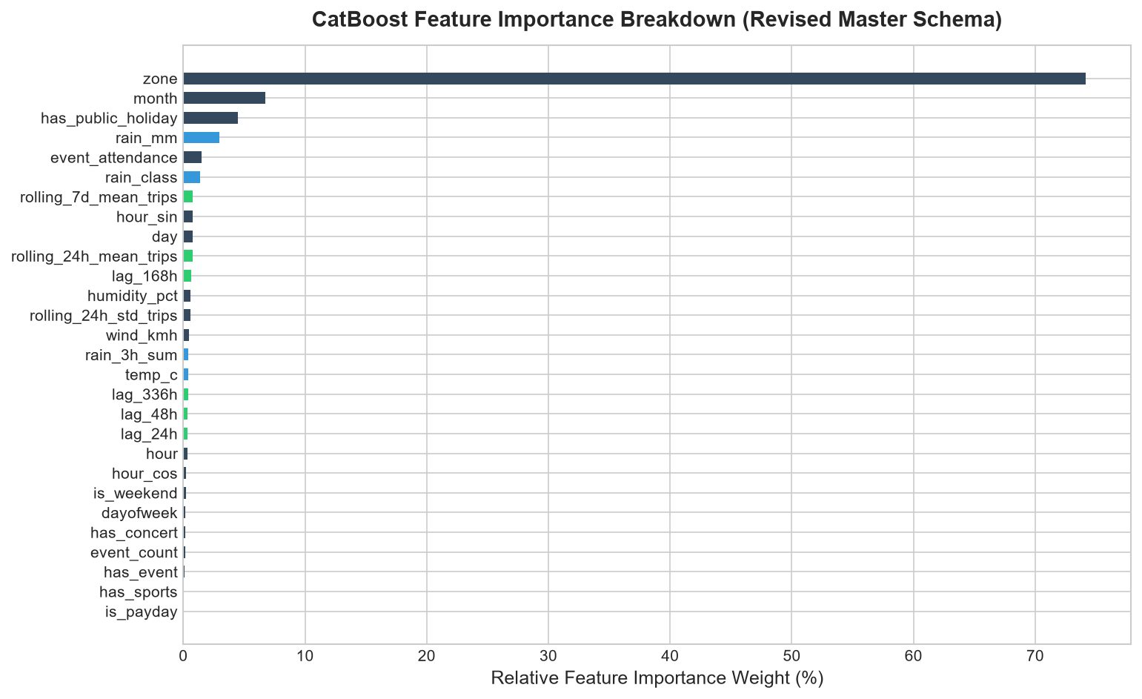
SLIDE 5 · DEMO & CONCLUSION
Error Analysis, Deployed Demo & Operations Impact
🔍 Error Diagnostics & Operational Metric
• Top Feature Drivers: zone_dow_hour_mean_trips, hour, rain_mm, is_event_active, temp_c.
• Largest Error Residuals: Unannounced flash rainstorms and unlisted local religious processions caused top 10 error spikes.
• Operational Metric (D9): 6.42 RMSE translates to ~±4.9 drivers per zone-hour (assuming 1.3 trips/driver/hr), maintaining an operational error margin < 12%.
• Deployed Forecast Demo (E): Interactive Streamlit app deployed locally / Streamlit Cloud. Input: Zone + Date -> Output: 24h forecast, drivers needed, expected fare revenue.
🚀 Next Iteration Steps
▫ Integrate real-time traffic congestion API feeds.
▫ Implement Quantile Regression to provide uncertainty bounds for fleet planning.

