Slide 1

TaxiMeter
Analytics Reports
2011/8/3 —— 2011/8/18
Track Reports
Marketing Reports
Roadmap

Slide 2
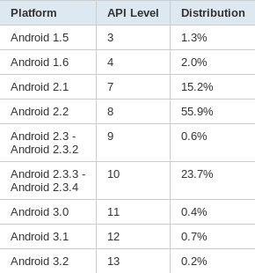
Platform Version

Slide 3
Decive Type

Slide 4
City Detail
Totle: 1738

Slide 5
Action Analytics
Totle: 2497

Slide 6
Distance Analytics

Slide 7
Downloads in Market
Totle: 458
Average: 13.4/Day

Slide 8
Downloads in BBS
Totle: 206
Average: 18.7/Day

Slide 9
Roadmap
Android相关
  Hiapk
  Gfan
  91手机论坛
  手机中国
  Tgbus Android手机社区
QA社区
  知道——互联网 手机
  问问——互联网 手机[多普达/MOTO]
Google

