Slide 1
MLE 10 Capstone:
Healthcare Claims - Anomaly Detection Iain McKone, Monika Sharma
Ann Chavarria, David Lederer
Notes:
This is the slide where you actually SAY your 1-2 sentence elevator pitch. Engage your audience!!

Slide 2
Outline
Problem Domain
Approach
Data, Model(s)
MLE Stack
Demo
Conclusions (and lessons learned)
Future Considerations
Q & A

Slide 3

Problem Domain:
Healthcare fraud is a serious white-collar crime in US
Est. $70B (3% of total spend) is attributed to fraud; max $300B
An increasingly sophisticated crime (e.g. collusion)
https://www.nhcaa.org/tools-insights/about-health-care-fraud/the-challenge-of-health-care-fraud/
https://www.bcbsm.com/health-care-fraud/fraud-statistics.html
Notes:
Specify what Problem is being solved, and ensure that everyone is in agreement as to Why that’s a problem.

Slide 4
Examples
($300M) 2022 April - 11 defendants charged with kickback schemes involving collusion between medical practitioners, laboratories, and a marketing firm.
https://www.justice.gov/usao-ndtx/pr/11-defendants-plead-guilty-300-million-healthcare-fraud
($143M) 2021 May - 14 defendants charged with multiple covid-related fraud schemes i.e. collusion between a medical doctor, laboratories, pharmacies, and a home health agency.
https://www.cnbc.com/2021/05/26/doj-charges-14-people-in-alleged-health-care-fraud-related-to-covid-19.html
Notes:
Specify what Problem is being solved, and ensure that everyone is in agreement as to Why that’s a problem.

Slide 5
Implications:
Overwhelms the system with unnecessary tests and procedures
Reduces availability of care (scheduling)
Increases the cost of care
Increases costs of insurance premiums ($)
Reduces accessibility to care ($)
Reduces overall value and quality of care
Notes:
Specify what Problem is being solved, and ensure that everyone is in agreement as to Why that’s a problem.

Slide 6
Current State: (envisioned as-is; do-nothing)
Increasing overall annual # and $ claims
Increasing associated annual #, %, and $ of anomalies and fraud cases
Increasing avg $ cost per detection; i.e. evolving fraud sophistication
(Relatively) Flat or decreasing % analyst manhours per claim
(Relatively) Flat or increasing data, and analysis tools (receptive)
Notes:
Specify what Problem is being solved, and ensure that everyone is in agreement as to Why that’s a problem.

Slide 7
Current State: (envisioned as-is; do-nothing)
 | Count (#) | Total Cost $ | yoy Growth %
Healthcare Claims
(Demand) Anomalies and Fraud cases
Anomaly and Fraud Detection
(Supply) Analyst Person Hours
Notes:
Specify what Problem is being solved, and ensure that everyone is in agreement as to Why that’s a problem.

Slide 8
Future State: (envisioned to-be)
Q: For Claims Anomalies, can Data Science:
Reduce the overall time and cost required for claims settlement?
Accurately minimize the number of invalid, erroneous claims and reimbursements?
Automate the detection process?
Continuously evolve in response to shifting data and behavior patterns?
Enable Community Vigilance, ie self-serve tools for each actor in the value chain
Notes:
Specify what Problem is being solved, and ensure that everyone is in agreement as to Why that’s a problem.

Slide 9
Future State: (envisioned to-be)
Q: For Claims Anomalies, can Data Science:
Recommend coarse guidelines for claim anomaly pre-filters and rule sets?
Provide supplementary insights, details and key contributing factors of each anomaly (features)?
Weigh the % likelihood of anomaly and/or fraud impact to assist with case prioritization?
Notes:
Specify what Problem is being solved, and ensure that everyone is in agreement as to Why that’s a problem.

Slide 10
Approach: Data
Kaggle Dataset - https://www.kaggle.com/code/rohitrox/medical-provider-fraud-detection/data
Anonymized
Pre-split Train and Test Claims data (~558k vs 135k rows)
Provider Labels: 506 Yes, 4904 No
Beneficiary Claims, Reimbursements
In/Out Patient Claims, Procedures, Admit Duration
Other: Geography, Race, Age, etc
Notes:
To do:
Add some info on nature of data set

Slide 11
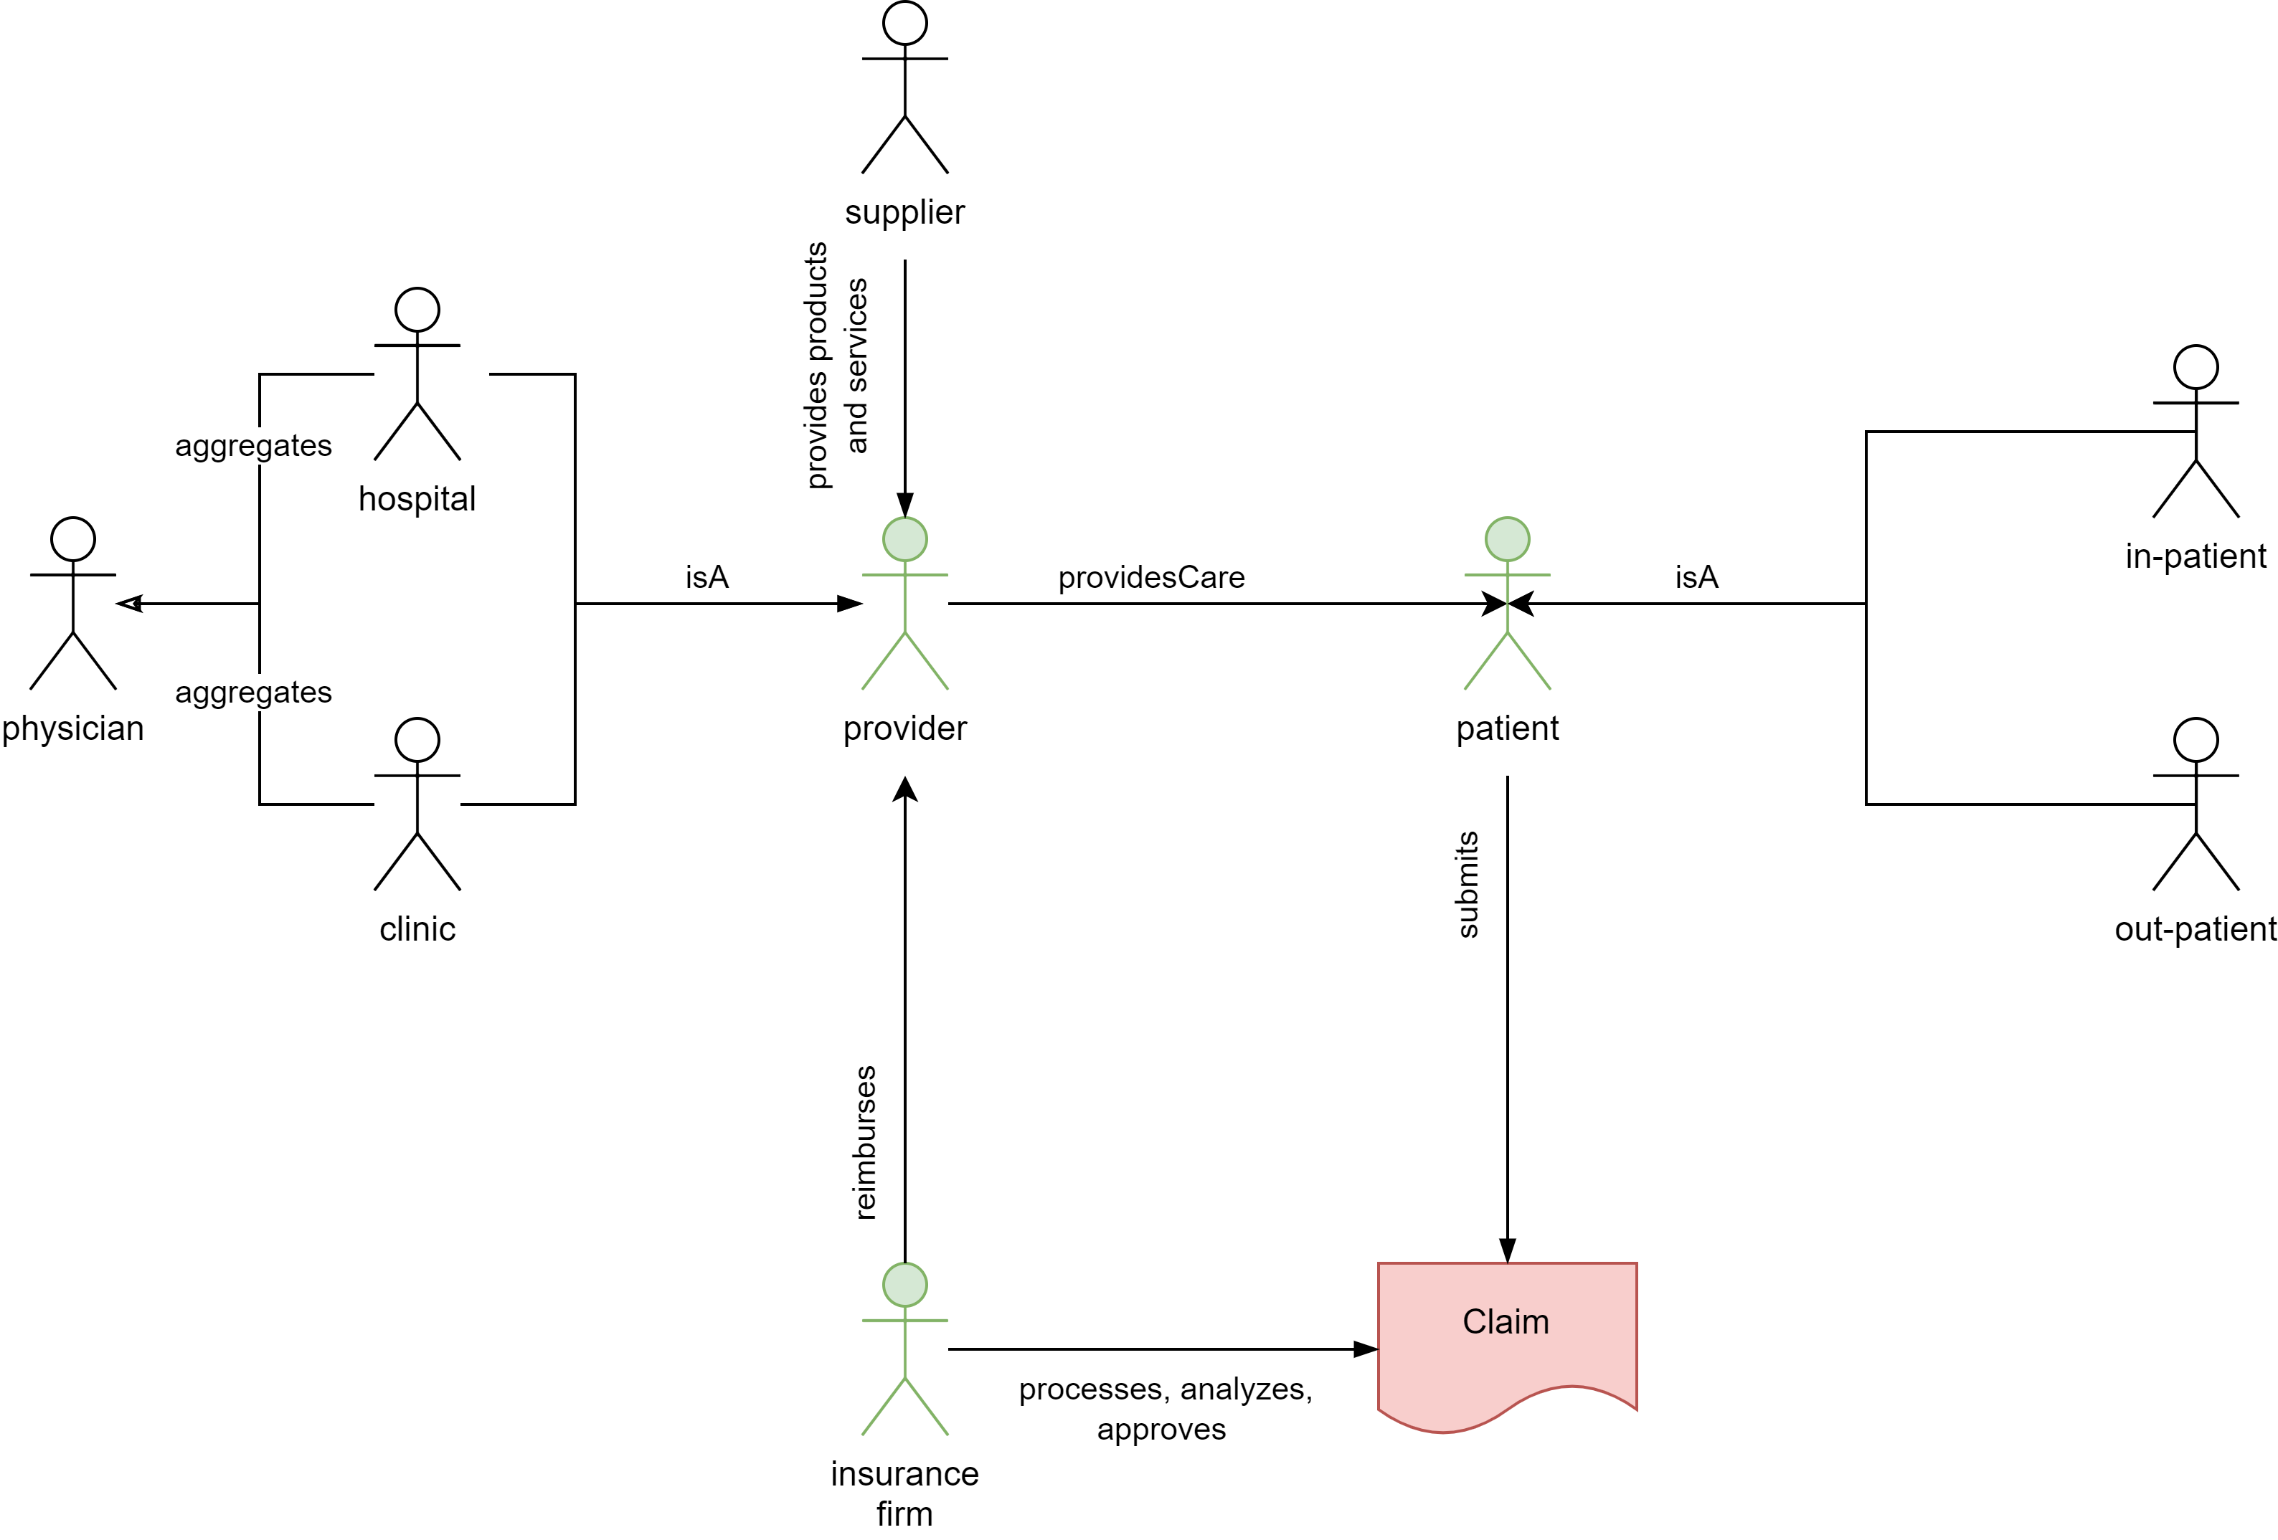

Slide 12
Findings: Claims EDA
Training data
Age: skewed towards patients >65 yrs
Geo: Most beneficiaries are from states 5, 10, 33, and 45
Procedures: ids 66, 3893, 8154, and 9904 have the highest cases of fraud
Out patients: some indications of repeat offense by provider
Insurance claim fraud – distribution of $ reimbursed
8% by provider
7% by attending physician
6% by operating physician
4% by claim diagnosis
Notes:
Specify what Problem is being solved, and ensure that everyone is in agreement as to Why that’s a problem.

Slide 13
Approach: Supervised Model – Labelled Providers
Data: Kaggle Dataset
Exploratory Data Analysis, Feature Engineering
Model Training: Supervised – Provider predictions, labels
Logistic Regression, Support Vector Machines, XG Boost, Auto-encoders, Auto-ML (TPOT)
Model Selection: XG Boost
Notes:
Specify what Problem is being solved, and ensure that everyone is in agreement as to Why that’s a problem.

Slide 14
Approach: Supervised Model – Labeled Providers
Amazon EC2
Kaggle Dataset
MLE10: Healthcare Claims Anomaly Detector
Data Eng
DEPLOY
Feat Eng
Auto Encoder
One Hot Encoding
Merged Train Data
TPOT
FastAPI
Correlation Check
SVM
Streamlit
Split Train, Valid
Feat Sel
XGB
New Feats (Avgs)
LogR
Merged Test Data
STAGE 1:
Model Comparison
STAGE 2:
Model Selection
STAGE 3:
Model Publishing
Notes:
Specify what Problem is being solved, and ensure that everyone is in agreement as to Why that’s a problem.

Slide 15
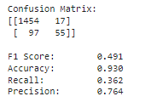
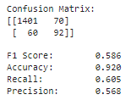
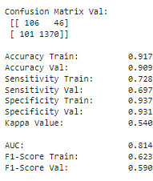

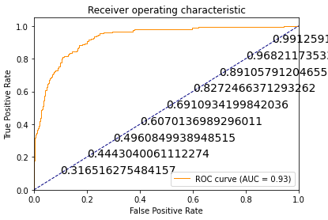

Findings: Supervised Model – Provider Labels
LogR | XG Boost | SVM | AutoEnc | TPot: XGBoost
Notes:
Specify what Problem is being solved, and ensure that everyone is in agreement as to Why that’s a problem.

Slide 16
Findings: Supervised Model – Provider Predictions
Creating addt'l features was extremely helpful to increase model accuracy ($Avgs)
Known Limitations:
Business Value: Predicting Anomalies at the Provider level is not compelling enough
Provider labels indicate at least one child claim is fraudulent, but you cannot infer anything further
Conversely, it is misleading to think that _all_ claims for a flagged Provider is fraudulent
Autoencoders were promising, however:
True labels only represent the scope of known fraud (unknowns exist)
False labels do not mean 'no fraud'; they should be viewed as 'indeterminate'
Notes:
Specify what Problem is being solved, and ensure that everyone is in agreement as to Why that’s a problem.

Slide 17
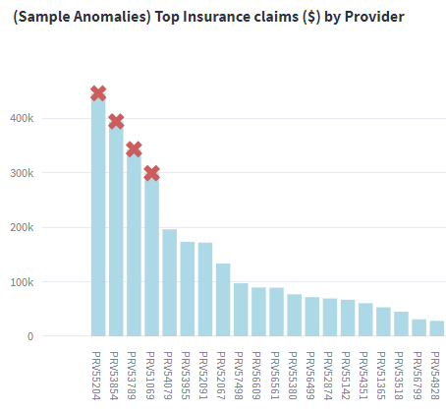
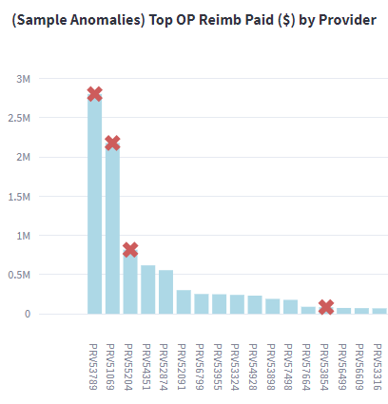
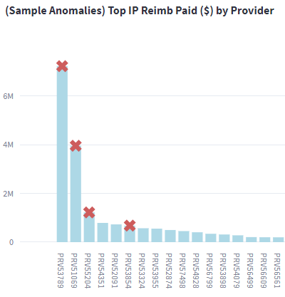
Findings: Supervised Model – XG Boost Provider Predictions
Notes:
Specify what Problem is being solved, and ensure that everyone is in agreement as to Why that’s a problem.

Slide 18
Approach 2: Unsupervised Model – Claim Labels
Data: Kaggle Dataset (same, but excluding provider labels)
Exploratory Data Analysis, Feature Engineering
Model Training: Unsupervised – Claim predictions, labels
KMeans Clustering
Notes:
Specify what Problem is being solved, and ensure that everyone is in agreement as to Why that’s a problem.

Slide 19
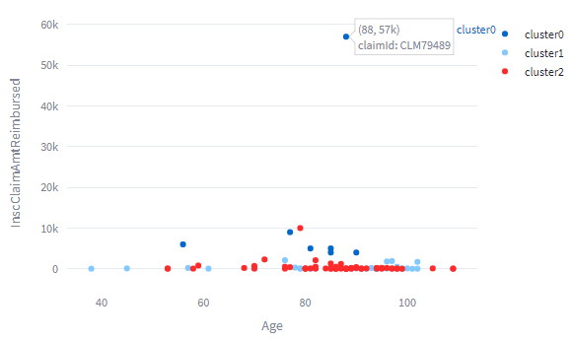
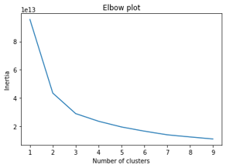
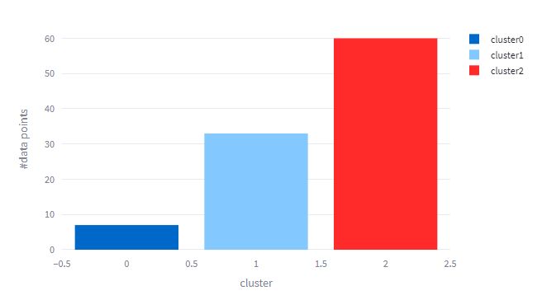
Findings: Unsupervised Model – KMeans Claim Labels
Notes:
Specify what Problem is being solved, and ensure that everyone is in agreement as to Why that’s a problem.

Slide 20
Findings: Unsupervised Model – Claim Labels
3 distinct clusters
Visual representation of anomalous claims is compelling
Known Limitations:
Business Value:
What uniquely distinguishes the 3 clusters? What does this tell us about anomaly profiles?
Provide more details re contributing factors to the claims anomaly
How to make it actionable as a recommendation system, or rule generation system?
Although criminals can be lazy, fraud is not a static entity. It evolves. As the model is re-trained and re-run, the end user needs to be provided better explainability tools
Notes:
Specify what Problem is being solved, and ensure that everyone is in agreement as to Why that’s a problem.

Slide 21
MLE Stack

Slide 22
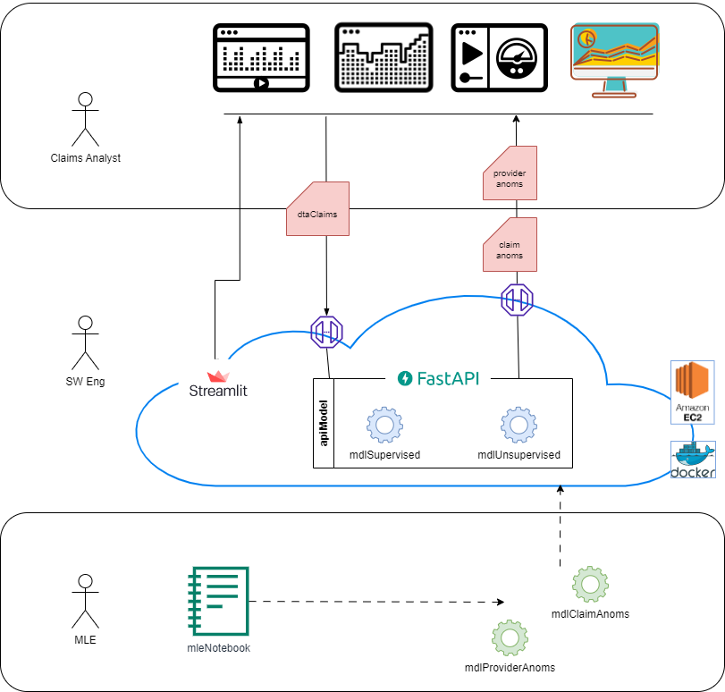

Slide 23
Demo

Slide 24
Future Work
Business Value:
Design a human feedback loop to capture which predictions were accurate or not;
Provide a fuzzy logic indicator of degree of fraud risk for a claim
Provide a breakdown of the attributes of fraud risk for a claim
Data:
Acquire claim-level labels to improve supervised training
Acquire labels for confirmed non-fraud, as well as confirmed fraud to improve Auto Encoder
Model:
Explore Variational Autoencoders, which have shown promise for credit card fraud

Slide 25
Future Work
Streamlit:
Provide capabilities to dig into claim to explore the contributing features of the anomaly
Upgrade to a HTML5 front-end
Separate hosting for Streamlit from FastAPI
FastAPI:
Expand api to include claims data verification, and json data request/response
Expand api to include model updates, retraining, and published model performance
Infrastructure:
Promote local Docker environments to hosted in Amazon EC2, or Kubernetes
MLOps:
Upgrade from Level0 to Level1; introduce aspects of retraining, monitoring
Host the model seperately in a service such as SageMaker

Slide 26
Questions? Feedback?

Slide 27
Appendices

Slide 28
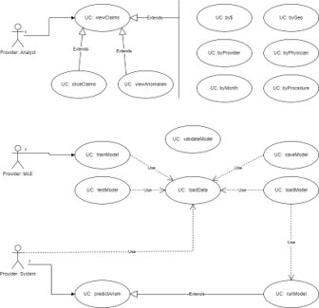

Slide 29
EDA: Training Data (csv)
Kaggle: https://www.kaggle.com/code/rohitrox/medical-provider-fraud-detection/data
The data isdivided into four sections:
Provider: labeled as fraud or not
Beneficiary information
In-patient information
Out-patient information
Data are anonymized; provider name,
Beneficiary name, state, insurance provider name are masked
5410 data points labelled Potential Fraud (Yes | No)
506 Yes, 4904 No
Imbalanced dataset (~10% target); class imbalance needs to be managed

Slide 30
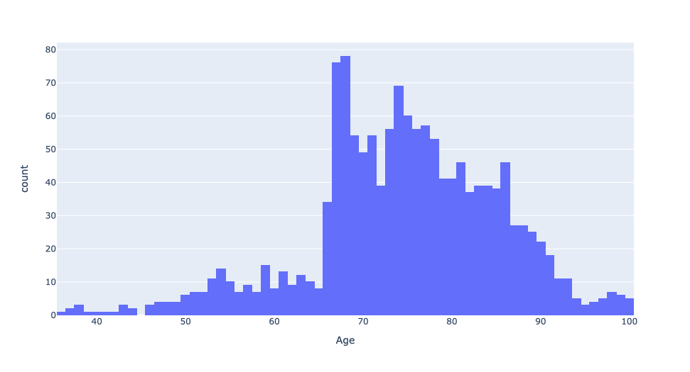
EDA: Training Data Feature: Age
Dataset biased towards age > 65 years
Is it easier indicative of prevalent fraud in one payer sector?
Feature: Age

Slide 31
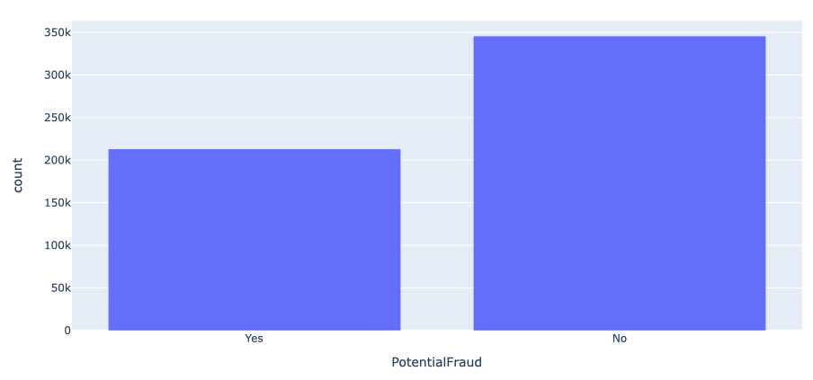
EDA: Fraud Label Distribution
Individual providers dataset when merged with patient dataset renders 60:40 ratio for no fraud/fraud
Key-take away: Providers who commit fraud victimize many patients (Note: misleading inference due to provider:claim mapping)
Fraud Label Distribution
Notes:
138,556 records, populated over the entire US, and many counties
Contains:
DOB, Gender, Race, Diseases, and Insurance related information
Diseases include:
Alzheimers, heart failure, kidney disease, cancer, pulmonary, depression, diabetes, Osteoporasis, rheumatoidarthritis, stroke condition etc.
Insurance related information:
Deductible amount, In-patient and Out-patient annual reimbursement amount etc.

Slide 32
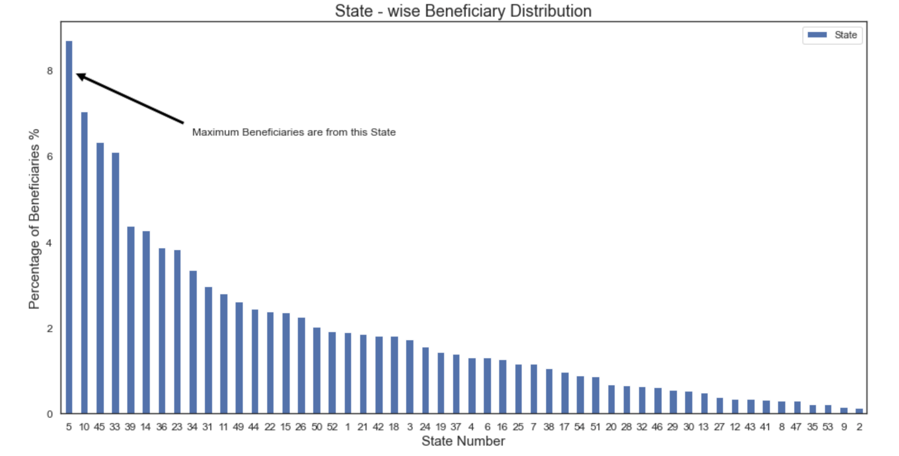
EDA: Beneficiary State-wise Distribution
Beneficiary state-wise distribution
Key-take away: Most beneficiaries are from states 5, 10, 45, and 33

Slide 33
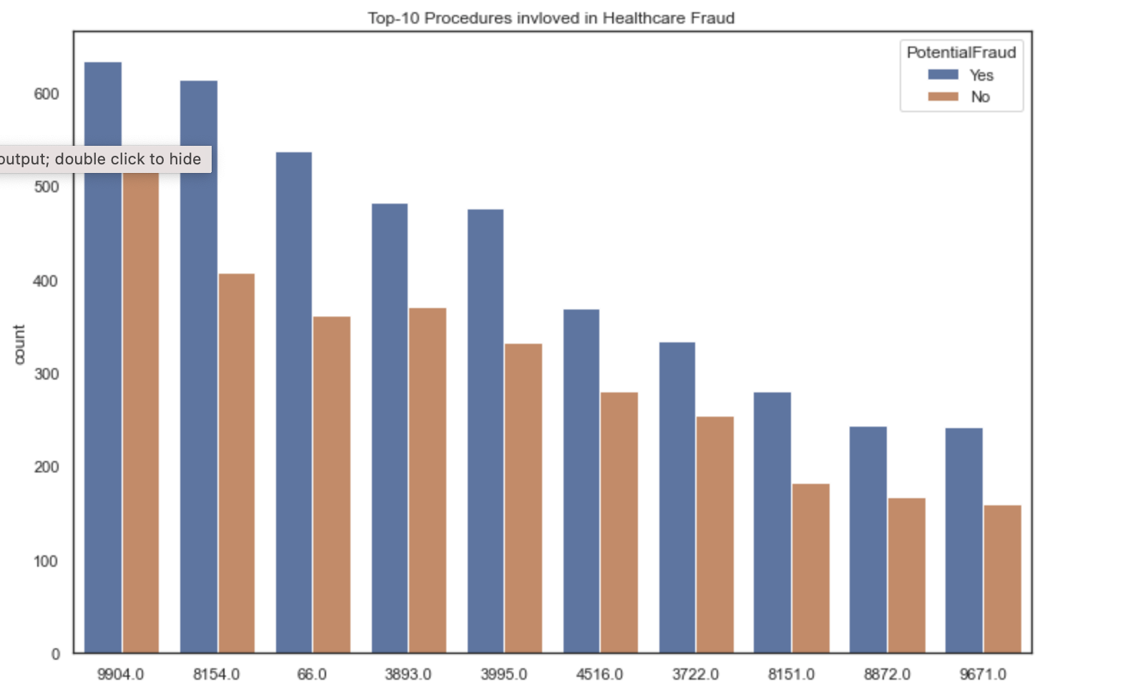
EDA: Procedures Where Fraud is Prevalent
Key-take away: Procedure IDs 9904, 8154, 66, and 3893 have largest number of fraud cases
Question: Why is it easier to commit fraud for these procedures
Fraud distribution by Procedure

Slide 34
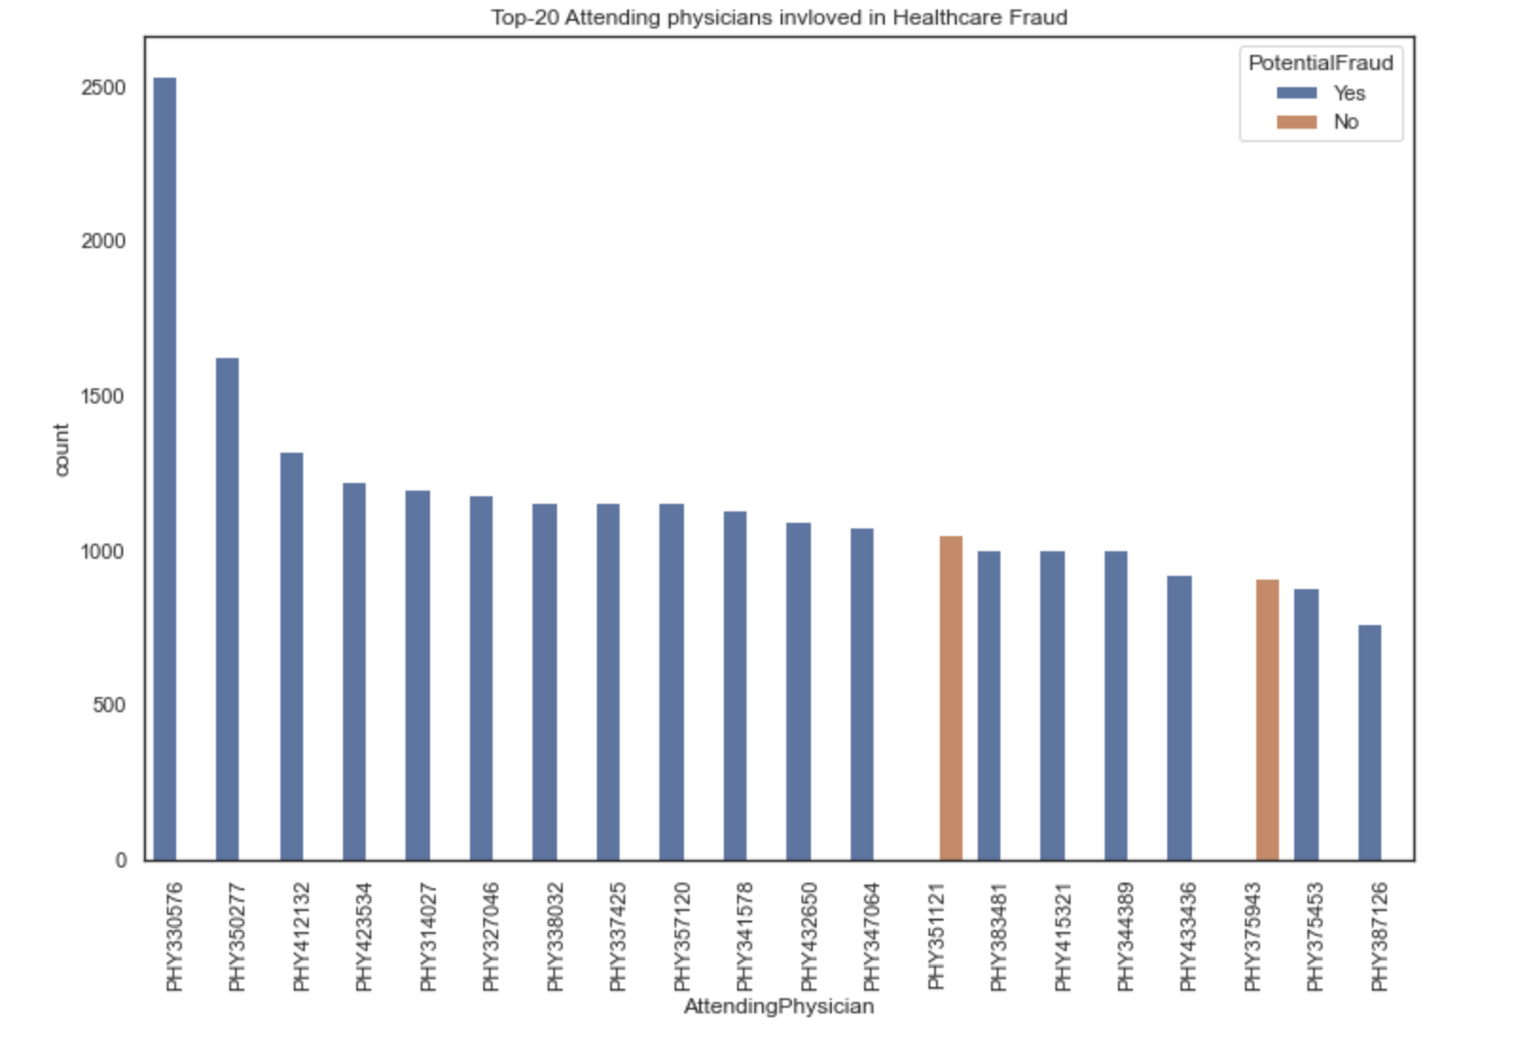
EDA: Out-Patient Train Data Summary
Key-take away: Providers who have a habit of committing fraud always commit fraud with every patient!

