Slide 1
Fourthbrain MLE10 Capstone Presentation Healthcare Fraud Detection
Ann Chevarria
David Lederer
Iain McKone
Monika Sharma
Notes:
[Iain]
Good evening and thankyou for your time and consideration
Today, our team including David, Monika, and Venkat will provide you a brief overview of
Not only a unique and compelling ML solution
But one that we believe will be positively impactful to the healthcare industry as a whole

Slide 2
Outline
Problem
Solution
Our Approach
Success Criteria, Audience
Data, Model
Demo
MLE Stack
Conclusions, Lessons Learned
Future Work
Q & A
Notes:
[Iain – the Pains]
Did you know that In 2021, during the height of the COVID pandemic … there was a team of healthcare fraudsters that caused consumers and insurers to lose an estimated $143M USD?
The DOJ list of accused included a doctor, lab owners, pharmacies and a home health agency
Healthcare fraud is lucrative, is becoming increasingly sophisticated
And it involves insiders who have intimate knowledge and access to tools, data, and processes
Due to cases like these, the US Healthcare Industry sees upwards of $300B/yr in fraud
Left unchecked, these losses drive the cost of healthcare up, the value of care down, and further reduces general accessibility to care
<next slide>
Arkansas: falsely submitted claims for deceased beneficiaries $88M
New Jersey: billed Medicare for services to beneficiaries that he never provided $19M
New Jersey: improper test bundling and kickbacks $5.4M

Slide 3
The Pain: Healthcare Fraud
A $300B/yr challenge!
Collusion exists across multiple parties
Abuse of data access, eg Identity theft
Unnecessary tests and procedures
Current detection is manual and ineffective
Source: https://www.cnbc.com/2021/05/26/doj-charges-14-people-in-alleged-health-care-fraud-related-to-covid-19.html
Notes:
[Iain – the Pains]
Did you know that In 2021, during the height of the COVID pandemic … there was a team of healthcare fraudsters that caused consumers and insurers to lose an estimated $143M USD?
The DOJ list of accused included a doctor, lab owners, pharmacies and a home health agency
Healthcare fraud is lucrative, is becoming increasingly sophisticated
And it involves insiders who have intimate knowledge and access to tools, data, and processes
Due to cases like these, the US Healthcare Industry sees upwards of $300B/yr in fraud
Left unchecked, these losses drive the cost of healthcare up, the value of care down, and further reduces general accessibility to care
<next slide>
Arkansas: falsely submitted claims for deceased beneficiaries $88M
New Jersey: billed Medicare for services to beneficiaries that he never provided $19M
New Jersey: improper test bundling and kickbacks $5.4M

Slide 4
The Promise: Increase Value & Care
for Healthcare Providers, Beneficiaries, Suppliers
Improved Fraud Detection
Recoup (and Prevention)
Improved consistency; automated detection
Reduce overall direct and indirect costs
Increase the accessibility of care
Notes:
[Iain – What can be done?]
What can be done?
Over the past few years there have been a number of advances, particularly in the space of data science that shows promise
this industry also has a wealth of historical financial data and fraud scenarios to leverage
Our team will explore the development of a solution
to detect financial anomalies and introduce a number of key benefits …
Combating fraud allows payers to drive positive revenue
It protects consumers from overbilling and increased premiums
And over time, financial assets are made more secure from criminal activity
Additionally, we expect that this solution framework and methodology will provide similar benefit to other fraud and compliance-sensitive industries
Given the complexity, and breadth of the problem domain, we must give careful thought to our MVP for immediate and measurable success
Monika will now walk us through some of the technical considerations, and general approach

Slide 5
The Solution: Our Approach
ML Anomaly Detection
Supervised
Unsupervised
Create mapping function from training data
Extracts knowledge from large datasets
Logistic Regression
Decision Trees
Random Forest
XGBoost/Light GBM
Support Vector Machines
Isolation Trees
K-means clustering
Auto-encoders
Notes:
[The How]

Slide 6
The Audience
John Smith
Chief Financial Officer
St. John Hospital
Mary Garland
Revenue Integrity Leader
St. Mary Mercy Hospital
Henry Jacob
Finance Planning and Analysis Leader
St. Jude Hospital
Business Metrics
ML Metrics
Number of new fraud cases detected
Recovery amount per fraud case detected
Fraud case priority (high/medium/low) based on financial risks/implications
Sensitivity
Specificity
F1-score
Source: All names and designation listed here are hypothetical

Slide 7
Data + Model
Kaggle: https://www.kaggle.com/code/rohitrox/medical-provider-fraud-detection/data
Data Exploration: Beneficiaries, Inpatients, Outpatients
Training Data: Fraud Labels
Imbalanced dataset (~10% target); class imbalance needs to be managed
Beneficiaries
Diseases: [0,1,2] values; replace 2’s with 0’s; does not have disease
Age: calculate based on DOB, DOD; majority dead > 65 yrs ; 1421 alive
IsDead: add a flag column
Inpatients
AdmittedDays: calculate based on admission and discharge datetimes
Outpatients

Slide 8
Demo

Slide 9
MLE Stack
Exploratory Data Analysis & Wrangling
Experimentation
Data Engineering Pipeline
Machine Learning Pipeline
Deployment Pipeline
These ^^ are probably worth talking about
Maybe consider…
Feature Store
Metadata store
Model registry
Model serving
Model Monitoring
Add your stack image here!

Slide 10
Conclusions
We learned to do end-to-end ML the easy way, the hard way
Let us tell you about it!
Here’s a tip or two for anyone who tries to walk down a similar path!
And the biggest lesson we’re taking with us into the future is …

Slide 11
Future Work
Given those conclusions and lessons…
here’s what we would do next…
in rank order…
and here’s why
That’s a wrap!

Slide 12
Closing Q/A
?

Slide 13
Executive Summary
01
02
03
04
The Pain
The Promise
Financial fraud currently impacts multiple industries.
Current data science techniques promise a compelling solution
Our Solution
Closing Q/A
A mix of data, ML technique, and talent
Open floor

Slide 14
The Solution
ML Anomaly Detection
for Healthcare Providers
14 weeks, 4 industry technical experts
representative data sets
supervised/unsupervised learning
Training, validation, testing
Process Engineering
Live Demo
Notes:
[Iain – high level solution overview]
Some simple performance measures could include: baseline and realized
Count of detection: #of anomalies (by category) /qtr
Impact of detection: Avg $ detected /qtr
Speed of detection: Avg Mean Time of Detection

Slide 15
EDA: Training Data (csv)
Kaggle: https://www.kaggle.com/code/rohitrox/medical-provider-fraud-detection/data
Data divided into four sections:
Provider: labeled as fraud or not
Beneficiary information
In-patient information
Out-patient information
Data are anonymized; provider name,
Beneficiary name, state, insurance provider name are masked
5410 data points labelled Potential Fraud (Yes | No)
506 Yes, 4904 No
Imbalanced dataset (~10% target); class imbalance needs to be managed

Slide 16
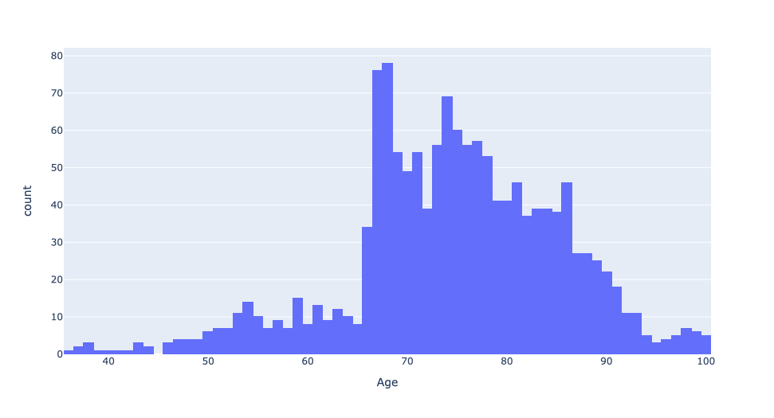
EDA: Training Data Feature: Age
Dataset biased towards age > 65 years
Is it easier indicative of prevalent fraud in one payer sector?
Feature: Age

Slide 17
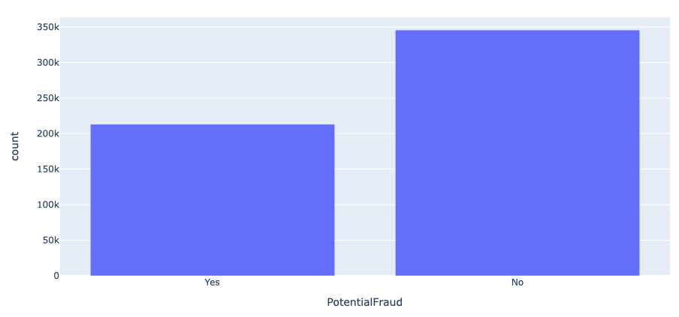
EDA: Fraud Label Distribution
Fraud Label Distribution
Individual providers dataset when merged with patient dataset renders 60:40 ratio for no fraud/fraud
Key-take away: Providers who commit fraud victimize many patients
Notes:
138,556 records, populated over the entire US, and many counties
Contains:
DOB, Gender, Race, Diseases, and Insurance related information
Diseases include:
Alzheimers, heart failure, kidney disease, cancer, pulmonary, depression, diabetes, Osteoporasis, rheumatoidarthritis, stroke condition etc.
Insurance related information:
Deductible amount, In-patient and Out-patient annual reimbursement amount etc.

Slide 18
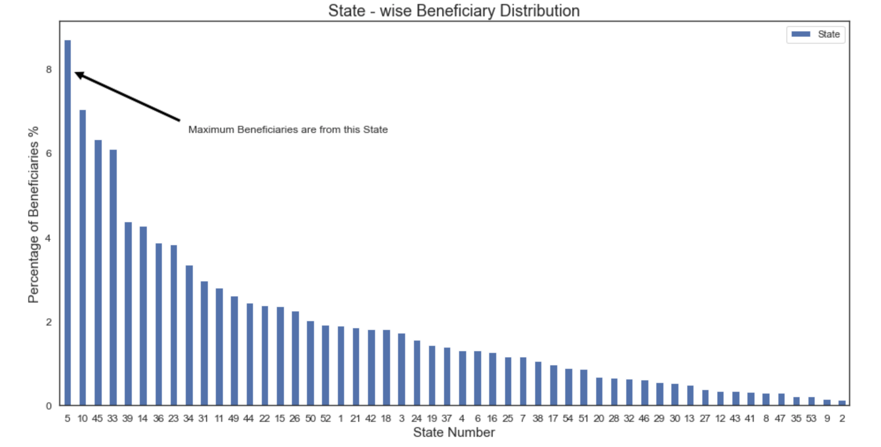
EDA: Beneficiary State-wise Distribution
Beneficiary state-wise distribution
Key-take away: Most beneficiaries are from states 5, 10, 45, and 33

Slide 19
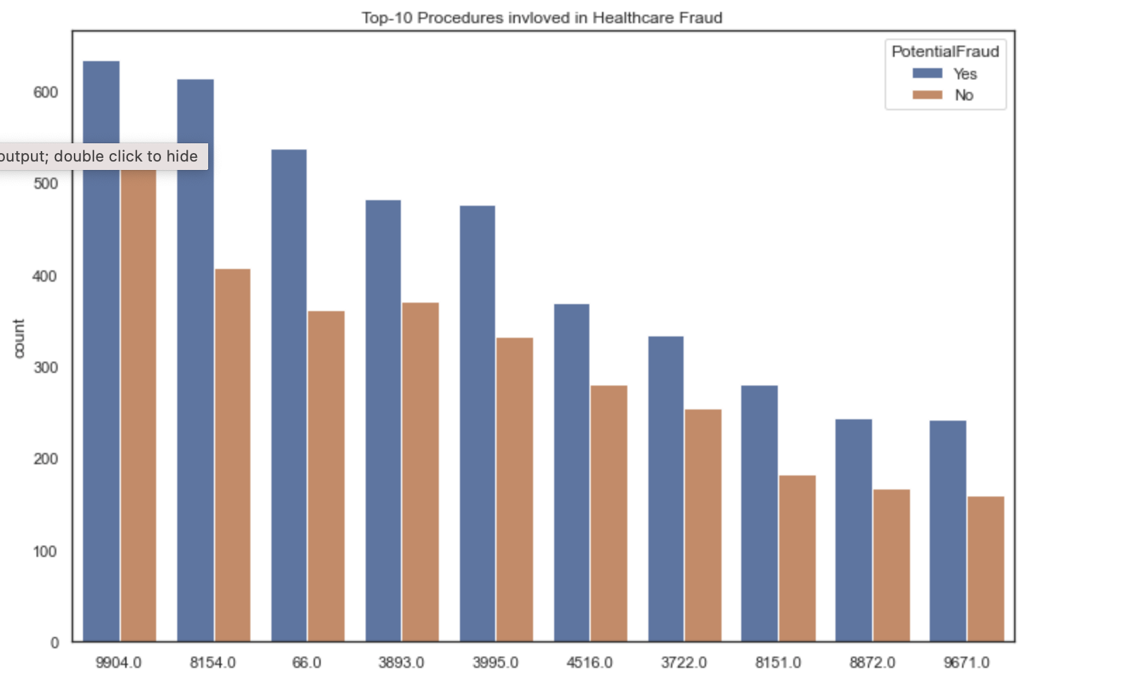
EDA: Procedures Where Fraud is Prevalent
Fraud distribution by Procedure
Key-take away: Procedure IDs 9904, 8154, 66, and 3893 have largest number of fraud cases
Question: Why is it easier to commit fraud for these procedures

Slide 20
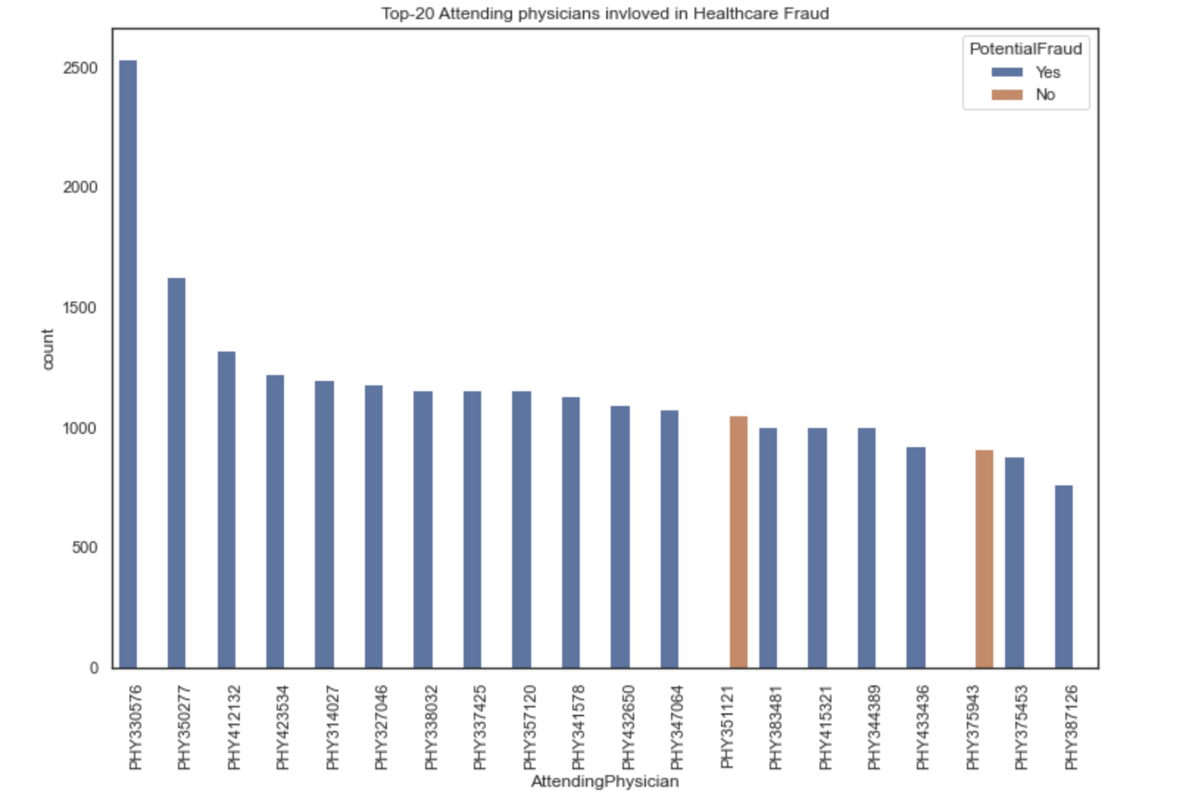
EDA: Out-Patient Train Data Summary
Key-take away: Providers who have a habit of committing fraud always commit fraud with every patient!

