Slide 1

Fourthbrain MLE10 Capstone Presentation Healthcare Fraud Detection
Ann Chavarria
David Lederer
Iain McKone
Monika Sharma
Notes:
[Iain]
Good evening and thankyou for your time and consideration
Today, our team including David, Monika, and Venkat will provide you a brief overview of
Not only a unique and compelling ML solution
But one that we believe will be positively impactful to the healthcare industry as a whole

Slide 2
Outline
Problem
Solution
Data + Model
Demo
MLE Stack
Conclusions, Lessons Learned
Future Work
Q & A
Notes:
[Iain – the Pains]
Did you know that In 2021, during the height of the COVID pandemic … there was a team of healthcare fraudsters that caused consumers and insurers to lose an estimated $143M USD?
The DOJ list of accused included a doctor, lab owners, pharmacies and a home health agency
Healthcare fraud is lucrative, is becoming increasingly sophisticated
And it involves insiders who have intimate knowledge and access to tools, data, and processes
Due to cases like these, the US Healthcare Industry sees upwards of $300B/yr in fraud
Left unchecked, these losses drive the cost of healthcare up, the value of care down, and further reduces general accessibility to care
<next slide>
Arkansas: falsely submitted claims for deceased beneficiaries $88M
New Jersey: billed Medicare for services to beneficiaries that he never provided $19M
New Jersey: improper test bundling and kickbacks $5.4M

Slide 3
Problem: Healthcare Fraud
A $300B/yr challenge! (USA)
A serious white-collar crime in US
Evolving and sophisticated
Collusion exists across multiple parties (see link)
Causes increased premiums
Reduction of access and quality of care
Current detection is manual and ineffective
Source: https://www.cnbc.com/2021/05/26/doj-charges-14-people-in-alleged-health-care-fraud-related-to-covid-19.html
Notes:
[Iain – the Pains]
Did you know that In 2021, during the height of the COVID pandemic … there was a team of healthcare fraudsters that caused consumers and insurers to lose an estimated $143M USD?
The DOJ list of accused included a doctor, lab owners, pharmacies and a home health agency
Healthcare fraud is lucrative, is becoming increasingly sophisticated
And it involves insiders who have intimate knowledge and access to tools, data, and processes
Due to cases like these, the US Healthcare Industry sees upwards of $300B/yr in fraud
Left unchecked, these losses drive the cost of healthcare up, the value of care down, and further reduces general accessibility to care
<next slide>
Arkansas: falsely submitted claims for deceased beneficiaries $88M
New Jersey: billed Medicare for services to beneficiaries that he never provided $19M
New Jersey: improper test bundling and kickbacks $5.4M

Slide 4



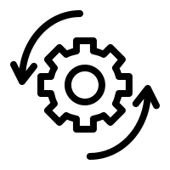
The Solution: Our Approach
ML Anomaly Detection
Use ML algorithms to automate:
analysis of claims data and
pattern identification for anomalies, e.g.
claims for services never rendered
services billed at inflated prices
Inconsistent billing codes (NLP?)
Assist insurers to:
more quickly settle genuine claims
identify unintentional claim errors
avoid fraudulent reimbursements
flag bad actors and recoup invalid claims
Notes:
[Notes –IM]
- By the time we hit the final preso, we should separate the final solution from the exploratory work; e.gg the final solution includes a combination of supervised and unsupervised learning using random forests and kmeans clustering. Please refer to appendices for an overview of

Slide 5
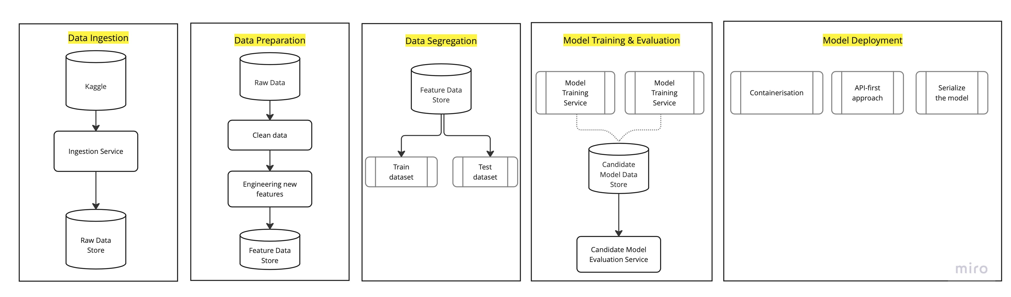
Data + Model
Kaggle: https://www.kaggle.com/code/rohitrox/medical-provider-fraud-detection/data

Slide 6
Data + Model
Supervised
Unsupervised
Create mapping function from training data and labels
Logistic Regression
Support Vector Machines
XGBoost*
TPOT
Extract knowledge / labels from large datasets
Isolation Trees
K-means clustering
Auto-encoders

Slide 7

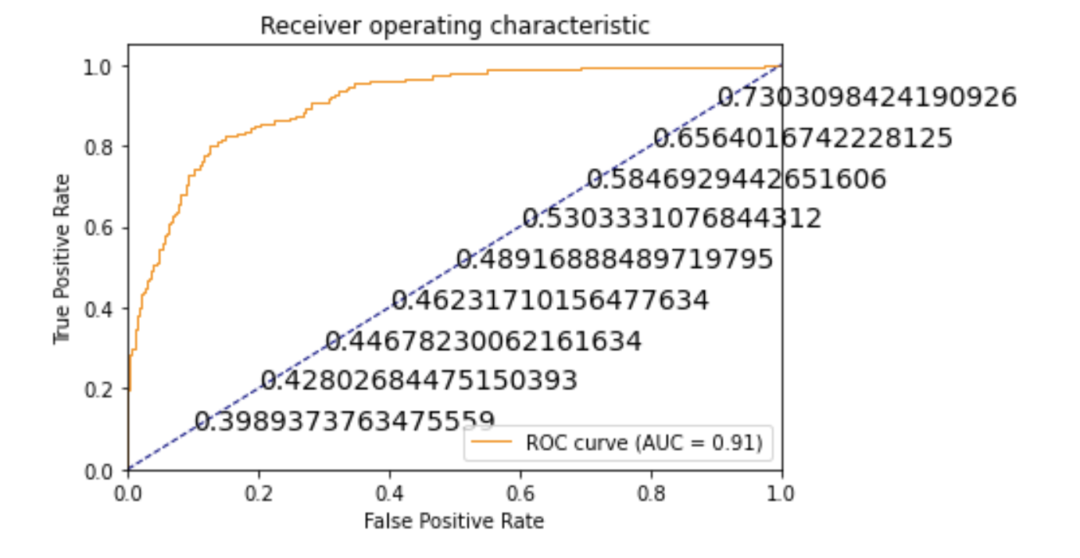
Data + Model: Supervised Evaluation
ROC-AUC curve based on XGBClassifier using TPOT
F1 Score | 0.59
Accuracy | 0.91
Recall | 0.61
Precision | 0.57

Slide 8
Learnings to Date
Creating additional features was extremely important (accuracy, fitting)
Avg Claim Reimbursement, Avg Deductible Paid
by Provider, by Attending Physician, by Operating Physician
Importance of features that help explain model predictability:
Amount of insurance claim reimbursed
Production considerations:
Evolving anomalies/fraud (supervised -> unsupervised learning)
Monthly Provider business and technical workflow (n+1 claims data)
per provider– 8%;
per attending physician – 7%
per operating physician – 6%
per claim diagnosis – 4%

Slide 9
Demo
Actor: Provider (Insurance Claim Analyst)
Use Case Scenarios:
UC1: Review monthly claim records
UC2: Identify potential anomalies

Slide 10
Future Work
Modelling
Supervised -> Unsupervised models – recognize that fraud is ever evolving.
Data
Mimic monthly update of claims data (no labels)
Find other sources or construe monthly data
Business workflow (Demo)
Mimic monthly analysis and detection of anomalies
Mimic change management of MLE process and model update (MLOps)
Technical workflow
UX workflow: Provider, MLE
Production-ready server api (dockerized fastAPI)

Slide 11
Closing Q/A
?

Slide 12
Appendices

Slide 13
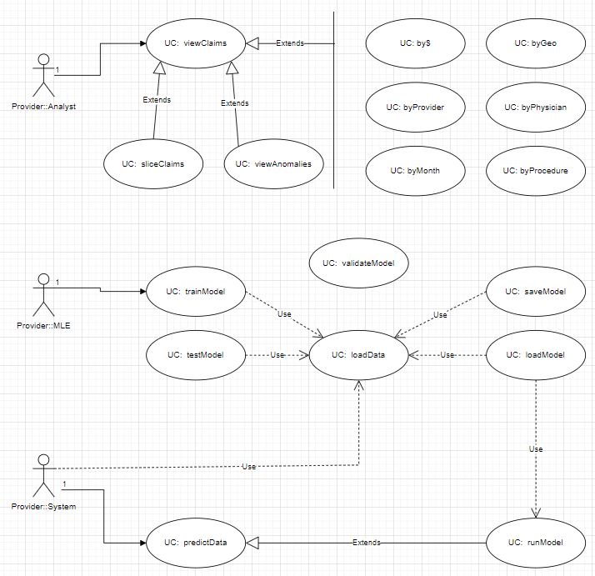

Slide 14
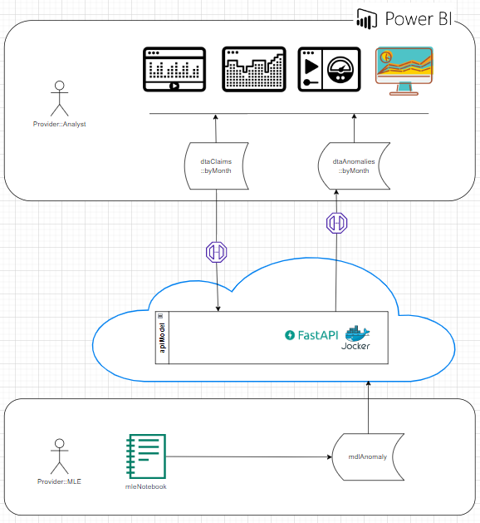

Slide 15
The Promise: Increase Value & Care
for Healthcare Providers, Beneficiaries, Suppliers
Improved Fraud Detection
Recoup (and Prevention)
Improved consistency; automated detection
Reduce overall direct and indirect costs
Increase the accessibility of care
Notes:
[Iain – What can be done?]
What can be done?
Over the past few years there have been a number of advances, particularly in the space of data science that shows promise
this industry also has a wealth of historical financial data and fraud scenarios to leverage
Our team will explore the development of a solution
to detect financial anomalies and introduce a number of key benefits …
Combating fraud allows payers to drive positive revenue
It protects consumers from overbilling and increased premiums
And over time, financial assets are made more secure from criminal activity
Additionally, we expect that this solution framework and methodology will provide similar benefit to other fraud and compliance-sensitive industries
Given the complexity, and breadth of the problem domain, we must give careful thought to our MVP for immediate and measurable success
Monika will now walk us through some of the technical considerations, and general approach

Slide 16
The Solution: Our Approach
ML Anomaly Detection
Map labels based on existing training data
Identify labels from large datasets
Supervised Learning
Unsupervised Learning
Explore:
Logistic Regression
Decision Trees
Random Forest
XGBoost/Light GBM
Support Vector Machines
Explore:
Isolation Trees ●
K-means clustering ●
Auto-encoders ●
Notes:
[Notes –IM]
- By the time we hit the final preso, we should separate the final solution from the exploratory work; e.gg the final solution includes a combination of supervised and unsupervised learning using random forests and kmeans clustering. Please refer to appendices for an overview of

Slide 17



The Audience
John Smith
Chief Financial Officer
St. John Hospital
Mary Garland
Revenue Integrity Leader
St. Mary Mercy Hospital
Henry Jacob
Finance Planning and Analysis Leader
St. Jude Hospital
Business Metrics
ML Metrics
Number of new fraud cases detected
Recovery amount per fraud case detected
Fraud case priority (high/medium/low) based on financial risks/implications
Sensitivity
Specificity
F1-score
Source: All names and designation listed here are hypothetical

Slide 18
Data + Model
Kaggle: https://www.kaggle.com/code/rohitrox/medical-provider-fraud-detection/data
Data Exploration: Beneficiaries, Inpatients, Outpatients
Training Data: Fraud Labels
Imbalanced dataset (~10% target); class imbalance needs to be managed
Beneficiaries
Majority are > 65 years of age
Inpatients
AdmittedDays: calculate based on admission and discharge datetimes
Outpatients

Slide 19
MLE Stack
Exploratory Data Analysis & Wrangling
Experimentation
Data Engineering Pipeline
Machine Learning Pipeline
Deployment Pipeline
These ^^ are probably worth talking about
Maybe consider…
Feature Store
Metadata store
Model registry
Model serving
Model Monitoring
Add your stack image here!

Slide 20
Conclusions
Fraud can be highly correlated to specific procedure codes
Fraud can be highly correlated to specific diagnoses
Fraud can be highly correlated to specific physicians
~30% of Beneficiaries are from 5 states (~40% from 10 states)
~80% of Beneficiaries are from 1 race (90% from 2 races)
Annual Deductible and Annual Reimbursement are highly correlated
DeductibleAmtPaid and AdmittedDays are highly correlated
We learned to do end-to-end ML the easy way, the hard way
Let us tell you about it!
Here’s a tip or two for anyone who tries to walk down a similar path!
And the biggest lesson we’re taking with us into the future is …

Slide 21
Future Work
Given those conclusions and lessons…
here’s what we would do next…
in rank order…
and here’s why
That’s a wrap!
Semi-supervised learning … what clusters of data? Can any be associated with fraud?

Slide 22
Executive Summary
01
02
03
04
The Pain
The Promise
Financial fraud currently impacts multiple industries.
Current data science techniques promise a compelling solution
Our Solution
Closing Q/A
A mix of data, ML technique, and talent
Open floor

Slide 23
The Solution
ML Anomaly Detection
for Healthcare Providers
14 weeks, 4 industry technical experts
representative data sets
supervised/unsupervised learning
Training, validation, testing
Process Engineering
Live Demo
Notes:
[Iain – high level solution overview]
Some simple performance measures could include: baseline and realized
Count of detection: #of anomalies (by category) /qtr
Impact of detection: Avg $ detected /qtr
Speed of detection: Avg Mean Time of Detection

Slide 24
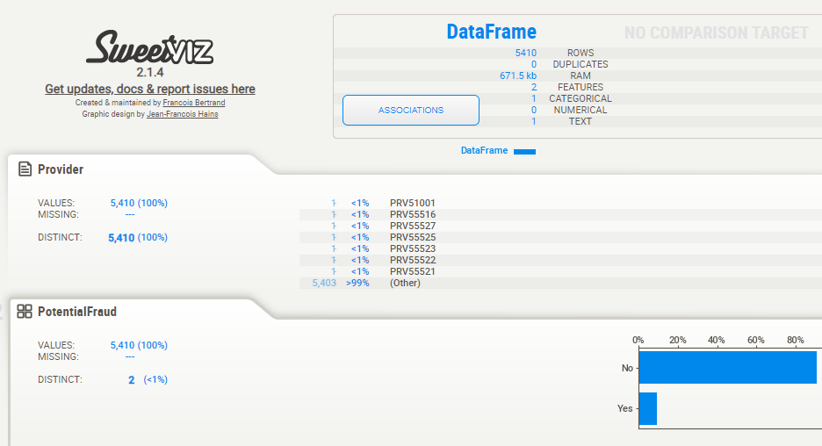
EDA: Training Data (csv)
Kaggle: https://www.kaggle.com/code/rohitrox/medical-provider-fraud-detection/data

Slide 25
EDA: Training Data (Potential Fraud)
5410 data points labelled Potential Fraud (Yes | No)
506 Yes, 4904 No
Imbalanced dataset (~10% target); class imbalance needs to be managed

Slide 26
EDA: Beneficiary Train Data Summary
138,556 records, populated over the entire US, and many counties
Contains:
DOB, Gender, Race, Diseases, and Insurance related information
Note: 99% of Date of Death data is missing; 1% were dead at the time of the report
Diseases include:
Alzheimers, heart failure, kidney disease, cancer, pulmonary, depression, diabetes, Osteoporasis, rheumatoidarthritis, stroke condition etc.
Insurance related information:
Deductible amount, In-patient and Out-patient annual reimbursement amount etc.
Notes:
Observations:
Training Data
5410 Rows; No Duplicates
2 Features: 1 Categorical, 1 Text
(target label) Potential Fraud: Yes::No = 506::4904
Class Imbalanced dataset: 10::90
Training Data: Beneficiaries
138556 Rows; No Duplicates
25 Features: 15 Categorical, 8 Numerical, 2 Text
DOD: Date of Death – 99% Missing Values
Training Dta

Slide 27
EDA: Beneficiary Train Data
Replaced disease column values 2 -> 0; ie does not have disease
Contains:
DOB, Gender, Race, Diseases, and Insurance related information
Diseases include:
Alzheimers, heart failure, kidney disease, cancer, pulmonary, depression, diabetes, Osteoporasis, rheumatoidarthritis, stroke condition etc.
Insurance related information:
Deductible amount, In-patient and Out-patient annual reimbursement amount etc.

Slide 28
EDA: In-Patient Train Data Summary
40,474 records
Contains:
Beneficiary ID, Claim ID, start and end day of the claim
Provider that rendered various services
Amount reimbursed by the insurance company
Most importantly, it contains
Diagnosis code,
Multiple claim diagnosis code,
Multiple claim procedure code etc.

Slide 29
EDA: Out-Patient Train Data Summary
517,737 records
Contains: (similar to In-Patient structure)
Beneficiary ID, Claim ID, start and end day of the claim
Provider that rendered various services
Amount reimbursed by the insurance company, deductible amt paid
Attending physician, Operating Physician
Most importantly, it contains
Diagnosis code,
Multiple claim diagnosis code,
Multiple claim procedure code etc.

Slide 30
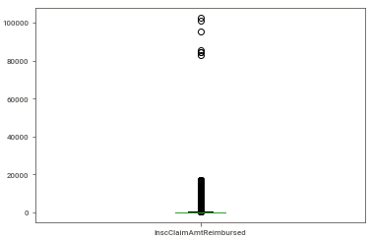
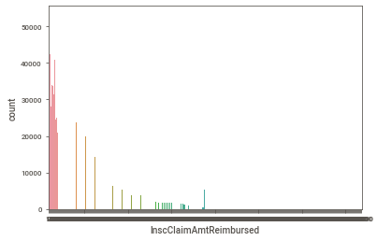
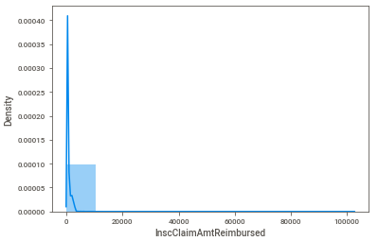
EDA: Out-Patient Train Data

