Slide 1
Detecting Fraud in United States Healthcare System Ann Chavarria, David Lederer, Iain McKone, Monika Sharma
Notes:
This is the slide where you actually SAY your 1-2 sentence elevator pitch. Engage your audience!!

Slide 2
Outline
Problem
Solution
Data + Model
Demo
MLE Stack
Conclusions (and lessons learned)
Future Work

Slide 3

Problem
Healthcare fraud is a serious white-collar crime in US
Results in increased premiums or pose harm to beneficiaries
Scale
According to National Health Care Anti-Fraud Association, ~$300 billion is lost to fraud in US
Example
14 people – including medical doctor, owners of laboratories, pharmacies, and home health agency – were charged in multiple Covid-related fraud schemes
Bilked consumers and insurers out of $143 million
Source: https://www.cnbc.com/2021/05/26/doj-charges-14-people-in-alleged-health-care-fraud-related-to-covid-19.html
Notes:
Specify what Problem is being solved, and ensure that everyone is in agreement as to Why that’s a problem.

Slide 4




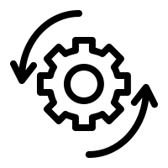
Solution
Use ML algorithms to automate claims data analysis and identify patterns of anomalies, e.g.
claims for services never rendered
services billed at inflated prices
inconsistent billing codes (NLP)
Assist insurers
to more quickly settle genuine claims
to identify unintentional claim errors
to avoid fraudulent reimbursements
to flag bad actors and potentially recoup funds
Notes:
Specify what Success looks like, and for what Audience.

Slide 5
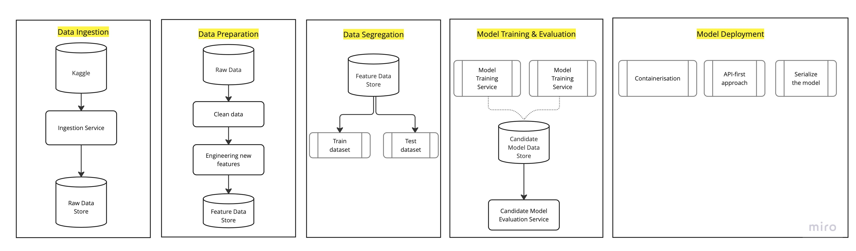
Data Lineage
Kaggle: https://www.kaggle.com/code/rohitrox/medical-provider-fraud-detection/data

Slide 6


Modeling
Supervised Technique
Unsupervised Technique
Create mapping function from training data
Extracts knowledge from large datasets
Logistic Regression
Support Vector Machines
XGBoost*
TPOT
Isolation Trees
K-means clustering
Auto-encoders

Slide 7

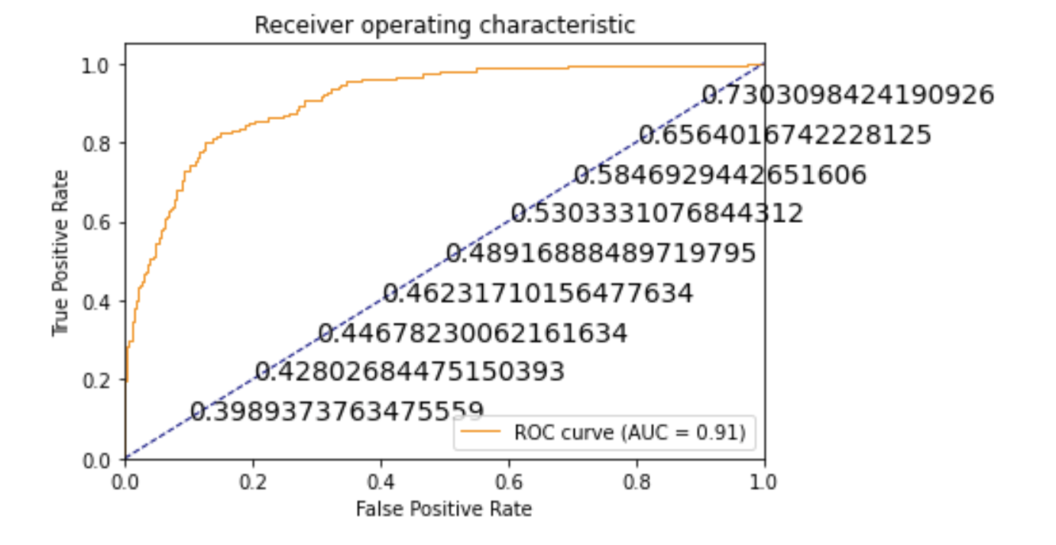
Model Evaluation
ROC-AUC curve based on XGBClassifier using TPOT
F1 Score | 0.59
Accuracy | 0.91
Recall | 0.61
Precision | 0.57

Slide 8
Learnings so far
Kaggle dataset is based on Medicare/Medicaid insurer.
Fraud is complex, sophisticated, and evolving; can include collusion of peers, businesses
Creating additional features was extremely important (accuracy, fitting)
Avg Claim Reimbursement, Avg Deductible Paid
by Provider, by Attending Physician, by Operating Physician
Importance of features that help explain model predictability:
Amount of insurance claim reimbursed
Production considerations:
Monthly Provider business and technical workflow (n+1 claims data)
Evolving anomalies/fraud (unsupervised learning)
per provider– 8%;
per attending physician – 7%
per operating physician – 6%
per claim diagnosis – 4%

Slide 9

Demo
… & screen share well!

Slide 10
Future Work
Modelling
Unsupervised models – recognize and respect that fraud is ever evolving.
Data
Mimic monthly update of claims data (no labels)
Find other sources or construe monthly data
Business workflow (Demo)
Mimic monthly analysis and detection of anomalies
Mimic change management of MLE process and model update (Notebook: exploration vs production updates)
Technical workflow
UX workflow: Provider, MLE, System (Tableau / Streamlit)
Production-ready server api (dockerized fastAPI)
Analyze Dataflows, and process flows

Slide 11
Thank You! Questions?

Slide 12
Appendices

Slide 13
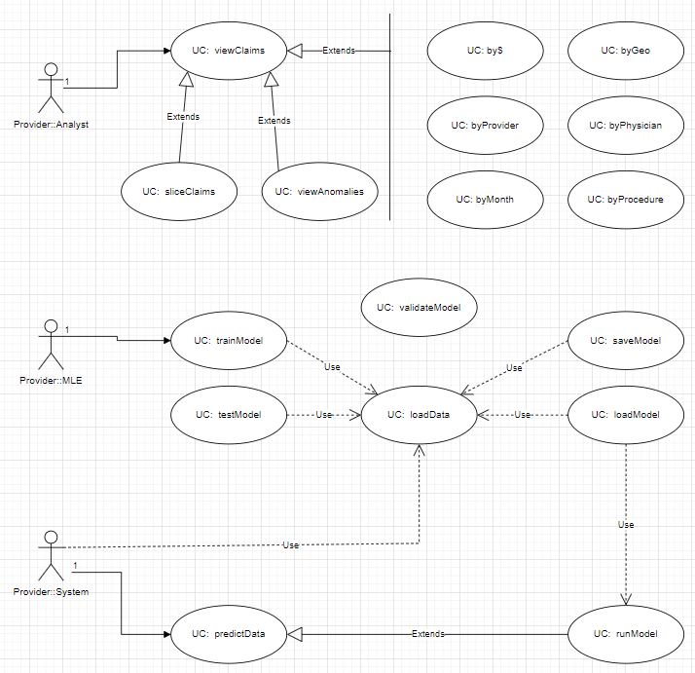

Slide 14
