Slide 1
MLE 10 Capstone:
Healthcare Claim Anomaly Detection Iain McKone, Monika Sharma
Notes:
This is the slide where you actually SAY your 1-2 sentence elevator pitch. Engage your audience!!

Slide 2
Outline
Problem Domain
Our Approach
Data, Model(s)
Demo
MLE Stack
Conclusions
Future Considerations
Q & A

Slide 3

Problem Domain:
Healthcare fraud is a serious white-collar crime in US
Est. $70B (3% of total spend) is attributed to fraud; max $300B
An increasingly sophisticated crime (e.g. collusion)
https://www.nhcaa.org/tools-insights/about-health-care-fraud/the-challenge-of-health-care-fraud/
https://www.bcbsm.com/health-care-fraud/fraud-statistics.html
Notes:
Specify what Problem is being solved, and ensure that everyone is in agreement as to Why that’s a problem.

Slide 4
Examples
($300M) 2022 April - 11 defendants charged with kickback schemes involving collusion between medical practitioners, laboratories, and a marketing firm.
https://www.justice.gov/usao-ndtx/pr/11-defendants-plead-guilty-300-million-healthcare-fraud
($143M) 2021 May - 14 defendants charged with multiple covid-related fraud schemes i.e. collusion between a medical doctor, laboratories, pharmacies, and a home health agency.
https://www.cnbc.com/2021/05/26/doj-charges-14-people-in-alleged-health-care-fraud-related-to-covid-19.html
Notes:
Specify what Problem is being solved, and ensure that everyone is in agreement as to Why that’s a problem.

Slide 5
Implications:
Overwhelms the system with unnecessary tests and procedures
Increases the cost of care
Increases insurance premiums ($)
Reduces accessibility to care ($)
Reduces availability of care (scheduling)
Reduces value, quality of care
Notes:
Specify what Problem is being solved, and ensure that everyone is in agreement as to Why that’s a problem.

Slide 6
Current State: (envisioned as-is; do-nothing)
 | yoy Growth
Claim Submissions
Anomalies
Reqd Effort: Detection
Available Effort: Analyst Person Hours
Notes:
Specify what Problem is being solved, and ensure that everyone is in agreement as to Why that’s a problem.

Slide 7
Future State: (envisioned to-be)
Q: For Claims Anomalies, can Data Science:
Automate; reduce the overall time and cost required for anomaly detection?
Accurately minimize the number of invalid, erroneous claims and reimbursements?
Continuously evolve in response to shifting data and behavior patterns?
Notes:
Specify what Problem is being solved, and ensure that everyone is in agreement as to Why that’s a problem.

Slide 8
Approach: Data
Kaggle - https://www.kaggle.com/code/rohitrox/medical-provider-fraud-detection/data
Anonymized: Geography, Race, Provider
Pre-split Train and Test Claims data (~558k vs 135k rows)
Provider Labels: 506 Yes, 4904 No
Beneficiary Claims, Reimbursements
In/Out Patient Claims, Procedures, Admit Duration
Notes:
To do:
Add some info on nature of data set

Slide 9
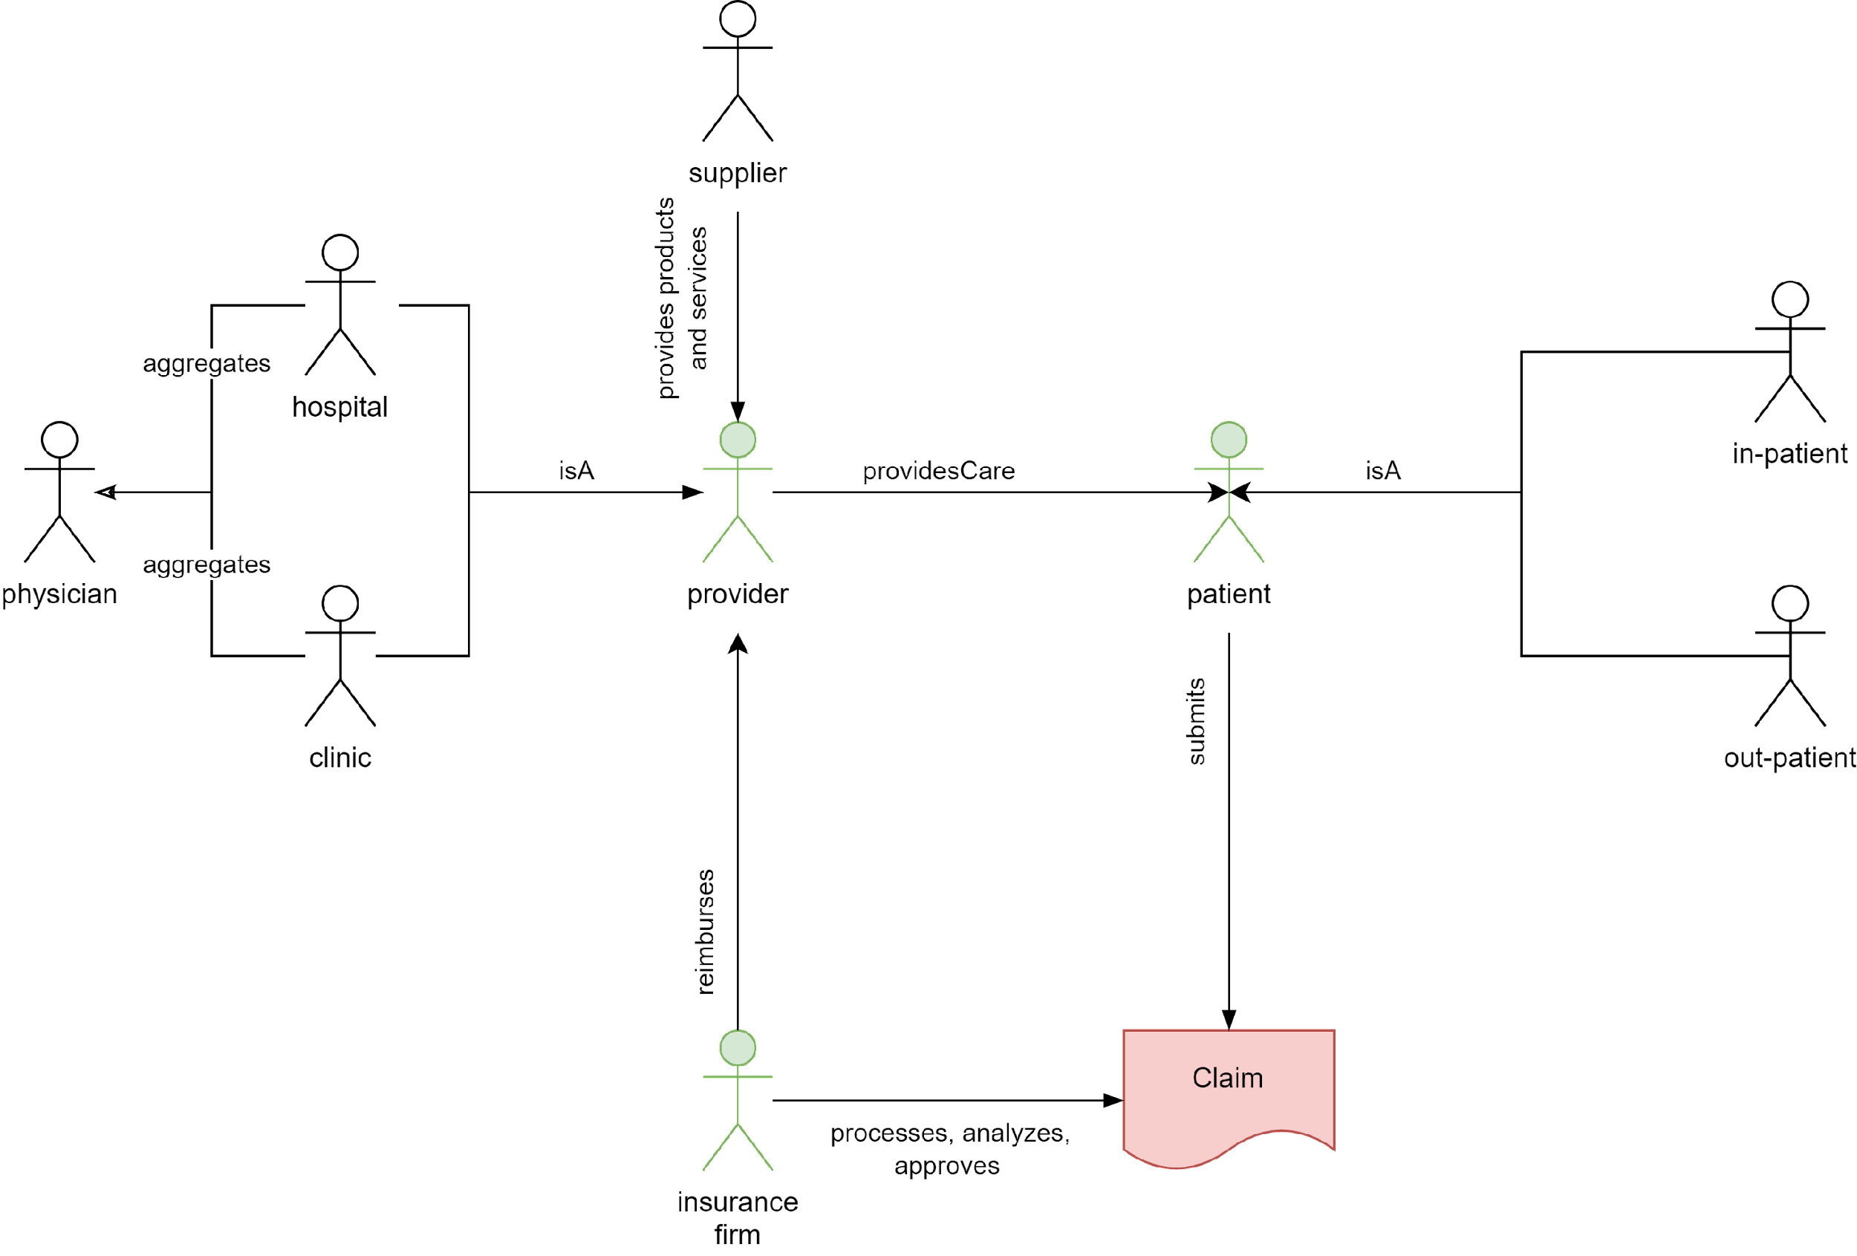

Slide 10
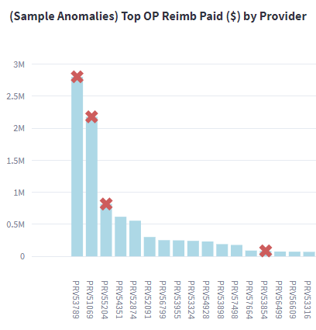
Approach 1: Providers - Supervised – Fraud Labels
Kaggle
Auto Encoders
Training
LogR
Provider Fraud
Validation
SVM
Claims
Test
XGB
STAGE 1:
Data Pipeline
STAGE 2:
Feature Eng
STAGE 3:
Model Comparison
STAGE 4:
Model Publishing
Notes:
Specify what Problem is being solved, and ensure that everyone is in agreement as to Why that’s a problem.

Slide 11
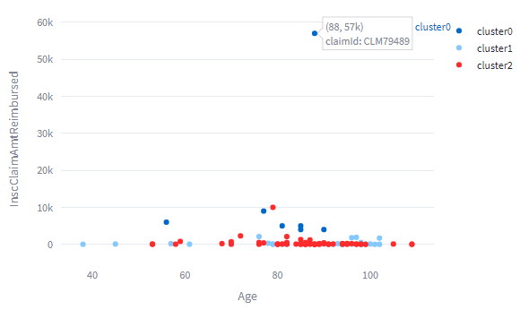
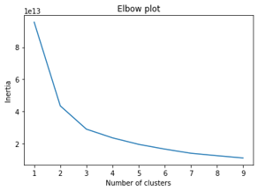
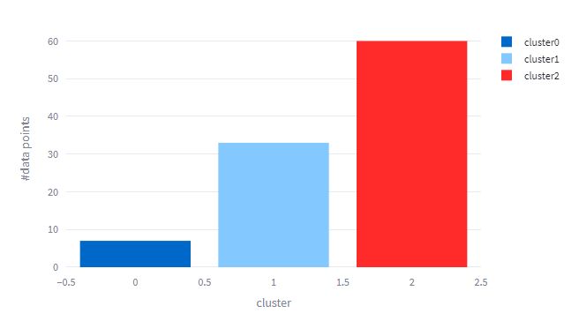
Approach 2: Claims - Unsupervised – No Fraud Labels
Random Forest Classifier
Kaggle Dataset
Claims
STAGE 1:
Data Pipeline
STAGE 2:
Feature Eng, Inertia Analysis
STAGE 3:
Cluster Analysis, Explainability
STAGE 4:
Model Publishing
Notes:
Specify what Problem is being solved, and ensure that everyone is in agreement as to Why that’s a problem.

Slide 12
Demo

Slide 13
MLE Stack

Slide 14
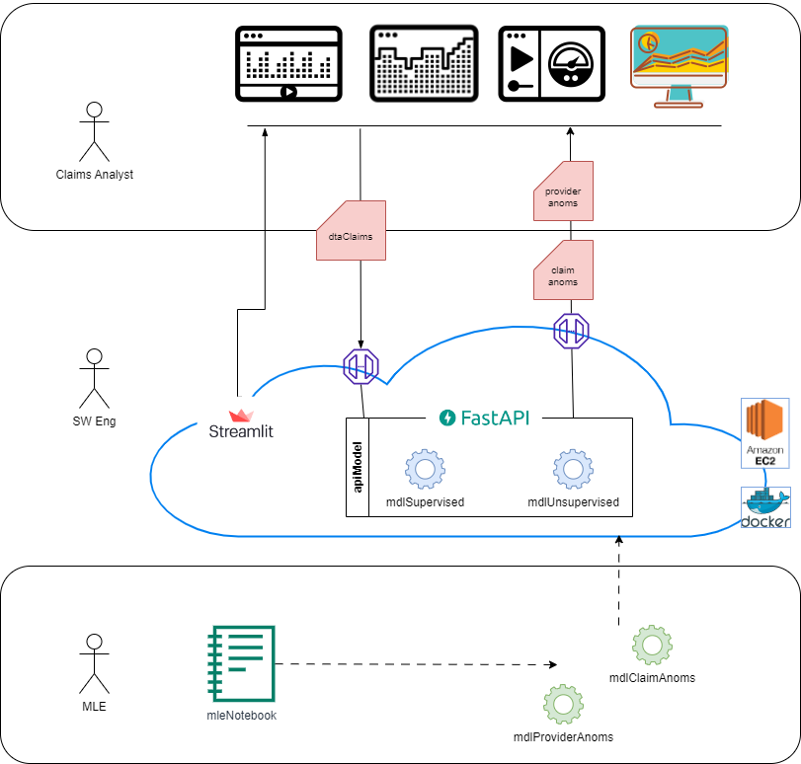

Slide 15
Approach 1 Findings: Supervised Provider Anomalies
 | LogR | XG Boost (TPot) | SVM | Auto Encoders
F1 Score | 0.591 | 0.586 | 0.491 | 0.802
Accuracy | 0.909 | 0.920 | 0.930 | 0.868
Recall | 0.697 | 0.605 | 0.362 | 0.752
Precision | 0.512 | 0.568 | 0.764 | 0.858
Notes:
Specify what Problem is being solved, and ensure that everyone is in agreement as to Why that’s a problem.

Slide 16
Approach 1 Findings: Supervised Provider Anomalies
Explainability: Insurance Claim Reimbursements ($) were flagged as the most influential feature
Known Limitations:
Business Value: Predicting Anomalies at the Provider level was not compelling enough
Models: Autoencoder Performance was very promising, however the data is misleading
Data
Provider True (Fraud) labels are at best incomplete
Provider False (No-Fraud) labels are at best 'indeterminate'
Mapping Provider Fraud Labels to all child Claims is a weak extrapolation
Notes:
Specify what Problem is being solved, and ensure that everyone is in agreement as to Why that’s a problem.

Slide 17
Approach 2 Findings: Unsupervised Claim Labels
Visual representation of anomalous claims is very compelling and user friendly
Cluster0 (90%-3f): AdmittedDays, DeductibleAmtPaid, InscClaimAmtReimbursed
Cluster1 (40%-3f): ChronicCond - KidneyDisease, Heartfailure, ObstrPulmonary
Cluster2 (40%-3f): ChronicCond - KidneyDisease, Heartfailure, ObstrPulmonary
Original Provider Labels were mapped to Cluster-Claims with even distribution, ~430 per
Known Limitations:
Business Value:
Cluster Explainability: What does this tell us about coarse anomaly profiles?
Supplementary Details: Provide more details re contributing factors to a claim anomaly
Notes:
Specify what Problem is being solved, and ensure that everyone is in agreement as to Why that’s a problem.

Slide 18
Conclusions
Business Value
Automation; reduce the overall time and cost required for anomaly detection
Accurately minimize the number of invalid, erroneous claims and reimbursements
Continuously evolve in response to shifting data and behavior patterns
Provide Deeper Insights – Explainability

Slide 19
Future Work
Business Value:
Introduce a human feedback loop for ongoing model improvements;
Provide a fuzzy logic indicator of degree of fraud risk for a claim
Provide a visual breakdown of the attributes of fraud risk for a claim
Data:
Acquire claim-level labels to improve supervised training
Acquire labels for confirmed non-fraud, as well as confirmed fraud to improve Auto Encoders
Model:
Explore Variational Autoencoders, which have shown promise for credit card fraud

Slide 20
Questions? Feedback?

Slide 21
Appendices

Slide 22
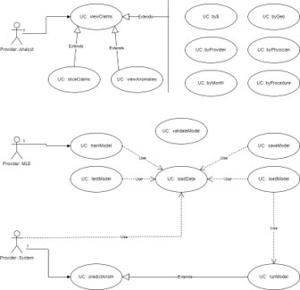

Slide 23
EDA: Training Data (csv)
Kaggle: https://www.kaggle.com/code/rohitrox/medical-provider-fraud-detection/data
Data divided into four sections:
Provider: labeled as fraud or not
Beneficiary information
In-patient information
Out-patient information
Data are anonymized; provider name,
Beneficiary name, state, insurance provider name are masked
5410 data points labelled Potential Fraud (Yes | No)
506 Yes, 4904 No
Imbalanced dataset (~10% target); class imbalance needs to be managed

Slide 24
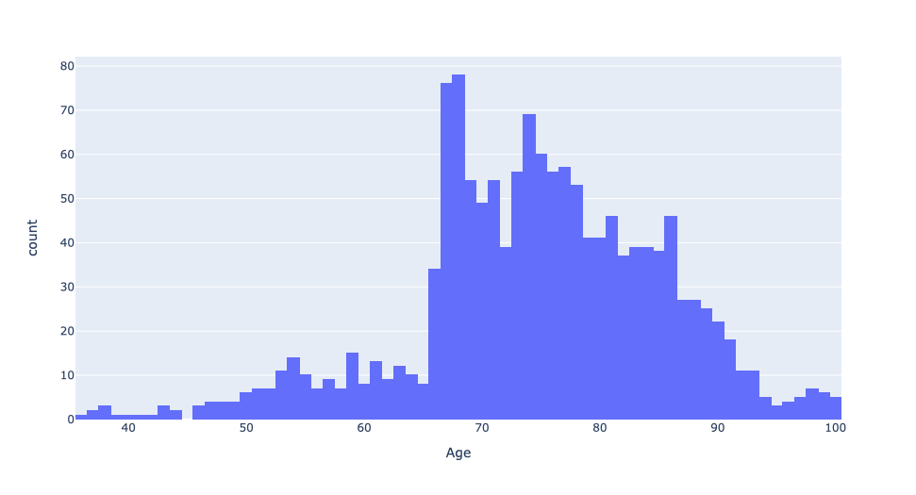
EDA: Training Data Feature: Age
Dataset biased towards age > 65 years
Is it easier indicative of prevalent fraud in one payer sector?
Feature: Age

Slide 25
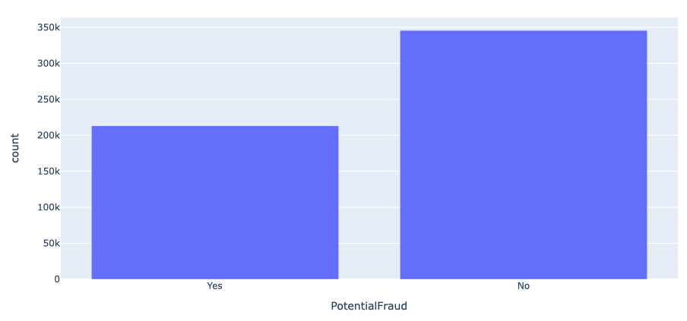
EDA: Fraud Label Distribution
Individual providers dataset when merged with patient dataset renders 60:40 ratio for no fraud/fraud
Key-take away: Providers who commit fraud victimize many patients (Note: misleading inference due to provider:claim mapping)
Fraud Label Distribution
Notes:
138,556 records, populated over the entire US, and many counties
Contains:
DOB, Gender, Race, Diseases, and Insurance related information
Diseases include:
Alzheimers, heart failure, kidney disease, cancer, pulmonary, depression, diabetes, Osteoporasis, rheumatoidarthritis, stroke condition etc.
Insurance related information:
Deductible amount, In-patient and Out-patient annual reimbursement amount etc.

Slide 26
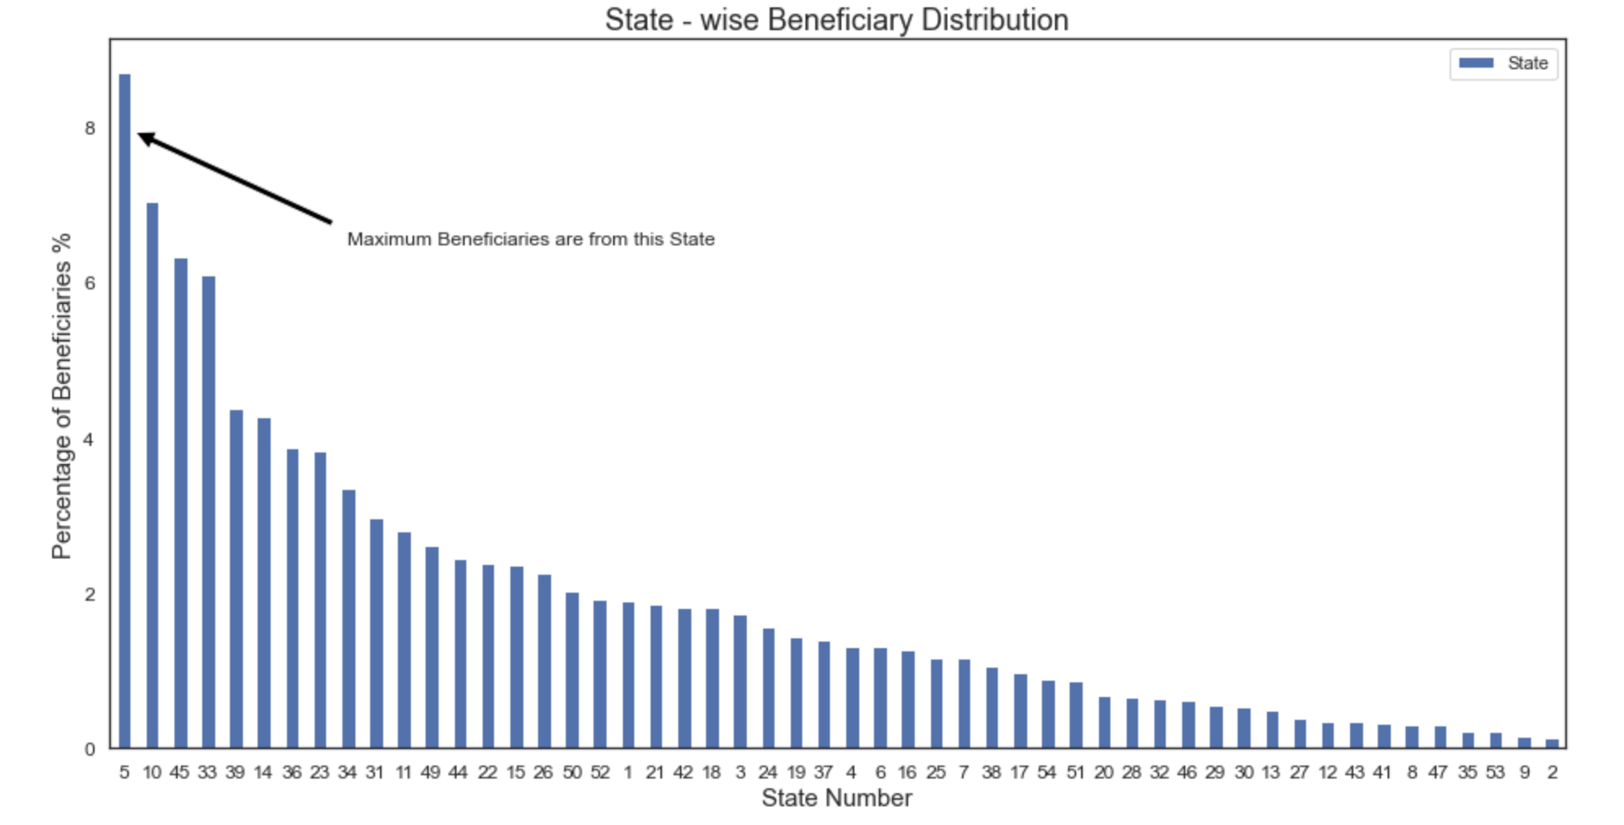
EDA: Beneficiary State-wise Distribution
Beneficiary state-wise distribution
Key-take away: Most beneficiaries are from states 5, 10, 45, and 33

Slide 27
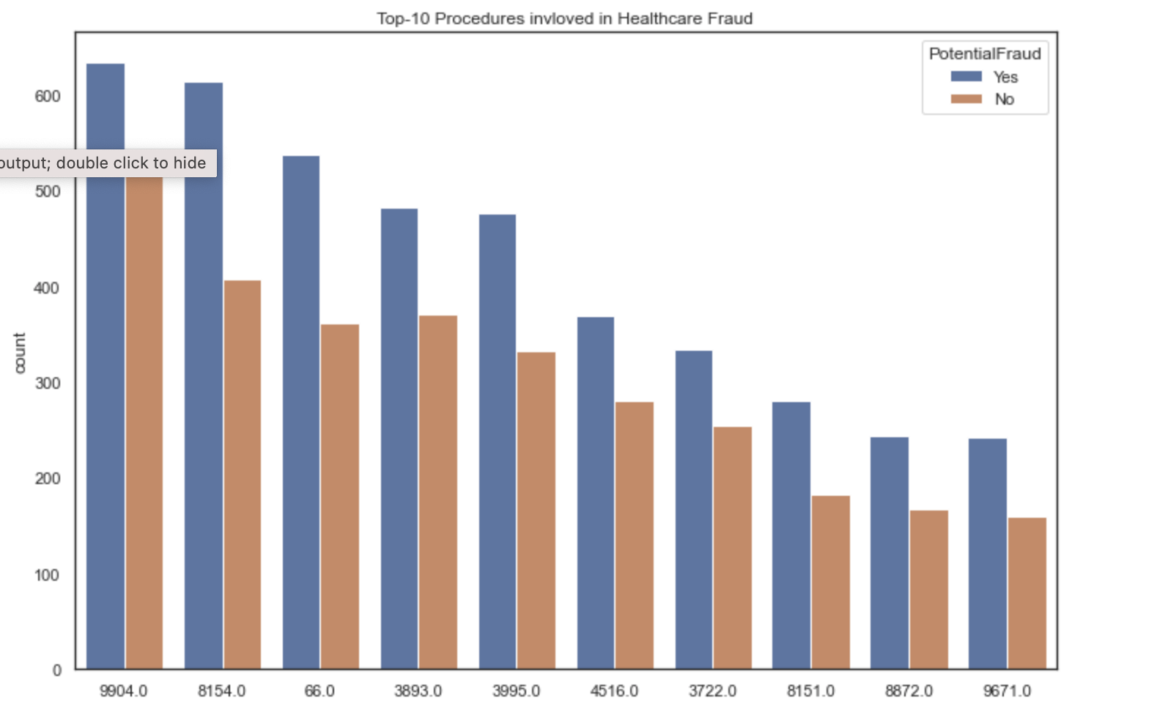
EDA: Procedures Where Fraud is Prevalent
Key-take away: Procedure IDs 9904, 8154, 66, and 3893 have largest number of fraud cases
Question: Why is it easier to commit fraud for these procedures
Fraud distribution by Procedure

Slide 28
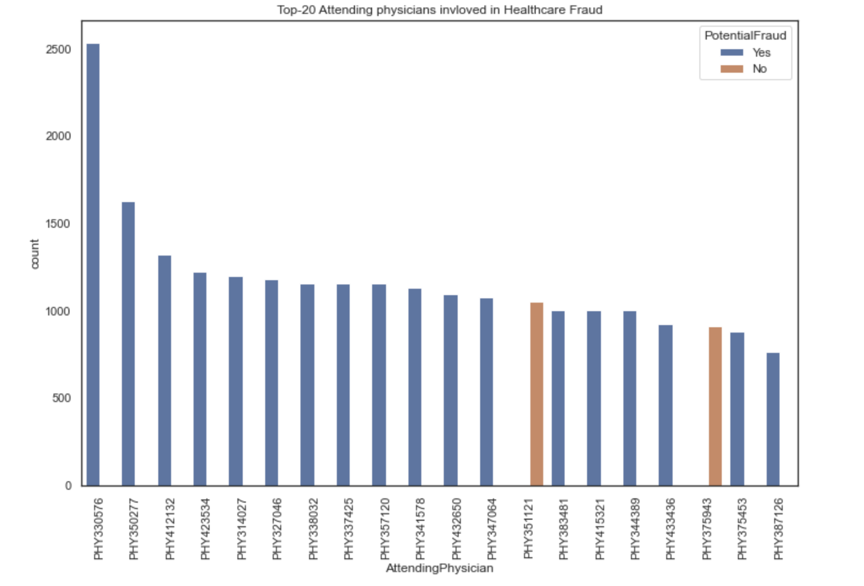
EDA: Out-Patient Train Data Summary
Key-take away: Providers who have a habit of committing fraud always commit fraud with every patient!

Slide 29
Approach: Supervised Model – Labelled Providers
Amazon EC2
Kaggle Dataset
MLE10: Healthcare Claims Anomaly Detector
Data Eng
DEPLOY
Feat Eng
Auto Encoder
One Hot Encoding
Merged Train Data
TPOT
FastAPI
Correlation Check
SVM
Streamlit
Split Train, Valid
Feat Sel
XGB
New Feats (Avgs)
LogR
Merged Test Data
STAGE 1:
Model Comparison
STAGE 2:
Model Selection
STAGE 3:
Model Publishing
Notes:
Specify what Problem is being solved, and ensure that everyone is in agreement as to Why that’s a problem.

Slide 30
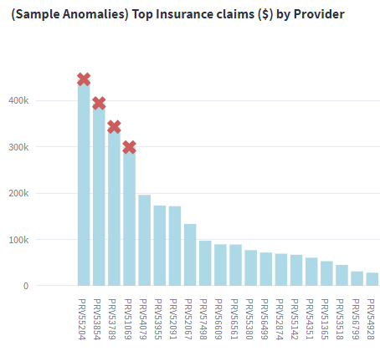
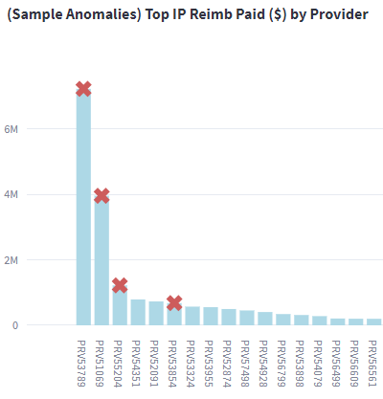
Findings: Supervised Model – XG Boost Provider Predictions
Notes:
Specify what Problem is being solved, and ensure that everyone is in agreement as to Why that’s a problem.

Slide 31
Findings: Unsupervised Model – KMeans Claim Labels
Notes:
Specify what Problem is being solved, and ensure that everyone is in agreement as to Why that’s a problem.

Slide 32
Current State: (envisioned as-is; do-nothing)
Increasing overall annual # and $ claims
Increasing associated annual #, %, and $ of anomalies and fraud cases
Increasing avg $ cost per detection; i.e. evolving fraud sophistication
(Relatively) Flat or decreasing % analyst manhours per claim
(Relatively) Flat or increasing data, and analysis tools (receptive)
Notes:
Specify what Problem is being solved, and ensure that everyone is in agreement as to Why that’s a problem.

Slide 33
Future State: (envisioned to-be)
Q: For Claims Anomalies, can Data Science:
Recommend coarse guidelines for claim anomaly filters and rule sets?
Provide deeper insights, i.e. supplementary details and key contributing attributes (features)?
Weigh the % likelihood of anomaly and/or fraud to assist with case prioritization?
Notes:
Specify what Problem is being solved, and ensure that everyone is in agreement as to Why that’s a problem.

Slide 34
Approach: Supervised Model – Labelled Providers
Data: Kaggle Dataset
Exploratory Data Analysis, Feature Engineering
Model Training: Supervised – Provider predictions, labels
Logistic Regression, Support Vector Machines, XG Boost, Auto-encoders, Auto-ML (TPOT)
Model Selection: XG Boost
Notes:
Specify what Problem is being solved, and ensure that everyone is in agreement as to Why that’s a problem.

Slide 35
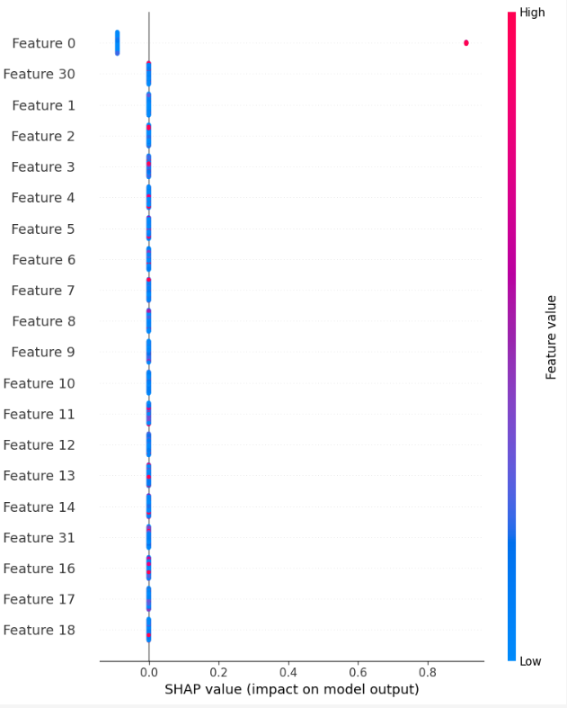
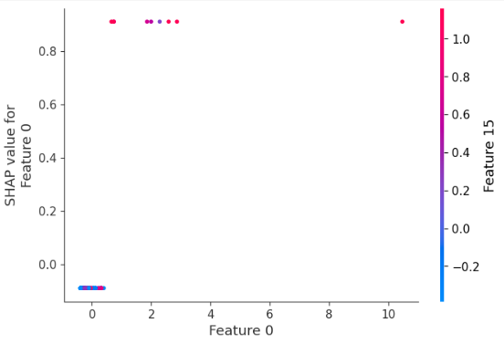
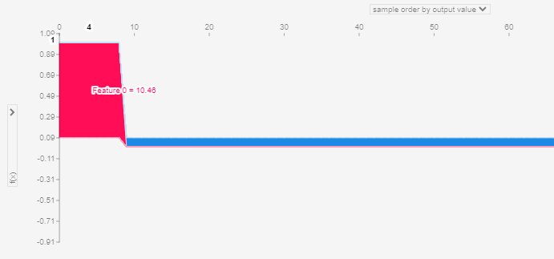
Notes:
Specify what Problem is being solved, and ensure that everyone is in agreement as to Why that’s a problem.

Slide 36
Findings: Claims EDA
Training data
Age: skewed towards patients >65 yrs
Geo: Most beneficiaries are from states 5, 10, 33, and 45
Procedures: ids 66, 3893, 8154, and 9904 have the highest cases of fraud
Out patients: some indications of repeat offense by provider
Insurance claim fraud – distribution of $ reimbursed
8% by provider
7% by attending physician
6% by operating physician
4% by claim diagnosis
Notes:
Specify what Problem is being solved, and ensure that everyone is in agreement as to Why that’s a problem.

Slide 37
Future Work
Streamlit:
Provide capabilities to dig into claim to explore the contributing features of the anomaly
Upgrade to a HTML5 front-end
Separate hosting for front-end from back-end
FastAPI:
Expand api to include claims data verification, and json data request/response
Expand api to include model updates, retraining, and published model performance
Infrastructure:
Promote local Docker environments to hosted in Amazon EC2, or Kubernetes
MLOps:
Upgrade from Level0 to Level1; introduce aspects of retraining, monitoring
Host the model seperately in a service such as SageMaker

