Slide 1
Vulnerability Disclosure
Dan Guido
Fall 2012

Slide 2

Background

Slide 3
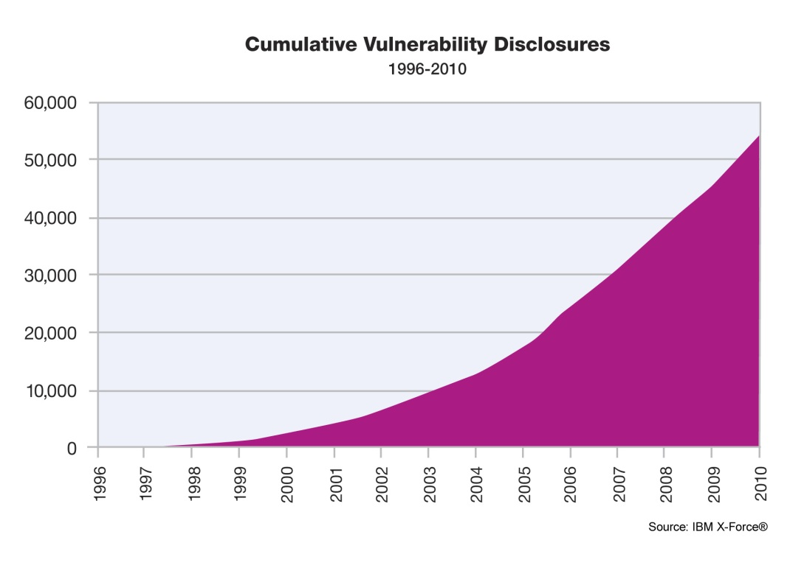
Let’s Talk About Vulnerabilities
8000+
*IBM X-Force 2010 Trend and Risk Report

Slide 4
The Vulnerability Industry
Companies pay to have them tracked
ZDI, iDefense, Secunia, Symantec
Used as marketing tools by orgs and individuals
CORE, VUPEN, Tavis
Purchased by vendors
Google, Mozilla, Barracuda, Facebook
Consulting industry revolves around vuln mitigation
iSEC, Matasano, GDS, Intrepidus, etc etc
Notes:
You may make this 8001 through your work this semester

Slide 5
The Vulnerability Underground
Rapidly consumed by mass malware
Crimepacks like Blackhole, Eleonore, and Mpack
Used for fun by script kiddies everywhere!
Anyone see kernel.org get compromised last year?
Discovered in the wild fairly regularly
Flash, Shockwave, IE, Windows kernel
APT groups, coordinated exfil of IP from US corps

Slide 6

How We Got Here
Notes:
zardoz

Slide 7
The Early Days
Limited discussion of general security issues pre-89
Rutgers Security List
UNIX Security Mailing List
Somewhat earlier, a wild Phrack appeared
First published in 1985
Original hacker e-zine, attacker-focused
Helped organize a community around offense
Security is a problem, but nobody knows it yet

Slide 8
Private Communities Evolved
Then the Morris Worm happened in 1988
Now it’s a problem and everyone knows it
Invite-only mailing lists set up in response
Zardoz, Phage, and Core
MASSIVE target for hackers
http://www.underground-book.net/
Actually described zardoz as “The Holy Grail”
Archives widely circulated underground, parodied in Phrack
Limited motivation to act if details are private
“Hey, this is interesting”
Brittle and ineffective at stated purpose
Notes:
Chapter 5 – “Holy Grail” profiles Mendax’s attempts to gain access to zardoz

Slide 9
Full Disclosure
Eight Legged Groove Machine Security Advisory Service (8LGM) releases first modern advisories in ‘93
http://www.8lgm.org
Basic format remains unchanged through today
Affected software and OS’s
Description of impact
Fix and workaround information
Reported to vendor and to the public
Extremely controversial at the time
Trend continued by l0pht and eEye throughout the 90s

Slide 10
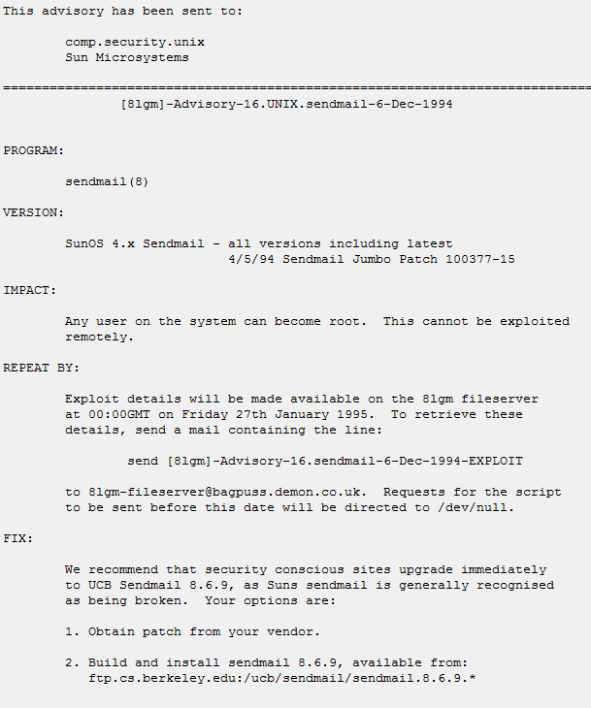

Slide 11
Full Disclosure Continues
Issues with full disclosure
Creates a problem to force vendors to act
“If you don’t react, I’m giving this to a bunch of 15 yr olds”
Lack of clarity around vuln research legal issues
Vendors first instinct is to get lawyers involved
Underground industry evolved around available info
Mass malware survives almost entirely on full disclosures
It’s not 1995 anymore! Script kiddies grew up too!
Full disclosure bottom line
“Researchers” keep at it b/c it makes them famous
Has FD resulted in a reduction of attacks? Hardly

Slide 12
Responsible Disclosure
Worms in the early 2000s made some reconsider FD
ILOVEYOU, Code Red, Code Red II, Nimda, Sadmind, Slammer, Blaster, Sobig.F, Agobot, Bagle, Nachi…
Most worms reused code released by researchers
“Responsible Vulnerability Disclosure Process”
Submitted to IETF by Christey and Wysopal in 2002*
Responsible – researcher withholds info until patch
Responsibilities targeted at researchers, not vendors
Branded researchers as irresponsible, bred contempt
* http://tools.ietf.org/html/draft-christey-wysopal-vuln-disclosure-00

Slide 13
Current Status
Coordinated Vulnerability Disclosure
“We swear we won’t sue you”
Vendor acceptance of responsibility for security issues
vendorsec Mailing List
Invite-only mailing list for sharing vulnerability details
Identified as compromised in March 2011
Remember kids, learning from your mistakes is evil
Delayed Disclosure
Issue PR release and do newspaper interviews about vuln
Usually incites researchers to co-discover. Oops!
Disclose at an enormous conference 3 months later
Maximize marketing benefit, self-interested

Slide 14
The Rise of Bug Bounties
Company | Scope | Bounty | URL
Google | Web and Native | $500 - $3133.7 | http://goo.gl/5LCJs
Facebook | Web | $500 | http://goo.gl/w3Kuu
Mozilla | Web and Native | $500 - $3000 | http://goo.gl/NRwpe
Barracuda | Appliances | $500 - $3133.7 | http://goo.gl/1SKGU
ZDI | Popular Software | $500 - $5000 | http://goo.gl/OEnc8
…plus a litany of smaller projects like:
tex, tarsnap, djbdns, qmail, hex rays, and ghostscript

Slide 15
Trends in Disclosure
No Disclosure (1950-1988)
Private Communities (1988-1993)
Full Disclosure (1993-~2002)
Responsible Disclosure (~2002-2010)
Bug Bounties (2010-Present)

Slide 16
My Thoughts
FD was necessary due to lack of awareness of impact
Companies hacked in August 2011 – United Nations, News Corp, RIM, HKEx, eBay, Nokia, DigiNotar…
Focus on vulnerability mitigation assumes that attackers are constrained by access to them
Vulns abused by mass malware / year: ~15
Vulns discovered in-the-wild by APT / year: ~15
“The Exploit Intelligence Project”
http://vimeo.com/24329182
http://goo.gl/04XFp

Slide 17
Ethics
The CS6573 Vulnerability Disclosure Policy
We follow Coordinated Vuln Disclosure (CVD)
Shared responsibility of researcher and vendor
Make every effort to report through a 3rd party
CERT, ZDI, etc reduce exposure to legal issues
Make every effort to limit impact to users
No details until patches available, unless…
If the vendor isn’t playing ball, disclose
http://go.microsoft.com/?linkid=9770197

Slide 18
Resources
Legal Issues
eff.org/issues/coders/grey-­‐hat-­‐guide
eff.org/issues/coders/vulnerability-­‐reporting-­‐faq
Places that handle disclosure for you
CERT - https://forms.cert.org/VulReport/
oCERT - https://www.ocert.org/
ZDI - http://www.zerodayinitiative.com/
History
http://securitydigest.org/
http://www.underground-book.net/

