Slide 1
MTT_Log_Parser_User_Guide
CE_TOOLS_TEAM

Slide 2
Overview
MTT_Log_Parser is an application that is used to generate report from MTT test logs
Report files include “.xls” file and “.svg file”, pick the test results from the MTT test logs

Slide 3
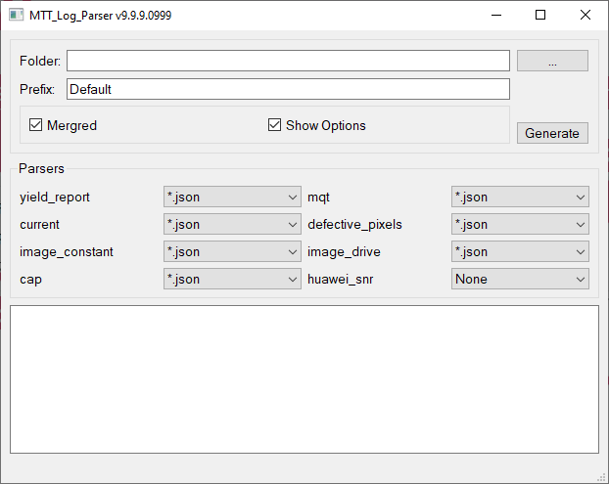
UI View
Path of MTT log
Click to select path
Prefix of report files
Click to start generate
Generate mergred report
Show Parsers Option
Logs of tool
Parser name
Parser file type, default json

Slide 4
Start To Use
Unpack all MTT log files(If log is compress type)
Click button “…” to select MTT log folder
Input Prefix string in the edit box
Click check box if you want to generate mergred report
Click button “Generate” to start
If success, tool will open the folder of report files

Slide 5
Options Setting
Clicked Checkbox “Show Options” to show parser settings
Selected every parser’s log file type, if selected “None”, tool will not generate any report, if selected “*.json” or “*.txt” or “*.html”, tool will generate report from specified log file type, usually default by “*.json”

Slide 6
Report File List
Mergred report: <Prefix>_all.xls
Capacitance Report: <Prefix>_capacitance.xls
Current Report: <Prefix>_ current.xls
Defective Report: <Prefix>_defective_pixels.xls
Image Constant Report: <Prefix>_image_constant.xls

Slide 7
Report File List
Image Drive Report: <Prefix>_image_drive.xls
Mqt Report: <Prefix>_mqt.xls
Yield Report: <Prefix>_yield.xls
HuaweiSNR Report: <Prefix>_Huawei_snr.xls

Slide 8
Report File List
Defective view:
<Prefix>_defective_pixels_errors.svg
<Prefix>_defective_pixels_type1.svg
<Prefix>_defective_pixels_type2.svg
Image view:
<Prefix>_image_constant.svg
<Prefix>_image_constantpixel_error.svg

Slide 9
Report File List
MQT view:
<Prefix>_mqt.svg
<Prefix>_mqt_FixedPatternPixels.svg
HuaweiSNR view:
<Prefix>_Huawei_snr.svg

Slide 10
Thanks

