Slide 1
Modeling Macromolecules with Movers
Xingjie Pan

Slide 2
The Mover class
Conceptually: a mover is a class that can modifies a pose.
Technically: a mover is a class that is derived from the Mover class.
Most of established Rosetta protocols are wrapped as movers.
The documentation of movers can be found on the wiki:
https://www.rosettacommons.org/docs/latest/scripting_documentation/RosettaScripts/Movers/Movers-RosettaScripts

Slide 3
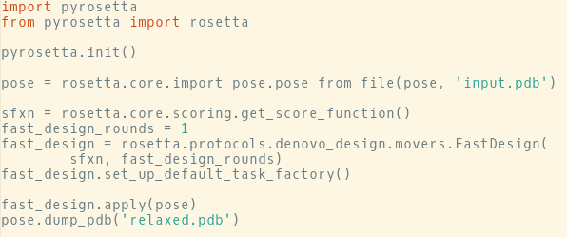
An example
Simple usage pattern: initialize -> configure -> apply(pose)

Slide 4
An example
Simple usage pattern: initialize -> configure -> apply(pose)

Slide 5
An example
Simple usage pattern: initialize -> configure -> apply(pose)

Slide 6
An example
Simple usage pattern: initialize -> configure -> apply(pose)

Slide 7

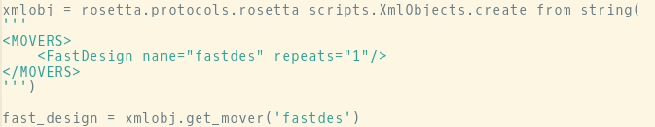
Alternative ways for initializing movers
Movers can be called using either the python style:
Or the Rosetta scripts style:
Some of the movers may only be accessible by the Rosetta script style.

Slide 8
Lab

