Slide 1
Searching Energy Minima by Minimization and Monte Carlo Sampling
Xingjie Pan

Slide 2
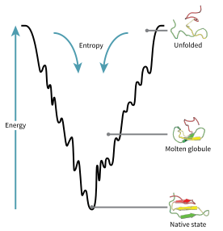
Anfinsen's dogma
At the environmental conditions (temperature, solvent concentration and composition, etc.) at which folding occurs, the native structure is a unique, stable and kinetically accessible minimum of the free energy.
Exceptions:
Prions
Intrinsically disordered proteins
Image from wikipedia

Slide 3
Physics based protein structure prediction
The structure of a protein can be solved by finding its global free energy minimum.
def predict_structure(sequence):
return min(all_conformations, key=free_energy)

Slide 4
The side chain design problem
Given a protein backbone, how to find a sequence of amino acids that folds into this backbone structure?
def side_chain_design(bb_structure):
for seq in all_sequences:
if bb_structure == predict_structure(seq):
return seq

Slide 5
The free energy hypothesis for design
Define a confined region in the conformational space, i.e. only sample side chains / backbone conformations near the starting structure.
Find the free energy minima for the product space of sequences and confined conformations.
def side_chain_design_practical(structure):
Return min(all_sequences_and_confined_conformations,
key=free_energy)

Slide 6
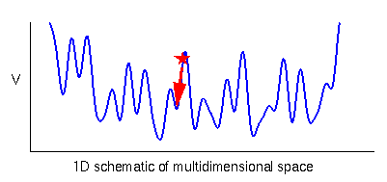
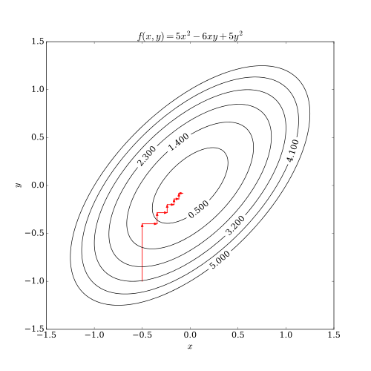
Minimization
In Rosetta, minimization is a deterministic process that searches a local minimum.
Minimization cannot go through energy barriers.
All minimization algorithms in Rosetta choose a vector as the descent direction, determine a step along that vector, then choose a new direction and repeat.
Image from cmm.cit.nih.gov,
wikipedia

Slide 7
The minimization algorithms used by Rosetta
Line minimization:
Iteratively searches along the gradient. Converges slowly.
Conjugate gradient:
Uses information from previous steps to determine the descent direction.
Quasi-Newton methods:
Use information from second derivatives. Converge much faster. The default minimization algorithm is the L-BFGS method.

Slide 8
Move maps
Rosetta uses a class called MoveMap to define what degrees of freedom are movable during minimization.
The important functions for a MoveMap includes:
set_bb()
set_chi()
set_jump()

Slide 9
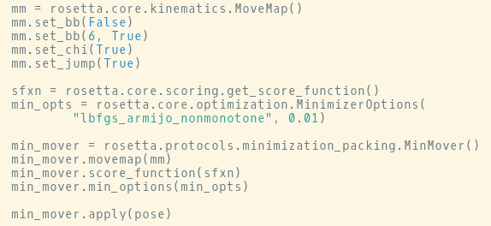
Running mimization in PyRosetta

Slide 10
Running mimization in PyRosetta

Slide 11
Running mimization in PyRosetta

Slide 12
Running mimization in PyRosetta

Slide 13
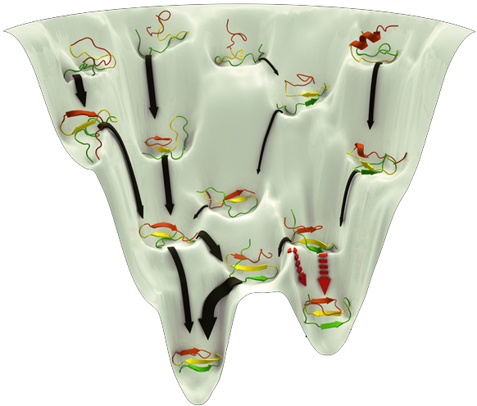
The rugged free energy landscape of macromolecules
The free energy landscapes in both conformational space and sequence space are rugged.
To find (get close to) the global minima, methods should be able to cross free energy barriers.
Image from www.mpbenowitz.work

Slide 14
The protein sequence/structure space is huge
The searching space is huge. Consider a 100 AA protein and assume each AA has 3 conformations. The total number of conformations is
3¹⁰⁰ ≈ 10⁴⁸
The speed of the most powerful supercomputer (cluster) Summit is
10¹⁷ Flop/s
To go through all the states, it takes
10³¹ s ≈ 10²³ years >> the age of the universe

Slide 15
Levinthal’s paradox
An 100 AA protein has more than 10⁴⁸ states. The frequency of hydrogen vibration is about
10¹⁶ s⁻¹
which is an upper bound for the number of states sampled in a second. However, a lot of proteins fold into their native states within 1 s.
There must be folding pathways through which the global minimum can be quickly reached.

Slide 16
Monte Carlo sampling
Monte Carlo methods are a broad class of random number based numerical methods. Monte Carlo sampling can be used for exploring a big variable space. Monte Carlo sampling algorithms in Rosetta usually have the following format.
def monte_carlo_sampling(initial_state, kT, N_iteration):
current_state = initial_state
for i in range(N_iteration):
new_state = random_state(current_state)
fe_delta = free_energy(new_state) - free_energy(current_state)
if fe_delta < 0 or uniform(1) < exp(-fe_delta / kT):
current_state = new_state

Slide 17
Simulated annealing
The parameter kT is critical for a Monte Carlo sampling.
When kT is big, large energy barriers can be passed.
When kT is small, the trajectory will converge to local minima.
A simulated annealing is a Monte Carlo sampling during which the temperature kT is gradually decreased. If the cooling down is infinitely slow, the global minimum is guaranteed to be reached.

Slide 18
Boltzmann distribution
At equilibrium, the probability of finding a system at state i is proportional to
exp(- E_{i} / (k * T))
where E_{i} is the free energy of the state, k is the Boltzmann constant and T is the temperature. This distribution is called Boltzmann distribution.

Slide 19
Detailed balance and its implication
def monte_carlo_sampling(initial_state, kT, N_iteration):
current_state = initial_state
for i in range(N_iteration):
new_state = random_state(current_state)
fe_delta = free_energy(new_state) -free_energy(current_state)
if fe_delta < 0 or uniform(1) < exp(-fe_delta / kT):
current_state = new_state
If prob(state_{i} == random_state(state_{j})) equals to prob(state_{j} == random_state(state_{i})), the sampling is called detail balanced. If detailed balanced, the sampled states will follow the Boltzmann distribution.

Slide 20
The application of simulated annealing in Rosetta
Simulated annealing is widely used in Rosetta, including the following protocols:
Side chain repacking/design
Folding
Docking
Loop modeling
De novo backbone design
Hydrogen bonding network design

Slide 21
Score function ramping
In simulated annealing, the temperature is ramped from high to low values. This concept can be generalized for ramping score function terms in order to balance:
Jumping over energy barriers
Converging to energy minima
The widely used FastRelax protocol ramps the repulsion score term.

