Slide 1
Packing and Relax
Jared Adolf-Bryfogle
January, 2019
(Slides adapted from Andrew Leaver-Fay)

Slide 2
Packer
Optimize rotamers on a fixed backbone.
Inputs:
Pose
ScoreFunction
PackerTask
Steps:
1. Detect neighbors
2. Build rotamers
3. Create an InteractionGraph
a. Compute 1-body rotamer energies
b. Compute 2-body rotamer energies
4. Run simulated annealing
Control: TaskFactory ->PackerTask
Given to PackRotamersMover

Slide 3
Design and Packing
In Rosetta, Design and packing go hand in hand.
Design is packing with rotamers of different AA
Design is default ON in Rosetta.
ALL AA are default ON in Rosetta.
Instructions (TaskOperations) turn things OFF
CANNOT turn things back on !
Think of it like an ice sculpture

Slide 4
Factory
Class that creates/builds another class
TaskFactory builds a PackerTask from instructions
factory = TaskFactory()
factory.push_back( operation )
packer_task = factory. create_task_and_apply_taskoperations(pose)
MANY factories exist in Rosetta
E.g.: MoverFactory that creates a Mover from a string for RosettaScripts
AbstractFactory

Slide 5

TaskFactory
List of TaskOperations which are instructions for which amino acids and rotamers to use at which positions
Examples:
InitiliazeFromCommandLine
ReadResFile
ResfileCommandOperation
RestrictToRepacking
import rosetta.core.pack.task.operation as operations
import rosetta.protocols.task_operations as operations2

Slide 6
TaskFactory->PackerTask
Final Bag of instructions for which amino acids and rotamers to use at which positions
Three peculiarities:
Knows the sequence of the starting Pose
All operations are commutative i.e. order independent

Slide 7
TaskFactory vs PackerTask
Some protocols such as PackRotamersMover and FastRelax allow setting either
IF setting TaskFactory, the PackerTask is re-created at each packing round
-> Allows instructions to respond to changing pose state
-> ie ‘neighbor recomputation’, etc.

Slide 8
Packer
Optimize rotamers on a fixed backbone.
Inputs:
Pose
ScoreFunction
PackerTask
Steps:
1. Detect neighbors
2. Build rotamers
3. Create an InteractionGraph
a. Compute 1-body rotamer energies
b. Compute 2-body rotamer energies
4. Run simulated annealing
Control: TaskFactory ->PackerTask
Given to PackRotamersMover

Slide 9
pack_rotamers: Sim. Annealing
4. Run simulated annealing
for ( int i = 1; i <= num_outer_iterations; ++i ) {
for ( int j = 1; j <= num_inner_iterations; ++j ) {
int newrot = pick_random_rotamer();
compute deltaE = E( newrot ) - E( oldrot )
if ( metropolis_accept( temp, deltaE )) {
accept random_rotamer;
}
}
decrease_temperature( temp );
}
deltaE:

Slide 10
pack_rotamers: InteractionGraph
Nodes:
num_states_ ( 1 per rotamer )
one_body_energies_
array with num_states_ entries
cache oldrot energies
Edges:
two_body_energies_
table of size
node1.num_states_ x
node2.num_states_

Slide 11
Packer: InteractionGraph
Scheme 1: “precompute and store”
compute a table E₂ for each edge in the interaction graph
Example case: 20K rotamers over 40 positions, with 300 edges
500 rotamers per node
500 x 500 table on each edge*
283 MB
Scheme 2:
compute pair energies on the fly; store some, but not all
Same test case, 20K rotamers over 40 positions, with 300 edges
500 rotamers per node
two 500 x 10 tables on each edge
11 MB
"LinearMemoryInteractionGraph"
-linmem_ig 10, or activatable in a PackerTask.

Slide 12
Packer: Rotamer Set
class RotamerSet_ : public RotamerSet {
public:
...
private:
utility::vector1< conformation::ResidueOP > rotamers_;
...
};

Slide 13
Packer: Rotamer Building
"Bump Check"
Discard rotamers that collide with the background
Threshold of 5 REU for Lennard Jones energies (lj_atr, lj_rep)

Slide 14
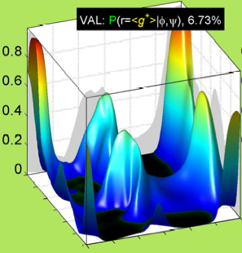
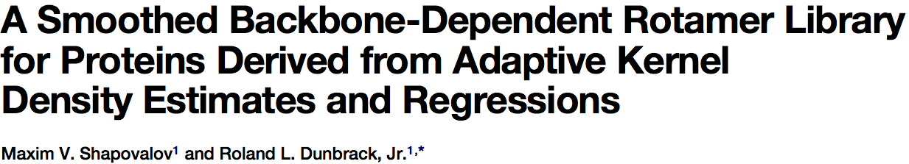
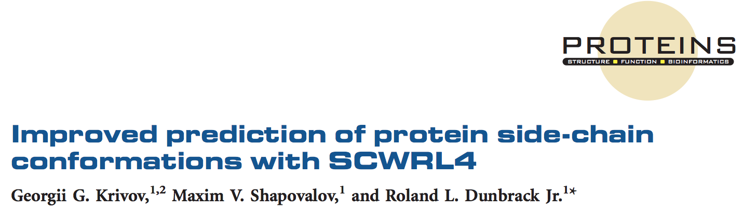
Rotamer Building
Uses the 2010 Dunbrack Backbone Dependant Rotamer Library.
Gives conformations of amino acid given (Phi,Psi), and their probability distributions
Derived through a bioinformatic analysis of the PDB
P(Rot|Phi,Psi)
Proteins
Structure

Slide 15
core.4
core.pack:
optimizes sidechain conformations
several variations
rotamer_trials: optimize one side chain at a time
pack_rotamers: optimize all side chains at once
rt_min: optimze one side chain at a time, minimizing rotamers
min_pack: optimize all side chains at once, minimizing rotamers
Typical use:
from rosetta.protocols.minimization_packing import PackRotamersMover
from rosetta.core.pack.task import TaskFactory
from rosetta.core.pack.task import operations
packer = PackRotamersMover() tf = TaskFactory()
tf.push_back(operations.InitializeFromCommandLine())
tf.push_back(operations.RestrictToRepacking())
packer.task_factory(tf)
packer.apply(pose)
 | one | all
disc. | rt | packrot
cont. | rt_min | minpack

Slide 16
Relax
Relaxation attempts to find nearby energy minima. It is more rigorous than minimization alone.
Default is 5 cycles of packing->minimization, while ramping up repulsive VDW weight (fa_rep)
Inputs:
ScoreFunction
TaskFactory
MoveMap

Slide 17
protocols.relax
Three main flavors:
ClassicRelax - A combination of small and shear moves - deprecated
FastRelax - Ramp repulsive vdw while minimizing with intermittent repacking
CentroidRelax - Ramp various energy terms while minimizing. Not very useful currently without centroid rotamers Design can be done in FastRelax by passing a TaskFactory

Slide 18
FastRelax
FastRelax:
Nested Loops
for i = 1:ncycles
fa_rep set to 1/10th its usual strength
for j = 1:nramp
fa_rep weight increased
repack
minimize
fa_rep
cycle

Slide 19
core.4
optimization/
AtomTreeMinimizer
minimizes in internal coordinates, usually dihedrals
AtomTree recursively calculates “f1” and “f2” derivative vectors
CartesianMinimizer
minimizes in Euclidean coordinates, 3 DOFs per atom
massively expensive!
relies on “f2” derivative vectors only
requires the “cart_bonded” term to be on, and the “pro_close” term off
Minimizer
actual implementation of abstract minimization routines
operates on a “MultiFunc”
virtual Real func( utility::vector1< Real > const & dofs ) = 0;
virtual void dfunc( utility::vector1< Real > const & dofs, utility::vector1< Real > & deriv ) = 0;

Slide 20
FastRelax
FastRelax:
Ramp: Increase weight of fa_rep
Repack: Pack sidechains
Minimize: dfpmin_armijo_nonmonotone
“DualSpace” FastRelax:
Combination of Cartesian and Dihedral space minimization
Shown to improve decoy selection
-Frank DiMaio & Patrick Conway
use -dualspace option and ref2015_cart.wts
Regional FastRelax in Dihedral Space:
Need MoveMap
Need TaskFactory
Need chainbreak energy term set
Need basic loop foldtree set for each region to stop propagation
Need cutpoint variants on each residue of cut for chainbreak term

Slide 21
FastRelax Examples
from rosetta.protocols.relax import FastRelax
from rosetta.core.pack.task import TaskFactory()
from rosetta.core.pack.task import operations
from pyrosetta import *
init(‘-ex1 –ex2 –include_input_sc’)
fr = FastRelax()
tf = TaskFactory()
tf.push_back(operations.InitializeFromCommandLine())
tf.push_back(operations.RestrictToRepacking())
fr.task_factory(tf)
fr.apply(pose)

