Slide 1
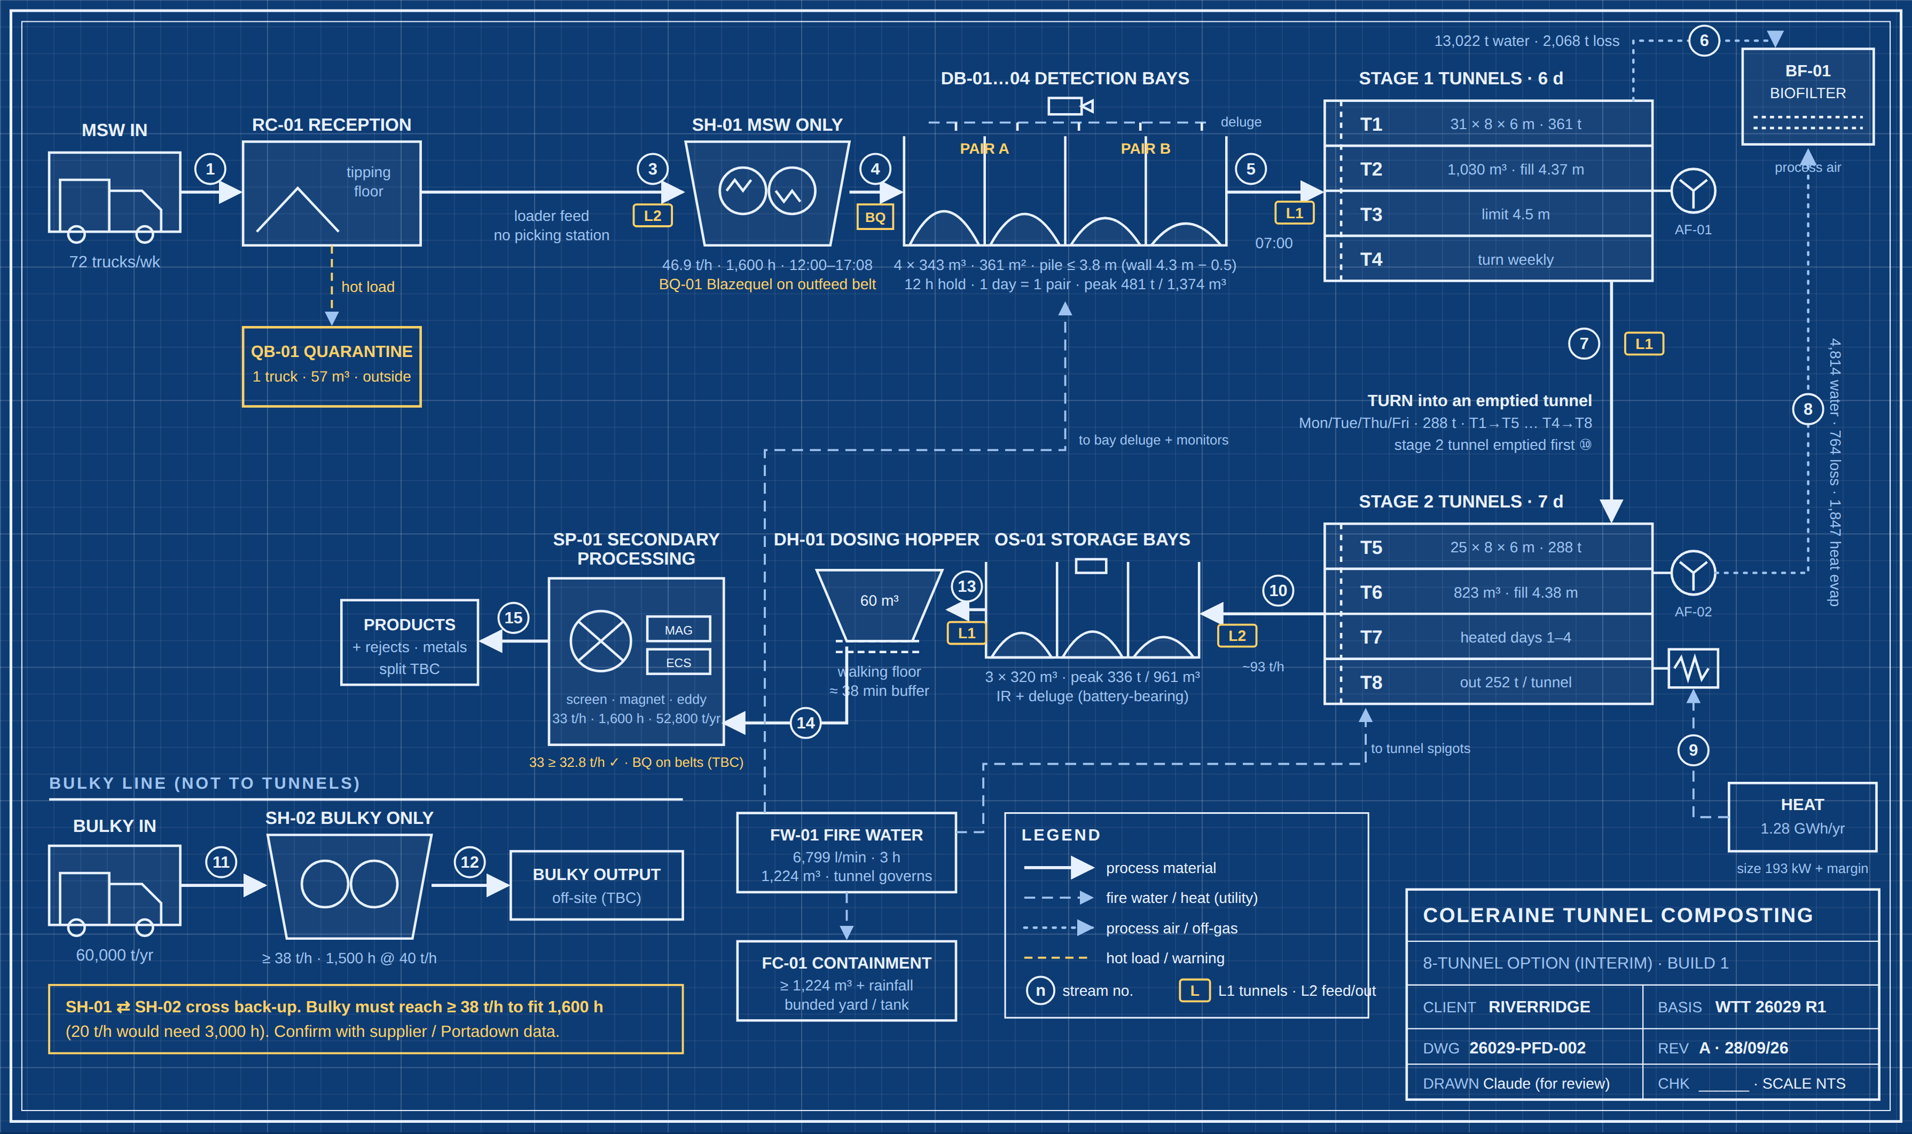
PROCESS FLOW SHEET · 8 TUNNELS
INTERIM · NOT FOR CONSTRUCTION
75,000 t/yr MSW · 4 × 31 m stage 1 (T1–T4) + 4 × 25 m stage 2 (T5–T8) · 8 m wide, 6 m high · Mon–Sat · 350 kg/m³
30.0%
MASS REDUCTION
75,000 → 52,485 t/yr
361 t
PER STAGE 1 FILL
4.37 m of 4.5 m limit
4 × 343 m³
DETECTION BAYS
12 h hold · peak 481 t
2 × 9 m³
LOADERS
~3,350 h/yr · busiest day 9.6 h
1,224 m³
FIRE WATER, LARGEST PILE
25% less than 6 tunnels
26029-PFD-002 rev A · Coleraine / Riverridge · WTT 26029 rev 1 basis · sheet 1 of 3
Notes:
8-tunnel option (WTT 4-tunnel sheet): 4 × 31 m stage 1 and 4 × 25 m stage 2, same 8 m width and 6 m height. Same mass balance as the 6-tunnel layout; batches are 361 t into stage 1 and 288 t into stage 2. MSW goes from reception straight to SH-01 (no picking station), with Blazequel fire detection on the outfeed belt. Shredded MSW waits at least 12 h in four IR-watched detection bays (two pairs, one per shredding day) before filling a stage 1 tunnel. Stage 1 turns into an emptied stage 2 tunnel on Mon/Tue/Thu/Fri and refills Tue/Wed/Fri/Sat. Stage 2 empties into the OS-01 storage bays, then the DH-01 dosing hopper meters SP-01 at 33 t/h. Bulky waste has its own shredder, SH-02, and does not go to the tunnels.

Slide 2
DAILY RHYTHM · 8 TUNNELS
INTERIM · NOT FOR CONSTRUCTION
4 turns (Mon/Tue/Thu/Fri) and 4 refills (Tue/Wed/Fri/Sat). Loading in the morning, shredding in the afternoon.
06:00
08:00
10:00
12:00
14:00
16:00
18:00
20:00
L1 · Mon/Thu
② turn T1→T5 · 92 b
feed DH-01
L1 · Tue/Fri
③ fill T1 · 115 b
② turn T2→T6 · 92 b
feed DH-01
L1 · Wed/Sat
③ fill T2 · 115 b
feed DH-01
L2 · Mon/Tue/Thu/Fri
① empty → OS-01 · 81 b
feed SH-01 (+ DH-01 to 13:54 Tue/Fri)
L2 · Wed/Sat
feed SH-01
SH-01 MSW
shred 240 t → next empty bay pair
DH-01 → SP-01
secondary processing 33 t/h
SH-02 bulky
bulky 4.8 h/day
Detection bays
IR cameras + auto deluge, 24/7
13.9 h
last shred 17:08 → next fill 07:00
9.6 h
busiest day (Tue/Fri)
~3,350 h
loader-hours a year
≥ 12 h hold on every load (max 66 h over the weekend)
empty + turn + fill, split L2 2.7 h and L1 6.9 h
2 loaders at ~1,676 h each (5% over 1,600 h) or a third
26029-PFD-002 rev A · Coleraine / Riverridge · WTT 26029 rev 1 basis · sheet 2 of 3
Notes:
Buckets per event: fill 115, turn 92, empty 81 (9 m³ bucket, assumed 2-minute cycle). L2 feeds SH-01 in short spells, about 2.6 h of work a day. L1 feeds the dosing hopper in the afternoons; L2 covers the hopper on Tue/Fri until L1 finishes turning at 13:54. SH-02 is assumed to have its own grab or feeder. The 12 h hold works because shredding ends at 17:08 and the next fill starts at 07:00.

Slide 3
STREAM TABLE & OPEN ITEMS
INTERIM · NOT FOR CONSTRUCTION
Annual averages, WTT 26029 rev 1 mass balance. MSW check: output 52,485 + off-gas 15,090 + 7,425 = 75,000 t/yr.
No. | Stream | t/yr | DS % | m³/yr
1 | MSW delivered | 75,000 | 63.0 | 214,286
3 | MSW to SH-01 (no picking; stream 2 deleted) | 75,000 | 63.0 | –
4 | Shredded MSW to detection bays | 75,000 | 63.0 | 214,286
5 | Bays → stage 1 (4 × 361 t/wk) | 75,000 | 63.0 | 214,286
6 | Stage 1 off-gas (water + degradation) | 15,090 | – | –
7 | Turn stage 1 → stage 2 (4 × 288 t/wk) | 59,910 | 75.4 | 171,171
8 | Stage 2 off-gas (incl. 1,847 t heat evap.) | 7,425 | – | –
9 | Additional heat (kWh/yr) | 1,282,844 | – | –
10 | Stage 2 output → OS-01 (4 × 252 t/wk) | 52,485 | 84.6 | 149,957
13 | OS-01 → DH-01 dosing hopper | 52,485 | 84.6 | 149,957
14 | DH-01 → SP-01 at 33 t/h · 1,600 h | 52,485 | 84.6 | 149,957
15 | SP-01 products / rejects (split TBC) | 52,485 | – | –
11 | Bulky delivered → SH-02 | 60,000 | – | –
12 | Shredded bulky off-site | 60,000 | – | –
DESIGN CHOICES
SH-01 MSW only, 46.9 t/h; SH-02 bulky only, ≥ 38 t/h
Blazequel on outfeed belt + 4 IR-watched bays, 12 h hold
4 × 31 m + 4 × 25 m; turns always into an emptied tunnel
Heat 64 kW/tunnel; plant 193 kW + margin, not 257 kW
SP-01 33 t/h in 1,600 h (0.6% margin)
STILL TO CONFIRM
Portadown Blazequel + post-belt fire log
SH-02 bulky rate (≥ 38 t/h?)
Loader cycle time (2 min assumed)
WTT: 6 days in stage 1 vs 7
NIEA / NIFRS pile limit and fire water
26029-PFD-002 rev A · Coleraine / Riverridge · WTT 26029 rev 1 basis · sheet 3 of 3
Notes:
Same mass balance as the 6-tunnel layout; fire water falls to 1,224 m³ because the largest pile is a 1,030 m³ tunnel. m³ at 350 kg/m³ throughout; the output density is not in the WTT sheet, so 0.35 t/m³ is assumed and may be low for dry compost. Build 2 doubles every MSW stream and uses T1–T6 stage 1 and T7–T12 stage 2; it needs a second 33 t/h line and about 4 loaders.

