Slide 1
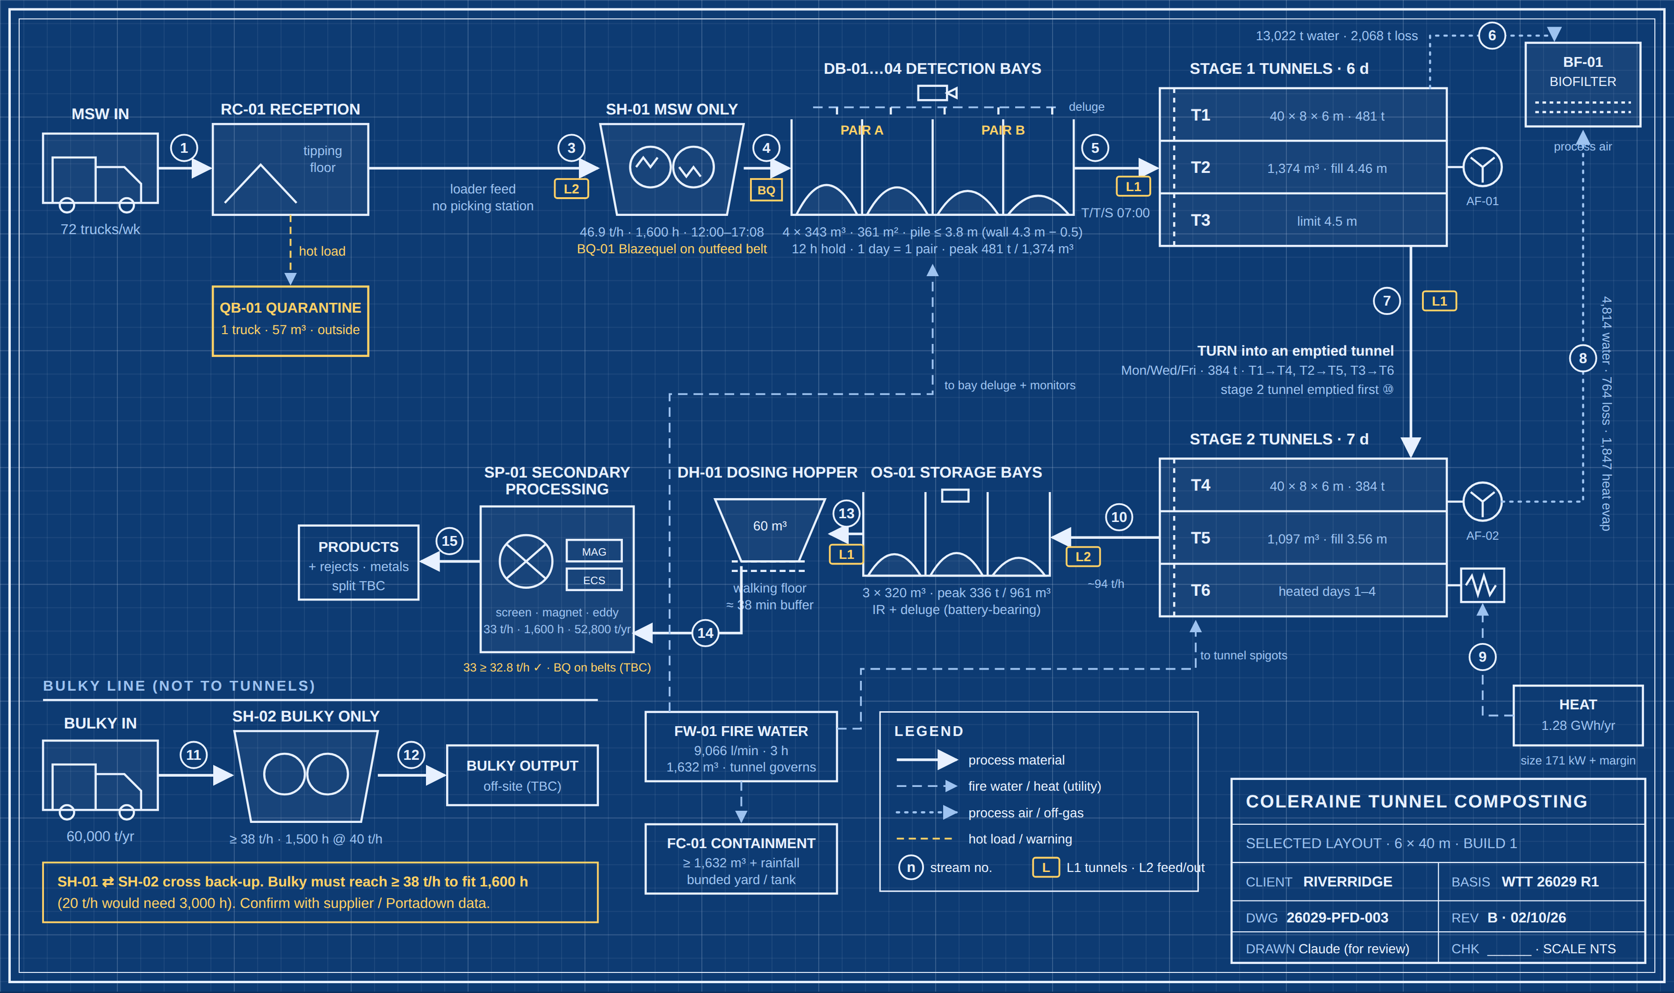
SELECTED LAYOUT · 6 × 40 m
SELECTED LAYOUT · INTERIM
75,000 t/yr MSW · 6 identical tunnels 40 × 8 × 6 m (T1–T3 stage 1, T4–T6 stage 2) · Mon–Sat · 350 kg/m³
30.0%
MASS REDUCTION
75,000 → 52,485 t/yr
3.56 m
STAGE 2 FILL (40 M)
384 t · 101 t spare per fill
4 × 343 m³
DETECTION BAYS
12 h hold · peak 481 t
2 × 9 m³
LOADERS
~3,340 h/yr in total
1,920 m²
TUNNEL FLOOR
+168 m² vs 40 + 33 m
26029-PFD-003 rev B · Coleraine / Riverridge · WTT 26029 rev 1 basis · sheet 1 of 3
Notes:
6 identical 40 m tunnels: stage 1 is unchanged from WTT (481 t at 4.46 m); stage 2 holds 384 t at 3.56 m, so any tunnel can take a stage 1 batch if one is out of service. WTT should confirm stage 2 heat and aeration for the lower pile. MSW goes from reception straight to SH-01 (no picking station), with Blazequel fire detection on the outfeed belt. Shredded MSW waits at least 12 h in four IR-watched detection bays (two pairs, one per shredding day) before filling a stage 1 tunnel. Stage 1 turns into an emptied stage 2 tunnel on Mon/Wed/Fri. Stage 2 empties into the OS-01 storage bays, then the DH-01 dosing hopper meters SP-01 at 33 t/h. Bulky waste has its own shredder, SH-02, and does not go to the tunnels.

Slide 2
DAILY RHYTHM · 6 × 40 m
SELECTED LAYOUT · INTERIM
Same as the 40 + 33 m layout: tonnes and volumes are unchanged. Loading in the morning, shredding in the afternoon.
06:00
08:00
10:00
12:00
14:00
16:00
18:00
20:00
L1 · Mon/Wed/Fri
② turn T1→T4 · 122 buckets
feed DH-01
L2 · Mon/Wed/Fri
① empty T4 → OS-01 · 107 b
feed SH-01 (+ DH-01 to 14:38)
L1 · Tue/Thu/Sat
③ fill T1 from bay pairs A + B · 153 b
feed DH-01
L2 · Tue/Thu/Sat
feed SH-01
SH-01 MSW
shred 240 t → next empty bay pair
DH-01 → SP-01
secondary processing 33 t/h
SH-02 bulky
bulky 4.8 h/day
Detection bays
IR cameras + auto deluge, 24/7
13.9 h
last shred 17:08 → next fill 07:00
①→②→③
empty, turn, refill
~3,340 h
loader-hours a year
≥ 12 h hold on every load (max 66 h over the weekend)
the stage 2 tunnel is emptied before each turn; stage 1 refills next day
2 loaders at ~1,670 h each (4% over 1,600 h) or a third
26029-PFD-003 rev B · Coleraine / Riverridge · WTT 26029 rev 1 basis · sheet 2 of 3
Notes:
Bucket counts use a 9 m³ bucket and an assumed 2-minute cycle. L2 feeds SH-01 in short spells, about 2.6 h of work a day. L1 feeds the dosing hopper in the afternoons; L2 covers the hopper on Mon/Wed/Fri until L1 finishes turning at 14:38. SH-02 is assumed to have its own grab or feeder. The 12 h hold works because shredding ends at 17:08 and the next fill starts at 07:00.

Slide 3
STREAM TABLE & OPEN ITEMS
SELECTED LAYOUT · INTERIM
Annual averages, WTT 26029 rev 1 mass balance. MSW check: output 52,485 + off-gas 15,090 + 7,425 = 75,000 t/yr.
No. | Stream | t/yr | DS % | m³/yr
1 | MSW delivered | 75,000 | 63.0 | 214,286
3 | MSW to SH-01 (no picking; stream 2 deleted) | 75,000 | 63.0 | –
4 | Shredded MSW to detection bays | 75,000 | 63.0 | 214,286
5 | Bays → stage 1 (3 × 481 t/wk) | 75,000 | 63.0 | 214,286
6 | Stage 1 off-gas (water + degradation) | 15,090 | – | –
7 | Turn stage 1 → stage 2 (3 × 384 t/wk) | 59,910 | 75.4 | 171,171
8 | Stage 2 off-gas (incl. 1,847 t heat evap.) | 7,425 | – | –
9 | Additional heat (kWh/yr) | 1,282,844 | – | –
10 | Stage 2 output → OS-01 storage bays | 52,485 | 84.6 | 149,957
13 | OS-01 → DH-01 dosing hopper | 52,485 | 84.6 | 149,957
14 | DH-01 → SP-01 at 33 t/h · 1,600 h | 52,485 | 84.6 | 149,957
15 | SP-01 products / rejects (split TBC) | 52,485 | – | –
11 | Bulky delivered → SH-02 | 60,000 | – | –
12 | Shredded bulky off-site | 60,000 | – | –
DESIGN CHOICES
SH-01 MSW only, 46.9 t/h; SH-02 bulky only, ≥ 38 t/h
Blazequel on outfeed belt + 4 IR-watched bays, 12 h hold
6 identical 40 m tunnels; turns always into an emptied one
Heat plant 171 kW + margin, not 257 kW
SP-01 33 t/h in 1,600 h (0.6% margin)
STILL TO CONFIRM
Portadown Blazequel + post-belt fire log
SH-02 bulky rate (≥ 38 t/h?)
Loader cycle time (2 min assumed)
WTT: 6 days in stage 1 vs 7
NIEA / NIFRS pile limit and fire water
26029-PFD-003 rev B · Coleraine / Riverridge · WTT 26029 rev 1 basis · sheet 3 of 3
Notes:
Streams are identical to the 40 + 33 m layout; only the stage 2 tunnel length changes. m³ at 350 kg/m³ throughout; the output density is not in the WTT sheet, so 0.35 t/m³ is assumed and may be low for dry compost. Build 2 doubles every MSW stream and uses T1–T6 stage 1 and T7–T12 stage 2; it needs a second 33 t/h line and about 4 loaders.

