Slide 1
Rent House UML Diagram
Created By:
Muhamad Hudya Ramadhana
Mutia Ayu Dianita
3SCI

Slide 2
System Analysis

Slide 3
Diagrams
Use Case
Sequence
State Machine
Class
Communication
Component
Object
Activity
Deployment

Slide 4
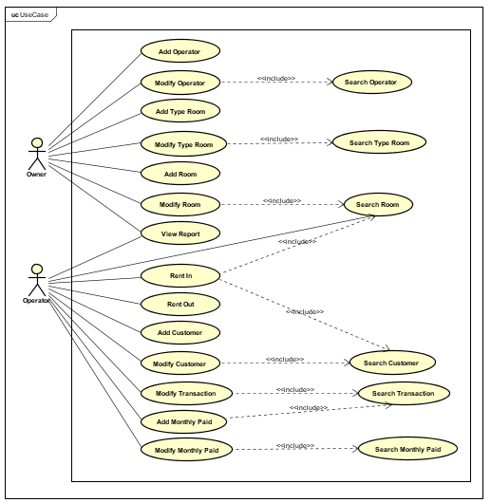
USE CASE

Slide 5
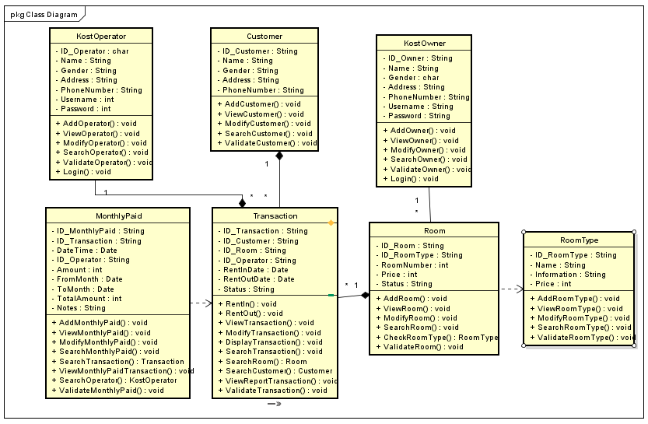
CLASS

Slide 6
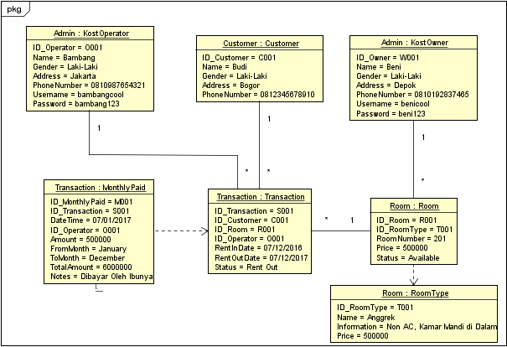
OBJECT

Slide 7
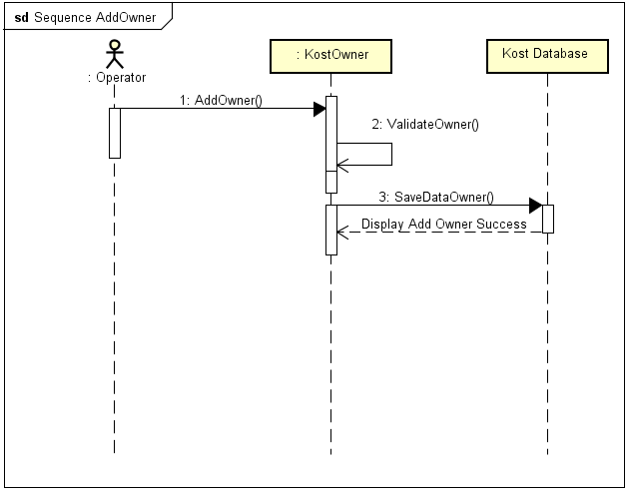
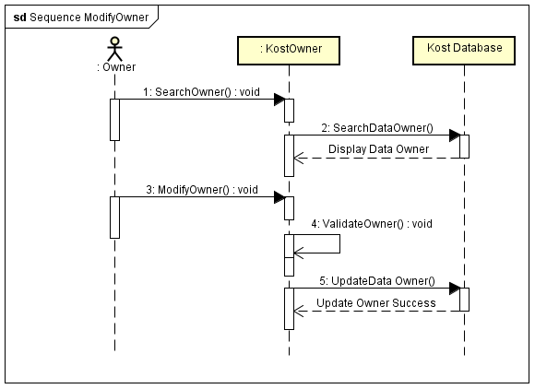
SEQUENCE
Add Owner
Modify Owner

Slide 8
SEQUENCE
Add Owner
Modify Owner

Slide 9
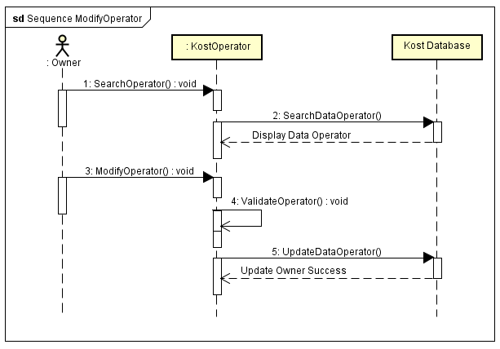
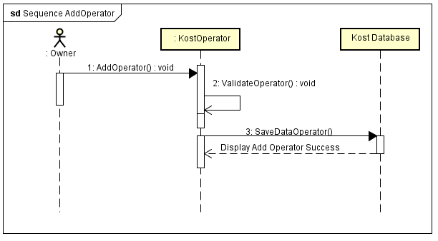
SEQUENCE
Add Operator
Modify Operator

Slide 10
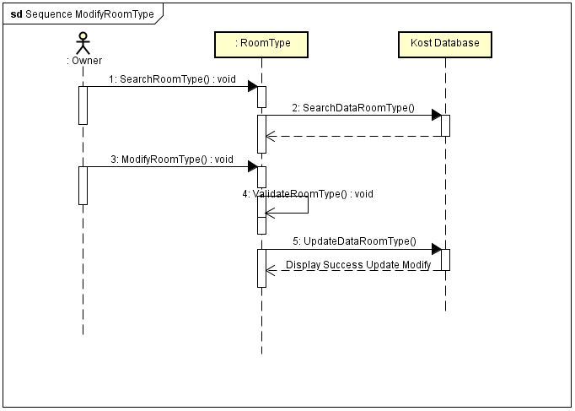
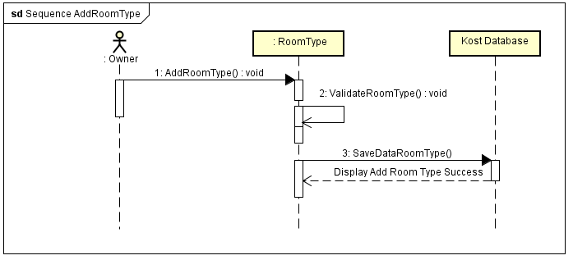
SEQUENCE
Add Room Type
Modify Room Type

Slide 11
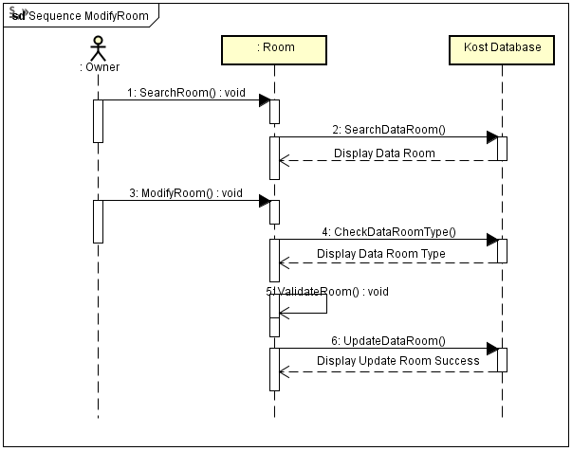
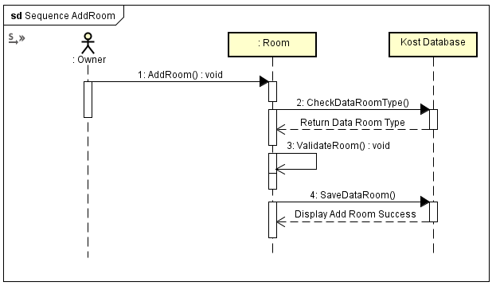
SEQUENCE
Add Room
Modify Room

Slide 12
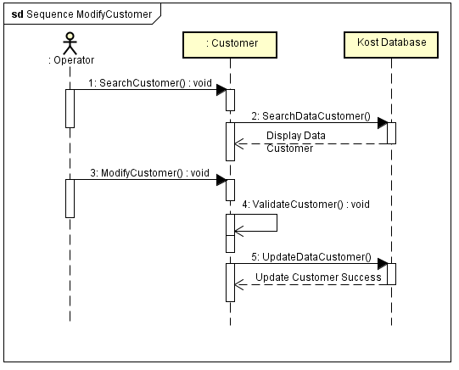
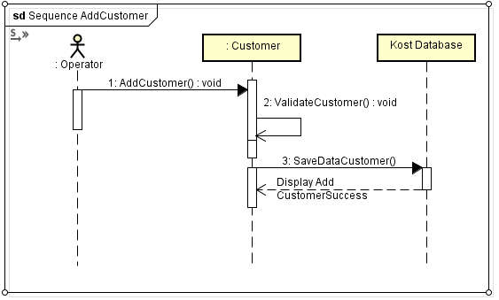
SEQUENCE
Add Customer
Modify Customer

Slide 13
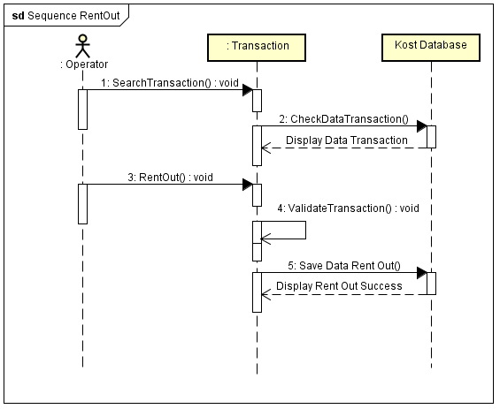
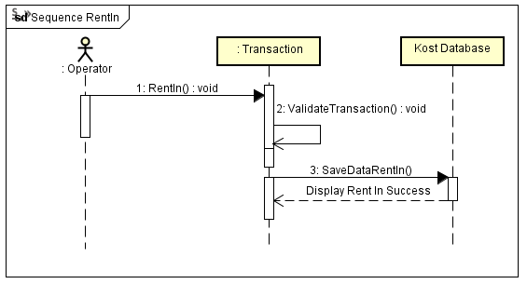
SEQUENCE
Rent In
Rent Out

Slide 14
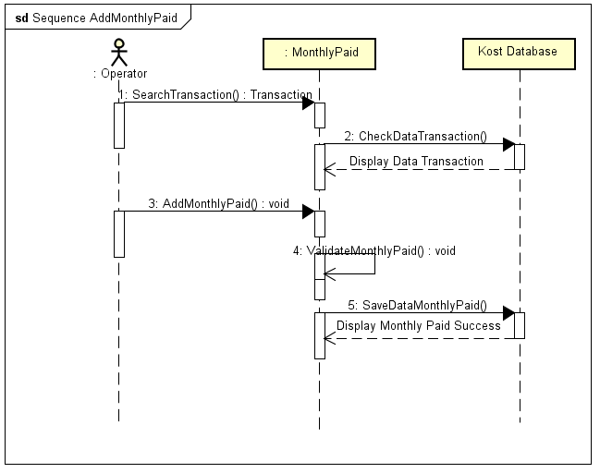
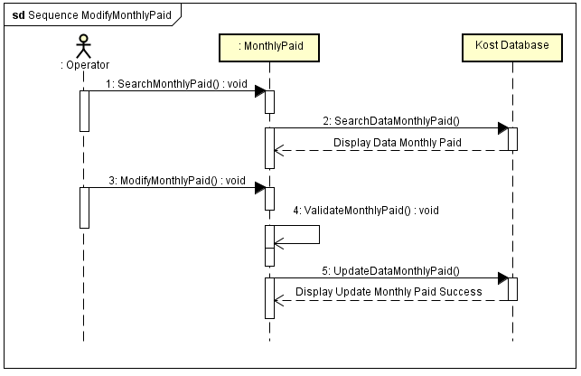
SEQUENCE
Add Monthly Paid
Modify Monthly Paid

Slide 15
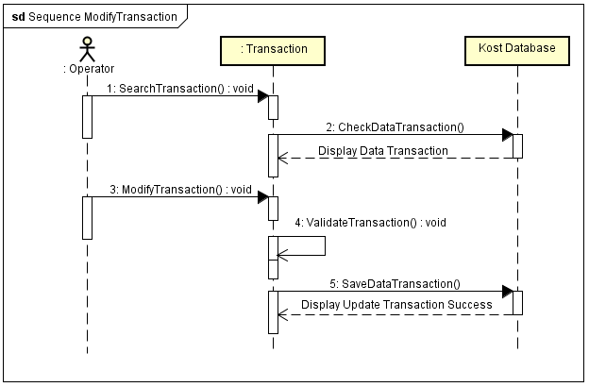
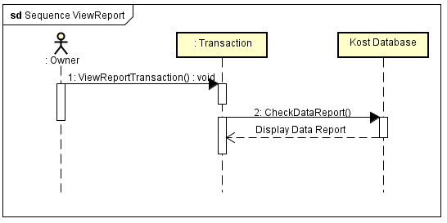
SEQUENCE
Modify Transaction
View Report

Slide 16
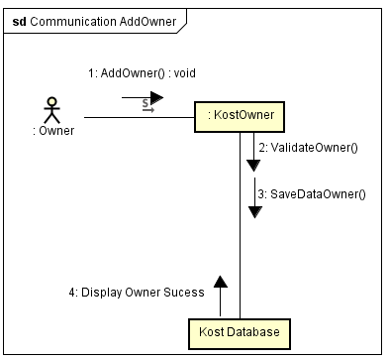
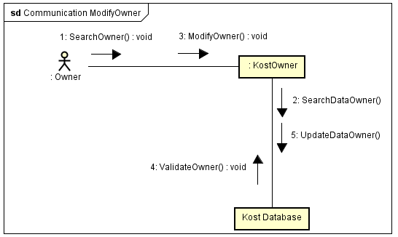
COMMUNICATION
Add Owner
Modify Owner

Slide 17
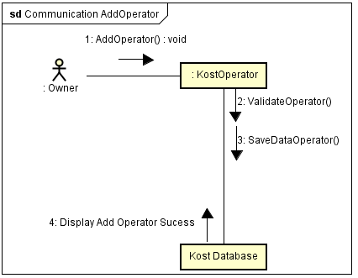
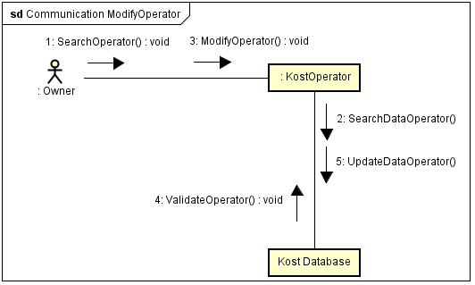
COMMUNICATION
Add Operator
Modify Operator

Slide 18
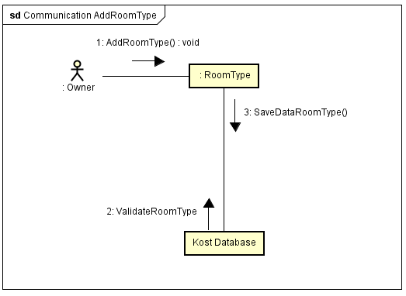
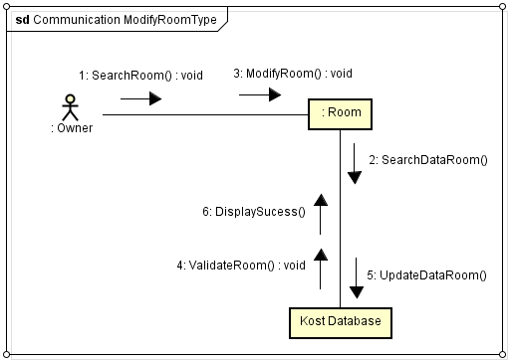
COMMUNICATION
Add Room Type
Modify Room Type

Slide 19
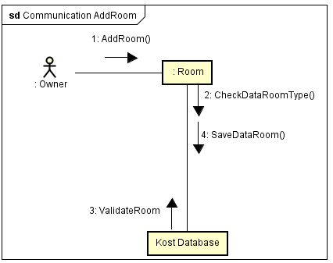
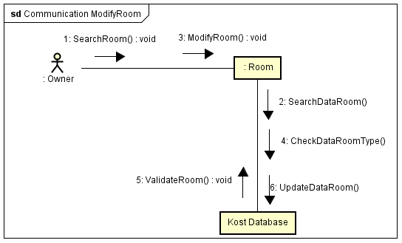
COMMUNICATION
Add Room
Modify Room

Slide 20
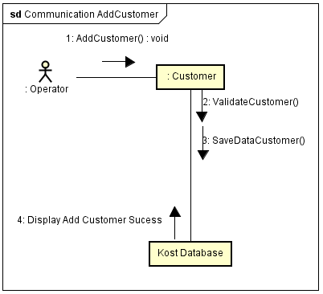
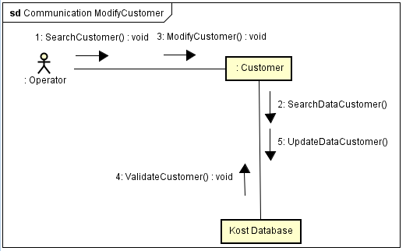
COMMUNICATION
Add Customer
Modify Customer

Slide 21
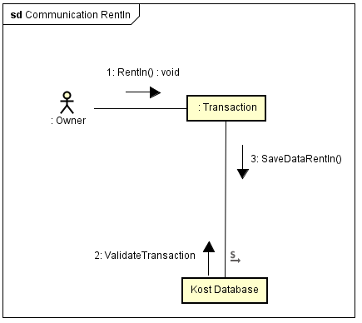
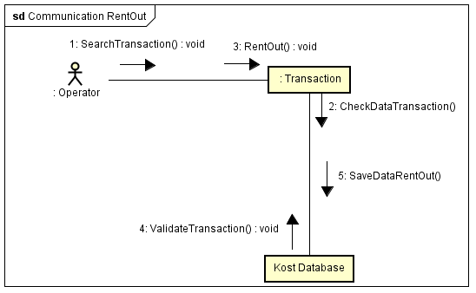
COMMUNICATION
Rent In
Rent Out

Slide 22
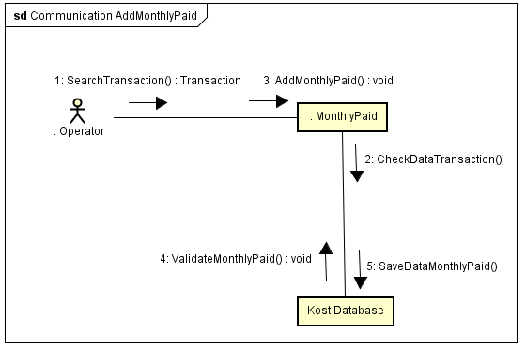
COMMUNICATION
Add Monthly Paid
Modify Monthly Paid

Slide 23
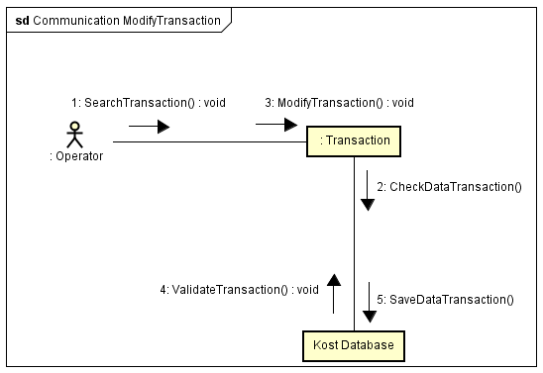
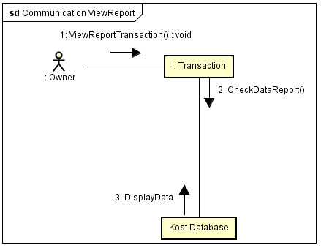
COMMUNICATION
Modify Transaction
View Report

Slide 24
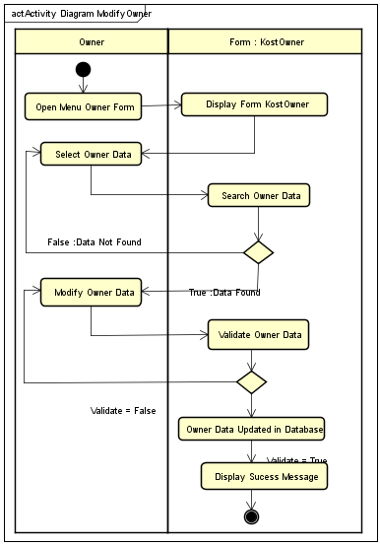
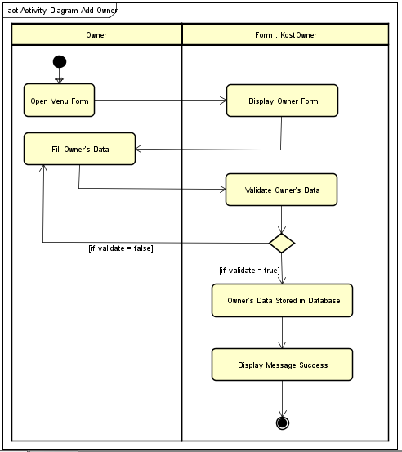
ACTIVITY
Add Owner
Modify Owner

Slide 25
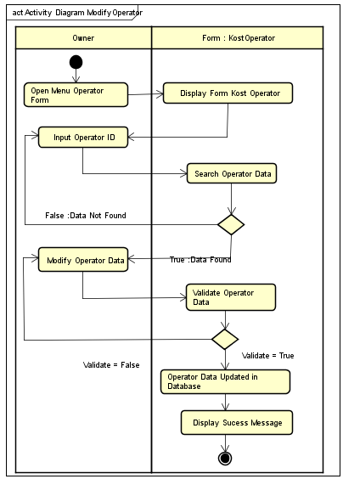
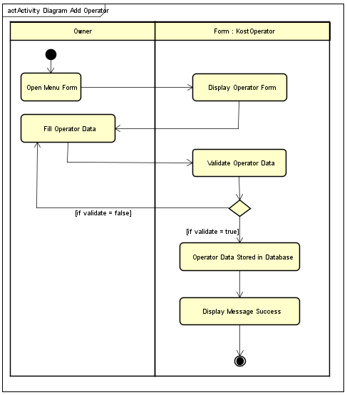
ACTIVITY
Add Operator
Modify Operator

Slide 26
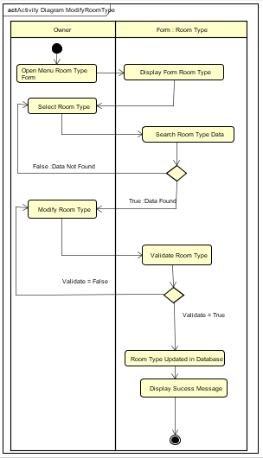
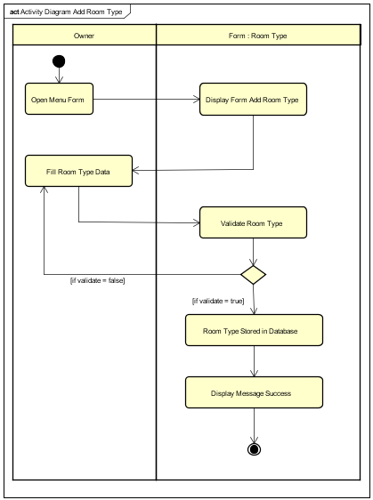
ACTIVITY
Add Room Type
Modify Room Type

Slide 27
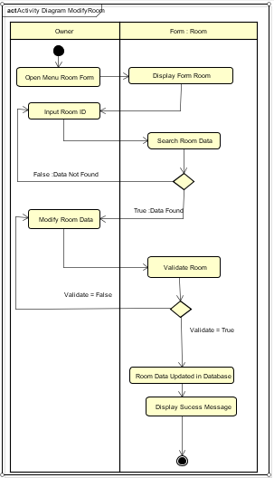
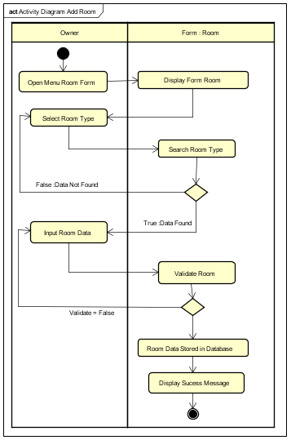
ACTIVITY
Add Room
Modify Room

Slide 28
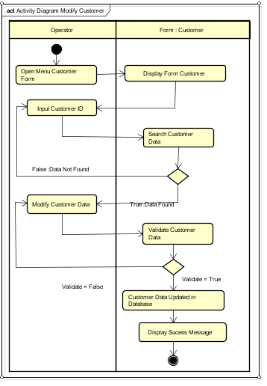
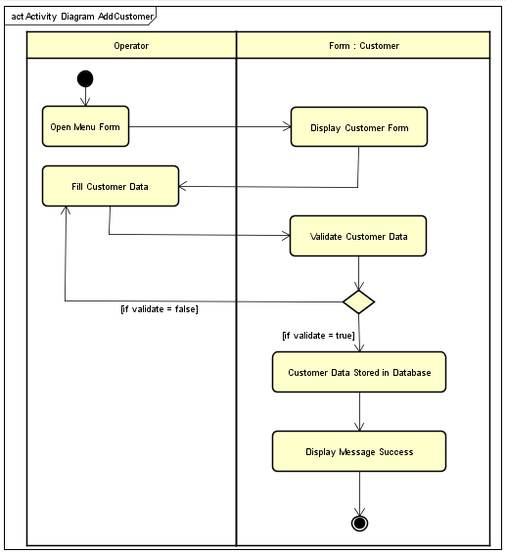
ACTIVITY
Add Customer
Modify Customer

Slide 29
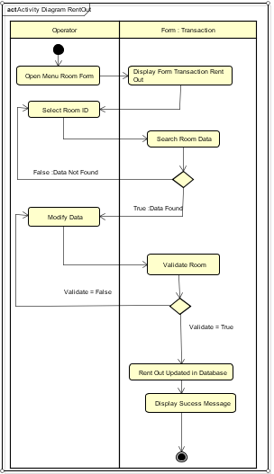
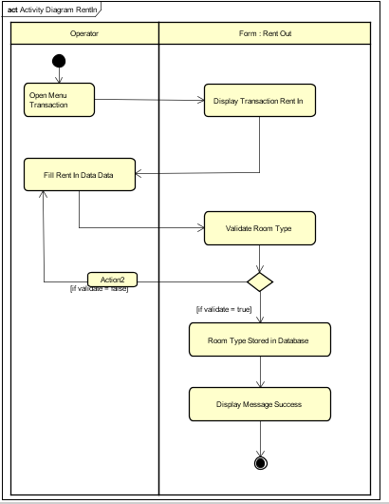
ACTIVITY
Rent In
Rent Out

Slide 30
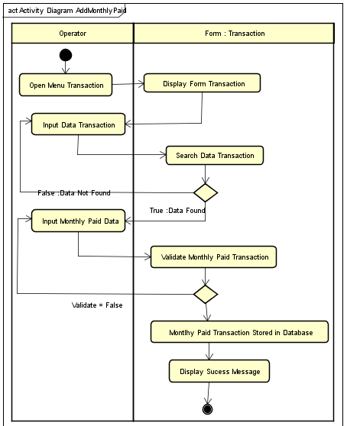
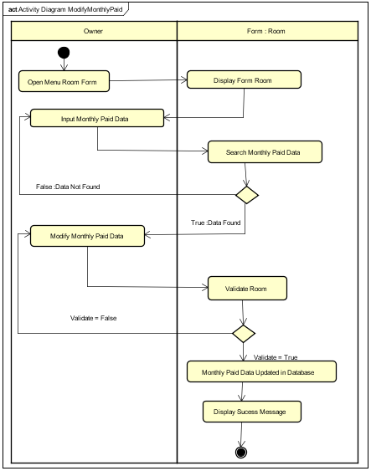
ACTIVITY
Add Monthly Paid
Modify Monthly Paid

Slide 31
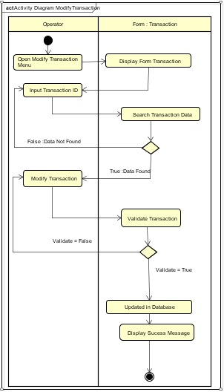
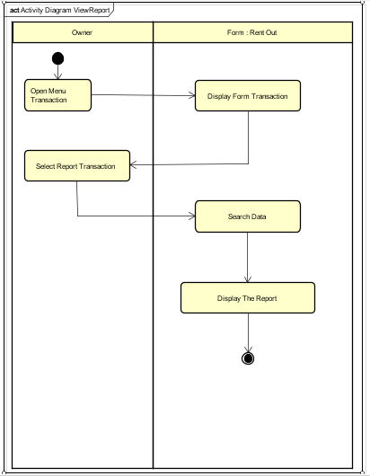
ACTIVITY
Modify Transaction
View Report

Slide 32


STATE MACHINE
Available
Not Available

Slide 33

COMPONENT

Slide 34

DEPLOYMENT

Slide 35
THANK YOU

