Slide 1

CODE IGNITER VERSION 3
M HUDYA R
Notes:
No slide master

Slide 2


BACKGROUND

Slide 3





PRESENTATION TIMELINE
BACKGROUND
PROGRAMMING
LANGUAGE
PHP
CODEIGNITER
MVC PATTERN
CODEIGNITER SCOPE
Describe about background of CodeIgniter
Briefly Description about Programming Language
Describe about PHP Programming Language
Describe about CodeIgniter
Analysis of MVC Pattern
Scope of CodeIgniter

Slide 4

PROGRAMMING LANGUAGE
BRIEFLY DESCRIPTION

Slide 5

PHP PROGRAMMING LANGUAGE

Slide 6

CODE IGNITER
DESCRIPTION
MODEL
VIEW
CONTROLLER

Slide 7
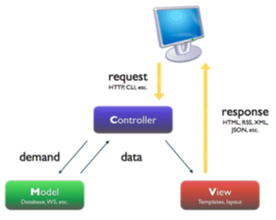

MVC Pattern
OUR WAY TO CREATE A PRODUCT

Slide 8
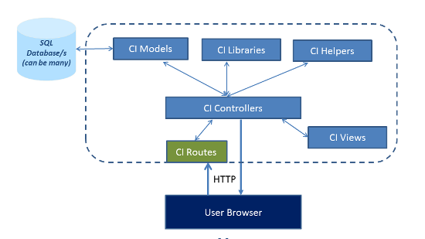
CODE IGNITER’S CONTROLLER SCOPE

Slide 9
CONCLUSION & SUGGESTION

Slide 10
THANK YOU!
ANY QUESTIONS?
M HUDYA RAMADHANA
CCIT – FACULTY OF ENGINEERING
UNIVERSITY OF INDONESIA
2016
“CODE IGNITER FRAMEWORK VERSION 3”

