Slide 1

Architecture Technology of Code Igniter
M Hudya Ramadhana

Slide 2

BACKGROUND

Slide 3

PROGRAMMING LANGUAGE : BRIEFLY DESCRIPTION

Slide 4

DEFINITION OF PHP

Slide 5
HISTORY OF PHP
June 1995
Rasmus Release code for PHP
1997 - 1998
PHP got a lot of user around the world
May 1998 - Now
60.000 domains reported having headers containing PHP and PHP used as open source web programming language

Slide 6
BENEFIT OF PHP
Easy Integrated
Open Source
Easy to use
Lot of Documentation

Slide 7

Definition of Framework Programming

Slide 8
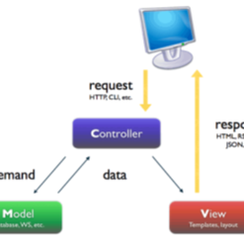
MVC Pattern
MODEL VIEW CONTROLLER

Slide 9

DEFINITION OF CODE IGNITER

Slide 10
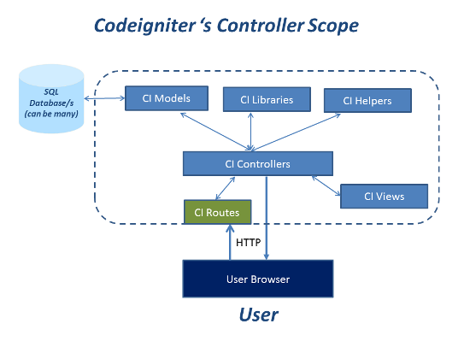
Code Igniter’s Controller Scope

Slide 11
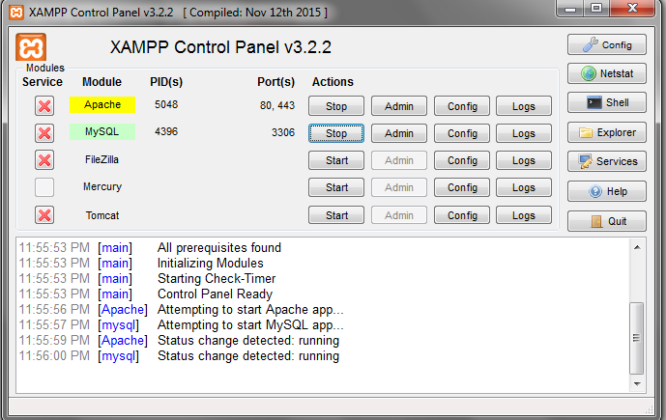
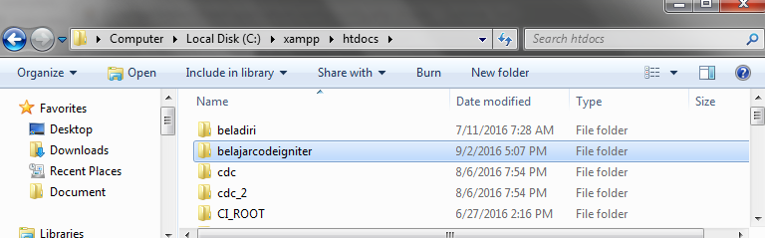
HOW TO USE CODE IGNITER
1. Turn on the XAMPP
2. Place the folder of code igniter framework in htdocs

Slide 12
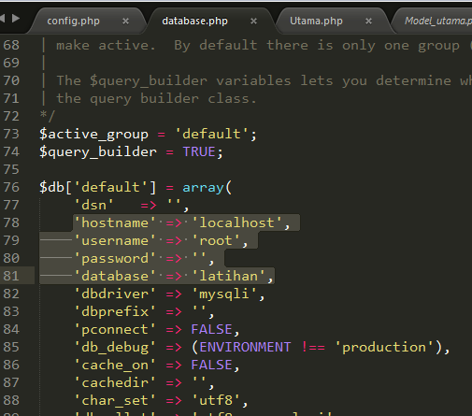
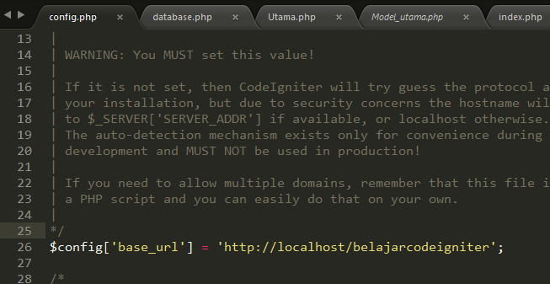
3. Setup the base url
4. Setup the database

Slide 13
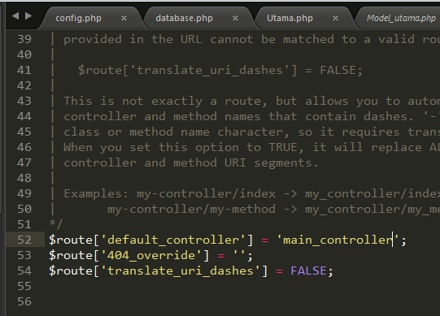
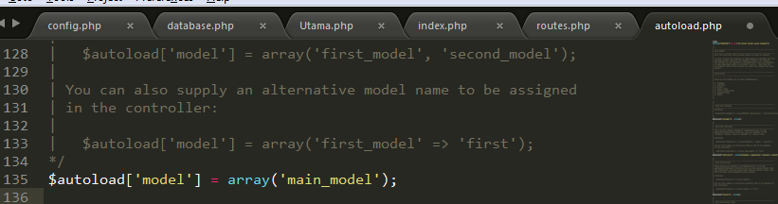
5. Setup the routes
6. Setup the autoload to write the model

Slide 14
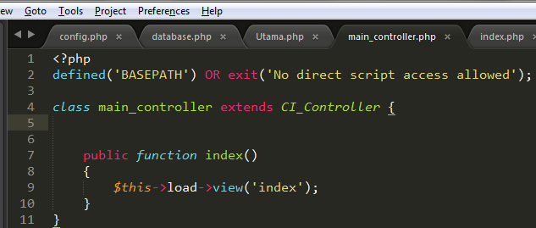
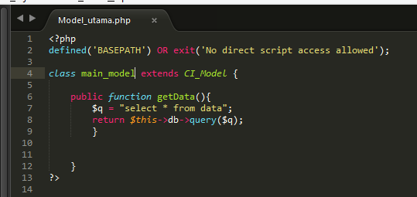
7. Controller’s Code
8. Model’s Code

Slide 15
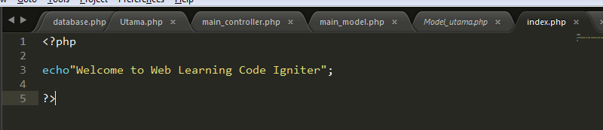
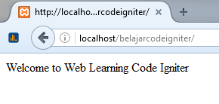
9. View’s Code
10. The display of user browser

Slide 16
THANK YOU!
Any Questions?
M HUDYA RAMADHANA

