Slide 1
RENT HOUSE
M Hudya Ramadhana
Mutia Ayu Dianita

Slide 2

<BACKGROUND/>

Slide 3
<SYSTEM ANALYST/>

Slide 4
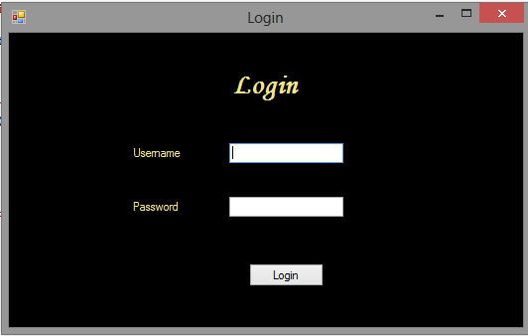
<INTERFACE>

Slide 5
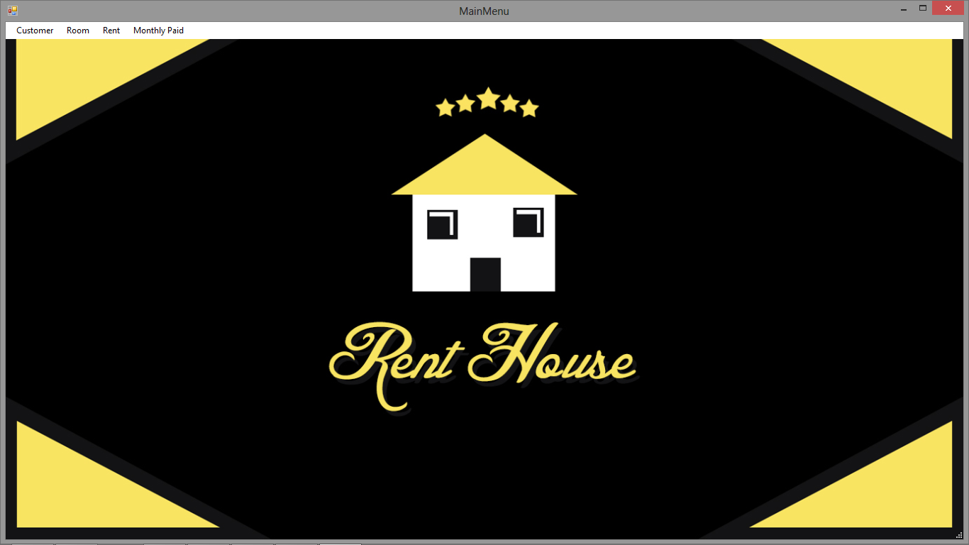

Slide 6
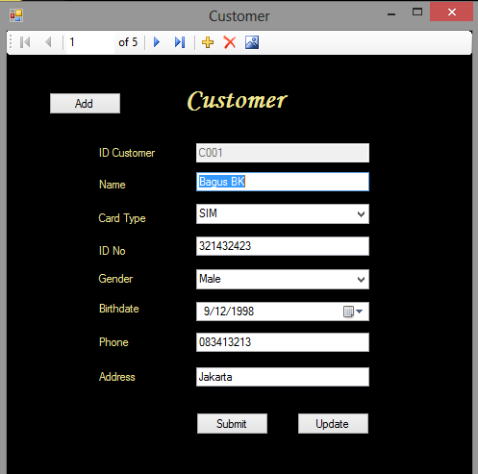

Slide 7
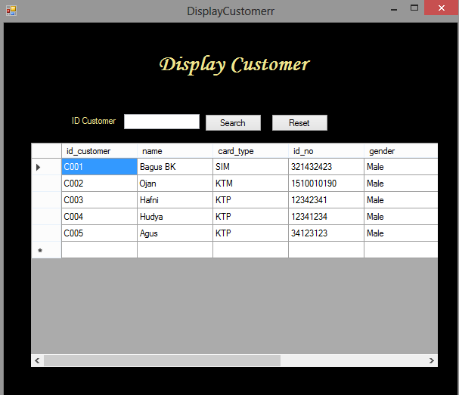

Slide 8
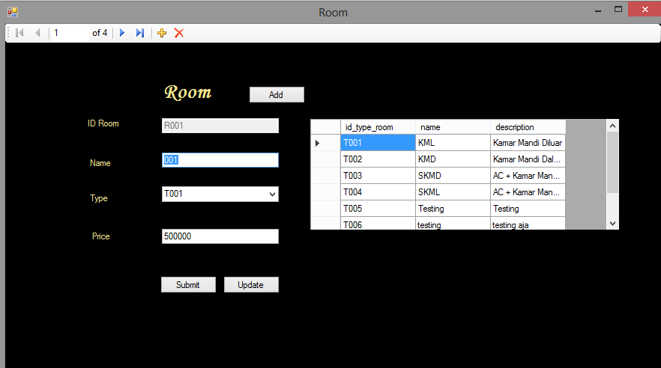

Slide 9
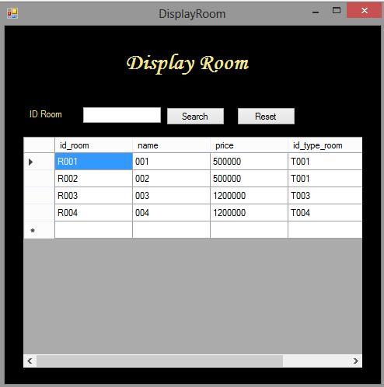

Slide 10
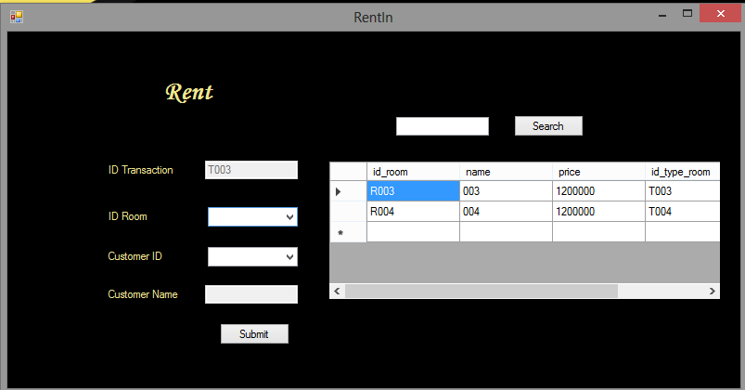

Slide 11
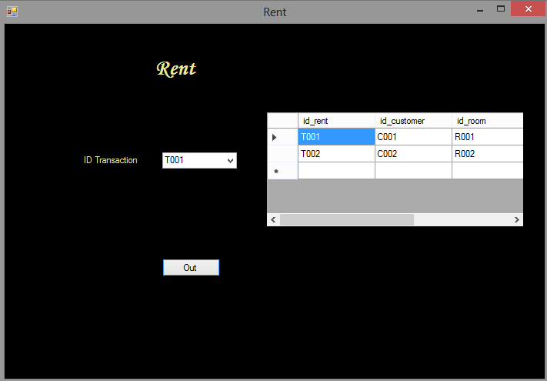

Slide 12
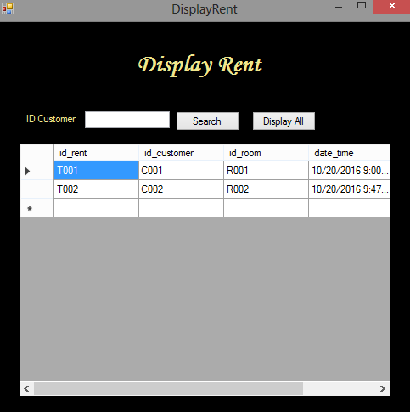

Slide 13
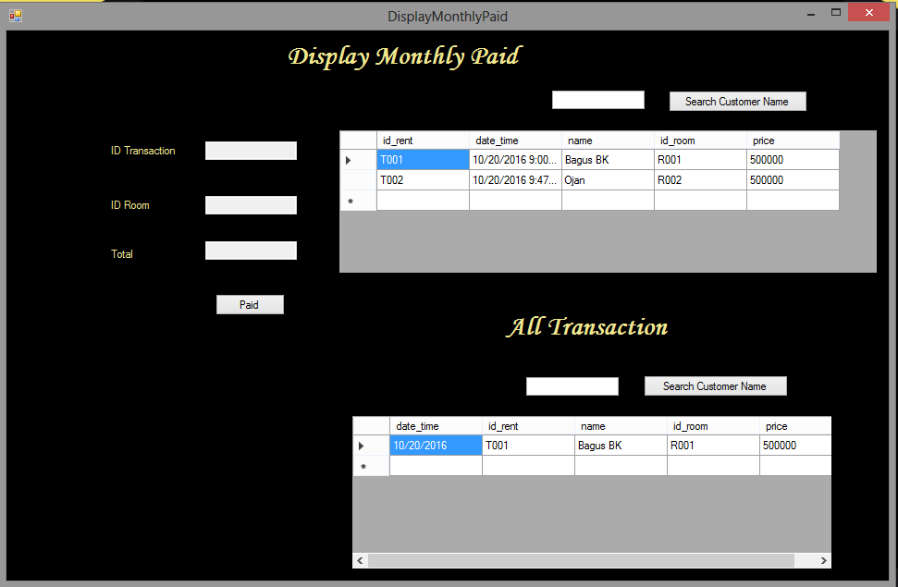

Slide 14
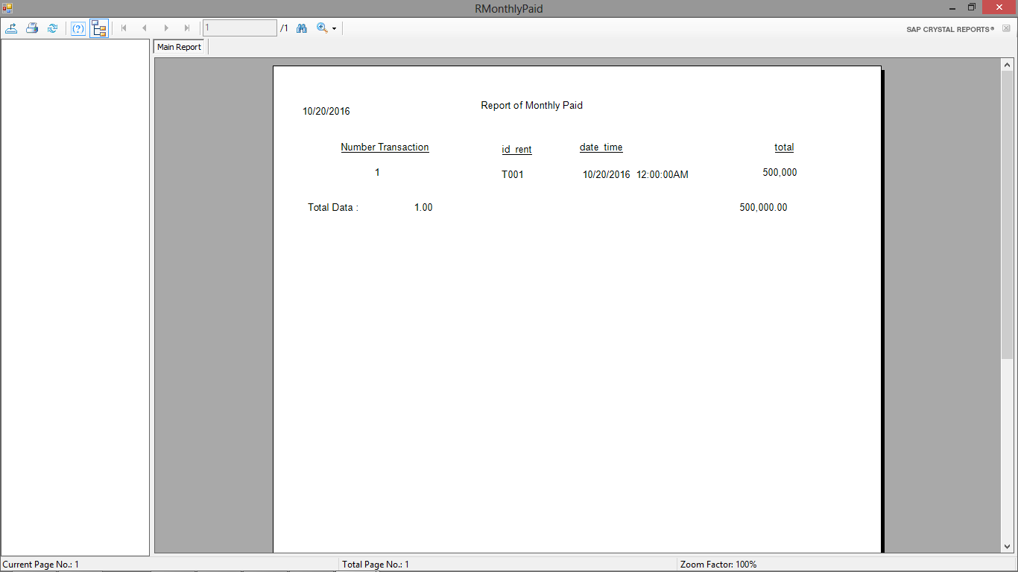
</INTERFACE>

Slide 15
THANK YOU

