Slide 1







01
WINTER
Feature Modelling using Support Vector Machine and Gaussian mixture Model Applied on Voice Based Biometric Authentication
Template
Felipe Gomes Barbosa, Federal Institute of Education, Science and Technology Department of Electronics. Sao Luıs, Brazil
Jakub Gałka, Member, IEEE, Mariusz Mąsior, and Michał Salasa
Presented by
Dina Nurhayati
Julian Maulana

Slide 2
02
Abstract
Feature extraction methods | Feature Modelling Methods
MFCC (Mel-frequency cepstral coefficients) LPCC (Linear predictive coding coefficients) | Generative approaches |  | Discriminative approaches
 | Text-Independent | Text-Dependent | SVM (Support Vector Machines) , ANN (artificial neural networks)
 | GMM (Gaussian Mixture Models), VQ (Vector Quantization), JFA (Joint Factor Analysis) | HMM (Hidden Markov Models)

Slide 3
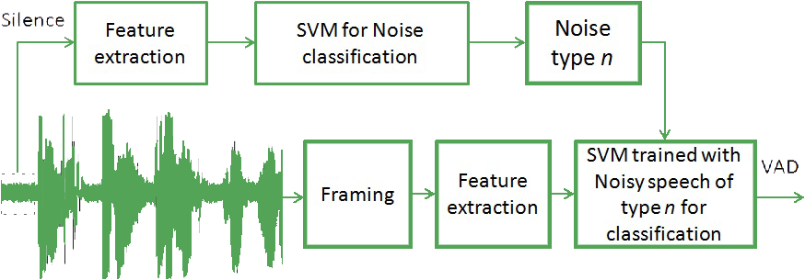
Introduction
03
Different Speech Modalities
Text-Independent
Text-Dependent

Slide 4
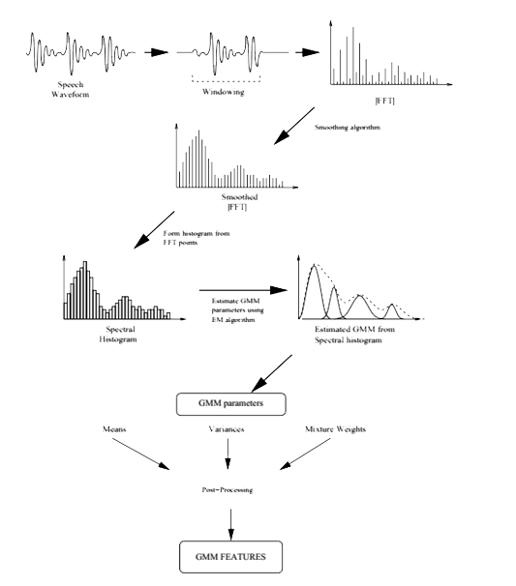
04
Methodology
Overview GMM features from signal

Slide 5
04
Methodology

Slide 6
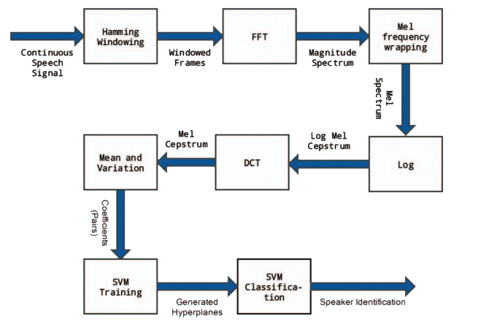
04
Methodology
Generic flowchart of whole method

Slide 7
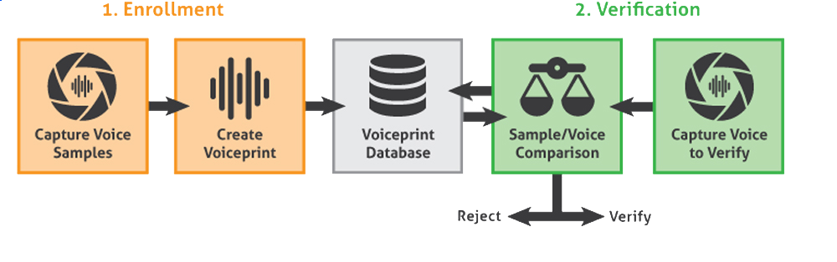
06
Result

Slide 8

07
Feature Modelling using Support Vector Machine and Gaussian mixture Model Applied on Voice Based Biometric Authentication
Felipe Gomes Barbosa, Federal Institute of Education, Science and Technology Department of Electronics. Sao Luıs, Brazil
Jakub Gałka, Member, IEEE, Mariusz Mąsior, and Michał Salasa
Presented by
Dina Nurhayati
Julian Maulana

