Slide 1
Created By: Muhammad Hudya Ramadhana Mutia Ayu Dianita 4SC1
Rent House

Slide 2

System Analysis

Slide 3
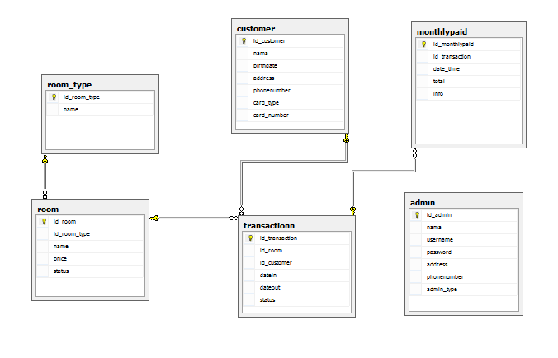
Database Diagram

Slide 4

Demo Application

Slide 5
THANK YOU

