Slide 1
Assembly Positions
5 cm
Switch
Switch
4 cm
Arduino Pro Micro
LED
LED

Slide 2
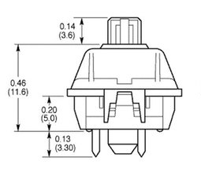
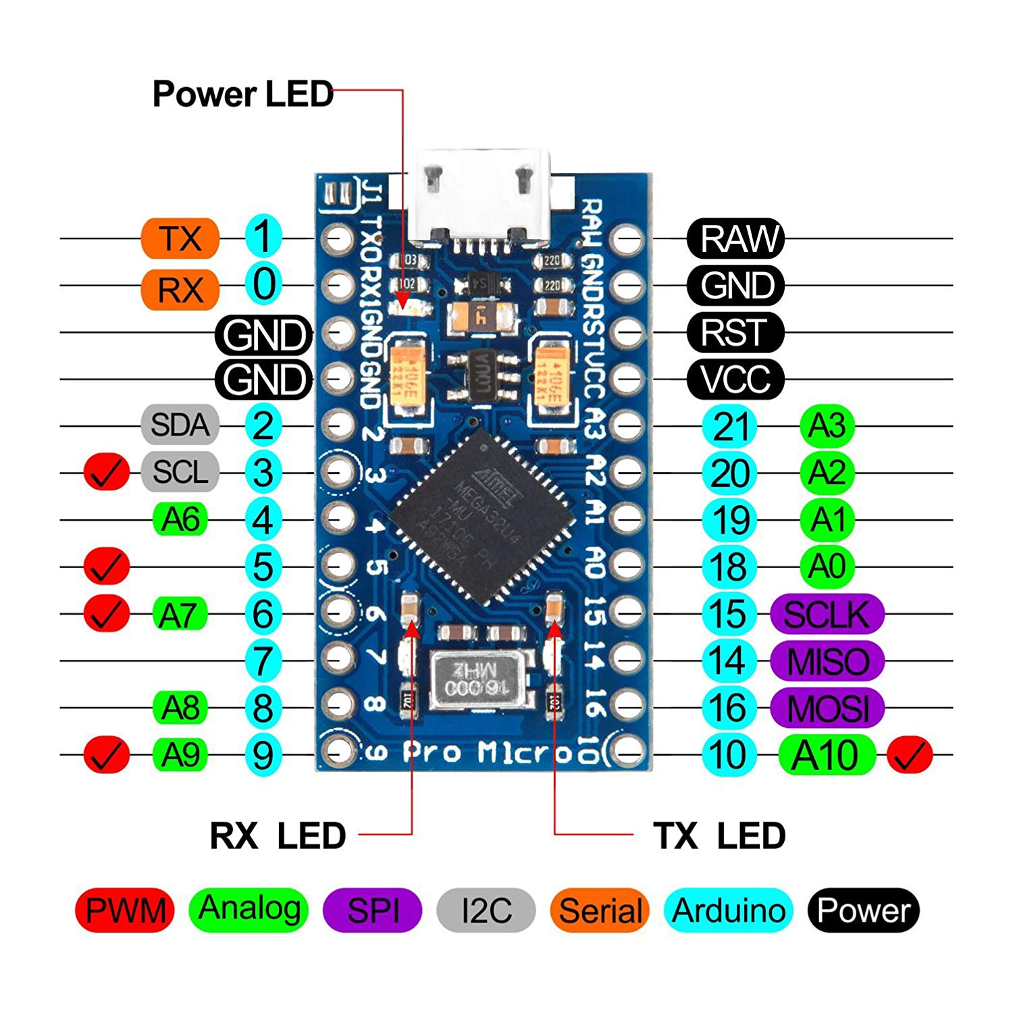
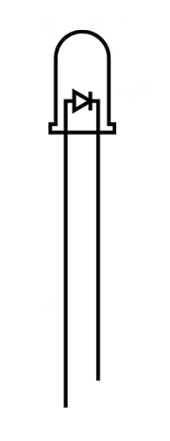
Writing Diagram

