Slide 1
Assembly Positions
5 cm
Switch
Switch
4 cm
Arduino Pro Micro

Slide 2
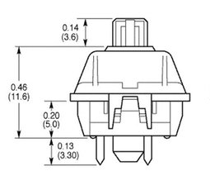
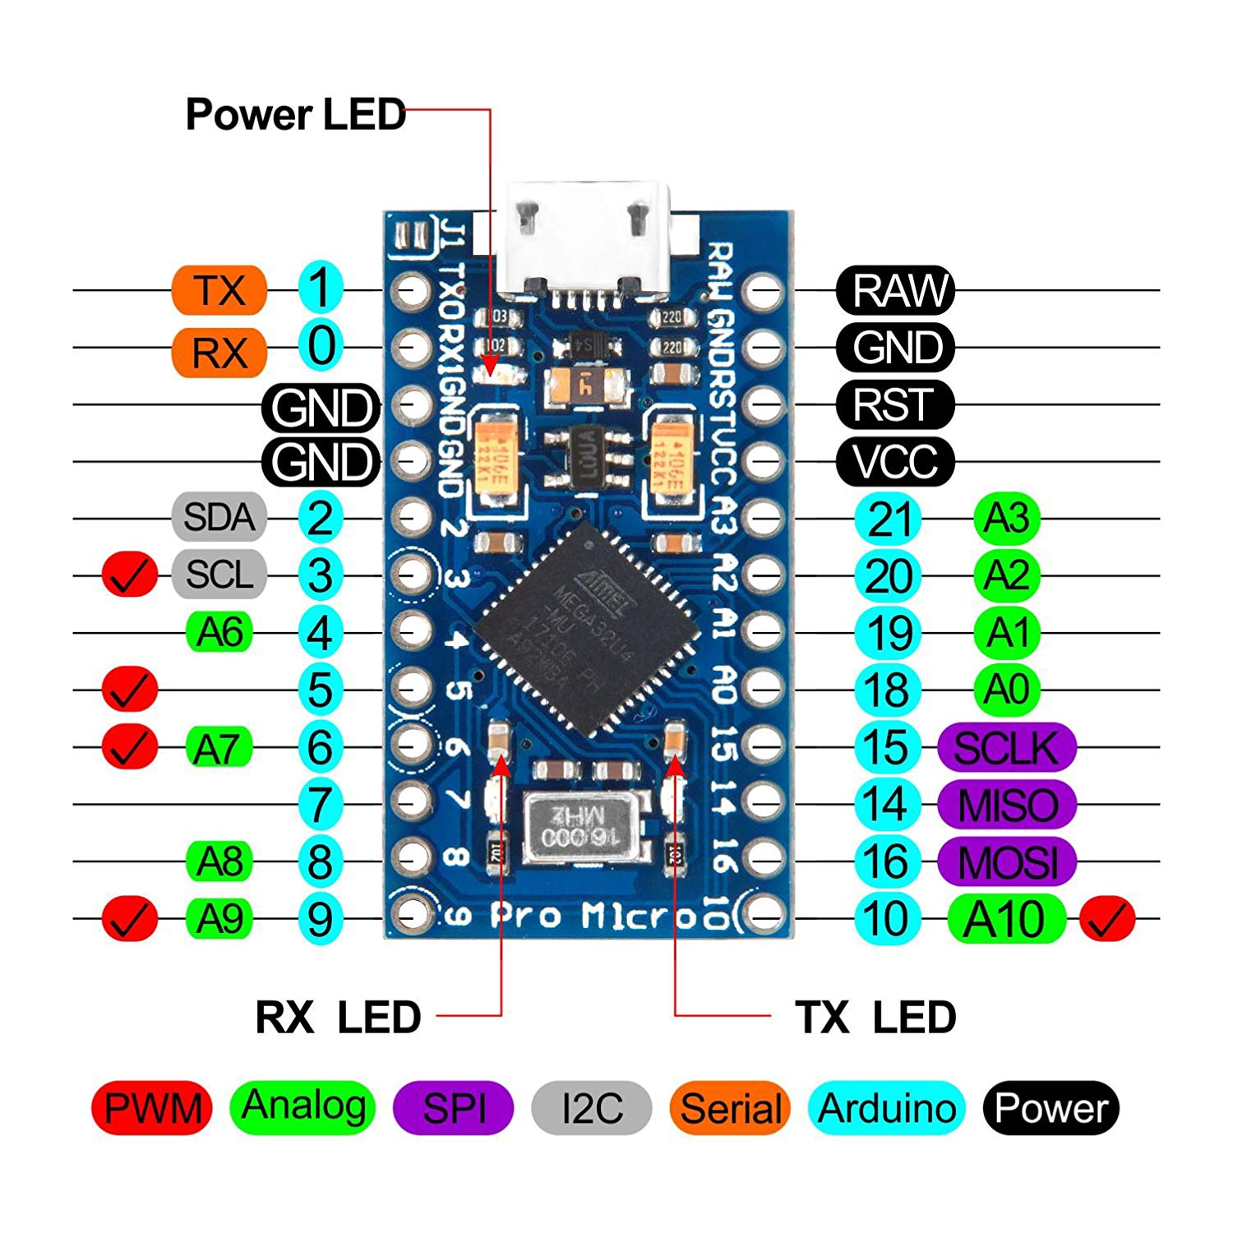
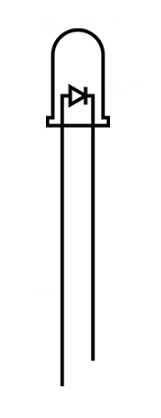
Writing Diagram

