Slide 1
User Guide
V2015.11.26

Slide 2
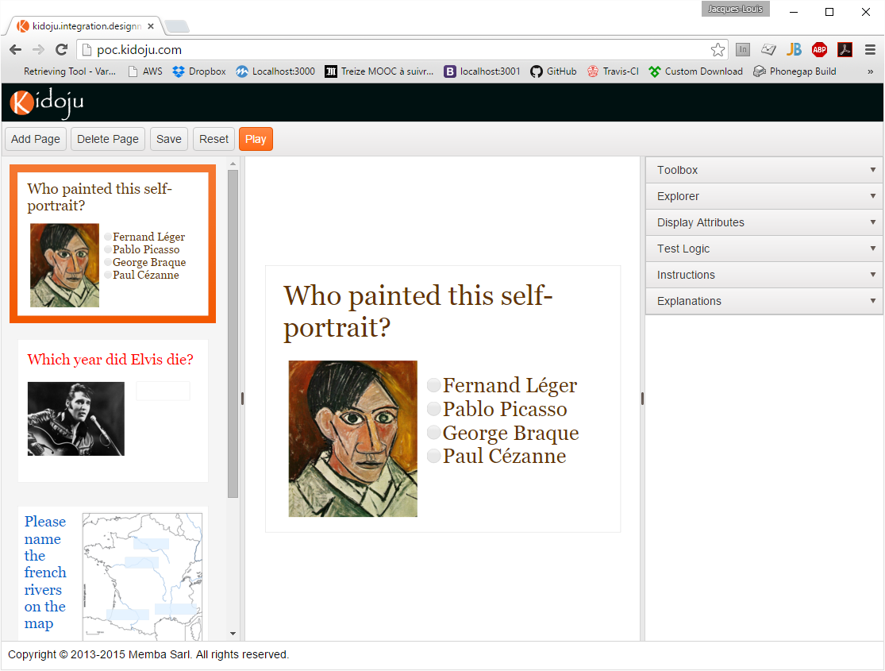
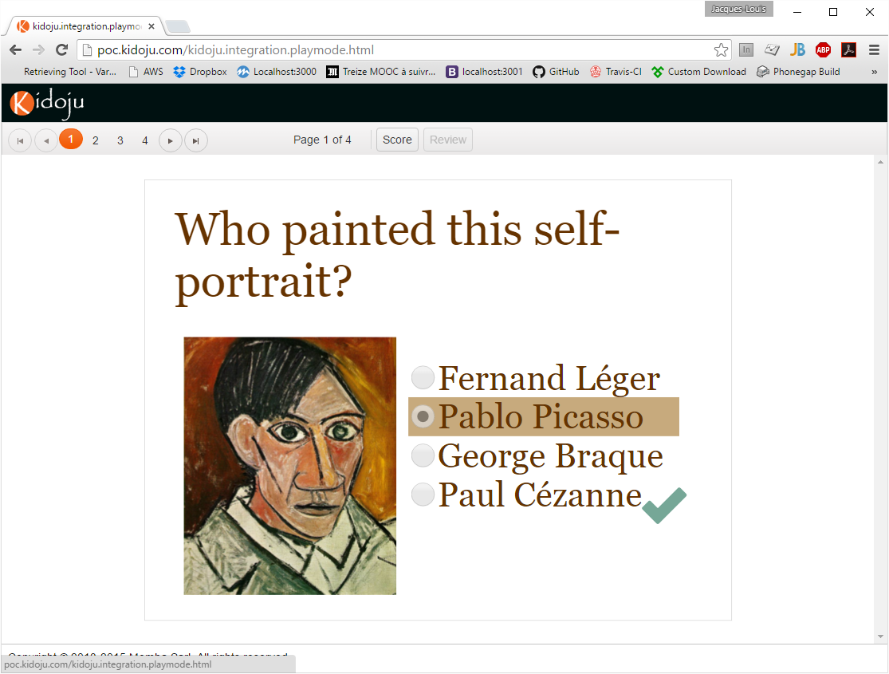
Designer and Player (like PowerPoint)
The designer is used to design knowledge tests
The player is used to play (record answers) and review (display corrections) knowledge tests
PLAY

Slide 3
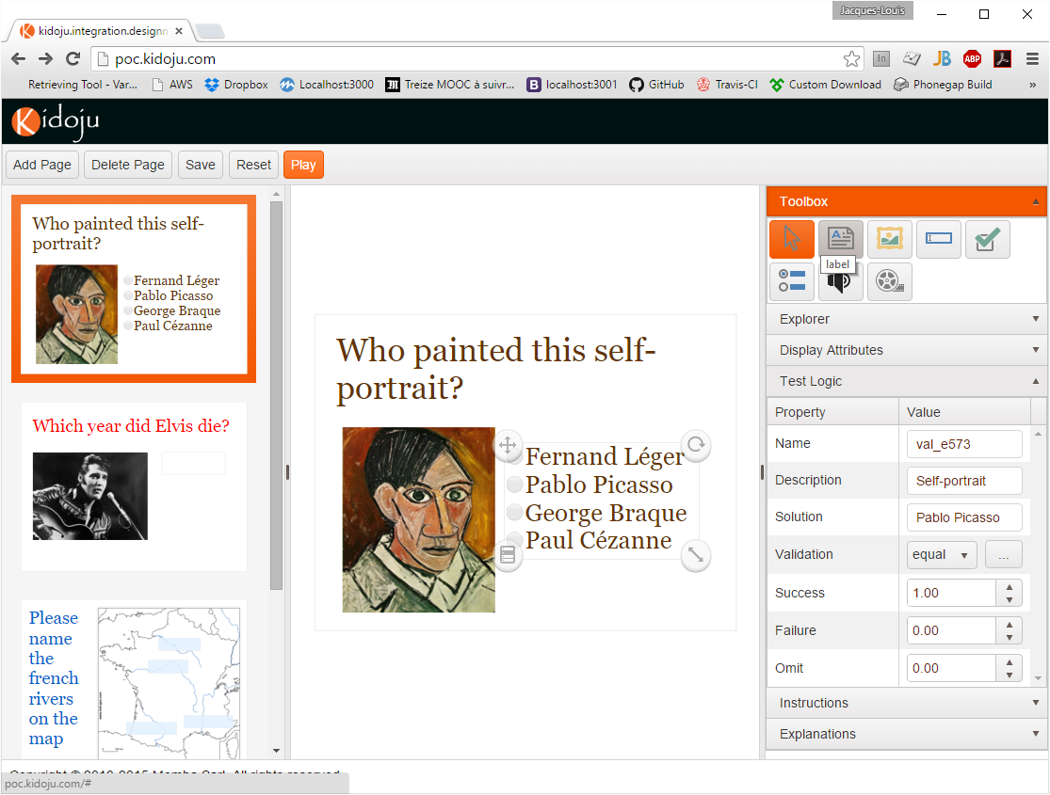
Designing knowledge tests
A test is made of pages
A page hosts elements
Elements are drawn using tools from the toolbox
Elements all have display attributes (position, style)
Some elements used to record answers have test logic (solution, validation, scores)
Page instructions are displayed when playing the test
Page explanations are displayed when reviewing the test

Slide 4
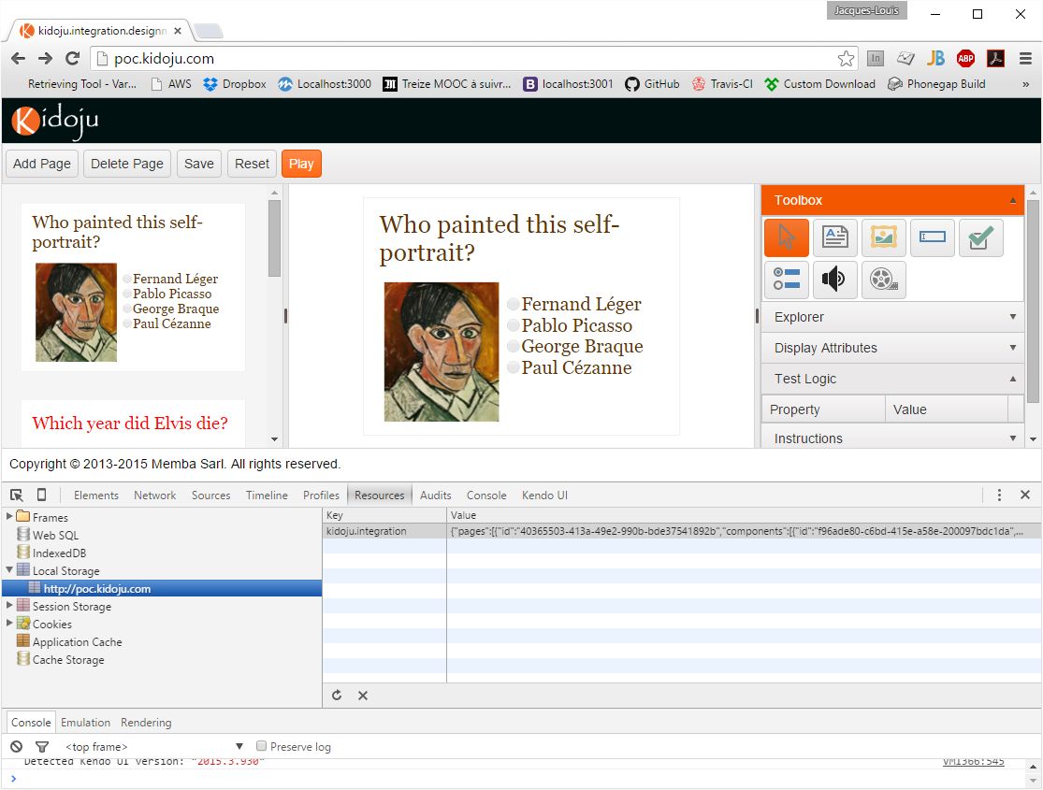
WARNING! Saving and resetting
This is a proof of concept, not a finished product
There is no authentication and no backend database
Save currently saves in local storage (Press F12 or Cmd + Opt + I to display developer tools in your browser)
Reset simply erases local storage

Slide 5
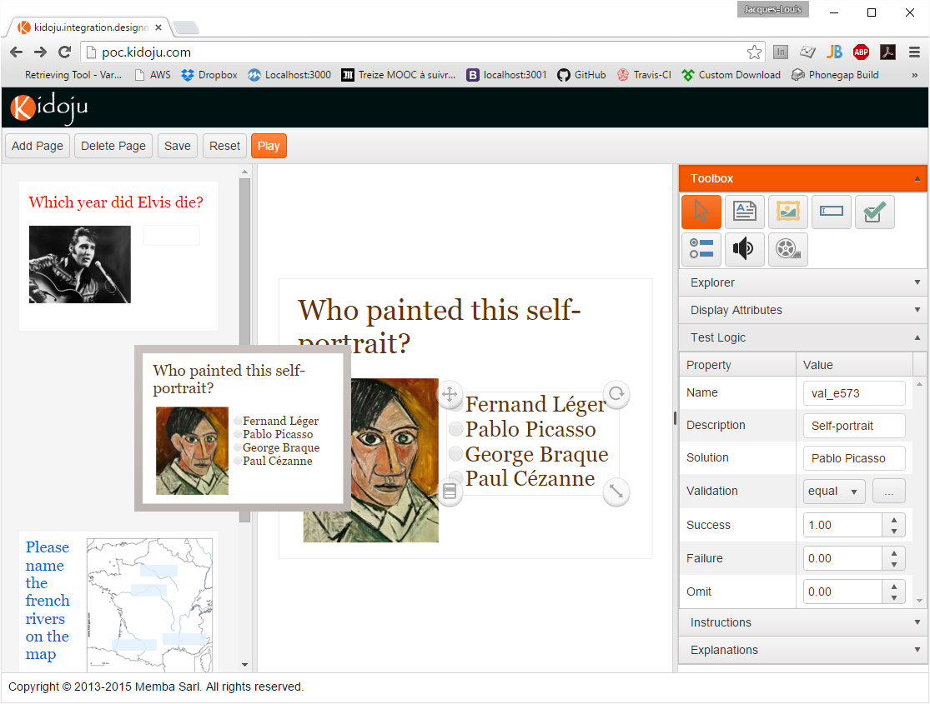
Adding, removing, reordering pages
Click the Add Page button to add a page
Click the Delete Page button to remove a page
Drag and Drop pages to reorder them

Slide 6
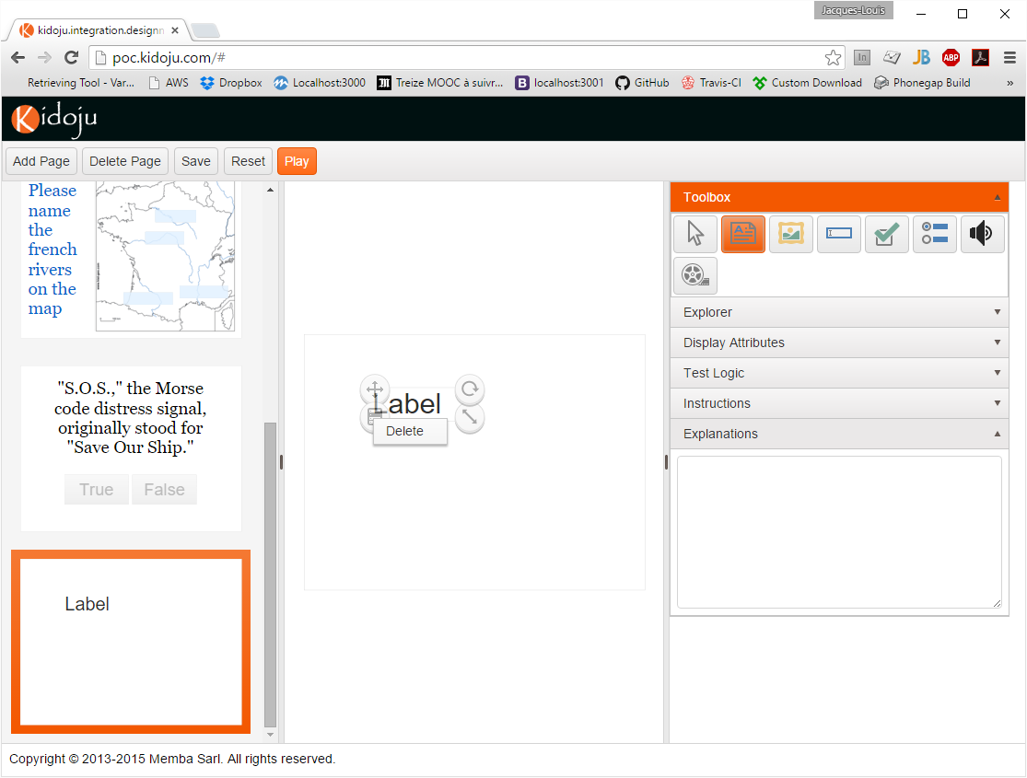
Adding and removing elements
To add an element to the stage (central area where pages are edited), click a tool in the toolbox, then click the stage
To remove an element from the stage, select the element to display the handles, click the menu handle, and click the delete item
Save often

Slide 7
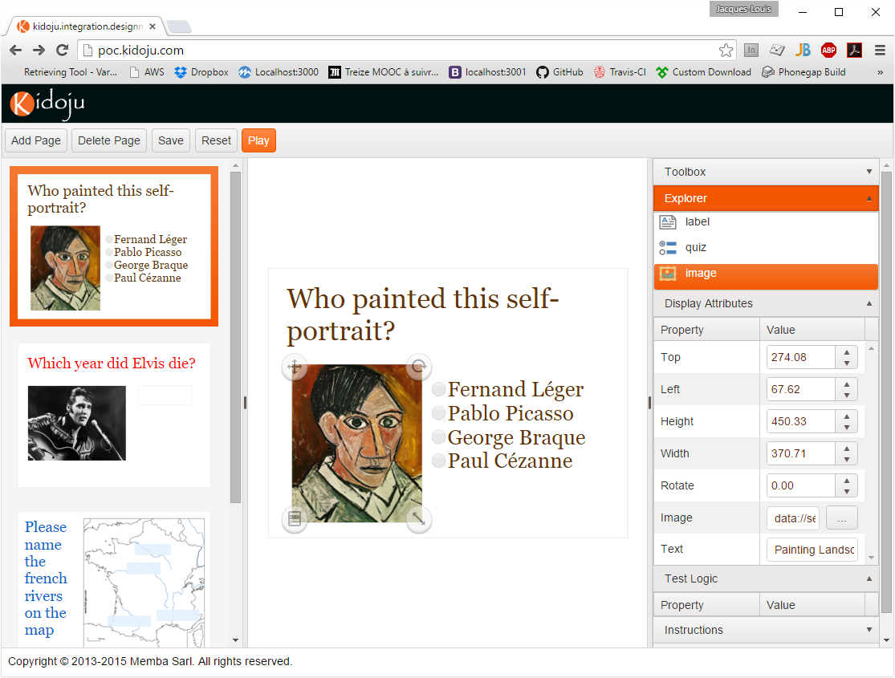
Display attributes: positioning
Select an element by clicking an instance on the stage or in the explorer
A selected element has 4 handles: move, rotate, size, menu
drag the move handle or enter a top and left value
drag the rotate handle or enter a rotate angle
drag the size handle or enter a height and width value

Slide 8
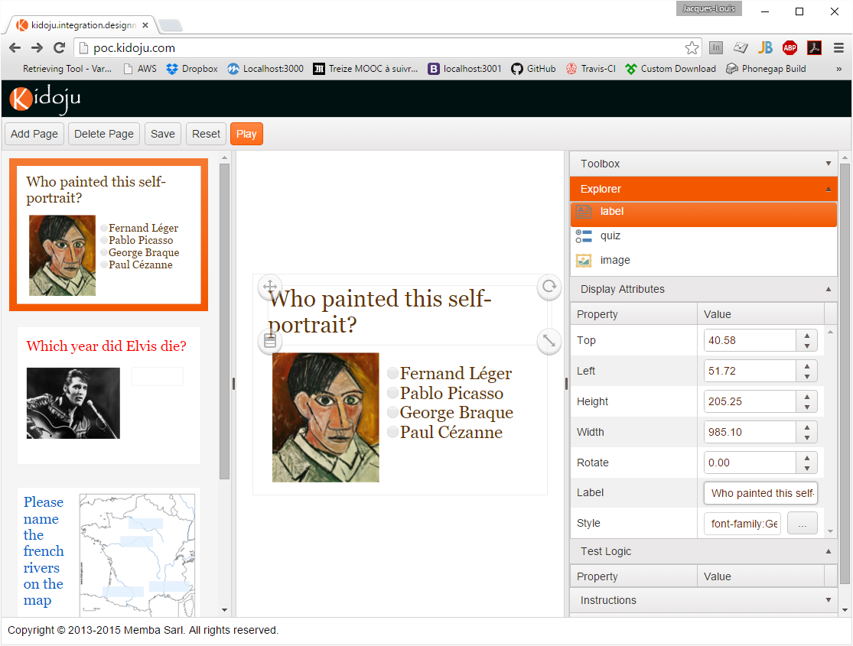
Display attributes: text
Some tools like the label tool display elements with text
Enter or modify the text in the display attributes

Slide 9
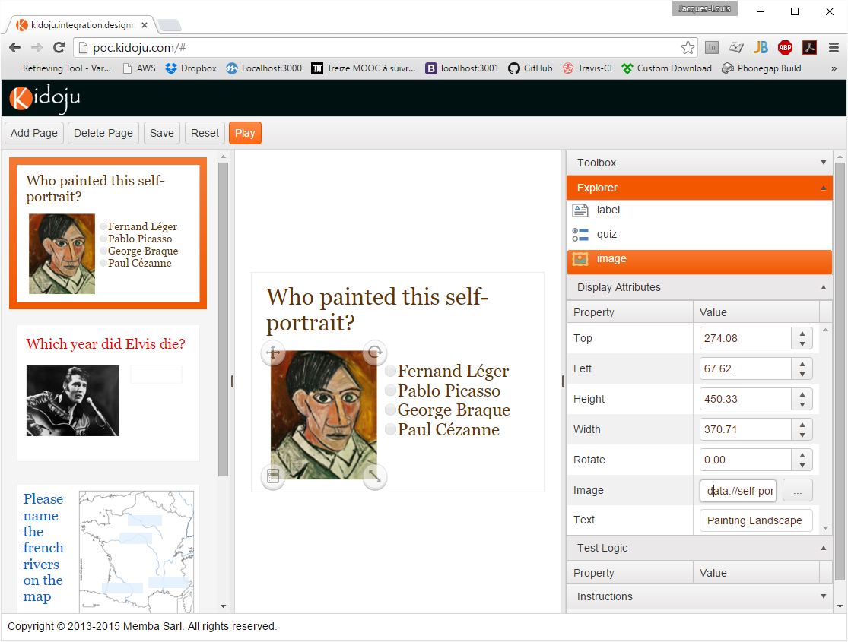
Display attributes: assets
Some tools like the image tool display elements with assets
An asset is a link pointing to a file (image, video, sound)
The link can be copy/pasted (not recommended)
Or a […] button opens an asset manager to upload and select files on our servers (recommended because this is the only guarantee the file will not be removed)
Note: the asset manager is not working in the proof of concept because one needs to be authenticated to access our servers and the proof of concept does not implement authentication

Slide 10
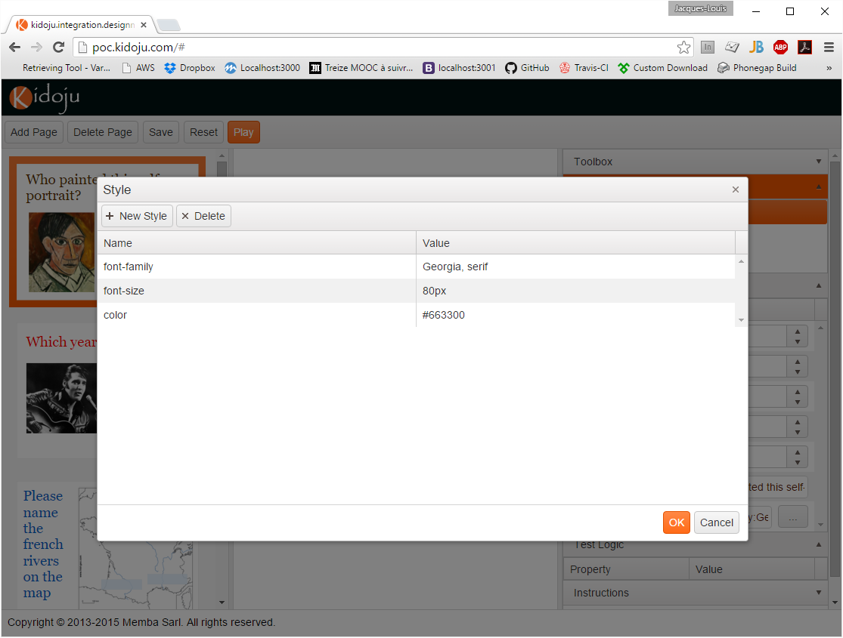
Display attributes: styles
Most tools display elements with styles
Styles define attributes like colors and borders
Styles refer to CSS attributes (see http://www.w3schools.com/css/default.asp)
Colors use #RGB (http://www.w3schools.com/tags/ref_colorpicker.asp)

Slide 11
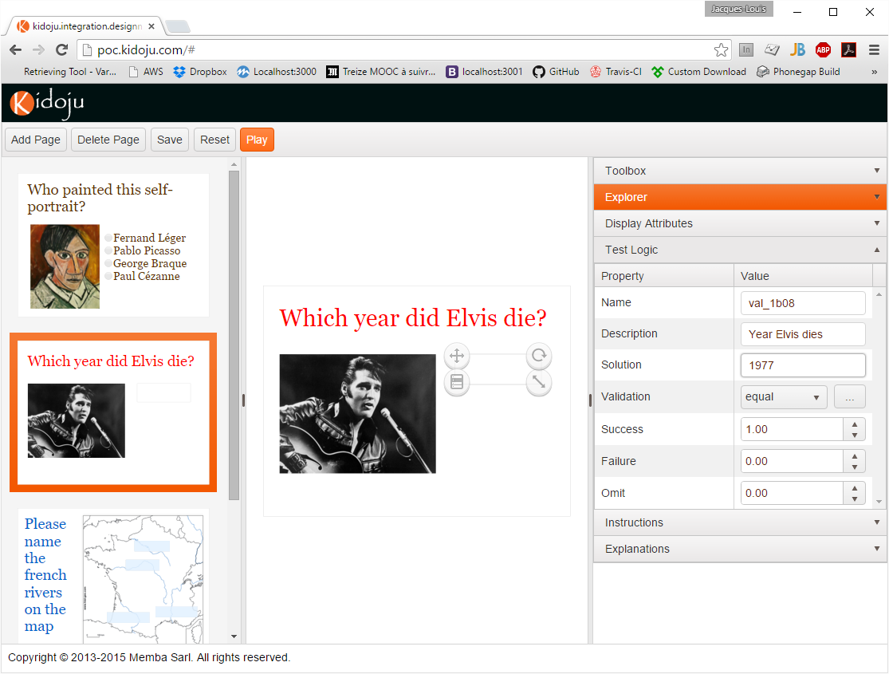
Test Logic: solution
Some tools like textbox and quiz display elements implementing test logic
The first component of test logic is the solution
The solution may or may not be used for validation
The solution is displayed with the score in review mode

Slide 12
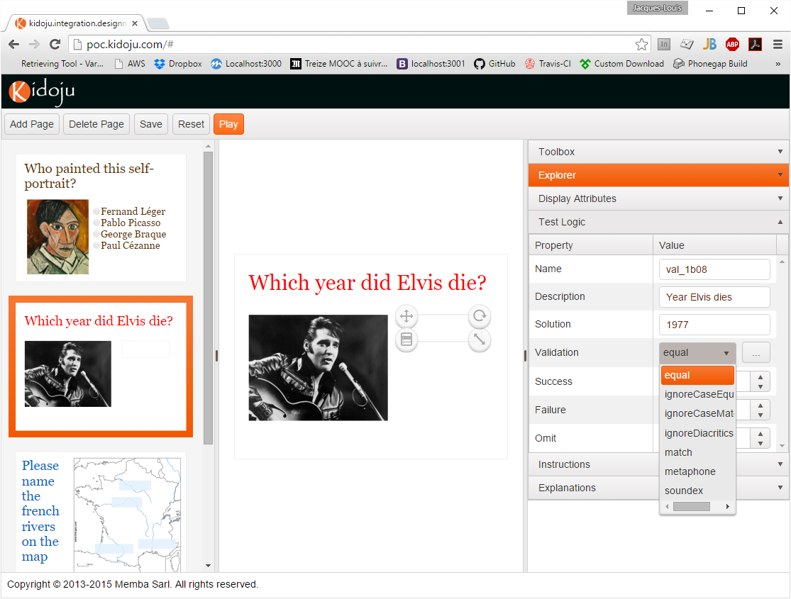
Test Logic: validation
The second component of test logic is the validation formula
Some generic formulas are listed (equal, match, soundex, …)
Generic formulas compare the value entered in play mode with the solution
match requires a solution that is a regular expression (http://regexone.com/)
The […] button empowers designers who can code their validation formulas
There is no limit to the complexity of formulas which can be coded

Slide 13
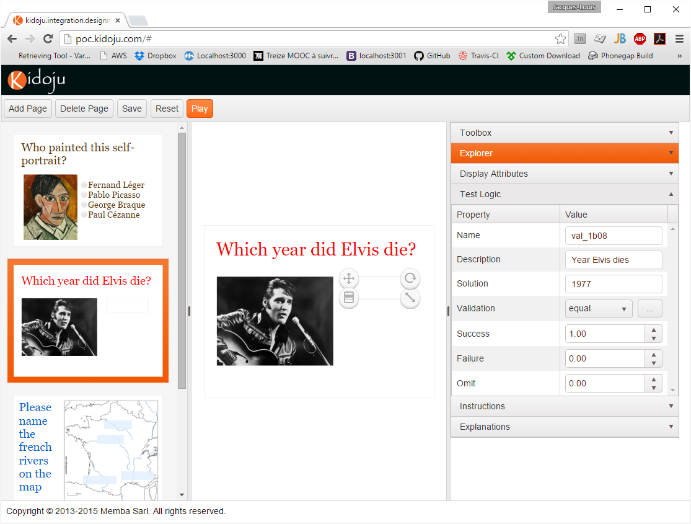
Test Logic: scores
The third and final component of test logic is scores
There are 3 scores for:
Success (the validation formula return true)
Failure (the validation formula returns false)
Omit (the user has not answered the question and the validation formula returns undefined)

Slide 14
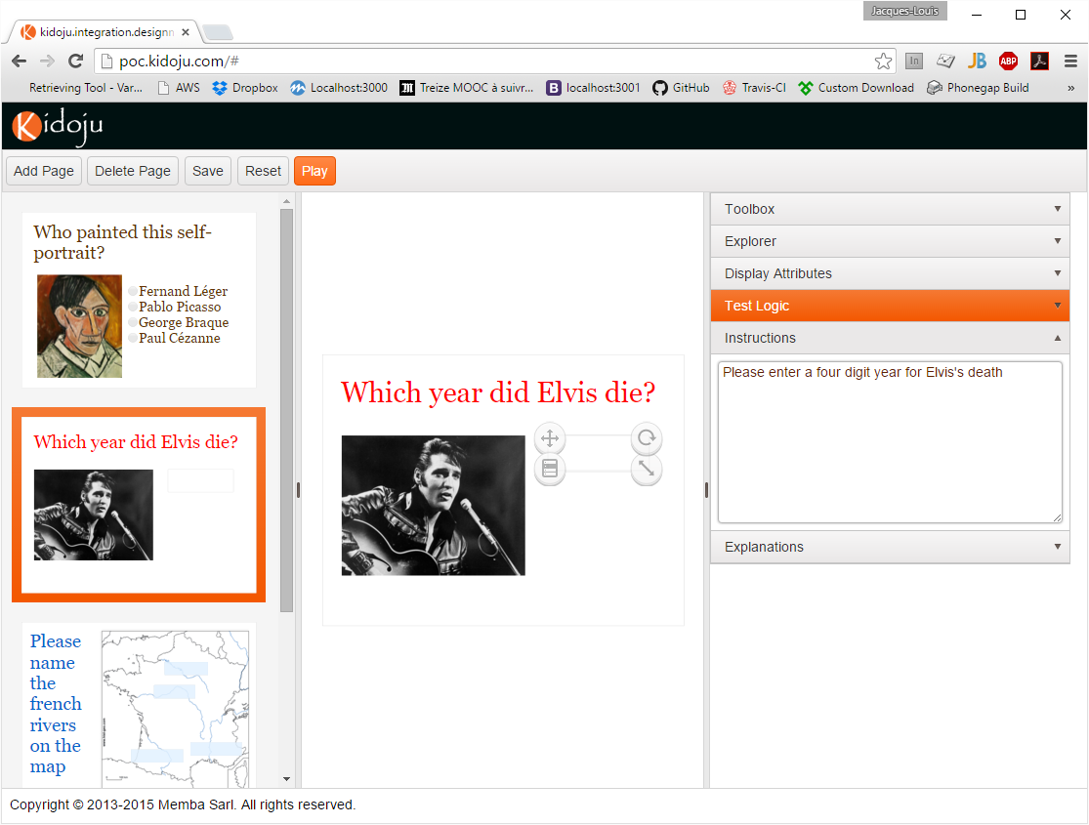
Instructions
Instructions are displayed to help users in play mode (not yet available in the proof of concept)

Slide 15
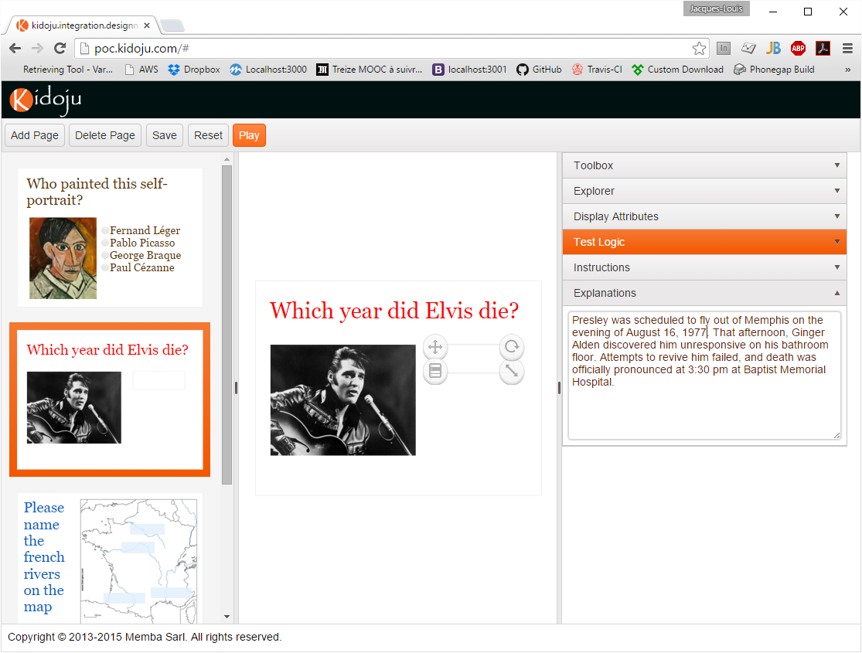
Explanations
Explanations are displayed to explain the solution in review mode (not yet available in the proof of concept)

Slide 16
BEWARE before playing a test
A proof of concept is not a finished product, it is unstable by nature
The test that is played is the one which is saved in local storage
So if you click play without saving, you lose your changes

Slide 17
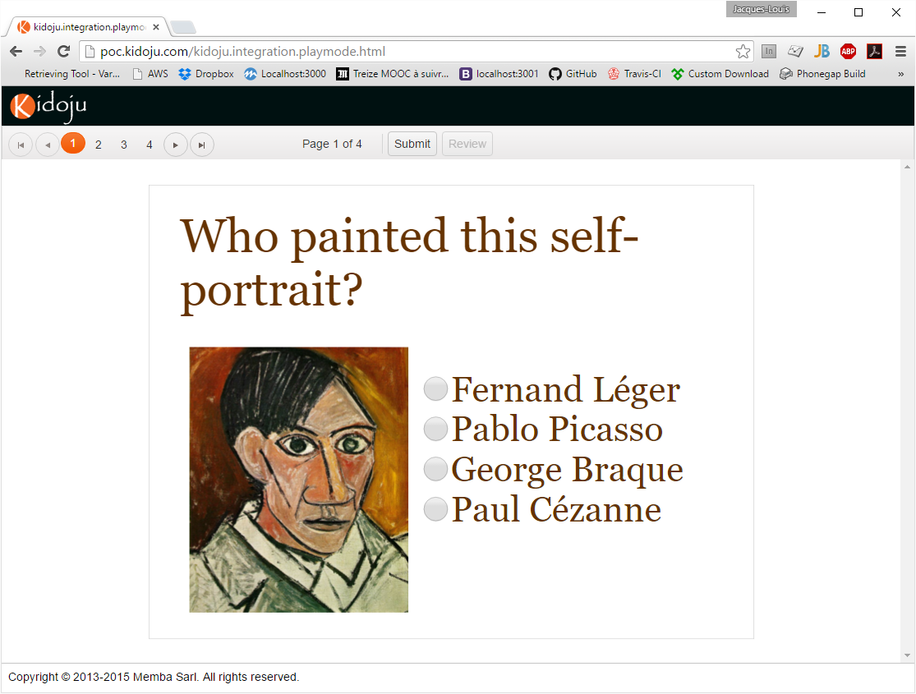
Playing a test
Click Play in the designer
Note: to get back to the designer, click the browser back button
Enter your answers and click the numbers and arrows in the toolbar to change pages
At the end, click Submit
Note: imagine instructions in a side panel

Slide 18
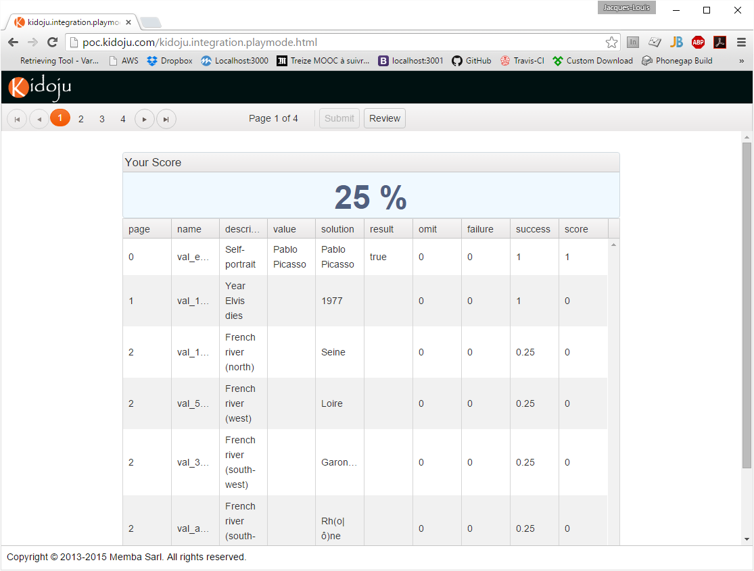
Your score
Clicking Submit displays a detailed scoresheet
Click Review to review corrections on each page
Note: keep the names in the form val_ for now

Slide 19
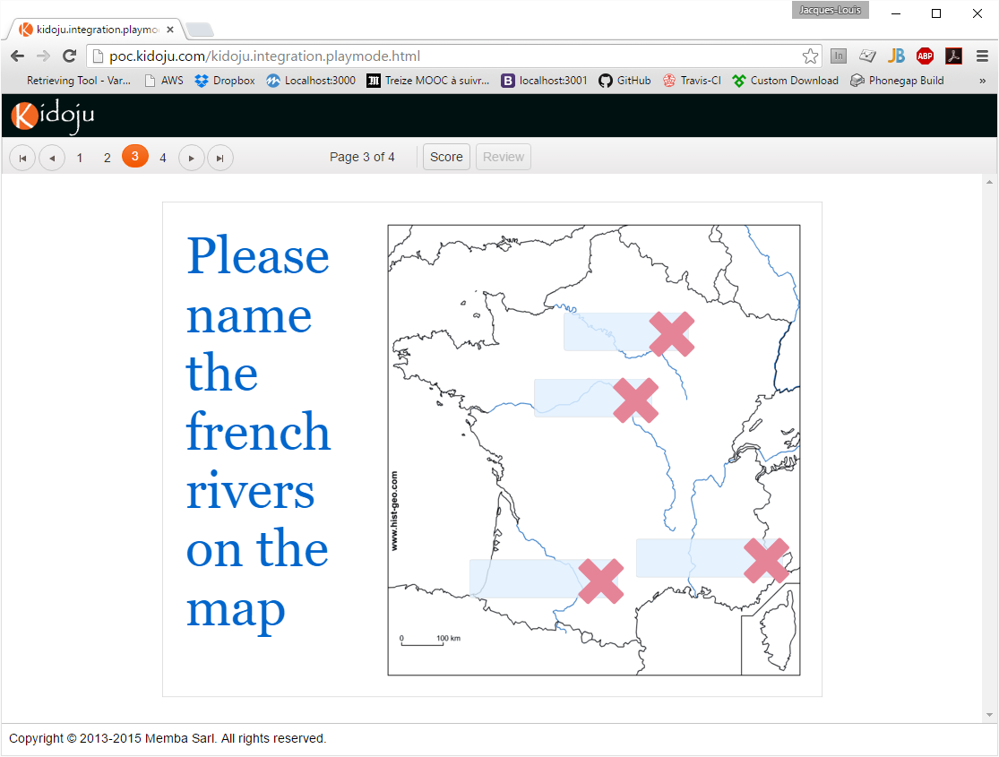
Reviewing a test
Clicking Review displays corrections
Click Score to display the scoresheet
Note: imagine instructions in a side panel
Click the browser refresh button to reactivate play mode or the browser back button to display design mode

