Slide 1
Optimization
By THIRTY

Slide 2
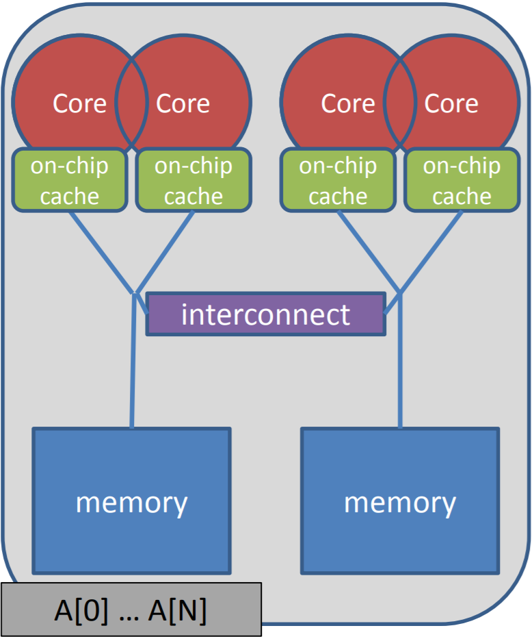
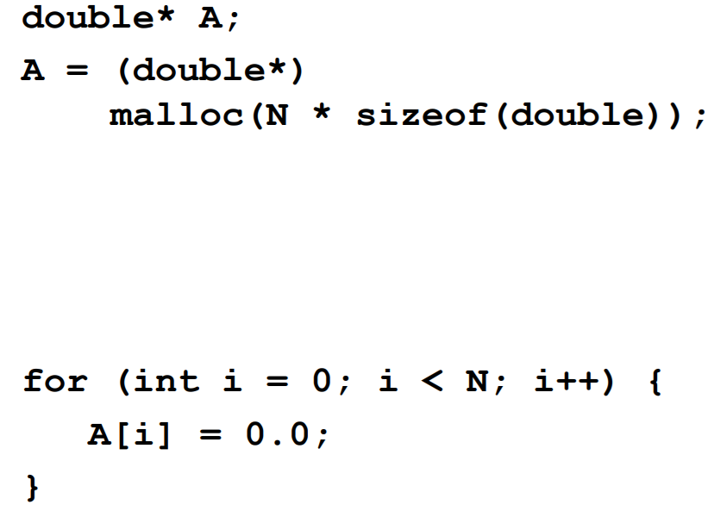
1. numa-aware allocation

Slide 3
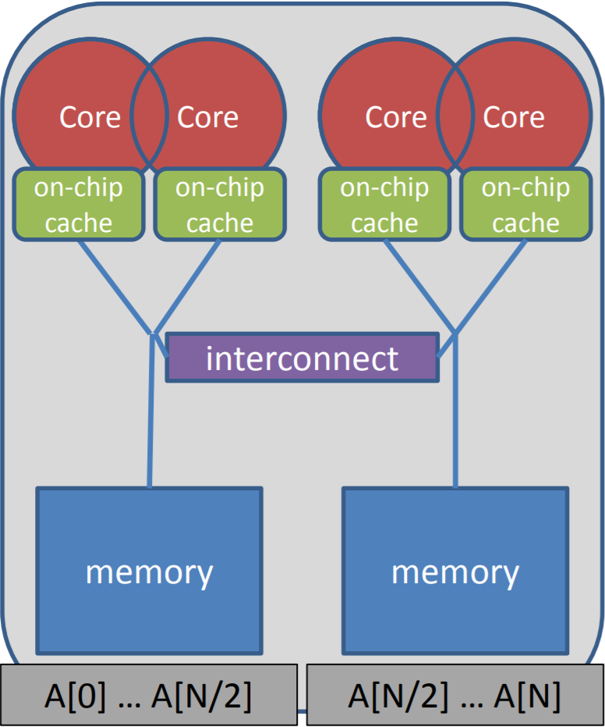
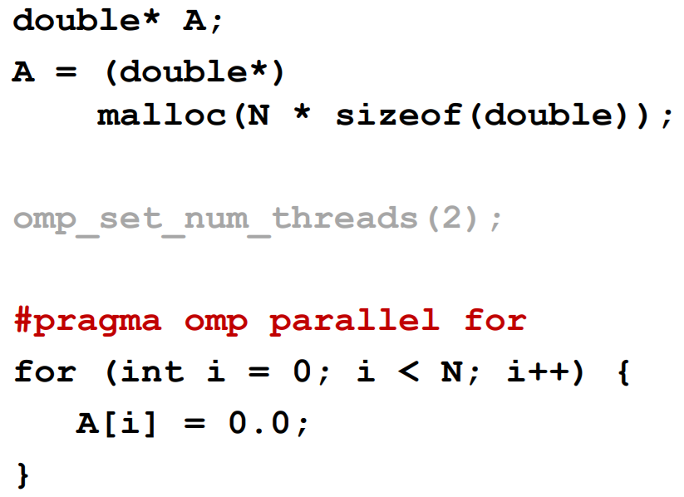
1. numa-aware allocation

Slide 4
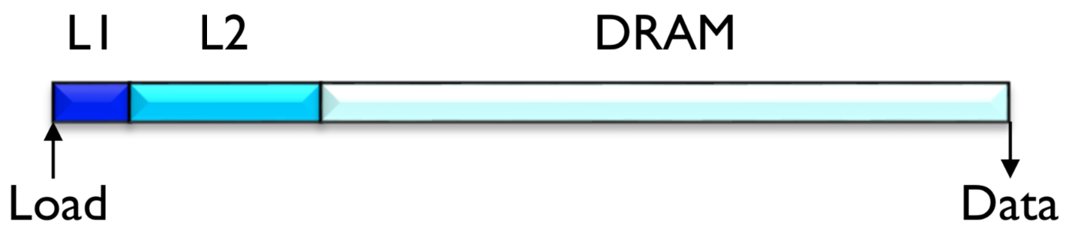
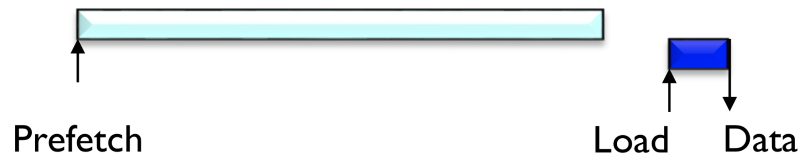
2. Software prefetching

Slide 5
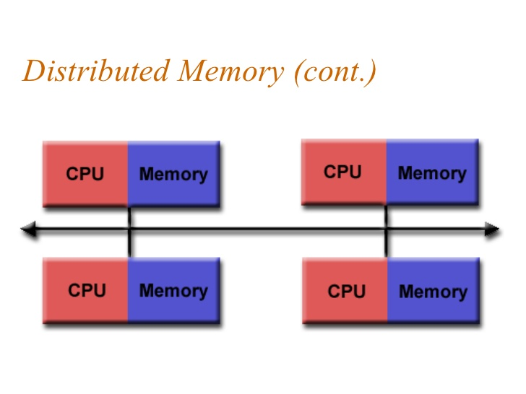
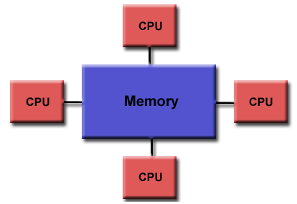
3. Ensure memory affinity

Slide 6
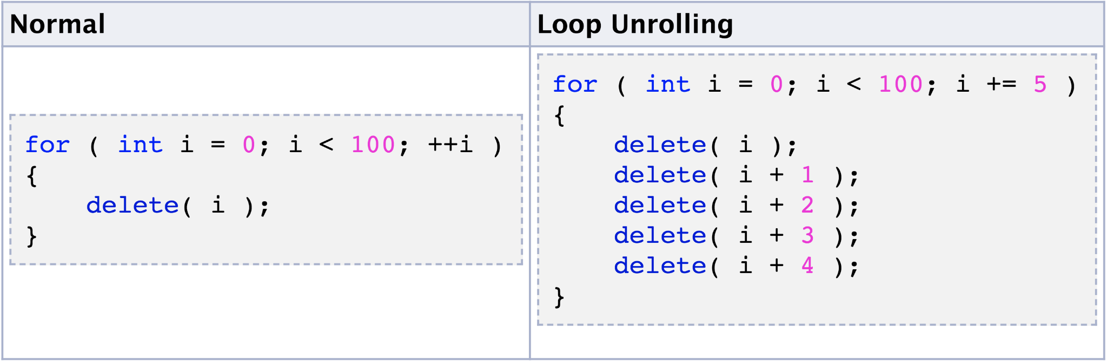
4. Loop unrolling

Slide 7
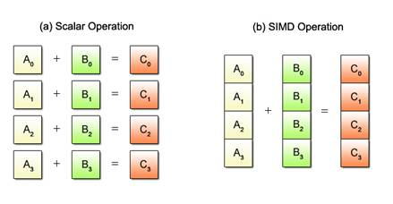
5. SIMDization

Slide 8




6. Balancing floating-point operation mix
25%
25%
25%
25%
100%
100%
100%
100%

Slide 9
7. Improve ILP
(1) E = A + B
(2) F = C + D
(3) G = E - F
Operation (1), (2) are able to calculate simultaneously

Slide 10
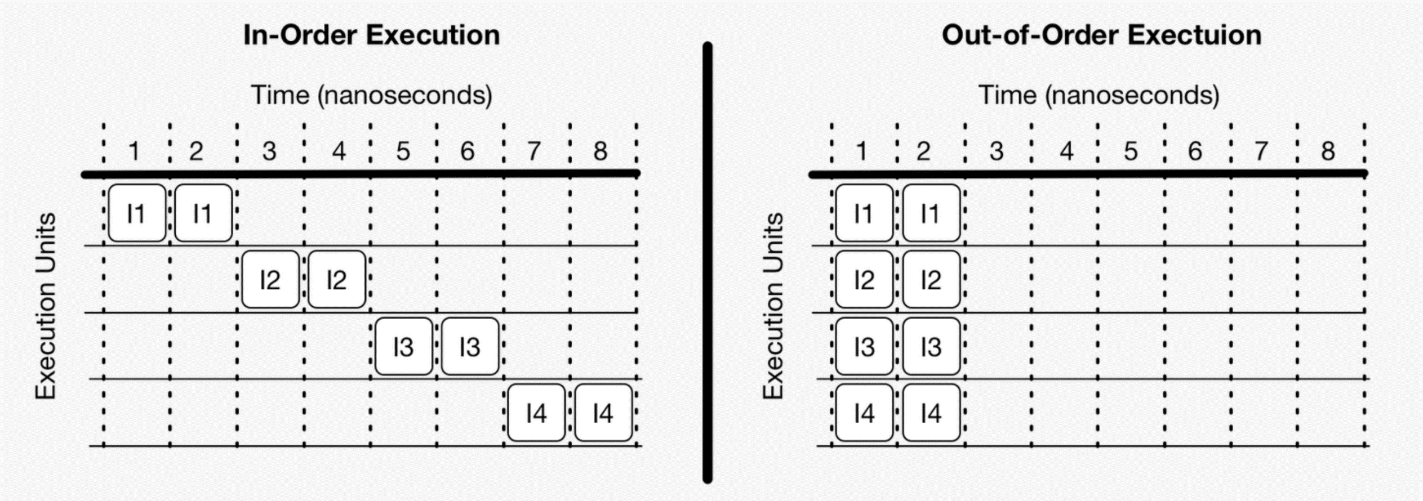
8. Out of order execution

Slide 11
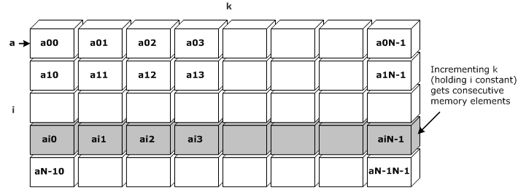
9. Unit stride access
Consecutive access

Slide 12
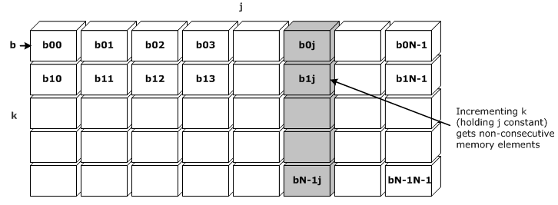
9. Unit stride access
Walk long steps

