Slide 1
Roofline Model
By THIRTY

Slide 2
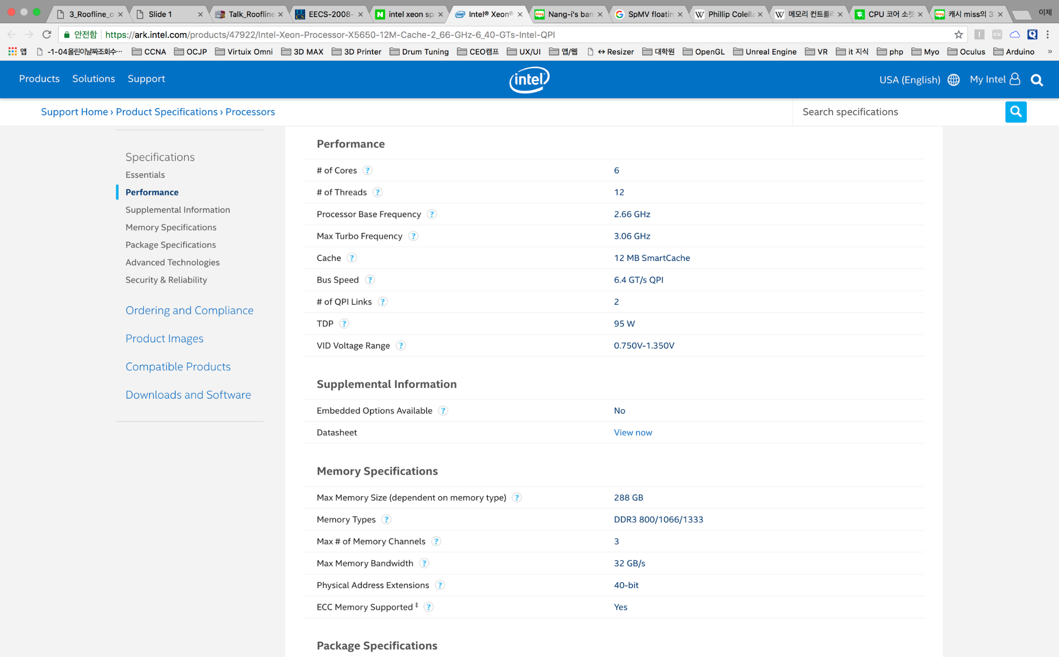
Performance Model
Specification
Ideal

Slide 3
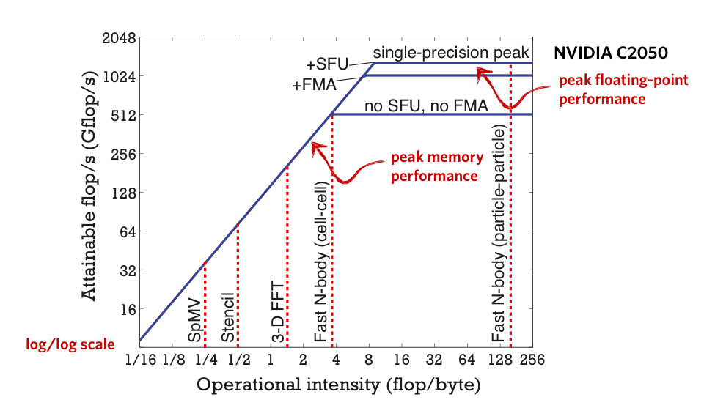
Performance Model
1. Realistic
2. Optimization

Slide 4
Performance Model –Major Components
Computation
Community

Slide 5
Computation
컴퓨팅 연산 속도를 의미
How to measure ?
Clock Rate
IPS (Instruction Per Second)
- 초당 수행할 수 있는 명령어의 수
FLOPS (Floating Point Operations Per Second)
- 초당 수행할 수 있는 부동소수점 연산의 수

Slide 6
Communication
메모리와 통신량을 의미
Arithmetic Intensity
- Traffic between the processor and cache
Operational Intensity
- Traffic between the caches and DRAM
= Flops / Byte (Computation / Communication)

Slide 7
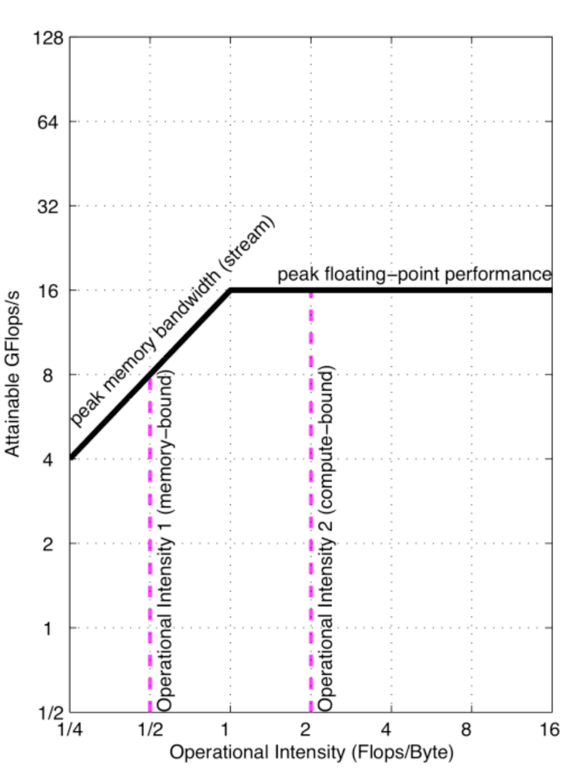

Basic Roofline
X-axis, Y-axis
Log scale
Peak memory bandwidth
Peak floating-point performance

Slide 8
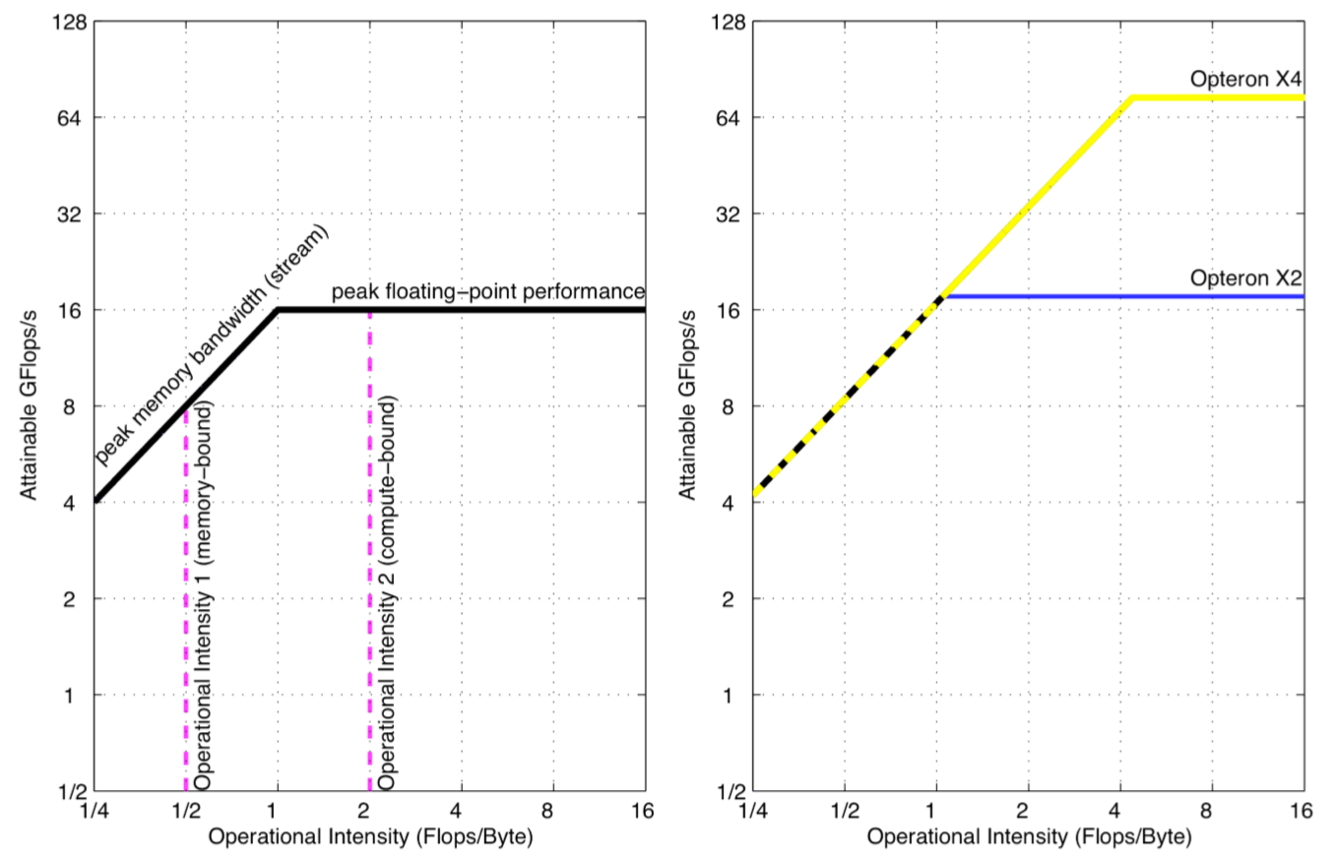
Basic Roofline

Slide 9
Optimization - Computation
What is means the peak?
The highest performance
How to reach?
Optimization

Slide 10




Optimization - Computation
1. Balance floating-point operation mix
25%
25%
25%
25%
100%
100%
100%
100%

Slide 11
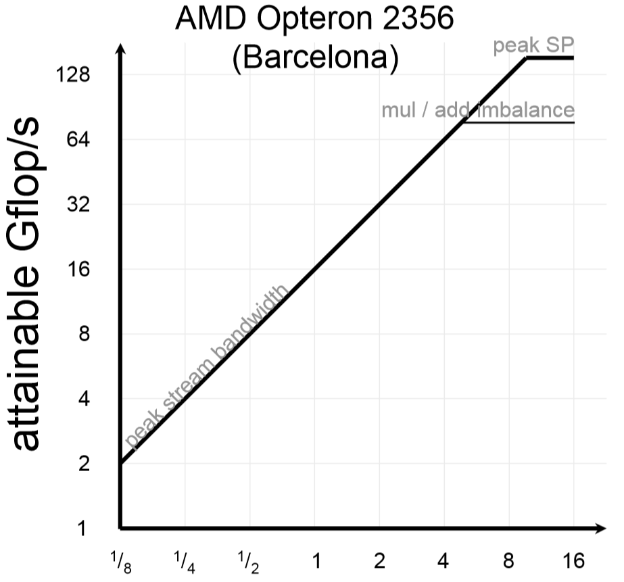
Optimization - Computation
Balance floating-point operation mix

Slide 12
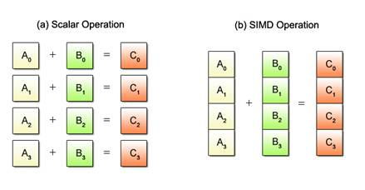
Optimization - Computation
2. Apply SIMD

Slide 13
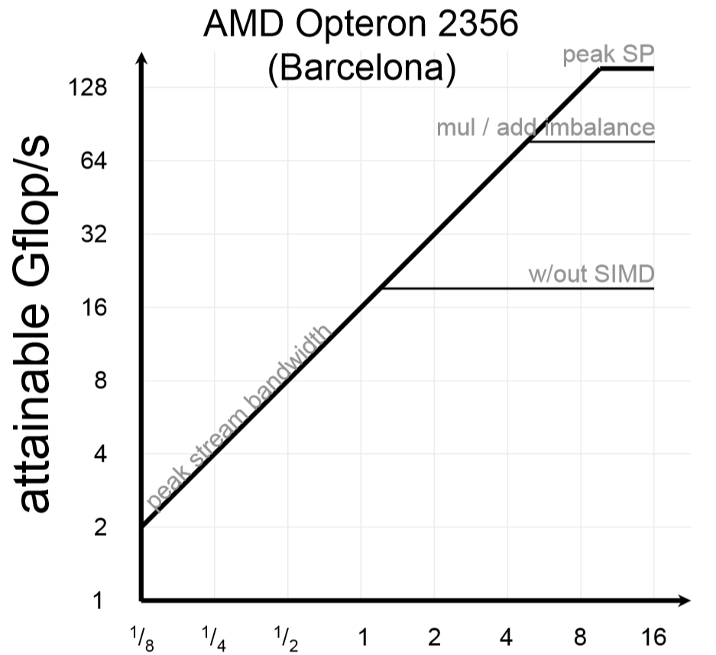
Optimization - Computation
Apply Single Instruction Multiple Data (SIMD)

Slide 14
Optimization - Computation
3. Improve ILP
(1) E = A + B
(2) F = C + D
(3) G = E - F
Operation (1), (2) are able to calculate simultaneously

Slide 15
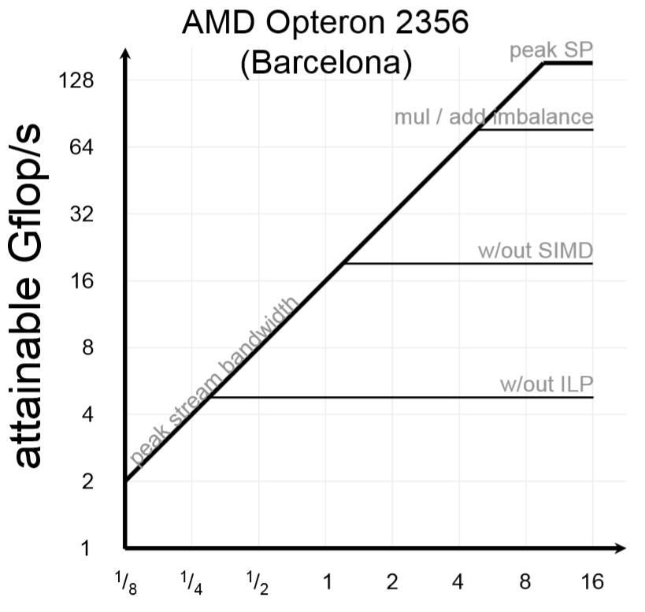
Optimization - Computation
Improve Instruction Level Parallelism (ILP)

Slide 16
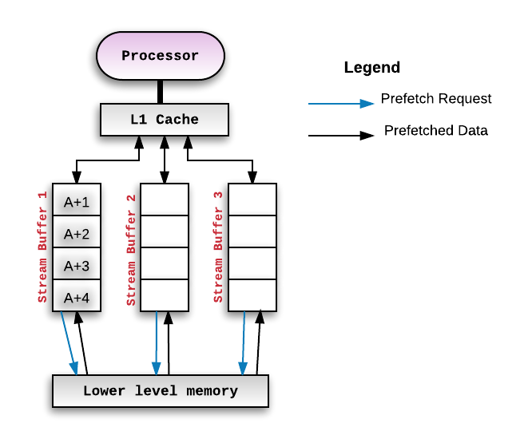
Optimization - Communication
4. Use Software prefetching

Slide 17
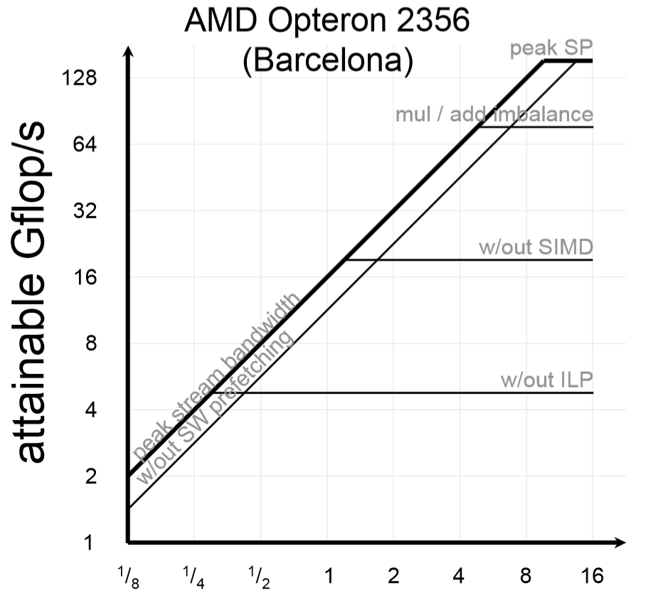
Optimization - Communication
Use Software prefetching

Slide 18
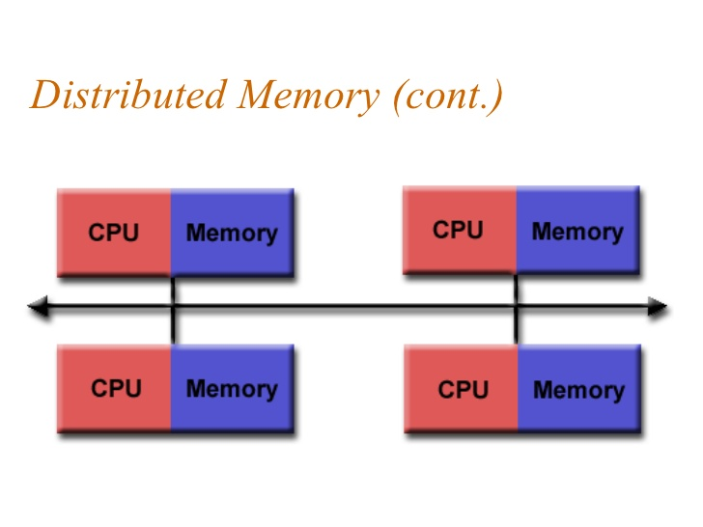
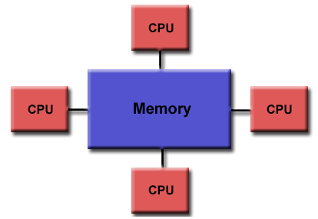
Optimization - Communication
5. Ensure memory affinity

Slide 19
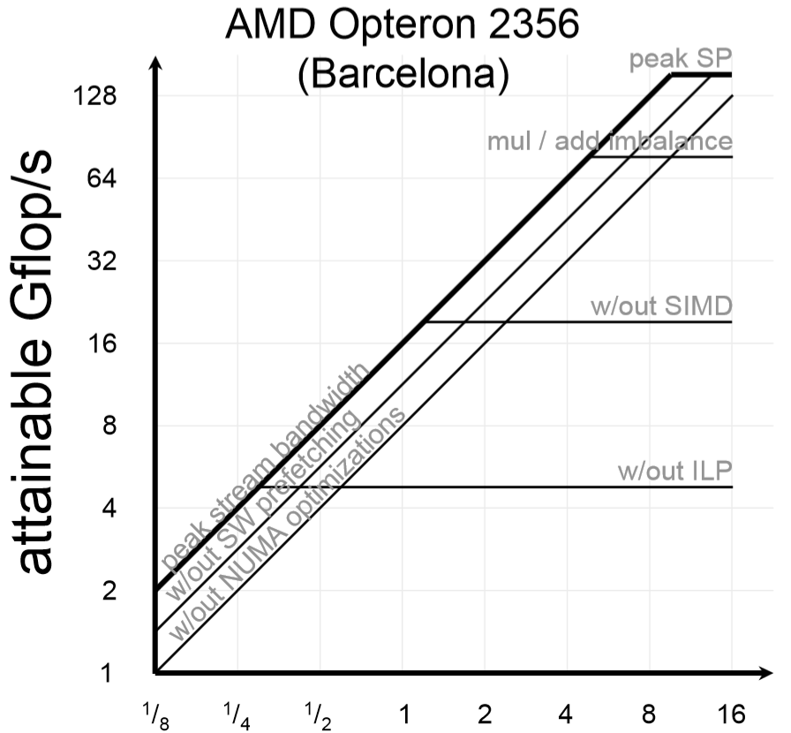
Optimization - Communication
Ensure memory affinity

Slide 20
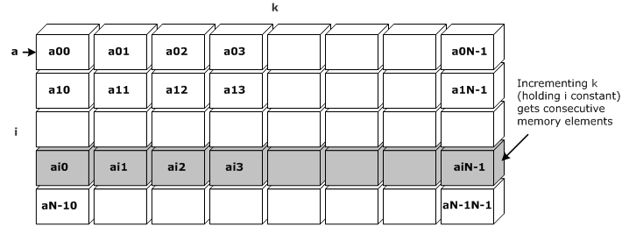
Optimization - Communication
5. Restructure loops for unit stride accesses
Consecutive access

Slide 21
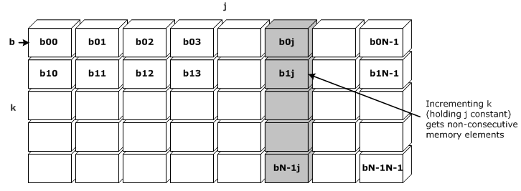
Optimization - Communication
5. Restructure loops for unit stride accesses
Walk long steps

Slide 22
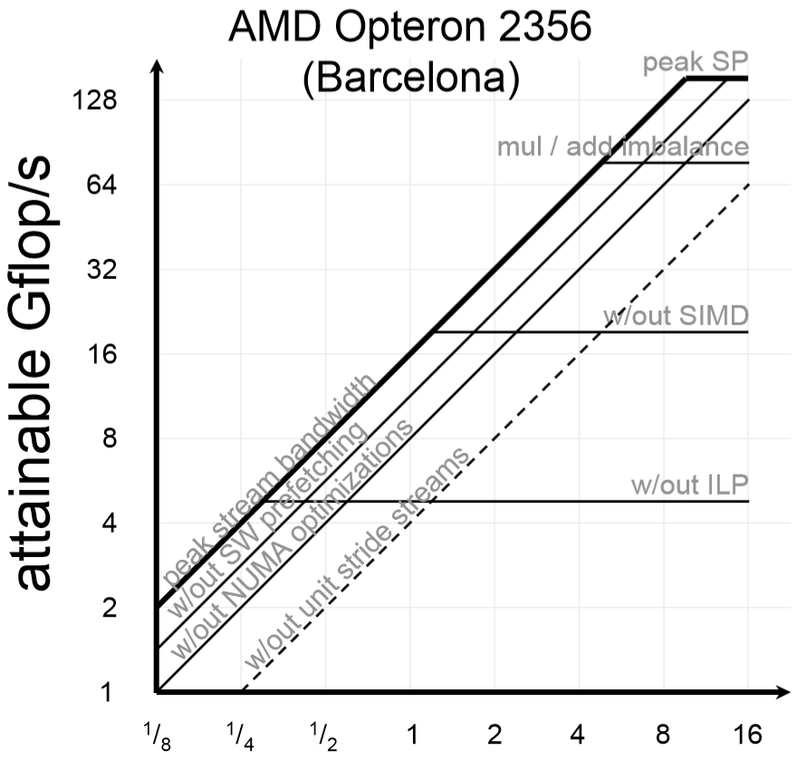
Optimization - Communication
Restructure loops for unit stride accesses

Slide 23
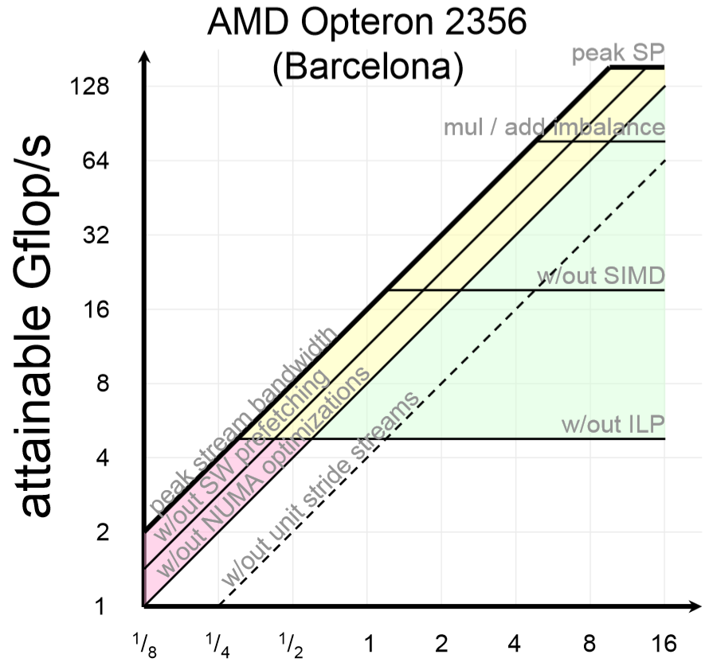
Optimization
Compute + Memory
Compute only
Memory only

Slide 24
3Cs
Compulsory misses
- 최초 데이터 접근 시 반드시 발생하는 Miss
- 해결 대상에서 제외
Capacity misses
- 캐시가 가득 차서 발생하는 Miss
- 캐시의 용량을 늘린다 / latency 악화
Conflict misses
- 캐시의 연관도가 부족해 발생하는 Miss
- 연관도를 늘린다 / hit latency 악화

Slide 25
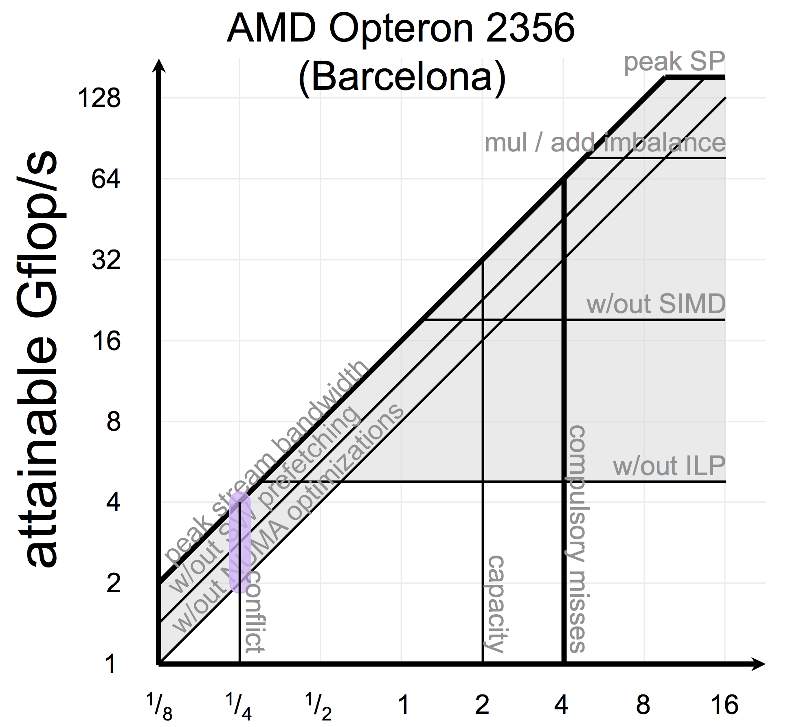
3Cs

Slide 26
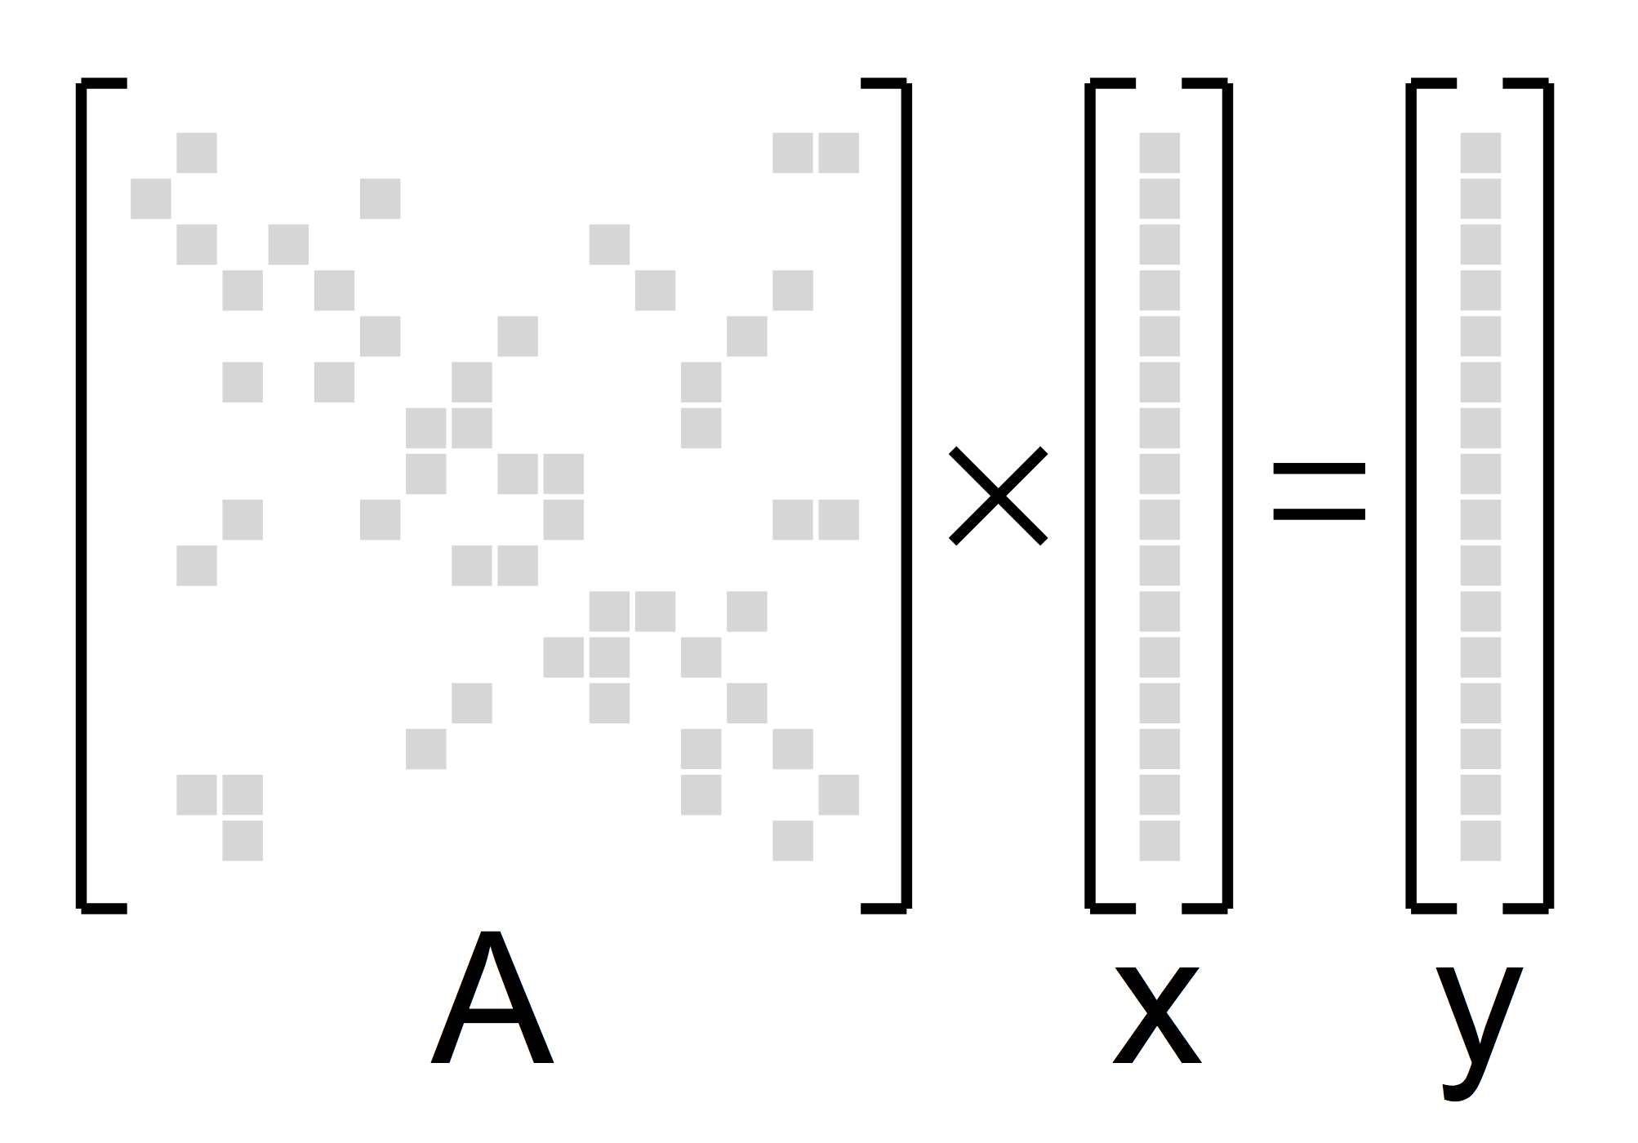
FP Kernels – SpMV
1. Sparse Matrix-Vector Multiplication
A is a sparse matrix
x & y are dense vectors
Evaluate y=Ax
Irregular memory accesses
Difficult to exploit ILP, SIMD
0.17 < Operation Intensity < 0.25

Slide 27
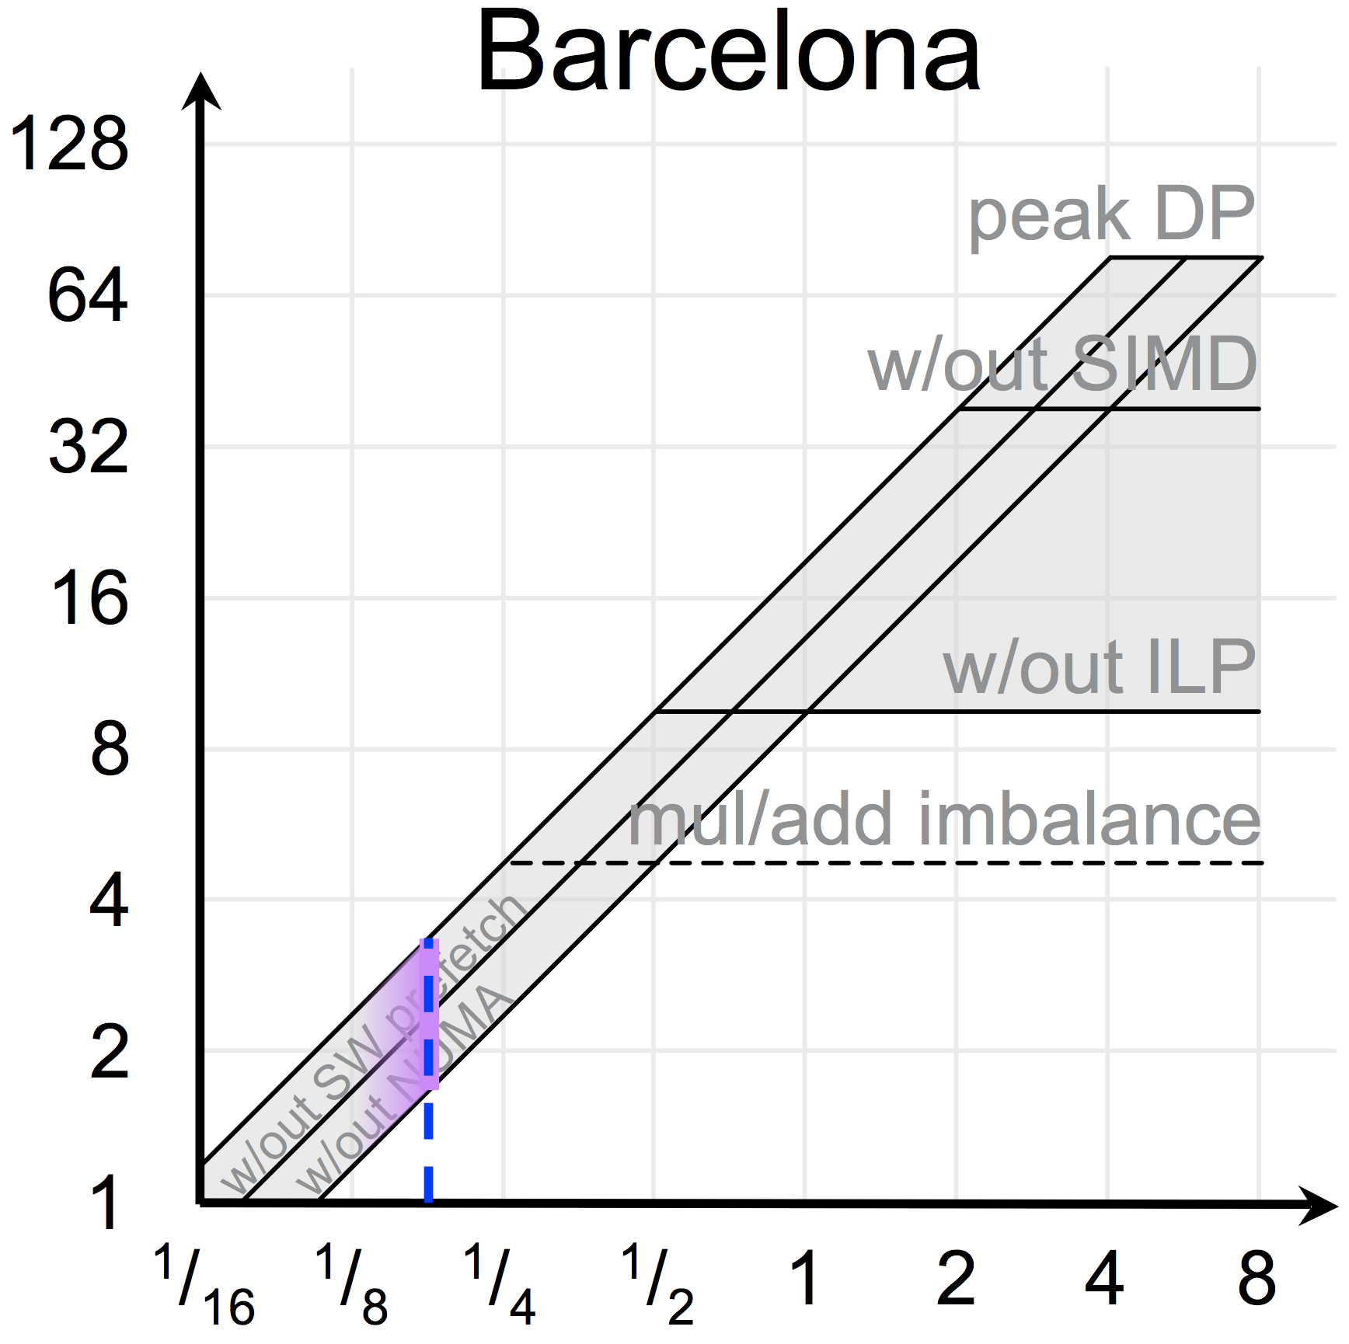
FP Kernels – SpMV
1. Sparse Matrix-Vector Multiplication
A is a sparse matrix
x & y are dense vectors
Evaluate y=Ax
Irregular memory accesses
Difficult to exploit ILP, SIMD
0.17 < Operation Intensity < 0.25

Slide 28
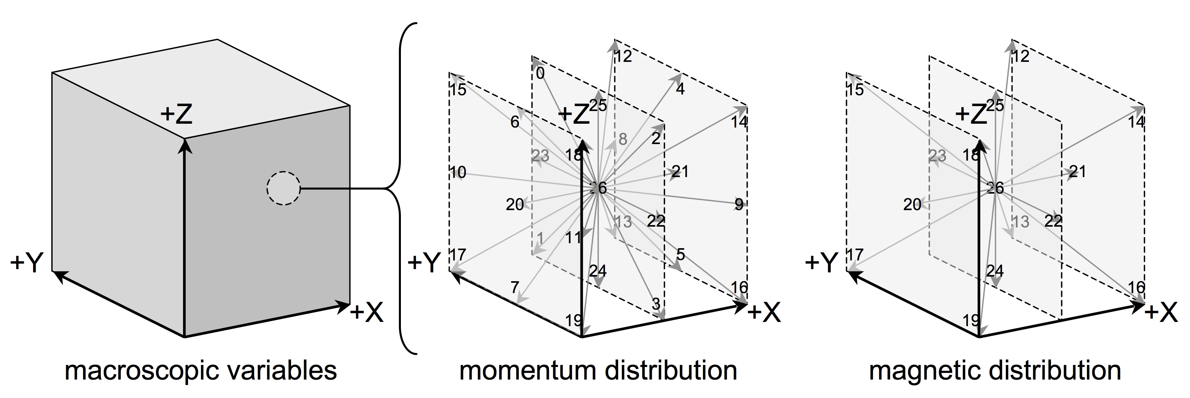
FP Kernels – LBMHD
1. Lattice-Boltzmann Method
momentum distribution (27 scalar components)
magnetic distribution (15 vector components)
Irregular memory accesses
More add than multiplies
0.70 < Operation Intensity < 1.07

Slide 29
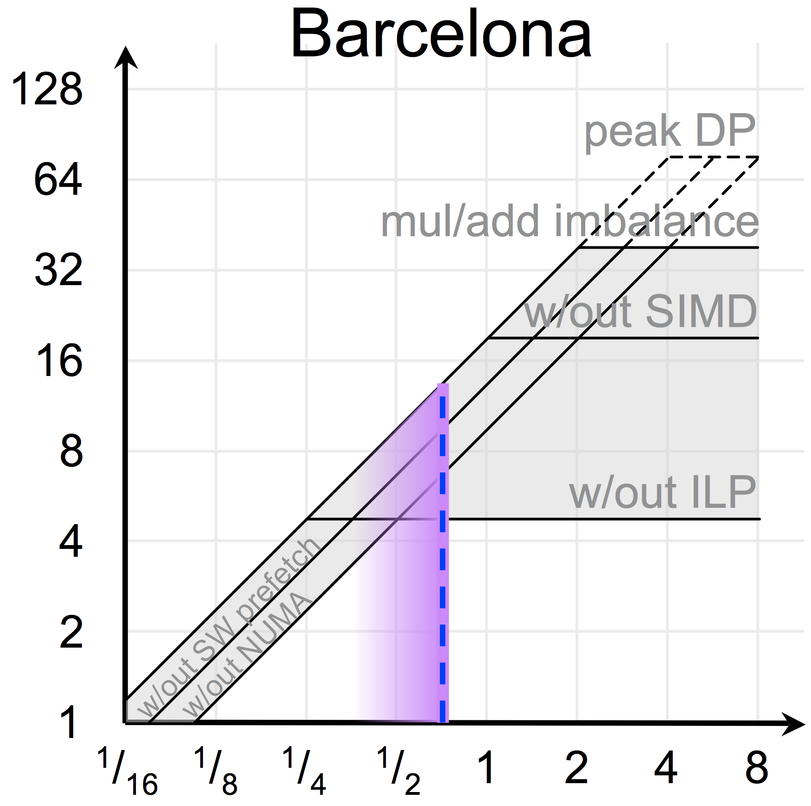
FP Kernels – LBMHD
1. Lattice-Boltzmann Method
momentum distribution (27 scalar components)
magnetic distribution (15 vector components)
Irregular memory accesses
More add than multiplies
0.70 < Operation Intensity < 1.07

