Slide 1
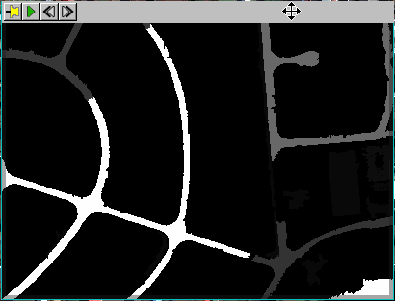
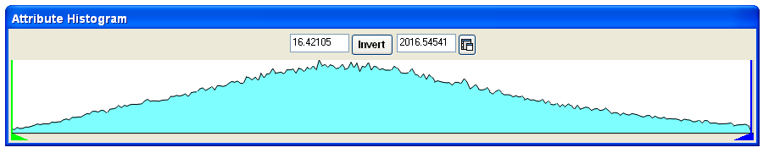
Road segments with high
Length attribute values
Road or parking lot
segments with low
Length attribute values

