Slide 1
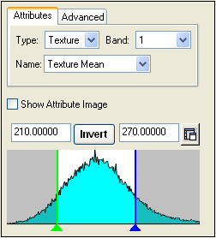
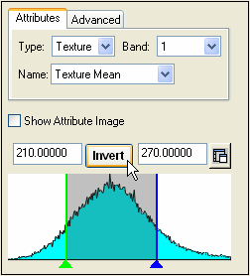
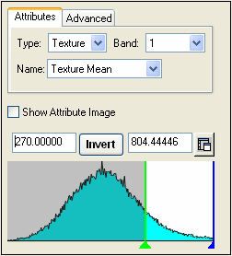
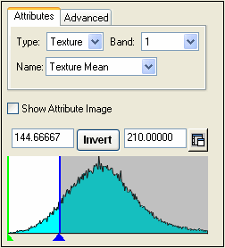
210 < Texture Mean < 270
Clicking Invert defines the attribute as:
(Texture Mean < 210) AND (Texture Mean > 270)
Texture Mean > 270
Texture Mean < 210

Slide 2
(Elongation > 2) OR [(Length > 112) AND (Area < 100)]
First rule
Second rule

