Slide 1
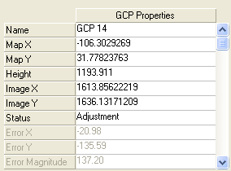
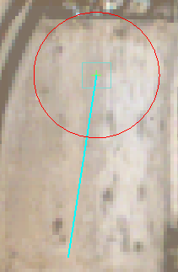

Slide 2
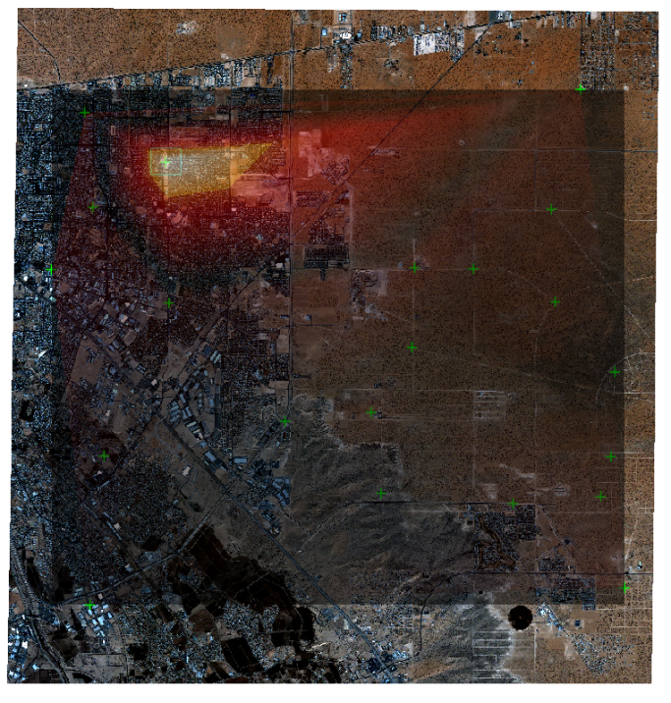
GCP with a large error
GCPs with the
smallest errors

Slide 3
Select this GCP

